Slide 1
Overview of Second Half of the Course
Overview of Second Half of the Course
Probability Basics
Probability Spaces and Events
Non-uniform Probability Spaces
Example: Four Biased Coins
Example: Sixteen Biased Coins
Trickier Uniform Probability Spaces
Poker Hands
Balls and Bins
The Birthday Paradox (n=50 case)
The Birthday Paradox (general case)
The Monty Hall Problem
Simple Analysis
Sample Space Analysis
Conclusion
Lecture 16, CS70 Summer 2025
Slides credit: Originals from Josh Hug (CS70 Fall 2024)

Slide 2
A 9 Percent Chance?
“A team of researchers from the University of Hawaiʻi at Mānoa published a study that estimated the probability of a magnitude 9+ earthquake in the Aleutian Islands—an event with sufficient power to create a mega-tsunami especially threatening to Hawaiʻi. In the next 50 years, they report, there is a 9 percent chance of such an event.” - The School of Ocean and Earth Science and Technology at the University of Hawai‘i at Mānoa

Slide 3
Probability and Intuition
Suppose we flip a coin 20 times.
Consider two outcomes:
a) HHHHHHHHHHHHHHHHHHHHH
b) HHTTHTHHHTTHTHTHHTHTH
Which outcome is more likely?
Neither! Both equally likely…
Which outcome is more random?
This is a deeper question…
Kolmogorov complexity says (b) is – we won’t deal with this notion of “random”

Slide 4
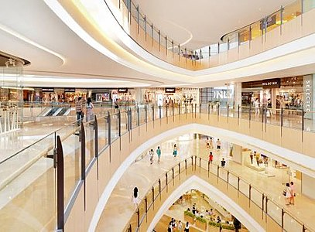
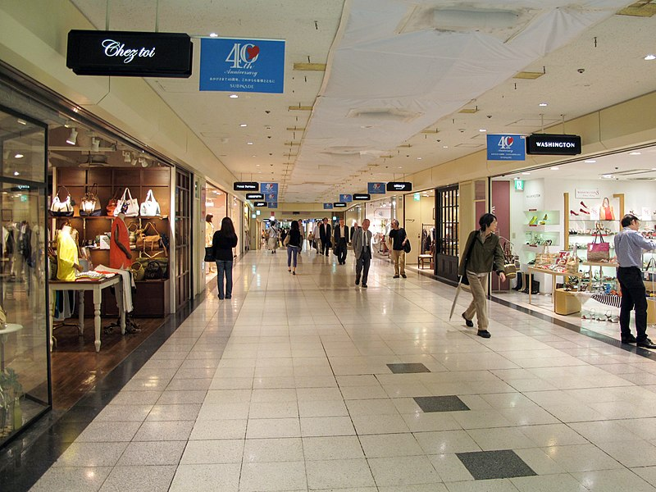
Probability and Intuition
Suppose we have two shopping centers.
Suppose we pick a center randomly with probability 50%, and then pick a restaurant at that center with equal probability.
If we eat at a Moroccan restaurant, what is the chance we picked center 1?
Shopping center 1:
3 Indian restaurants
2 Moroccan restaurants
Shopping center 2:
1 Indian restaurant
1 Moroccan restaurant

Slide 5
Probability and CS70
In CS70, we’ll give you a solid foundation for probability.
What did the “9%” mean in that chance for a mega-tsunami?
Which outcome of coin flips is more likely?
What is the chance we picked shopping center 1?
Probabilistic reasoning is famously counterintuitive!
A firm foundation will keep you safe from easy mistakes.

Slide 6
Probability
Second part of the class – time for a fresh start!
Most important topics/skills from the first part:
Rigorous reasoning and writing formal proofs
Counting
Others do come up…. Some we’ll talk about in CS70, others not…
Graphs: Random graph generation or random traversals
Random transmission errors (for error detection/correction)
…

Slide 7
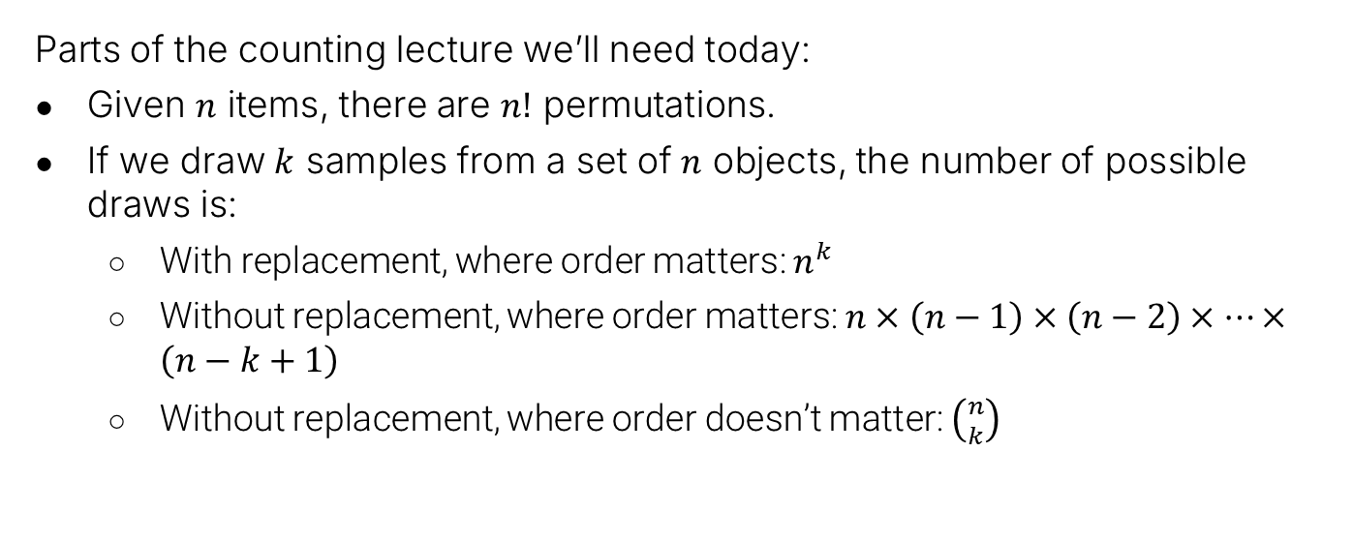
Counting Summary
Parts of the counting lecture we’ll need today:
Given $n$ items, there are $n!$ permutations.
If we draw $k$ samples from a set of $n$ objects, the number of possible draws is:
With replacement, where order matters: $n^{k}$
Without replacement, where order matters: $n×\left(n−1\right)×\left(n−2\right)×…×\left(n−k+1\right)$
Without replacement, where order doesn’t matter: $\left({n \atop k}\right)$

Slide 8
Probability Spaces and Events
Overview of Second Half of the Course
Probability Basics
Probability Spaces and Events
Non-uniform Probability Spaces
Example: Four Biased Coins
Example: Sixteen Biased Coins
Trickier Uniform Probability Spaces
Poker Hands
Balls and Bins
The Birthday Paradox (n=50 case)
The Birthday Paradox (general case)
The Monty Hall Problem
Simple Analysis
Sample Space Analysis
Conclusion
Lecture 16, CS70 Summer 2025

Slide 9
Probability Basics
Much like part one of this class, only a few terms/concepts
It’s the variations and application that you need to practice with!
Concepts for today:
Random experiments
Outcomes
Sample spaces (just the set of all outcomes)
Probability spaces (just a function/measure defined on a sample space)
Events (just a subset of a sample space)
That’s it!
The rest is just counting…

Slide 10
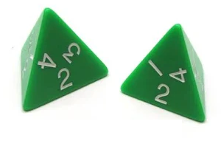
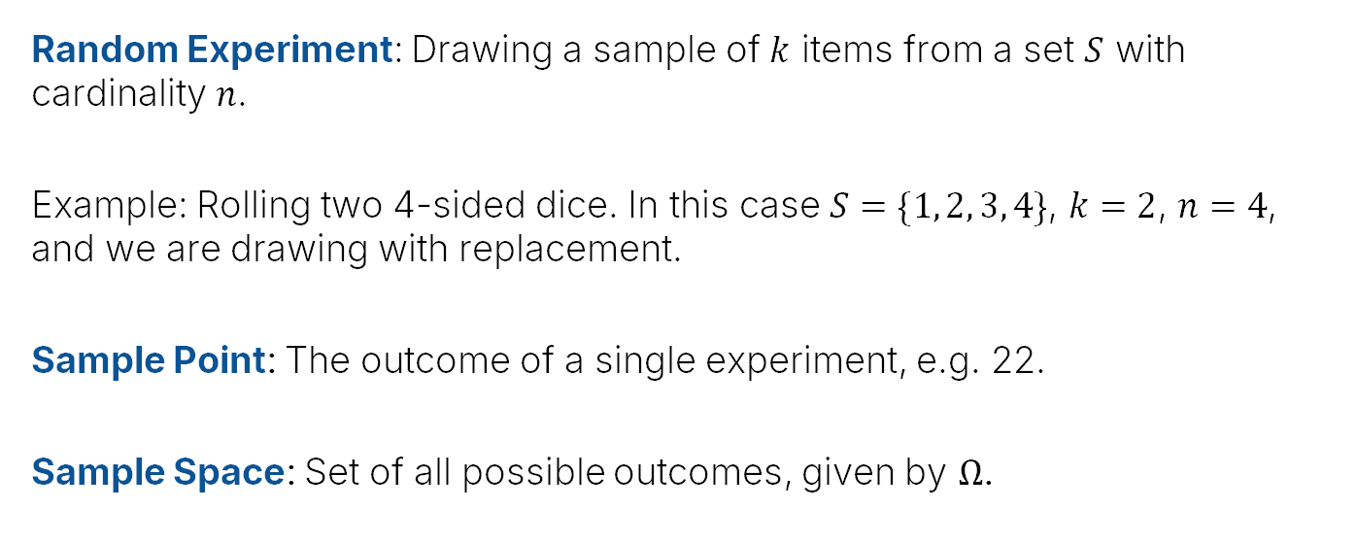

Random Experiment, Sample Point, Sample Space
Random Experiment: Drawing a sample of $k$ items from a set $S$ with cardinality $n$.
Example: Rolling two 4-sided dice. In this case $S=\{1, 2, 3, 4\}$, $k=2$, $n=4$, and we are drawing with replacement.
Sample Point: The outcome of a single experiment, e.g. 22.
Sample Space: Set of all possible outcomes, given by $Ω$.
11 12 13 14
21 22 23 24
31 32 33 34
41 42 43 44
$$Ω=$$

Slide 11



Probability Space
A Probability Space consists of:
A sample space $Ω$
A probability function $P(ω)$ that maps $ω∈Ω$ to a real number such that:
$0≤ P\left(ω\right)≤1$ for all $ω∈Ω$
$\sum_{w∈Ω}{P(ω)}=1$
Example: Rolling two fair 4-sided dice. In this case, $Ω$ and $P$ are:
$$P\left(ω\right)=\frac{1}{16}$$
11 12 13 14
21 22 23 24
31 32 33 34
41 42 43 44
$$Ω=$$
This is a “uniform probability space”.

Slide 12

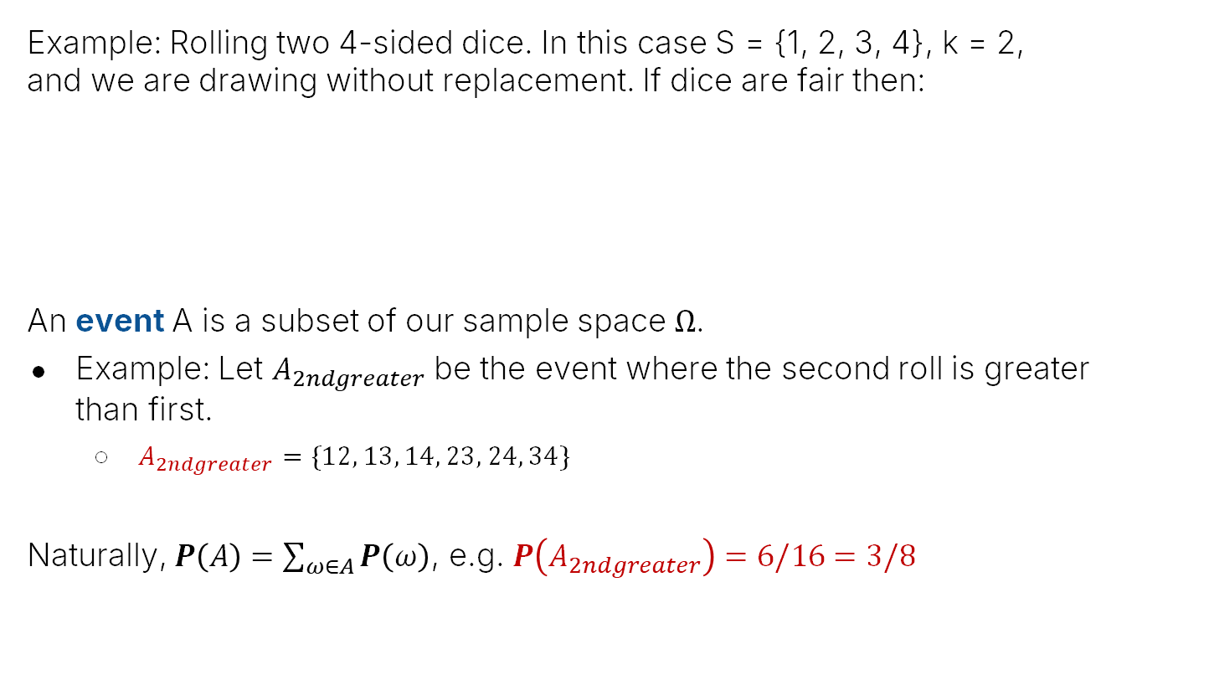
Event
Example: Rolling two 4-sided dice. In this case S = {1, 2, 3, 4}, k = 2, and we are drawing without replacement. If dice are fair then:
An event A is a subset of our sample space $Ω$.
Example: Let $A_{2ndgreater}$ be the event where the second roll is greater than first.
$A_{2ndgreater}=\{12, 13, 14, 23, 24, 34\}$
Naturally, $P\left(A\right)=\sum_{ω∈A}{P\left(ω\right)}$, e.g. $P\left(A_{2ndgreater}\right)=6/16=3/8$
11 12 13 14
21 22 23 24
31 32 33 34
41 42 43 44
$$P\left(ω\right)=\frac{1}{16}$$
$$Ω=$$

Slide 13

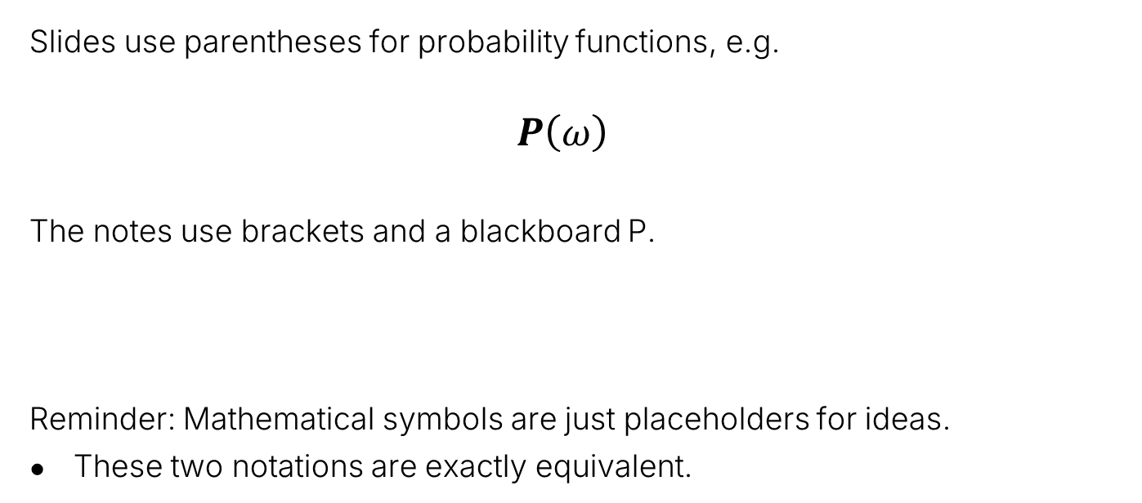
Quick Note on Notation
Slides use parentheses for probability functions, e.g.
$$P\left(ω\right)$$
The notes use brackets and a blackboard P.
Reminder: Mathematical symbols are just placeholders for ideas.
These two notations are exactly equivalent.

Slide 14
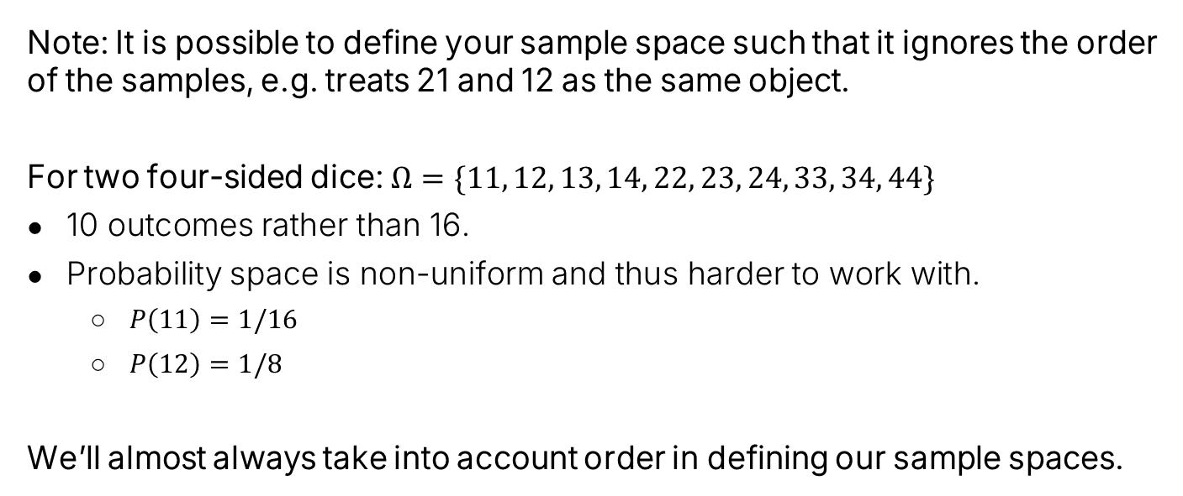

Sample Space Ignoring Order
Note: It is possible to define your sample space such that it ignores the order of the samples, e.g. treats 21 and 12 as the same object.
For two four-sided dice: $Ω=\{11, 12, 13, 14, 22, 23, 24, 33, 34, 44\}$
10 outcomes rather than 16.
Probability space is non-uniform and thus harder to work with.
$P\left(11\right)=1/16$
$P\left(12\right)=1/8$
We’ll almost always take into account order in defining our sample spaces.
11 12 13 14
21 22 23 24
31 32 33 34
41 42 43 44
11 12 13 14
22 23 24
33 34
44
$$Ω=$$
$$Ω=$$
vs.

Slide 15
Non-uniform Probability Spaces
Overview of Second Half of the Course
Probability Basics
Probability Spaces and Events
Non-uniform Probability Spaces
Example: Four Biased Coins
Example: Sixteen Biased Coins
Trickier Uniform Probability Spaces
Poker Hands
Balls and Bins
The Birthday Paradox (n=50 case)
The Birthday Paradox (general case)
The Monty Hall Problem
Simple Analysis
Sample Space Analysis
Conclusion
Lecture 16, CS70 Summer 2025

Slide 16
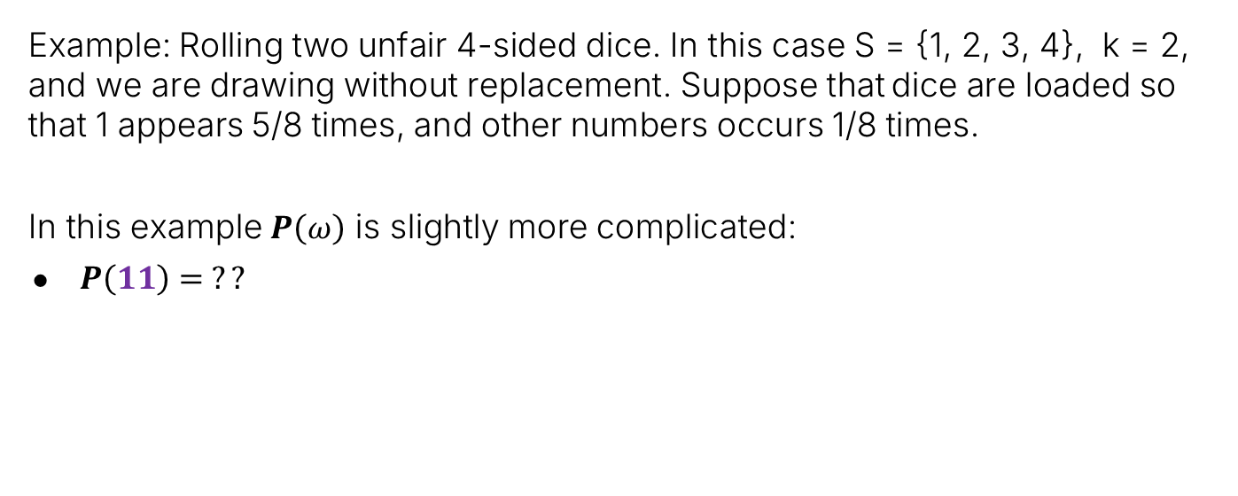
Another Example Probability Space
Example: Rolling two unfair 4-sided dice. In this case S = {1, 2, 3, 4}, k = 2, and we are drawing without replacement. Suppose that dice are loaded so that 1 appears 5/8 times, and other numbers occurs 1/8 times.
In this example $P\left(ω\right)$ is slightly more complicated:
$P\left(11\right)= ??$
11 12 13 14
21 22 23 24
31 32 33 34
41 42 43 44
$$Ω=$$

Slide 17

Another Example Probability Space
Example: Rolling two unfair 4-sided dice. In this case S = {1, 2, 3, 4}, k = 2, and we are drawing without replacement. Suppose that dice are loaded so that 1 appears 5/8 times, and other numbers occurs 1/8 times.
In this example $P\left(ω\right)$ is slightly more complicated:
$P\left(11\right)=25/64$
11 12 13 14
21 22 23 24
31 32 33 34
41 42 43 44
$$Ω=$$

Slide 18
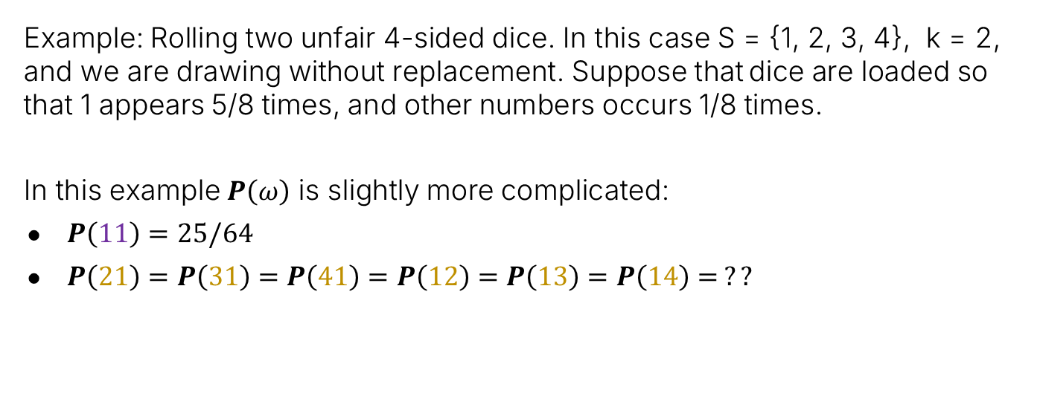
Another Example Probability Space
Example: Rolling two unfair 4-sided dice. In this case S = {1, 2, 3, 4}, k = 2, and we are drawing without replacement. Suppose that dice are loaded so that 1 appears 5/8 times, and other numbers occurs 1/8 times.
In this example $P\left(ω\right)$ is slightly more complicated:
$P\left(11\right)=25/64$
$P\left(21\right)=P\left(31\right)=P\left(41\right)=P\left(12\right)=P\left(13\right)=P\left(14\right)= ??$
11 12 13 14
21 22 23 24
31 32 33 34
41 42 43 44
$$Ω=$$

Slide 19
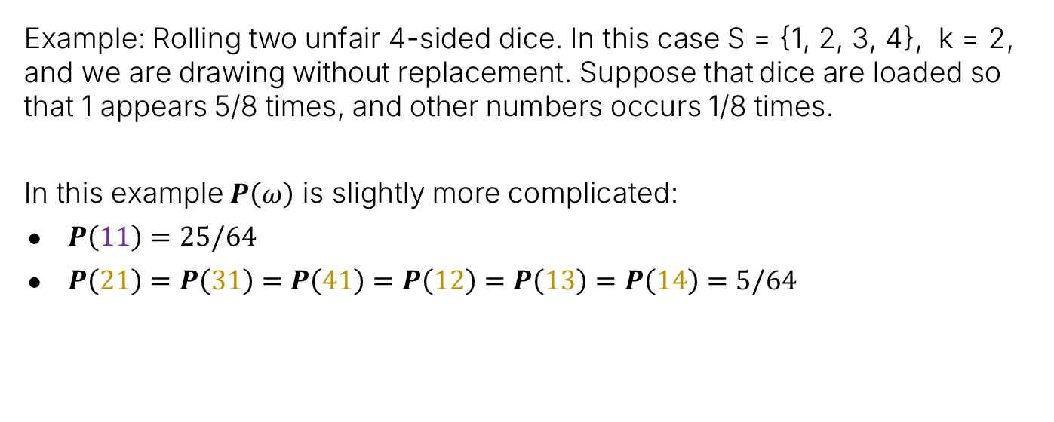
Another Example Probability Space
Example: Rolling two unfair 4-sided dice. In this case S = {1, 2, 3, 4}, k = 2, and we are drawing without replacement. Suppose that dice are loaded so that 1 appears 5/8 times, and other numbers occurs 1/8 times.
In this example $P\left(ω\right)$ is slightly more complicated:
$P\left(11\right)=25/64$
$P\left(21\right)=P\left(31\right)=P\left(41\right)=P\left(12\right)=P\left(13\right)=P\left(14\right)=5/64$
11 12 13 14
21 22 23 24
31 32 33 34
41 42 43 44
$$Ω=$$
This is a non-uniform probability space.

Slide 20
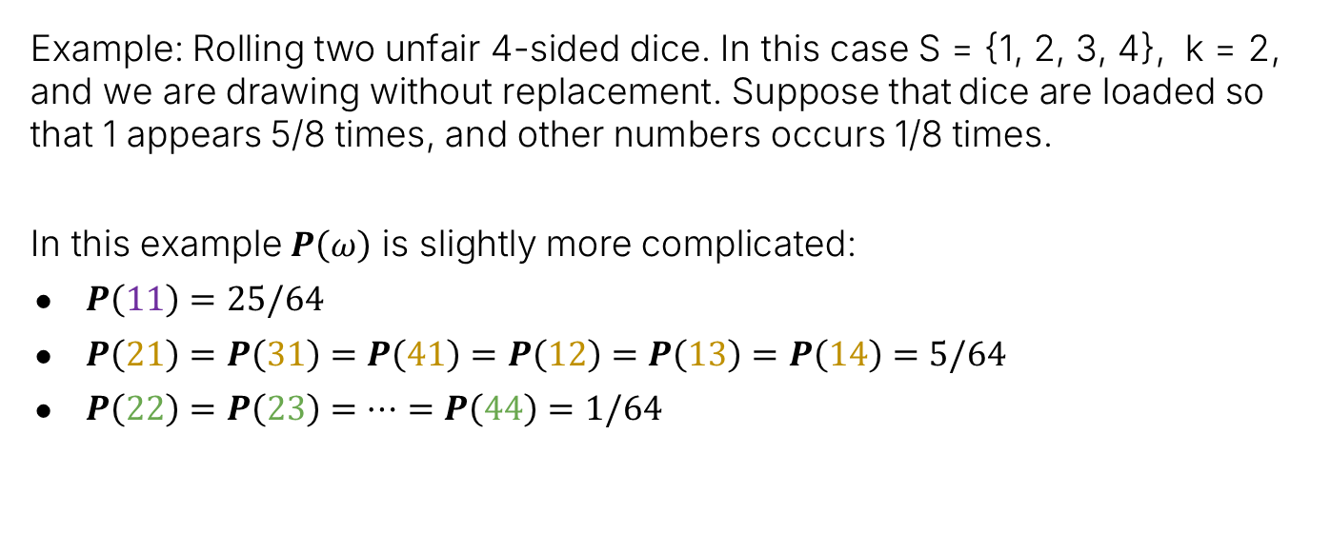
Another Example Probability Space
Example: Rolling two unfair 4-sided dice. In this case S = {1, 2, 3, 4}, k = 2, and we are drawing without replacement. Suppose that dice are loaded so that 1 appears 5/8 times, and other numbers occurs 1/8 times.
In this example $P\left(ω\right)$ is slightly more complicated:
$P\left(11\right)=25/64$
$P\left(21\right)=P\left(31\right)=P\left(41\right)=P\left(12\right)=P\left(13\right)=P\left(14\right)=5/64$
$P\left(22\right)=P\left(23\right)=…=P\left(44\right)=1/64$
11 12 13 14
21 22 23 24
31 32 33 34
41 42 43 44
$$Ω=$$
This is a non-uniform probability space.

Slide 21
Tree Diagram for a Non-Uniform Probability Space
4
1/8
3
1/8
A tree diagram gives a somewhat more formal explanation of the probability of each outcome.
1/8
2
5/8
1

Slide 22

Tree Diagram for a Non-Uniform Probability Space
$P\left(11\right)=\frac{5}{8}×\frac{5}{8}=25/64$
4
1/8
3
1/8
The tree diagram gives a somewhat more formal explanation of the probability of each outcome.
1/8
2
5/8
1
5/8
1

Slide 23
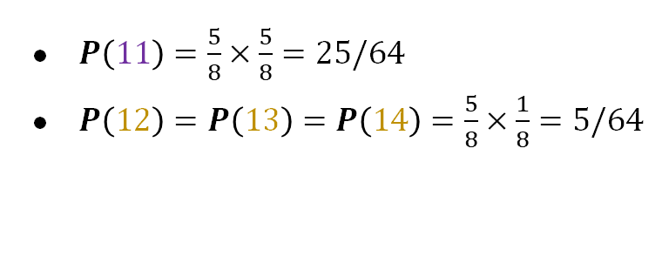
Tree Diagram for a Non-Uniform Probability Space
$P\left(11\right)=\frac{5}{8}×\frac{5}{8}=25/64$
$P\left(12\right)=P\left(13\right)=P\left(14\right)=\frac{5}{8}×\frac{1}{8}=5/64$
4
1/8
3
1/8
The tree diagram gives a somewhat more formal explanation of the probability of each outcome.
Here, we can multiply the probabilities together because the dice rolls are independent. More on this in a later lecture.
1/8
2
5/8
1/8
4
1/8
3
1
1/8
2
5/8
1

Slide 24
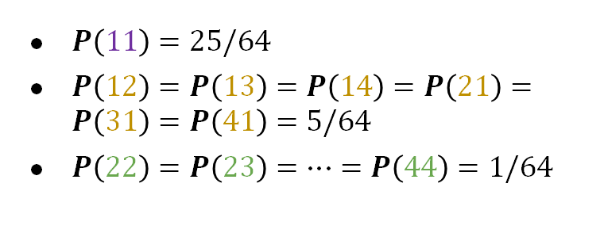
Tree Diagram for a Non-Uniform Probability Space
1/8
$P\left(11\right)=25/64$
$P\left(12\right)=P\left(13\right)=P\left(14\right)=P\left(21\right)=P\left(31\right)=P\left(41\right)=5/64$
$P\left(22\right)=P\left(23\right)=…=P\left(44\right)=1/64$
4
1/8
3
4
1/8
2
5/8
1
1/8
1/8
4
1/8
3
3
1/8
1/8
2
5/8
The tree diagram gives a somewhat more formal explanation of the probability of each outcome.
Here, we can multiply the probabilities together because the dice rolls are independent. More on this in a later lecture.
1
1/8
1/8
4
1/8
3
2
1/8
2
5/8
5/8
1
1/8
4
1/8
3
1
1/8
2
5/8
1

Slide 25


Events in a Non Uniform Probability Space
Example: Rolling two unfair 4-sided dice. In this case S = {1, 2, 3, 4}, k = 2, and we are drawing without replacement. Suppose that dice are loaded so that 1 appears 5/8 times, and other numbers occurs 1/8 times.
In this example $P\left(ω\right)$ yields a non-uniform probability space:
$P\left(11\right)=25/64$
$P\left(21\right)=P\left(31\right)=P\left(41\right)=P\left(12\right)=P\left(13\right)=P\left(14\right)=5/64$
$P\left(22\right)=P\left(23\right)=…=P\left(44\right)=1/64$
11 12 13 14
21 22 23 24
31 32 33 34
41 42 43 44
What is $P\left(A_{2ndgreater}\right)$?
$$Ω=$$

Slide 26
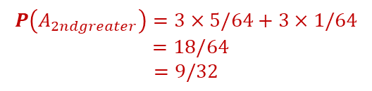
Events in a Non Uniform Probability Space
Example: Rolling two unfair 4-sided dice. In this case S = {1, 2, 3, 4}, k = 2, and we are drawing without replacement. Suppose that dice are loaded so that 1 appears 5/8 times, and other numbers occurs 1/8 times.
In this example $P\left(ω\right)$ yields a non-uniform probability space:
$P\left(11\right)=25/64$
$P\left(21\right)=P\left(31\right)=P\left(41\right)=P\left(12\right)=P\left(13\right)=P\left(14\right)=5/64$
$P\left(22\right)=P\left(23\right)=…=P\left(44\right)=1/64$
11 12 13 14
21 22 23 24
31 32 33 34
41 42 43 44
What is $P\left(A_{2ndgreater}\right)$?
$$Ω=$$
$$P\left(A_{2ndgreater}\right)=3×5/64+3×1/64$$
$$=18/64$$
$$=9/32$$

Slide 27
Example: Four Biased Coins
Overview of Second Half of the Course
Probability Basics
Probability Spaces and Events
Non-uniform Probability Spaces
Example: Four Biased Coins
Example: Sixteen Biased Coins
Trickier Uniform Probability Spaces
Poker Hands
Balls and Bins
The Birthday Paradox (n=50 case)
The Birthday Paradox (general case)
The Monty Hall Problem
Simple Analysis
Sample Space Analysis
Conclusion
Lecture 16, CS70 Summer 2025

Slide 28
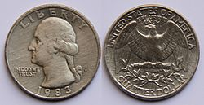
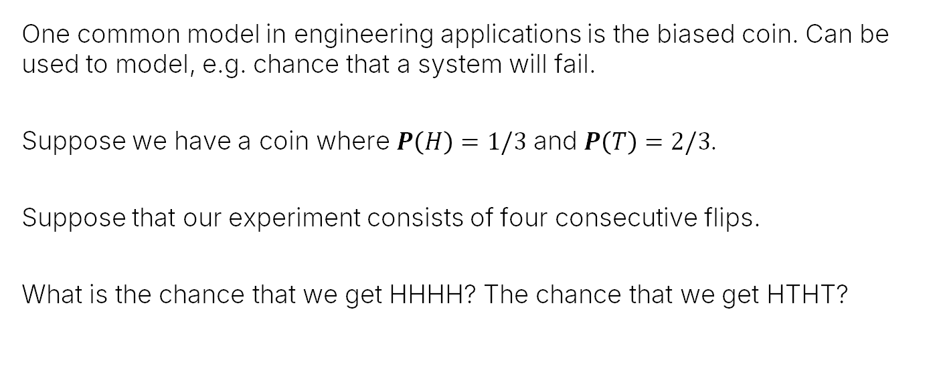
Four Biased Coins
One common model in engineering applications is the biased coin. Can be used to model, e.g. chance that a system will fail.
Suppose we have a coin where $P\left(H\right)=1/3$ and $P\left(T\right)=2/3$.
Suppose that our experiment consists of four consecutive flips.
What is the chance that we get HHHH? The chance that we get HTHT?
HHHH HHHT HHTH HHTT
HTHH HTHT HTTH HTTT
THHH THHT THTH THTT
TTHH TTHT TTTH TTTT
$$Ω=$$
Notes:
Give me a .dot file showing all possible outcomes of flipping four biased coins with probability of heads 1/3 and tails 2/3. The graph should go from left to right with a node for the start, then 2 nodes connected to the start corresponding to heads and tails. Edges should be labeled with their probability. Nodes should be rectangles labeled either H or T. Highlight the edges in orange that go HHHH and highlight the edges in orange that go HTHT. All other edges should be black. All nodes should be black text on white background except the start node which should be a solid black circle.

Slide 29
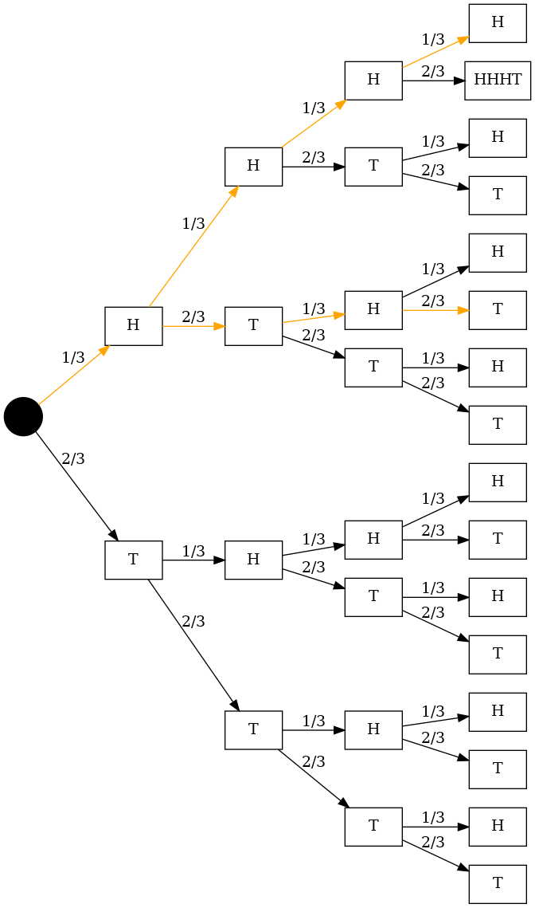
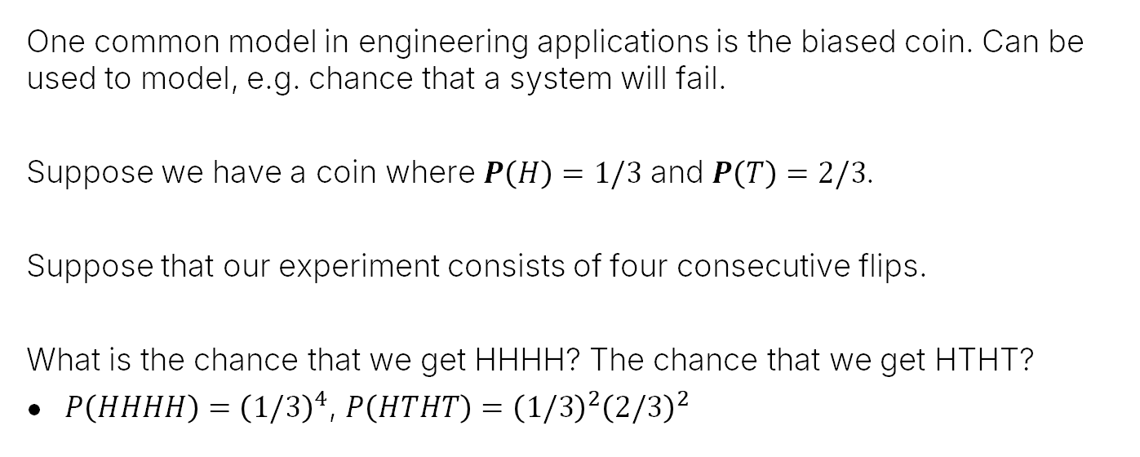
Four Biased Coins
One common model in engineering applications is the biased coin. Can be used to model, e.g. chance that a system will fail.
Suppose we have a coin where $P\left(H\right)=1/3$ and $P\left(T\right)=2/3$.
Suppose that our experiment consists of four consecutive flips.
What is the chance that we get HHHH? The chance that we get HTHT?
$P\left(HHHH\right)={\left(1/3\right)}^{4}$, $P\left(HTHT\right)={\left(1/3\right)}^{2}{\left(2/3\right)}^{2}$
HHHH HHHT HHTH HHTT
HTHH HTHT HTTH HTTT
THHH THHT THTH THTT
TTHH TTHT TTTH TTTT
$$Ω=$$
Notes:
Give me a .dot file showing all possible outcomes of flipping four biased coins with probability of heads 1/3 and tails 2/3. The graph should go from left to right with a node for the start, then 2 nodes connected to the start corresponding to heads and tails. Edges should be labeled with their probability. Nodes should be rectangles labeled either H or T. Highlight the edges in orange that go HHHH and highlight the edges in orange that go HTHT. All other edges should be black. All nodes should be black text on white background except the start node which should be a solid black circle.

Slide 30
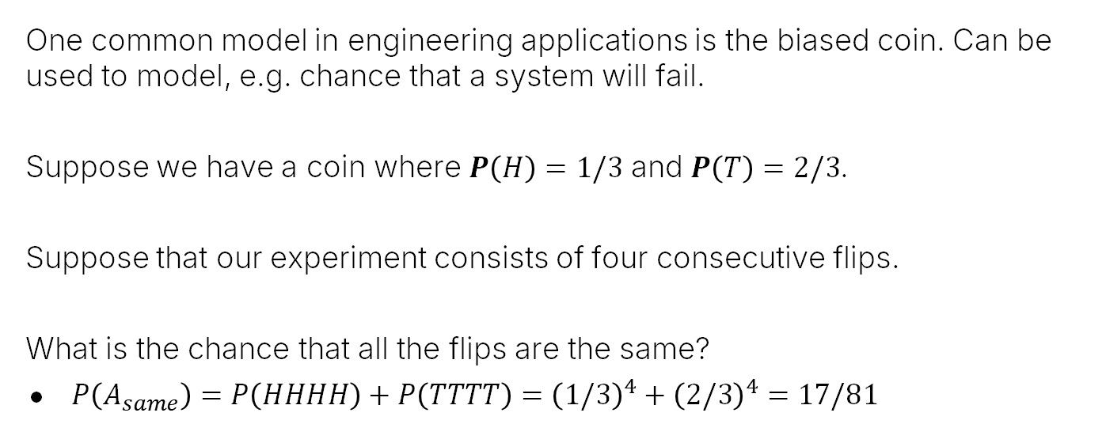
Four Biased Coins
One common model in engineering applications is the biased coin. Can be used to model, e.g. chance that a system will fail.
Suppose we have a coin where $P\left(H\right)=1/3$ and $P\left(T\right)=2/3$.
Suppose that our experiment consists of four consecutive flips.
What is the chance that all the flips are the same?
$P\left(A_{same}\right)=P\left(HHHH\right)+P\left(TTTT\right)={\left(1/3\right)}^{4}+{\left(2/3\right)}^{4}=17/81$
HHHH HHHT HHTH HHTT
HTHH HTHT HTTH HTTT
THHH THHT THTH THTT
TTHH TTHT TTTH TTTT
$$Ω=$$

Slide 31
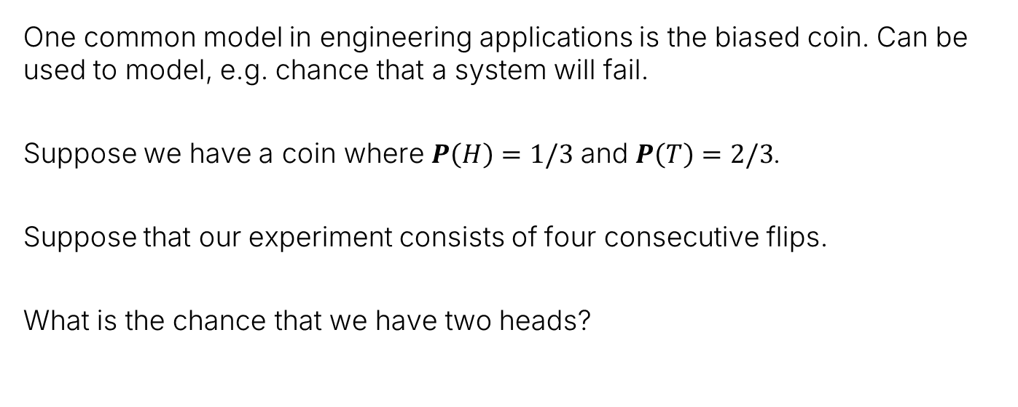
Four Biased Coins
One common model in engineering applications is the biased coin. Can be used to model, e.g. chance that a system will fail.
Suppose we have a coin where $P\left(H\right)=1/3$ and $P\left(T\right)=2/3$.
Suppose that our experiment consists of four consecutive flips.
What is the chance that we have two heads?
HHHH HHHT HHTH HHTT
HTHH HTHT HTTH HTTT
THHH THHT THTH THTT
TTHH TTHT TTTH TTTT
$$Ω=$$

Slide 32
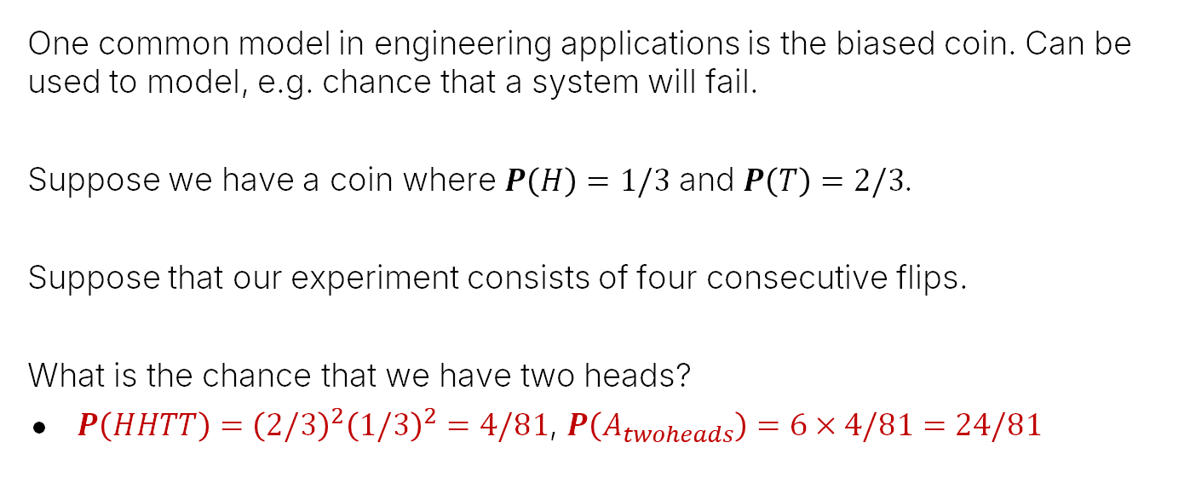
Four Biased Coins
One common model in engineering applications is the biased coin. Can be used to model, e.g. chance that a system will fail.
Suppose we have a coin where $P\left(H\right)=1/3$ and $P\left(T\right)=2/3$.
Suppose that our experiment consists of four consecutive flips.
What is the chance that we have two heads?
$P\left(HHTT\right)={\left(2/3\right)}^{2}{\left(1/3\right)}^{2}=4/81$, $P\left(A_{twoheads}\right)=6×4/81=24/81$
HHHH HHHT HHTH HHTT
HTHH HTHT HTTH HTTT
THHH THHT THTH THTT
TTHH TTHT TTTH TTTT
$$Ω=$$
Note: This “manual counting” approach doesn’t scale to larger k!

Slide 33
Example: Sixteen Biased Coins
Overview of Second Half of the Course
Probability Basics
Probability Spaces and Events
Non-uniform Probability Spaces
Example: Four Biased Coins
Example: Sixteen Biased Coins
Trickier Uniform Probability Spaces
Poker Hands
Balls and Bins
The Birthday Paradox (n=50 case)
The Birthday Paradox (general case)
The Monty Hall Problem
Simple Analysis
Sample Space Analysis
Conclusion
Lecture 16, CS70 Summer 2025

Slide 34
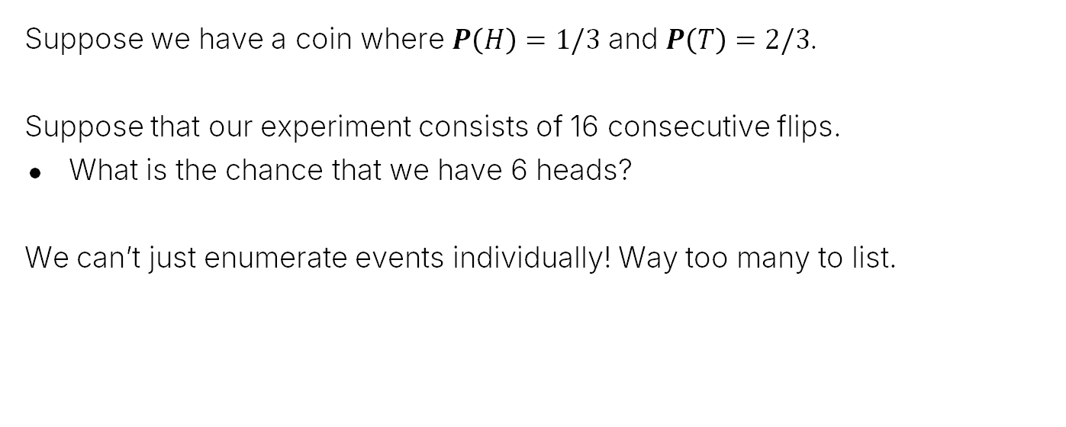
Sixteen Biased Coins
Suppose we have a coin where $P\left(H\right)=1/3$ and $P\left(T\right)=2/3$.
Suppose that our experiment consists of 16 consecutive flips.
What is the chance that we have 6 heads?
We can’t just enumerate events individually! Way too many to list.

Slide 35
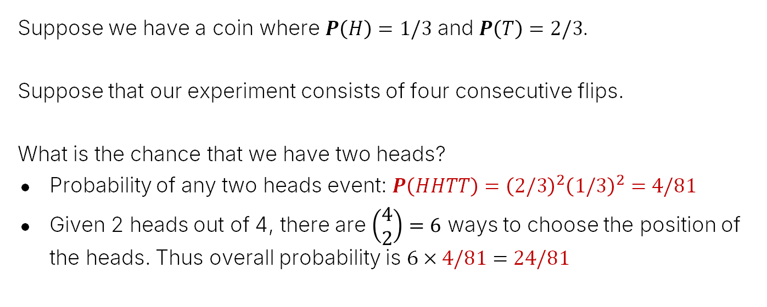
Back to Four Biased Coins
Suppose we have a coin where $P\left(H\right)=1/3$ and $P\left(T\right)=2/3$.
Suppose that our experiment consists of four consecutive flips.
What is the chance that we have two heads?
Probability of any two heads event: $P\left(HHTT\right)={\left(2/3\right)}^{2}{\left(1/3\right)}^{2}=4/81$
Given 2 heads out of 4, there are $\left(\begin{matrix}4 \\ 2\end{matrix}\right)=6$ ways to choose the position of the heads. Thus overall probability is $6×4/81=24/81$
HHHH HHHT HHTH HHTT
HTHH HTHT HTTH HTTT
THHH THHT THTH THTT
TTHH TTHT TTTH TTTT
We just did this process of counting the 6 sample points with 2 heads, but without drawing it out visually.
$$Ω=$$

Slide 36
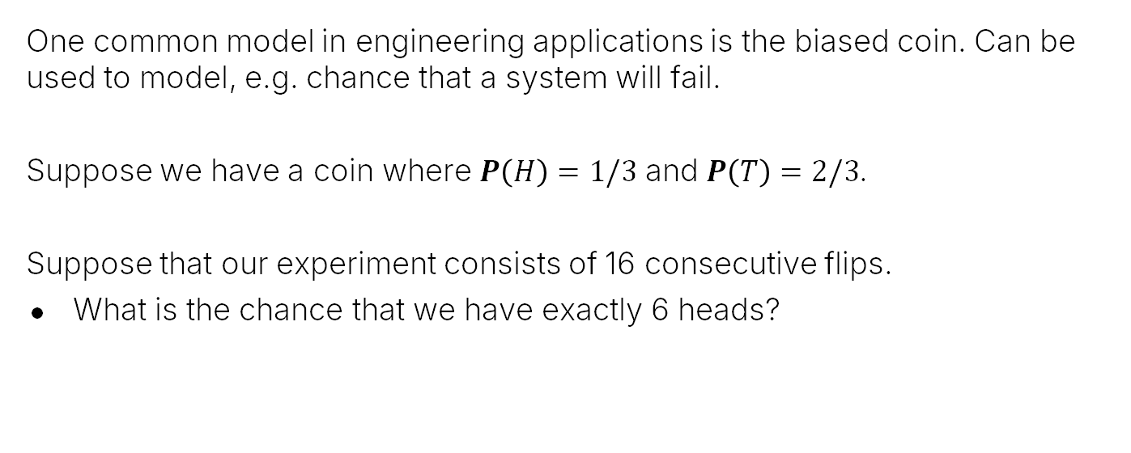
Sixteen Biased Coins
One common model in engineering applications is the biased coin. Can be used to model, e.g. chance that a system will fail.
Suppose we have a coin where $P\left(H\right)=1/3$ and $P\left(T\right)=2/3$.
Suppose that our experiment consists of 16 consecutive flips.
What is the chance that we have exactly 6 heads?

Slide 37
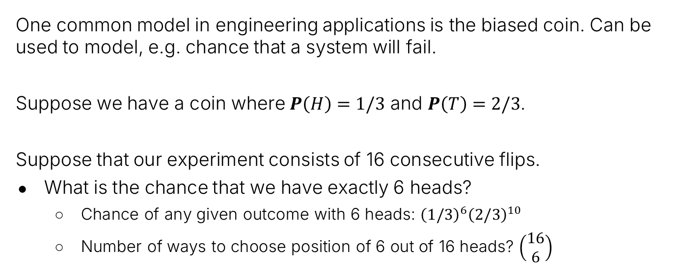
Sixteen Biased Coins
One common model in engineering applications is the biased coin. Can be used to model, e.g. chance that a system will fail.
Suppose we have a coin where $P\left(H\right)=1/3$ and $P\left(T\right)=2/3$.
Suppose that our experiment consists of 16 consecutive flips.
What is the chance that we have exactly 6 heads?
Chance of any given outcome with 6 heads: ${\left(1/3\right)}^{6}{\left(2/3\right)}^{10}$
Number of ways to choose position of 6 out of 16 heads? $\left(\begin{matrix}16 \\ 6\end{matrix}\right)$

Slide 38
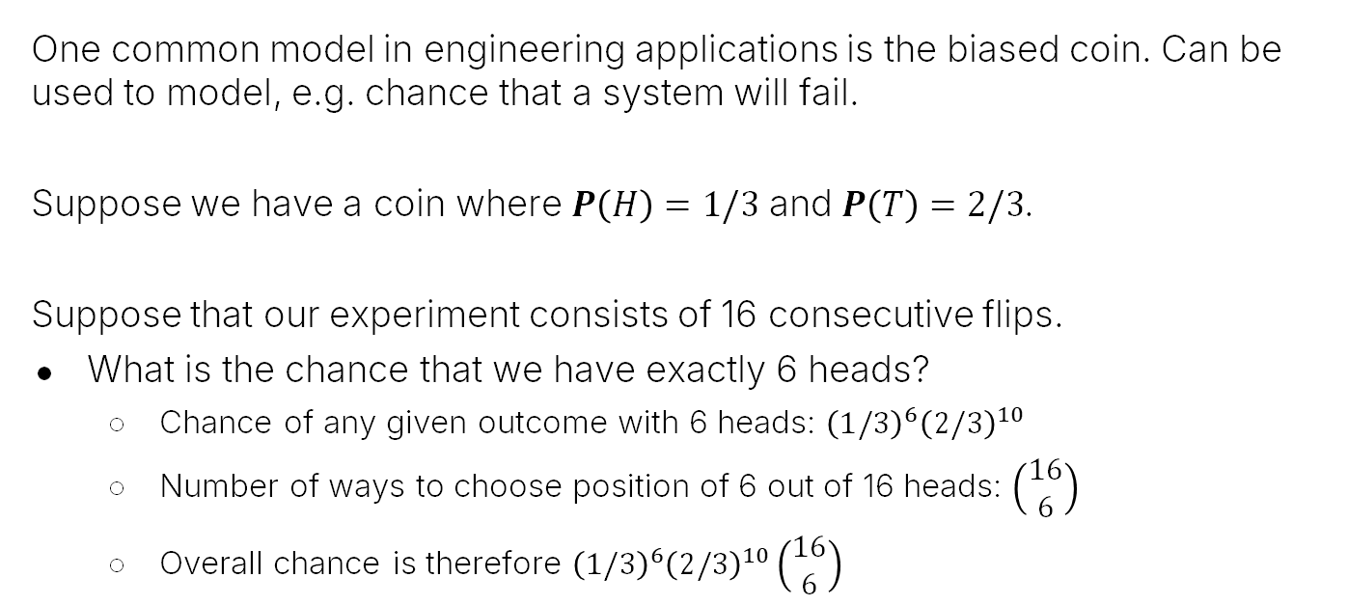
Sixteen Biased Coins
One common model in engineering applications is the biased coin. Can be used to model, e.g. chance that a system will fail.
Suppose we have a coin where $P\left(H\right)=1/3$ and $P\left(T\right)=2/3$.
Suppose that our experiment consists of 16 consecutive flips.
What is the chance that we have exactly 6 heads?
Chance of any given outcome with 6 heads: ${\left(1/3\right)}^{6}{\left(2/3\right)}^{10}$
Number of ways to choose position of 6 out of 16 heads: $\left(\begin{matrix}16 \\ 6\end{matrix}\right)$
Overall chance is therefore ${\left(1/3\right)}^{6}{\left(2/3\right)}^{10}\left(\begin{matrix}16 \\ 6\end{matrix}\right)$

Slide 39


Sixteen Biased Coins
One common model in engineering applications is the biased coin. Can be used to model, e.g. chance that a system will fail.
Suppose we have a coin where $P\left(H\right)=1/3$ and $P\left(T\right)=2/3$.
Suppose that our experiment consists of 16 consecutive flips.
What is the chance that we have exactly 6 heads?
Chance of any given outcome with 6 heads: ${\left(1/3\right)}^{6}{\left(2/3\right)}^{10}$
Number of ways to choose position of 6 out of 16 heads: $\left(\begin{matrix}16 \\ 6\end{matrix}\right)$
Overall chance is therefore ${\left(1/3\right)}^{6}{\left(2/3\right)}^{10}\left(\begin{matrix}16 \\ 6\end{matrix}\right)$
${\left(1/3\right)}^{6}{\left(2/3\right)}^{10}\left(\begin{matrix}16 \\ 10\end{matrix}\right)$ is also correct!
$$\left(\begin{matrix}16 \\ 10\end{matrix}\right)=\left(\begin{matrix}16 \\ 6\end{matrix}\right)=8008$$

Slide 40
Poker Hands
Overview of Second Half of the Course
Probability Basics
Probability Spaces and Events
Non-uniform Probability Spaces
Example: Four Biased Coins
Example: Sixteen Biased Coins
Trickier Uniform Probability Spaces
Poker Hands
Balls and Bins
The Birthday Paradox (n=50 case)
The Birthday Paradox (general case)
The Monty Hall Problem
Simple Analysis
Sample Space Analysis
Conclusion
Lecture 16, CS70 Summer 2025

Slide 41
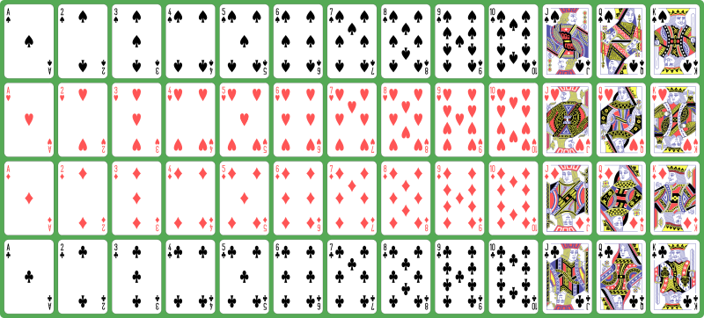
Playing Cards
In a standard deck of American playing cards, there are 52 cards.
Each card has a “rank” and a “suit”.
Ranks: {A, 2, 3, 4, 5, 6, 7, 8, 9, 10, J, Q, K}
Suits: {♠, ♥,♦,♣}
When shuffled, there are 52! (roughly $8×{10}^{67}$) permutations.
No two shuffled decks have ever been the same!

Slide 42
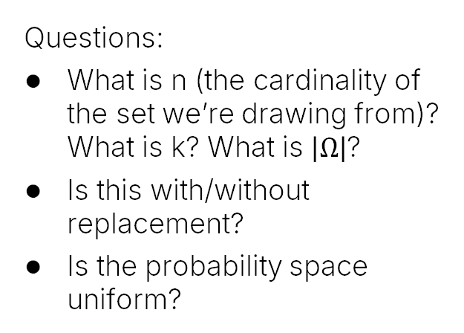
Poker Hands as a Random Experiment
In the game of poker, each player is given a “hand” consisting of 5 cards from the set of 52 cards shown below.
Each card has a “rank” and a “suit”.
Ranks: {A, 2, 3, 4, 5, 6, 7, 8, 9, 10, J, Q, K}
Suits: {♠, ♥,♦,♣}
Example Hand: {A♥, 2♣, 5♣, K♣, Q♦}
Questions:
What is n (the cardinality of the set we’re drawing from)? What is k? What is $\left|Ω\right|$?
Is this with/without replacement?
Is the probability space uniform?

Slide 43
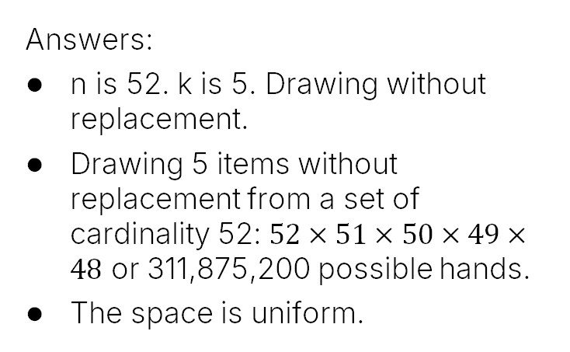
Poker Hands as a Random Experiment
In the game of poker, each player is given a “hand” consisting of 5 cards from the set of 52 cards shown below.
Each card has a “rank” and a “suit”.
Ranks: {A, 2, 3, 4, 5, 6, 7, 8, 9, 10, J, Q, K}
Suits: {♠, ♥,♦,♣}
Example Hand: {A♥, 2♣, 5♣, K♣, Q♦}
Questions:
What is n (the cardinality of the set we’re drawing from)? What is k? What is $\left|Ω\right|$?
Is this with/without replacement?
Is the probability space uniform?
Answers:
n is 52. k is 5. Drawing without replacement.
Drawing 5 items without replacement from a set of cardinality 52: $52×51×50×49×48$ or 311,875,200 possible hands.
The space is uniform.

Slide 44
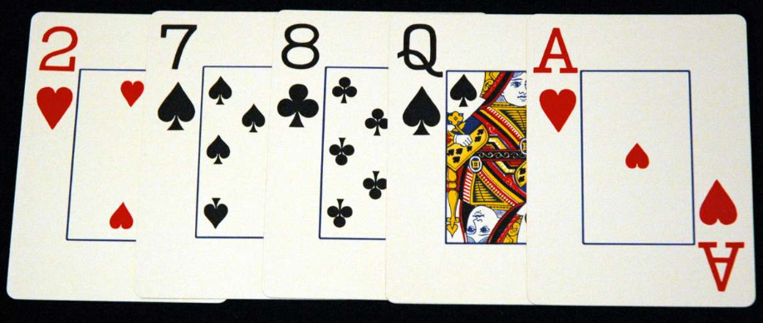
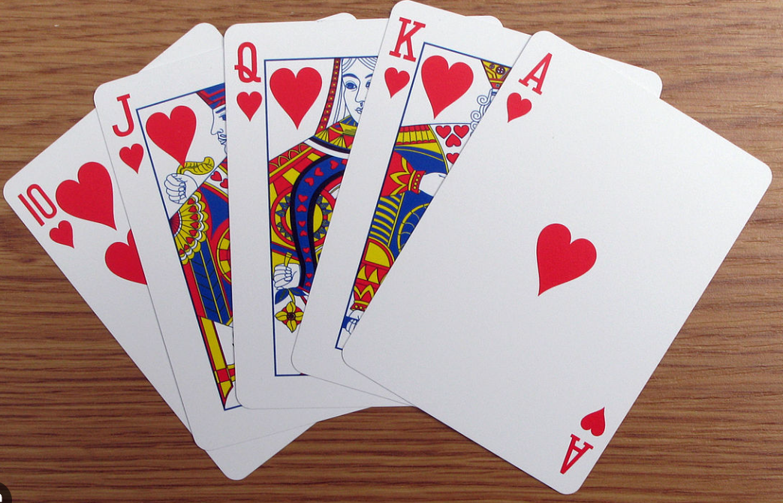
Poker Hands as a Random Experiment
In the game of poker, each player is given a “hand” consisting of 5 cards from the set of 52 cards shown below.
Each card has a “rank” and a “suit”.
Ranks: {A, 2, 3, 4, 5, 6, 7, 8, 9, 10, J, Q, K}
Suits: {♠, ♥,♦,♣}
Example Hand: {A♥, 2♣, 5♣, K♣, Q♦}
Question: Which hand is more likely?

Slide 45
Poker Hands as a Random Experiment
In the game of poker, each player is given a “hand” consisting of 5 cards from the set of 52 cards shown below.
Each card has a “rank” and a “suit”.
Ranks: {A, 2, 3, 4, 5, 6, 7, 8, 9, 10, J, Q, K}
Suits: {♠, ♥,♦,♣}
Example Hand: {A♥, 2♣, 5♣, K♣, Q♦}
Question: Which hand is more likely?
They are equally likely. It’s a uniform probability space.

Slide 46
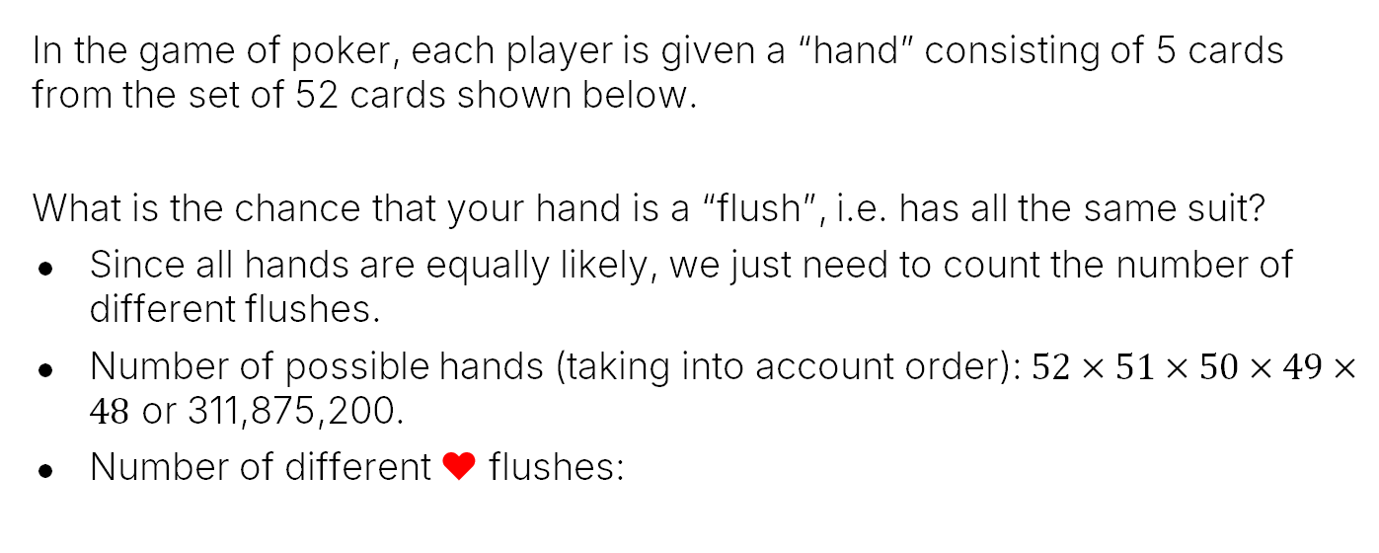
Poker Hands: Probability of a “Flush”
In the game of poker, each player is given a “hand” consisting of 5 cards from the set of 52 cards shown below.
What is the chance that your hand is a “flush”, i.e. has all the same suit?
Since all hands are equally likely, we just need to count the number of different flushes.
Number of possible hands (taking into account order): $52×51×50×49×48$ or 311,875,200.
Number of different ♥ flushes:
Example Flushes: {A♥, 2♥, 5♥, K♥, Q♥}
{5♥, A♥, 2♥, Q♥, K♥}

Slide 47
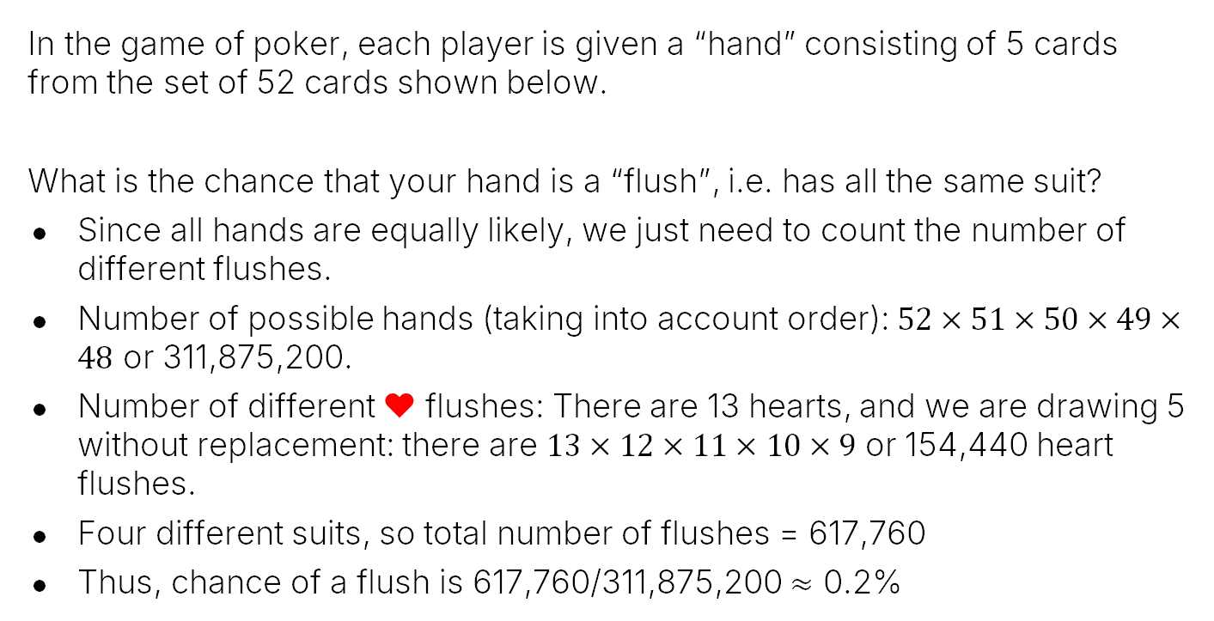
Poker Hands: Probability of a “Flush”
In the game of poker, each player is given a “hand” consisting of 5 cards from the set of 52 cards shown below.
What is the chance that your hand is a “flush”, i.e. has all the same suit?
Since all hands are equally likely, we just need to count the number of different flushes.
Number of possible hands (taking into account order): $52×51×50×49×48$ or 311,875,200.
Number of different ♥ flushes: There are 13 hearts, and we are drawing 5 without replacement: there are $13×12×11×10×9$ or 154,440 heart flushes.
Four different suits, so total number of flushes = 617,760
Thus, chance of a flush is 617,760/311,875,200 $≈$ 0.2%
Example Flushes: {A♥, 2♥, 5♥, K♥, Q♥}
{5♥, A♥, 2♥, Q♥, K♥}

Slide 48

Alternate Framing: Ignoring Order
With hands playing cards it’s also perfectly reasonable to define the sample space so that we ignore order.
{1♥, 2♥, 3♥, 4♥, 5♥} $≡\text{\{5}\text{♥}\text{, }\text{3}\text{♥}\text{, }\text{1}\text{♥}\text{, }\text{2}\text{♥}\text{, }\text{4}\text{♥}\text{\}}$
Questions:
What is n (the cardinality of the set we’re drawing from)? What is k? What is $\left|Ω\right|$?
Is this with/without replacement?
Is the probability space uniform?
Answers:
n is 52. k is 5. Drawing without replacement.
Drawing 5 items without replacement from a set of cardinality 52, ignoring order: ??
The space is ??

Slide 49
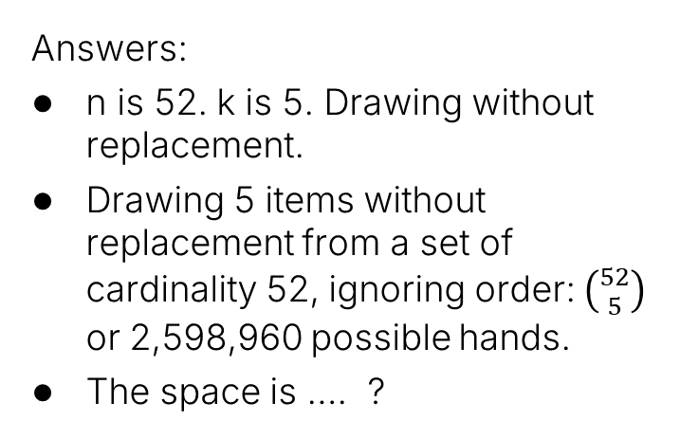
Alternate Framing: Ignoring Order
With hands playing cards it’s also perfectly reasonable to define the sample space so that we ignore order.
{1♥, 2♥, 3♥, 4♥, 5♥} $≡\text{\{5}\text{♥}\text{, }\text{3}\text{♥}\text{, }\text{1}\text{♥}\text{, }\text{2}\text{♥}\text{, }\text{4}\text{♥}\text{\}}$
Questions:
What is n (the cardinality of the set we’re drawing from)? What is k? What is $\left|Ω\right|$?
Is this with/without replacement?
Is the probability space uniform?
Answers:
n is 52. k is 5. Drawing without replacement.
Drawing 5 items without replacement from a set of cardinality 52, ignoring order: $\left({52 \atop 5}\right)$ or 2,598,960 possible hands.
The space is …. ?

Slide 50
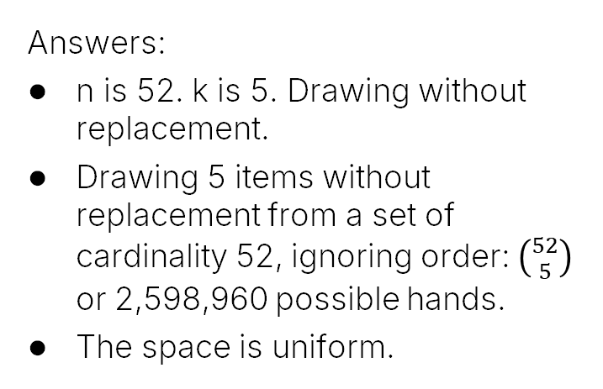
Alternate Framing: Ignoring Order
With hands playing cards it’s also perfectly reasonable to define the sample space so that we ignore order.
Why is this probability space uniform, but the probability space of two four-sided dice ignoring order was not uniform?
{1♥, 2♥, 3♥, 4♥, 5♥} $≡\text{\{5}\text{♥}\text{, }\text{3}\text{♥}\text{, }\text{1}\text{♥}\text{, }\text{2}\text{♥}\text{, }\text{4}\text{♥}\text{\}}$
Questions:
What is n (the cardinality of the set we’re drawing from)? What is k? What is $\left|Ω\right|$?
Is this with/without replacement?
Is the probability space uniform?
Answers:
n is 52. k is 5. Drawing without replacement.
Drawing 5 items without replacement from a set of cardinality 52, ignoring order: $\left({52 \atop 5}\right)$ or 2,598,960 possible hands.
The space is uniform.

Slide 51
Alternate Framing: Ignoring Order
With hands playing cards it’s also perfectly reasonable to define the sample space so that we ignore order.
Why is this probability space uniform, but the probability space of two four-sided dice ignoring order was not uniform? We’re drawing without replacement, so duplicates are impossible! No 12 vs. 21 situation.
{1♥, 2♥, 3♥, 4♥, 5♥} $≡\text{\{5}\text{♥}\text{, }\text{3}\text{♥}\text{, }\text{1}\text{♥}\text{, }\text{2}\text{♥}\text{, }\text{4}\text{♥}\text{\}}$
Questions:
What is n (the cardinality of the set we’re drawing from)? What is k? What is $\left|Ω\right|$?
Is this with/without replacement?
Is the probability space uniform?
Answers:
n is 52. k is 5. Drawing without replacement.
Drawing 5 items without replacement from a set of cardinality 52, ignoring order: $\left({52 \atop 5}\right)$ or 2,598,960 possible hands.
The space is uniform.

Slide 52
Poker Hands: Probability of a “Flush”
We can analyze the probability of a flush in this sample space as well.
What is the chance that your hand is a “flush”, i.e. has all the same suit?
Since probability space is uniform, we just need to count the number of different flushes.
Number of different ♥ flushes:
Example Flush: {A♥, 2♥, 5♥, K♥, Q♥}

Slide 53
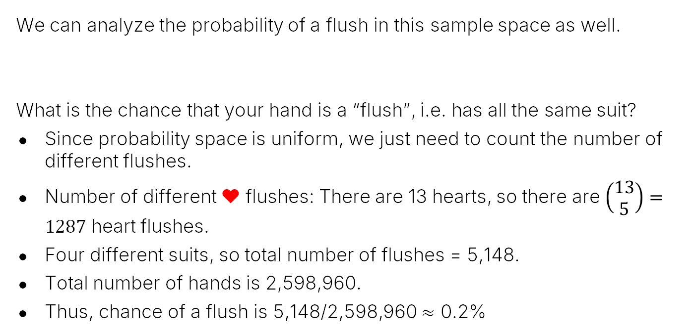
Poker Hands: Probability of a “Flush”
We can analyze the probability of a flush in this sample space as well.
What is the chance that your hand is a “flush”, i.e. has all the same suit?
Since probability space is uniform, we just need to count the number of different flushes.
Number of different ♥ flushes: There are 13 hearts, so there are $\left(\begin{matrix}13 \\ 5\end{matrix}\right)=1287$ heart flushes.
Four different suits, so total number of flushes = 5,148.
Total number of hands is 2,598,960.
Thus, chance of a flush is 5,148/2,598,960 $≈$ 0.2%
Example Flush: {A♥, 2♥, 5♥, K♥, Q♥}

Slide 54
Balls and Bins
Overview of Second Half of the Course
Probability Basics
Probability Spaces and Events
Non-uniform Probability Spaces
Example: Four Biased Coins
Example: Sixteen Biased Coins
Trickier Uniform Probability Spaces
Poker Hands
Balls and Bins
The Birthday Paradox (n=50 case)
The Birthday Paradox (general case)
The Monty Hall Problem
Simple Analysis
Sample Space Analysis
Conclusion
Lecture 16, CS70 Summer 2025

Slide 55
Example: Balls and Bins
Suppose we throw 20 balls independently into 10 bins. Assume each ball is equally likely to land in any of the ten bins.
Let’s do a quick demo.
20 balls thrown!

Slide 56
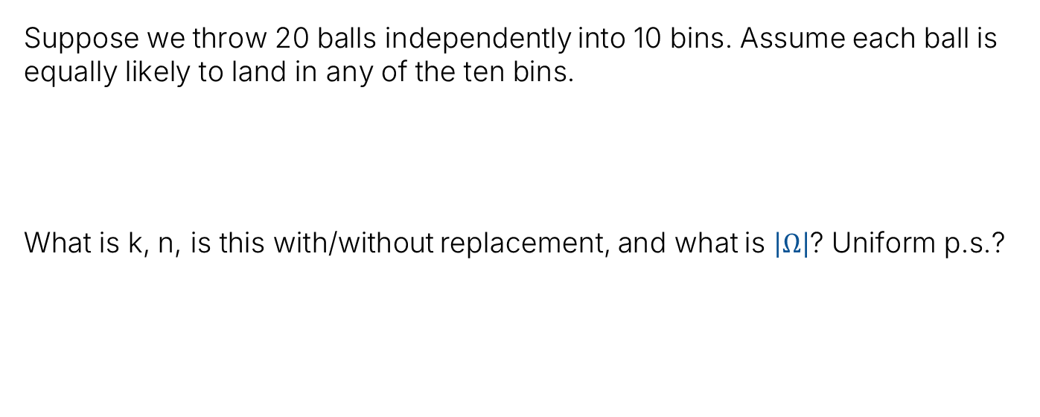
Example: Balls and Bins
Suppose we throw 20 balls independently into 10 bins. Assume each ball is equally likely to land in any of the ten bins.
What is k, n, is this with/without replacement, and what is $\left|Ω\right|$? Uniform p.s.?

Slide 57
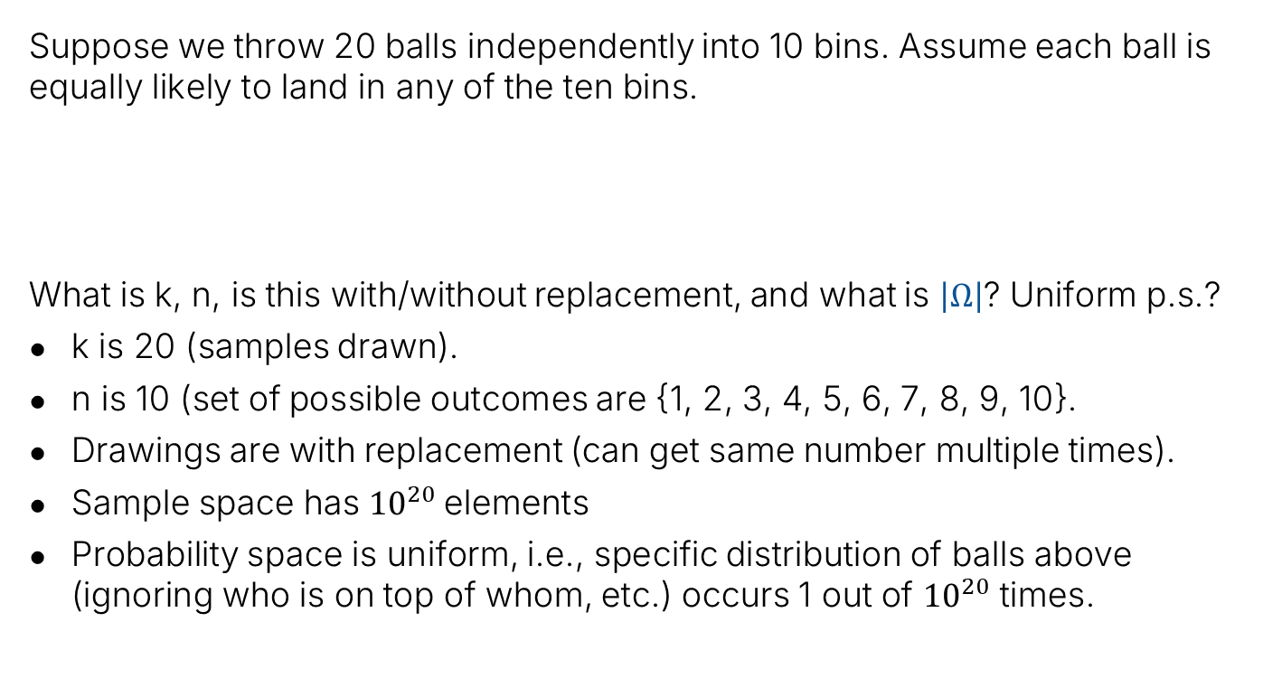
Example: Balls and Bins
Suppose we throw 20 balls independently into 10 bins. Assume each ball is equally likely to land in any of the ten bins.
What is k, n, is this with/without replacement, and what is $\left|Ω\right|$? Uniform p.s.?
k is 20 (samples drawn).
n is 10 (set of possible outcomes are {1, 2, 3, 4, 5, 6, 7, 8, 9, 10}.
Drawings are with replacement (can get same number multiple times).
Sample space has ${10}^{20}$elements
Probability space is uniform, i.e., specific distribution of balls above (ignoring who is on top of whom, etc.) occurs 1 out of ${10}^{20}$ times.

Slide 58
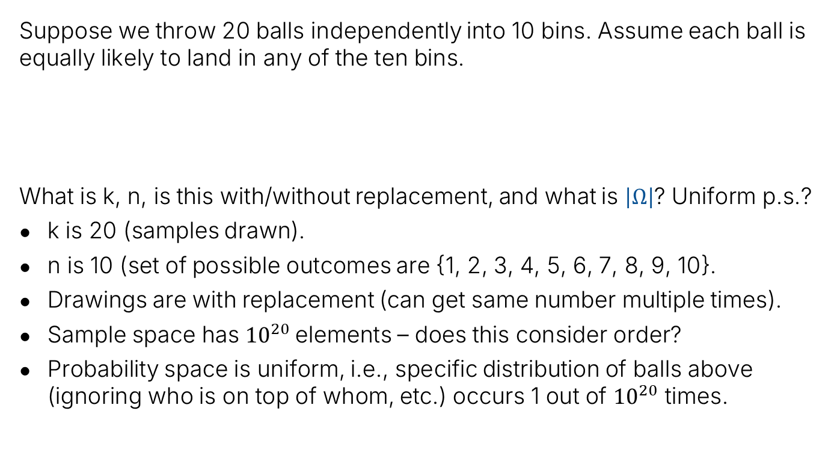
Example: Balls and Bins
Suppose we throw 20 balls independently into 10 bins. Assume each ball is equally likely to land in any of the ten bins.
What is k, n, is this with/without replacement, and what is $\left|Ω\right|$? Uniform p.s.?
k is 20 (samples drawn).
n is 10 (set of possible outcomes are {1, 2, 3, 4, 5, 6, 7, 8, 9, 10}.
Drawings are with replacement (can get same number multiple times).
Sample space has ${10}^{20}$elements – does this consider order?
Probability space is uniform, i.e., specific distribution of balls above (ignoring who is on top of whom, etc.) occurs 1 out of ${10}^{20}$ times.

Slide 59
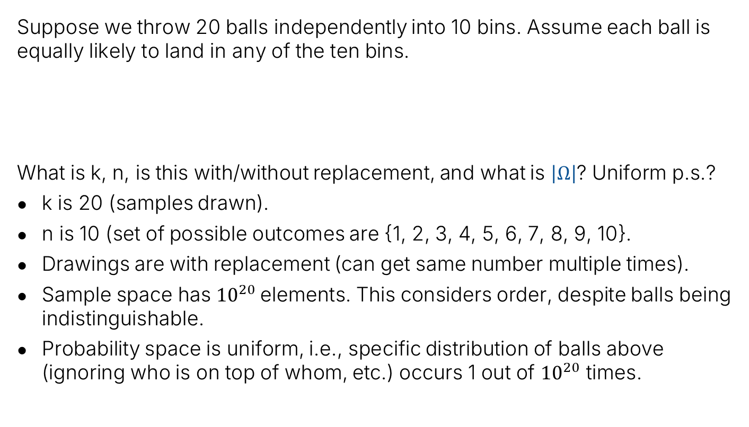
Example: Balls and Bins
Suppose we throw 20 balls independently into 10 bins. Assume each ball is equally likely to land in any of the ten bins.
What is k, n, is this with/without replacement, and what is $\left|Ω\right|$? Uniform p.s.?
k is 20 (samples drawn).
n is 10 (set of possible outcomes are {1, 2, 3, 4, 5, 6, 7, 8, 9, 10}.
Drawings are with replacement (can get same number multiple times).
Sample space has ${10}^{20}$elements. This considers order, despite balls being indistinguishable.
Probability space is uniform, i.e., specific distribution of balls above (ignoring who is on top of whom, etc.) occurs 1 out of ${10}^{20}$ times.

Slide 60
Example: Balls and Bins
Suppose we throw 20 balls independently into 10 bins. Assume each ball is equally likely to land in any of the ten bins.
Why do you think I chose to consider order in defining my sample space?

Slide 61
Example: Balls and Bins
Suppose we throw 20 balls independently into 10 bins. Assume each ball is equally likely to land in any of the ten bins.
Why do you think I chose to consider order in defining my sample space?
So that the probability space is uniform!
Otherwise, some sample points would be more likely than others.
Example: Only one configuration where all balls go in bin 1 (unlikely). Many configurations where 2 balls go in each bin (thus more likely).

Slide 62
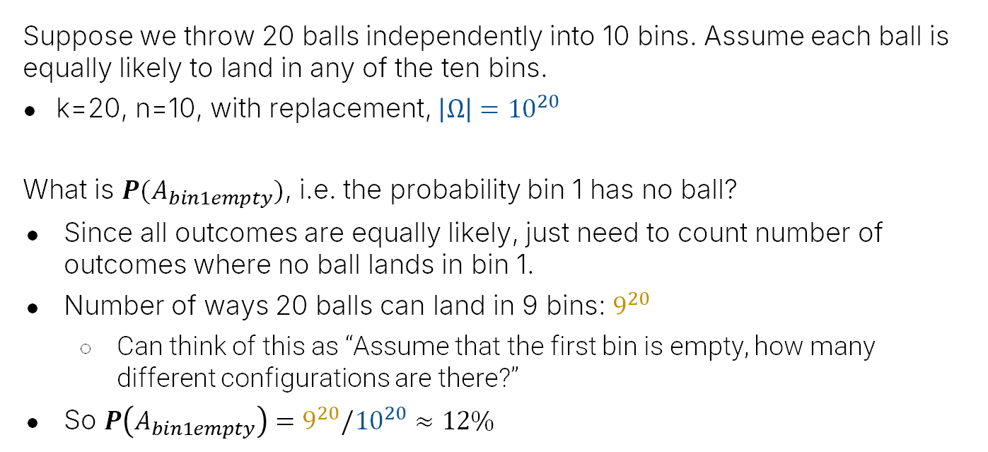
Example: Balls and Bins
Suppose we throw 20 balls independently into 10 bins. Assume each ball is equally likely to land in any of the ten bins.
k=20, n=10, with replacement, $\left|Ω\right|={10}^{20}$
What is $P(A_{bin1empty})$, i.e. the probability bin 1 has no ball?
Since all outcomes are equally likely, just need to count number of outcomes where no ball lands in bin 1.
Number of ways 20 balls can land in 9 bins: $9^{20}$
Can think of this as “Assume that the first bin is empty, how many different configurations are there?”
So $P\left(A_{bin1empty}\right)=9^{20}/{10}^{20}≈12\%$

Slide 63
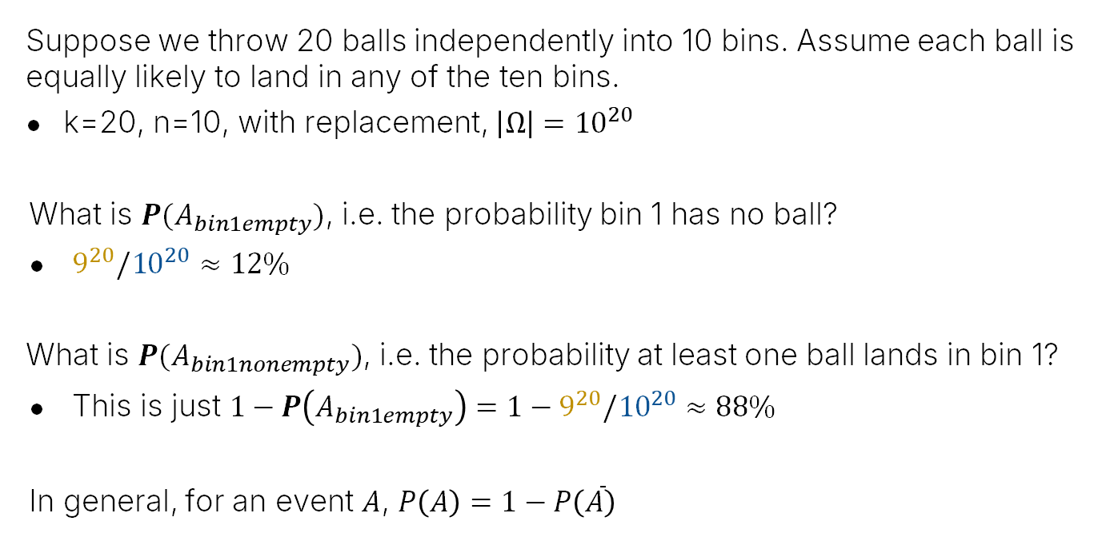
Example: Balls and Bins
Suppose we throw 20 balls independently into 10 bins. Assume each ball is equally likely to land in any of the ten bins.
k=20, n=10, with replacement, $\left|Ω\right|={10}^{20}$
What is $P(A_{bin1empty})$, i.e. the probability bin 1 has no ball?
$9^{20}/{10}^{20}$ $≈12\%$
What is $P(A_{bin1nonempty})$, i.e. the probability at least one ball lands in bin 1?
This is just $1−P\left(A_{bin1empty}\right)=1−9^{20}/{10}^{20}≈88\%$
In general, for an event $A$, $P\left(A\right)=1−P\left(\overline{A}\right)$

Slide 64
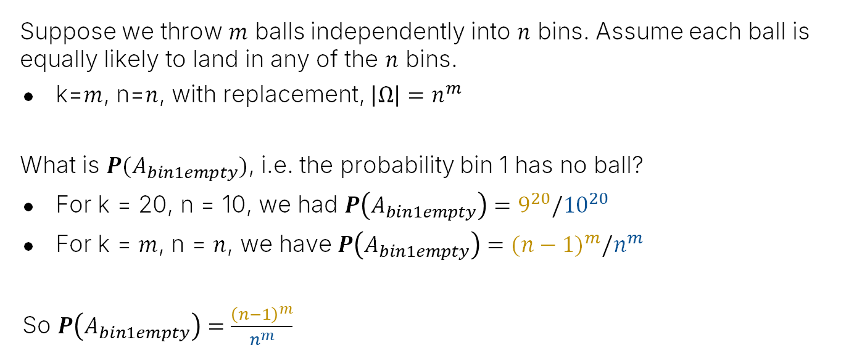



Example: Balls and Bins
Suppose we throw $m$ balls independently into $n$ bins. Assume each ball is equally likely to land in any of the $n$ bins.
k=$m$, n=$n$, with replacement, $\left|Ω\right|=n^{m}$
What is $P(A_{bin1empty})$, i.e. the probability bin 1 has no ball?
For k = 20, n = 10, we had $P\left(A_{bin1empty}\right)=9^{20}/{10}^{20}$
For k = $m$, n = $n$, we have $P\left(A_{bin1empty}\right)={(n−1)}^{m}/n^{m}$
So $P\left(A_{bin1empty}\right)=\frac{{\left(n−1\right)}^{m}}{n^{m}}$
$$={\left(\frac{n−1}{n}\right)}^{m}$$
$$={\left(1−\frac{1}{n}\right)}^{m}$$
Number of ways m balls can land in n-1 bins: ${(n−1)}^{m}$

Slide 65
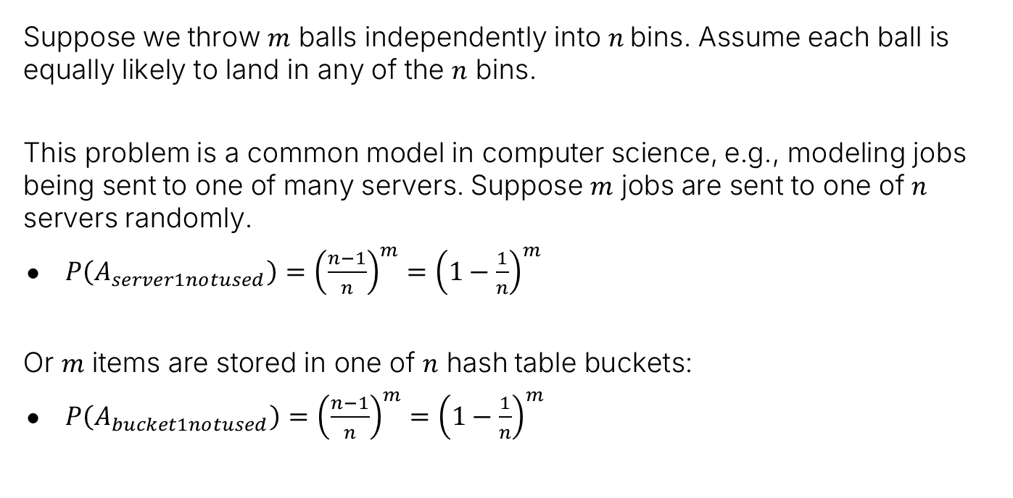
Buckets and Balls and the World
Suppose we throw $m$ balls independently into $n$ bins. Assume each ball is equally likely to land in any of the $n$ bins.
This problem is a common model in computer science, e.g., modeling jobs being sent to one of many servers. Suppose $m$ jobs are sent to one of $n$ servers randomly.
$P\left(A_{server1notused}\right)={\left(\frac{n−1}{n}\right)}^{m}={\left(1−\frac{1}{n}\right)}^{m}$
Or $m$ items are stored in one of $n$ hash table buckets:
$P\left(A_{bucket1notused}\right)={\left(\frac{n−1}{n}\right)}^{m}={\left(1−\frac{1}{n}\right)}^{m}$

Slide 66
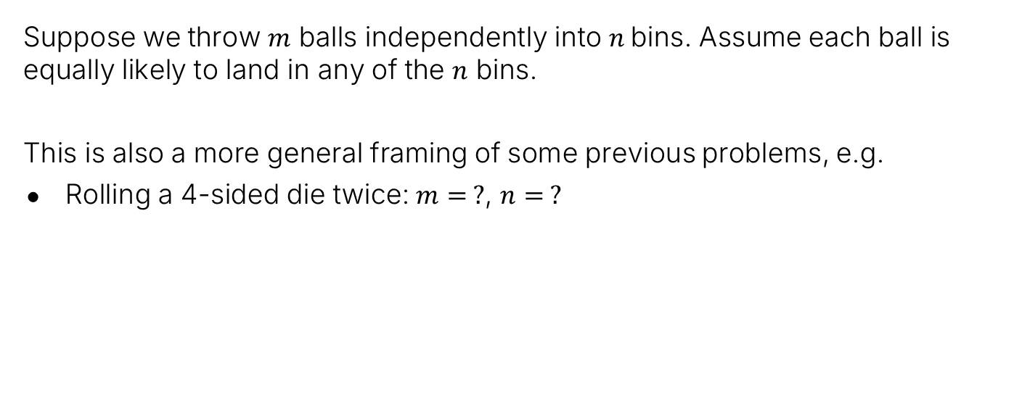
Example: Buckets and Balls and Dice and Coins
Suppose we throw $m$ balls independently into $n$ bins. Assume each ball is equally likely to land in any of the $n$ bins.
This is also a more general framing of some previous problems, e.g.
Rolling a 4-sided die twice: $m= ?$, $n= ?$

Slide 67

Example: Buckets and Balls and Dice and Coins
Suppose we throw $m$ balls independently into $n$ bins. Assume each ball is equally likely to land in any of the $n$ bins.
This is also a more general framing of some previous problems, e.g.
Rolling a 4-sided die twice: $m=2$, $n=4$.
Flipping a coin 16 times, $m= ?$, $n= ?$.

Slide 68

Example: Buckets and Balls and Dice and Coins
Suppose we throw $m$ balls independently into $n$ bins. Assume each ball is equally likely to land in any of the $n$ bins.
This is also a more general framing of some previous problems, e.g.
Rolling a 4-sided die twice: $m=2$, $n=4$.
Flipping a coin 16 times, $m=16$, $n=2$.
Drawing a hand of 5 cards from a deck of 52 cards? $m= ?$, $n= ?$.

Slide 69

Example: Buckets and Balls and Dice and Coins
Suppose we throw $m$ balls independently into $n$ bins. Assume each ball is equally likely to land in any of the $n$ bins.
This is also a more general framing of some previous problems, e.g.
Rolling a 4-sided die twice: $m=2$, $n=4$.
Flipping a coin 16 times, $m=16$, $n=2$.
Drawing a hand of 5 cards from a deck of 52 cards? Doesn’t apply!
Drawing a hand is without replacement! Doesn’t match independent ball throwing.

Slide 70
The Birthday Paradox (n=50 case)
Overview of Second Half of the Course
Probability Basics
Probability Spaces and Events
Non-uniform Probability Spaces
Example: Four Biased Coins
Example: Sixteen Biased Coins
Trickier Uniform Probability Spaces
Poker Hands
Balls and Bins
The Birthday Paradox (n=50 case)
The Birthday Paradox (general case)
The Monty Hall Problem
Simple Analysis
Sample Space Analysis
Conclusion
Lecture 16, CS70 Summer 2025

Slide 71
Birthdays
Suppose we have 50 people in a room. What is the chance that two share a birthday? (For simplicity, ignore leap year birthdays, i.e., assume each year has 365 days).
What’s your gut feeling?
Less than 20%?
Decent chance, say 50%ish?
Very likely, say >90%?

Slide 72

Birthdays
Suppose we have 50 people in a room who all have a birthday between day 1 and day 365.
In terms of probability spaces:
What is the cardinality of the set S that we’re drawing from?
How many samples are we drawing?
Are we drawing with or without replacement?
What is the cardinality of the sample space $Ω$?

Slide 73

Birthdays
Suppose we have 50 people in a room who all have a birthday between day 1 and day 365.
What is the probability space for the possible birthdays?
What is the cardinality of the set S that we’re drawing from? 365
How many samples are we drawing? 50
Are we drawing with or without replacement? With
What is the cardinality of the sample space $Ω$? $\left|Ω\right|={365}^{50}$
The probability space is again uniform.

Slide 74

Birthdays
Suppose we have 50 people in a room who all have a birthday between day 1 and day 365.
Cardinality of the sample space $Ω$? $\left|Ω\right|={365}^{50}$
Let $A$ be the event where two (or more) of the birthdays are the same. Then:
$$P\left(A\right)=\frac{\left|A\right|}{\left|Ω\right|}$$
Examples from $A$: [1, 1, …], [5, 5, …5, …], [66, 12, 51, 66, …]
Problem: How the heck do we figure out $\left|A\right|$?

Slide 75

Birthdays
Suppose we have 50 people in a room who all have a birthday between day 1 and day 365.
Cardinality of the sample space $Ω$? $\left|Ω\right|={365}^{50}$
Let $A$ be the event where two (or more) of the birthdays are the same. Hard to compute $\left|A\right|$.
As often the case, $\left|\overline{A}\right|$ is easier to compute.
Example from $\left|\overline{A}\right|$: [55, 1, 67, 2, 99, …, 33, 41], with no repeats.
How many samples are there like this with no repeats?
Let’s go back to the random experiments framework.

Slide 76
Birthdays with no Repeats
Suppose we have 50 people in a room who all have a birthday between day 1 and day 365 AND THERE ARE NO REPEAT BIRTHDAYS.
Goal: Figure out the size of this sample space.
What is the cardinality of the set S that we’re drawing from?
How many samples are we drawing?
Are we drawing with or without replacement?
What is the cardinality of this sample space?

Slide 77
Birthdays with no Repeats
Suppose we have 50 people in a room who all have a birthday between day 1 and day 365 AND THERE ARE NO REPEAT BIRTHDAYS.
Goal: Figure out the size of this sample space.
What is the cardinality of the set S that we’re drawing from? 365
How many samples are we drawing? 50
Are we drawing with or without replacement? Without
What is the cardinality of this sample space?

Slide 78

Birthdays with no Repeats
Suppose we have 50 people in a room who all have a birthday between day 1 and day 365 AND THERE ARE NO REPEAT BIRTHDAYS.
In terms of probability spaces:
What is the cardinality of the set S that we’re drawing from? 365
How many samples are we drawing? 50
Are we drawing with or without replacement? Without
What is the cardinality of this sample space? $365×364×…×316$
Note that this sample space is just $\overline{A}$, i.e. $\left|\overline{A}\right|=365×364×…×316$

Slide 79


Birthdays
Suppose we have 50 people in a room who all have a birthday between day 1 and day 365. What is the chance that two of those 50 people share the same birthday?
Let $A$ be the event where two (or more) of the birthdays are the same. Then:
$$P\left(A\right)=\frac{\left|A\right|}{\left|Ω\right|}=1−P\left(\overline{A}\right)=1−\frac{\left|\overline{A}\right|}{\left|Ω\right|}$$
For $k=50$, $\left|\overline{A}\right|=365×364×…×316$, and $\left|Ω\right|={365}^{50}$, so
$$P\left(A\right)=1−\frac{365×364×…×316}{{365}^{50}}$$
Can use e.g. Wolfram alpha to compute.

Slide 80

Birthdays
Suppose we have 50 people in a room who all have a birthday between day 1 and day 365. What is the chance that two of those 50 people share the same birthday?
Let $A$ be the event where two (or more) of the birthdays are the same. Then:
$$P\left(A\right)=\frac{\left|A\right|}{\left|Ω\right|}=1−P\left(\overline{A}\right)=1−\frac{\left|\overline{A}\right|}{\left|Ω\right|}$$
For $k=50$, $\left|\overline{A}\right|=365×364×…×316$, and $\left|Ω\right|={365}^{50}$, so
$$P\left(A\right)=1−\frac{365×364×…×316}{{365}^{50}}≈1−0.03≈0.97$$

Slide 81
The Birthday Paradox (general case)
Overview of Second Half of the Course
Probability Basics
Probability Spaces and Events
Non-uniform Probability Spaces
Example: Four Biased Coins
Example: Sixteen Biased Coins
Trickier Uniform Probability Spaces
Poker Hands
Balls and Bins
The Birthday Paradox (n=50 case)
The Birthday Paradox (general case)
The Monty Hall Problem
Simple Analysis
Sample Space Analysis
Conclusion
Lecture 16, CS70 Summer 2025

Slide 82

Birthdays
Suppose we have 50 people in a room who all have a birthday between day 1 and day 365. What is the chance that two of those 50 people share the same birthday?
Compute by counting number of birthday combinations with no repeats.
$$\left|\overline{A}\right|=365×364×…×316$$
Suppose we want to generalize to the case where we have $n$ people. What is $\left|\overline{A}\right|$ in that case?
$$P\left(A\right)=1−\frac{365×364×…×316}{{365}^{50}}≈1−0.03≈0.97$$

Slide 83
Birthdays
Suppose we have 50 people in a room who all have a birthday between day 1 and day 365. What is the chance that two of those 50 people share the same birthday?
Compute by counting number of birthday combinations with no repeats.
$$\left|\overline{A}\right|=365×364×…×316$$
Suppose we want to generalize to the case where we have $n$ people. What is $\left|\overline{A}\right|$ in that case?
$$\left|\overline{A}\right|=365×364×…×\left(365−n+1\right)$$

Slide 84

Birthdays
Suppose we have $n$ people in a room who all have a birthday between day 1 and day 365. What is the chance that two of those $n$ people share the same birthday?
$$P\left(A\right)=1−\frac{365×364×…×\left(365−n+1\right)}{{365}^{n}}$$

Slide 85
Quick Aside: Computing This Function
Suppose we want to compute the results of the function below.
Why might it be a bad idea to compute the numerator and denominator separately?
How can we compute the result more efficiently?
$$P\left(A\right)=1−\frac{365×364×…×\left(365−n+1\right)}{{365}^{n}}$$

Slide 86

Quick Aside: Computing This Function
Suppose we want to compute the results of the function below.
Why might it be a bad idea to compute the numerator and denominator separately?
In many programming languages like Java, we’d get overflow issues.
In languages that support huge integers, performance will be slow. ${365}^{100}$ is an 852 bit number, much bigger than 64 bits for typical operations.
How can we compute the result more efficiently?
One idea: Compute product of $\frac{365}{365}×\frac{364}{365}×\frac{363}{365}×…$
You can compute this approximately in constant time (maybe try to come up with a technique, happy to discuss at office hours!)
$$P\left(A\right)=1−\frac{365×364×…×\left(365−n+1\right)}{{365}^{n}}$$

Slide 87



Birthday Paradox Table
For various $n$, the probability that at least two people share a birthday is given below.
$$n$$ | $$P(A)$$ | $$\%$$
1 | 0 | 0%
2 | 0.0027 | 0.27%
3 | 0.008 | 0.8%
4 | 0.016 | 1.6%
10 | 0.117 | 11.7%
15 | 0.252 | 25.2%
20 | 0.411 | 41.1%
23 | 0.507 | 50.7%
50 | 0.97 | 97.0%
60 | 0.994 | 99.4%
23 is where we cross 50%

Slide 88
The Monty Hall Problem: Simple Analysis
Overview of Second Half of the Course
Probability Basics
Probability Spaces and Events
Non-uniform Probability Spaces
Example: Four Biased Coins
Example: Sixteen Biased Coins
Trickier Uniform Probability Spaces
Poker Hands
Balls and Bins
The Birthday Paradox (n=50 case)
The Birthday Paradox (general case)
The Monty Hall Problem
Simple Analysis
Sample Space Analysis
Conclusion
Lecture 16, CS70 Summer 2025

Slide 89
Probability Spaces and Event Probabilities
Let’s consider a much trickier problem using the same framework as before.

Slide 90

The Monty Hall Problem
Let’s start by imagining a game. In this game there are 3 doors with prizes behind them, and you want to win the car.
One door has a car behind it.
Two doors have a goat behind them.

Slide 91
The Monty Hall Problem
Let’s start by imagining a game. In this game there are 3 doors with prizes behind them, and you want to win the car.
One door has a car behind it.
Two doors have a goat behind them.
The rules are as follows:
You pick one of 3 doors.
The host reveals what is behind one of the other doors. The answer is ALWAYS a goat.
You get a chance to switch doors after the host shows you the goat.
Let’s try to play a few rounds: https://www.rossmanchance.com/applets/2021/montyhall/Monty.html

Slide 92

The Monty Hall Problem
Suppose we’re playing, pick the left door, and we get to this state:
Should you switch doors? (Note: You are ALWAYS shown a goat)

Slide 93
Monty Hall Problem
Strangely the answer is yes - your chance of winning is better if you switch!

Slide 94

Explanation (1/4)
The chance that you were correct with your first guess is 1/3.
Only two possibilities exist:
You were right (with probability 1/3).
You were wrong (with probability 2/3).

Slide 95

Explanation (2/4)
Suppose the host opens door 3, how do the probabilities change?
Chance that your original choice is correct is unchanged. It’s still 1/3.

Slide 96
Explanation (3/4)
Suppose the host opens door 3, how do the probabilities change?
Chance that your original choice is correct is unchanged. It’s still 1/3.
Chance that door 3 has the car is now zero.

Slide 97
Explanation (4/4)
Suppose the host opens door 3, how do the probabilities change?
Chance that your original choice is correct is unchanged. It’s still 1/3.
Chance that door 3 has the car is now zero.
Chance that door 2 has the car is now 2/3 (since door 3 can’t have car).

Slide 98
Explanation Summary
The chance that you were correct with your first guess is 1/3.
That is, only two possibilities exist before the door is open:
You are right (with probability 1/3).
You are wrong (with probability 2/3).
After opening a door, the chance you were right is STILL 1/3.
So switching (to the other binary choice) must have a probability of 2/3.

Slide 99
Monty Hall Problem
When this problem was answered in Parade magazine by columnist Marilyn vos Savant in 1990, the answer drew huge amounts of angry mail including from folks holding PhDs.
Let’s take a walk down memory lane: https://web.archive.org/web/20130121183432/http://marilynvossavant.com/game-show-problem/

Slide 100
The Monty Hall Problem: Sample Space Analysis
Overview of Second Half of the Course
Probability Basics
Probability Spaces and Events
Non-uniform Probability Spaces
Example: Four Biased Coins
Example: Sixteen Biased Coins
Trickier Uniform Probability Spaces
Poker Hands
Balls and Bins
The Birthday Paradox (n=50 case)
The Birthday Paradox (general case)
The Monty Hall Problem
Simple Analysis
Sample Space Analysis
Conclusion
Lecture 16, CS70 Spring 2025

Slide 101

Explanation in Terms of Sample Spaces
We can also think about this problem in terms of a sample space where we draw 3 samples from the set S = {1, 2, 3}:
$i$: the door with the car prize (randomly chosen by TV show crew)
$j$: the door that you select (randomly chosen by you)
$k$: the door that gets opened (randomly chosen by host, with caveat that they will never select the door with the car or the door chosen by you)

Slide 102

Explanation in Terms of Sample Spaces
We can also think about this problem in terms of a sample space where we draw 3 samples from the set S = {1, 2, 3}:
$i$: the door with the car prize (randomly chosen by TV show crew)
$j$: the door that you select (randomly chosen by you)
$k$: the door that gets opened (randomly chosen by host, with caveat that they will never select the door with the car or the door chosen by you)
Our usual questions:
What is the cardinality of the set S that we’re drawing from?
How many samples are we drawing?
Are we drawing with or without replacement?
What is the cardinality of this sample space?

Slide 103

Explanation in Terms of Sample Spaces
We can also think about this problem in terms of a sample space where we draw 3 samples from the set S = {1, 2, 3}:
$i$: the door with the car prize (randomly chosen by TV show crew)
$j$: the door that you select (randomly chosen by you)
$k$: the door that gets opened (randomly chosen by host, with caveat that they will never select the door with the car or the door chosen by you)
Our usual questions:
What is the cardinality of the set S that we’re drawing from? 3
How many samples are we drawing? 3
Are we drawing with or without replacement? Neither. $j$is drawn with replacement, and $k$ is drawn without replacement (after $i$ and $j$).
What is the cardinality of this sample space? See next slide.

Slide 104

The Sample Space for Monty Hall
3
$i$: the door with the car prize
$j$: the door that you select first
$k$: the door that gets opened
1/3
1/3
2
1/3
1

Slide 105
The Sample Space for Monty Hall
3
$i$: the door with the car prize
$j$: the door that you select first
$k$: the door that gets opened
1/3
1/3
2
1/3
1/3
3
1/3
1
2
1/3
1

Slide 106
The Sample Space for Monty Hall
3
$i$: the door with the car prize
$j$: the door that you select first
$k$: the door that gets opened
1/3
1/3
2
1/3
1
1/9
1/3
2
3
1/3
1
1/9
1
2
3
1/2
1/18
1/3
2
1
3
1/18
1/2

Slide 107
The Sample Space for Monty Hall
3
$i$: the door with the car prize
$j$: the door that you select first
$k$: the door that gets opened
1/3
1
1/9
3
1
1/3
1/2
1/18
1/3
3
1/3
2
2
1/2
1/18
1
1/3
1
1
3
1/9
1/3
1
1/9
1/3
2
3
1/3
1
1/9
1
2
3
1/2
1/18
1/3
2
1
3
1/18
1/2

Slide 108
The Sample Space for Monty Hall
1/2
1/18
2
3
1/18
1/3
1
1/2
1/3
1
1/9
3
2
1
1/3
1
1
2
1/9
$i$: the door with the car prize
$j$: the door that you select first
$k$: the door that gets opened
1/3
1
1/9
3
1
1/3
1/2
1/18
1/3
3
1/3
2
2
1/2
1/18
1
1/3
1
1
3
1/9
1/3
1
1/9
1/3
2
3
1/3
1
1/9
So what? How is this useful for understanding what to do?
1
2
3
1/2
1/18
1/3
2
1
Have to consider the final and deterministic step – our strategy.
3
1/18
1/2

Slide 109

The Sample Space for Monty Hall + Not Switching Strategy
1/2
1/18
2
3
3
1/18
1/3
1
1/2
3
1/3
1
1/9
3
2
1
2
1/3
1
2
1/9
1
1
$i$: the door with the car prize
$j$: the door that you select first
$k$: the door that gets opened
1/3
1
1/9
3
1
3
1/3
1/2
1/18
1/3
3
2
1/3
2
2
1/2
1/18
1
2
1/3
1
1/9
1
3
1
1/3
1
1/9
1/3
2
3
3
1/3
1
1/9
1
2
3
2
Chance of winning if not switching: $6×\frac{1}{18}=1/3$
1/2
1/18
1/3
2
1
1
3
1/18
1/2
1

Slide 110

The Sample Space for Monty Hall + Switching Strategy
1/2
1/18
2
1
3
1/18
1/3
1
1/2
2
1/3
1
1/9
3
2
1
3
1/3
1
2
1/9
1
3
$i$: the door with the car prize
$j$: the door that you select first
$k$: the door that gets opened
1/3
1
1/9
3
1
2
1/3
1/2
1/18
1/3
3
1
1/3
2
2
1/2
1/18
1
3
1/3
1
1/9
1
3
2
1/3
1
1/9
1/3
2
1
3
1/3
1
1/9
1
2
3
1
Chance of winning not switching: $6×\frac{1}{9}=2/3$
1/2
1/18
1/3
2
3
1
3
1/18
1/2
2

Slide 111


Quick Note on Monty Hall
The first argument from earlier (on the left below) is much easier to follow than the sample space argument (on the right below).
Both are rigorous. First is clearer.
Why bother with the second argument? To show the universal applicability of the sample space framework.

Slide 112
Conclusion
Overview of Second Half of the Course
Probability Basics
Probability Spaces and Events
Non-uniform Probability Spaces
Example: Four Biased Coins
Example: Sixteen Biased Coins
Trickier Uniform Probability Spaces
Poker Hands
Balls and Bins
The Birthday Paradox (n=50 case)
The Birthday Paradox (general case)
The Monty Hall Problem
Simple Analysis
Sample Space Analysis
Conclusion
Lecture 16, CS70 Summer 2025

Slide 113

Conclusion
Probability is hard!
Intuitions can be wildly wrong.
Rigor is critical for correctness.
Recall the key steps in all our calculations (framed slightly differently):
Determine $Ω$, the set of all possible outcomes.
Determine $P(ω)$, the probability of each outcome $ω∈Ω$?
For uniform probability spaces, $P\left(ω\right)=1/\left|Ω\right|$
Determine the event $A$ that we’re interested in.
Compute the probability of $A$ by adding up the probabilities of the sample points contained in it.

