Slide 1


Motivating Puzzle
Suppose we have two shopping centers.
Suppose we pick a center randomly with probability 50%, and then pick a restaurant at that center with equal probability.
If we eat at a Moroccan restaurant, what is the chance we picked center 1?
Shopping center 1:
3 Indian restaurants
2 Moroccan restaurants
Shopping center 2:
1 Indian restaurant
1 Moroccan restaurant

Slide 2
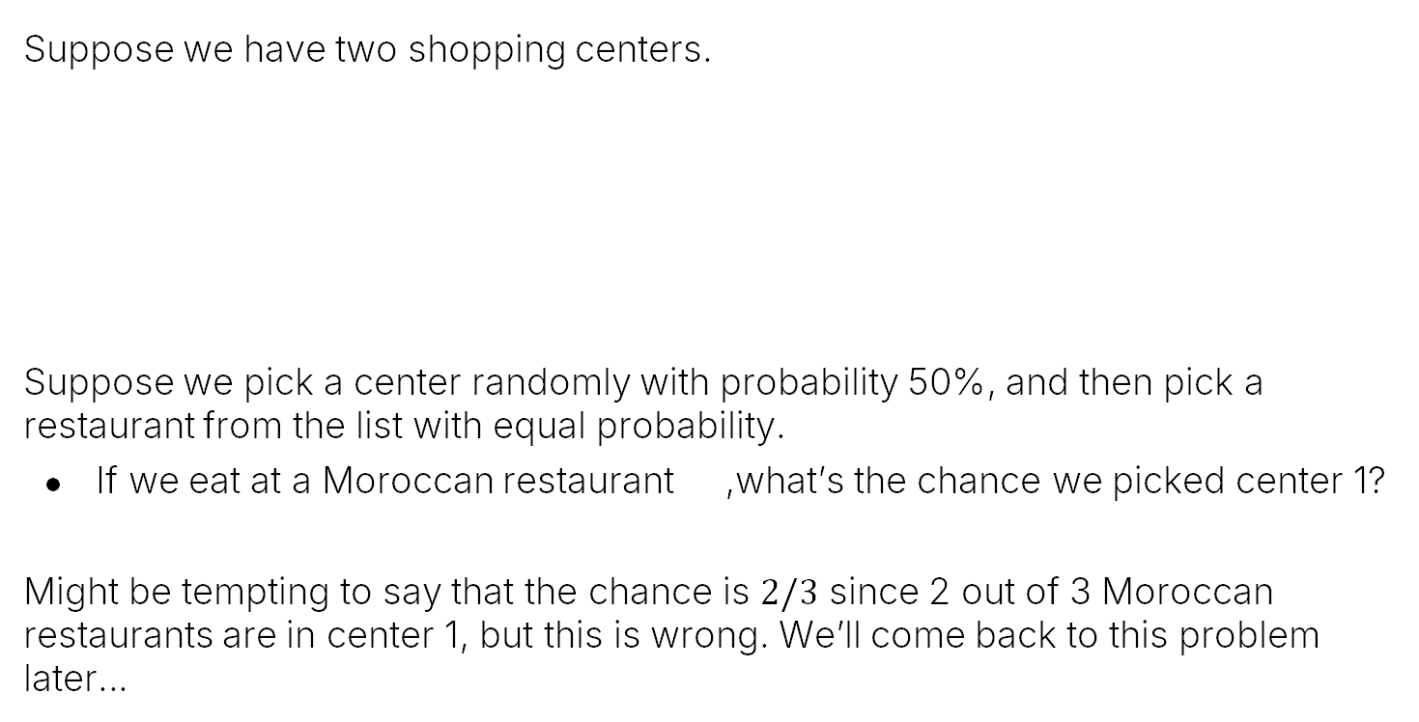
Motivating Puzzle
Suppose we have two shopping centers.
Suppose we pick a center randomly with probability 50%, and then pick a restaurant from the list with equal probability.
If we eat at a Moroccan restaurant ,what’s the chance we picked center 1?
Might be tempting to say that the chance is $2/3$ since 2 out of 3 Moroccan restaurants are in center 1, but this is wrong. We’ll come back to this problem later…
Shopping center 1:
3 Indian restaurants
2 Moroccan restaurants
Shopping center 2:
1 Indian restaurant
1 Moroccan restaurant

Slide 3
Conditional Probability of a Sample
Conditional Probabilities:
Conditional Probability of a Sample
Conditional Probability of an Event
Bayesian Inference
Bayes Rule and the Total Probability Rule (TPR)
Applications of Bayes and TPR
Generalized Bayes and TPR
Combinations of Events
Independence
Intersections and The Product Rule
Product Rule Applications
Unions of Events
Unions of Events (Large N)
Summary
Lecture 17, CS70 Summer 2025

Slide 4








Fruit and Bins, Review #1: Chance of a Specific Outcome
Suppose we have 4 fruits that we randomly throw into 3 large bins, durian first, then peach, then orange, then strawberry.
1
2
3
4
$$α$$
$$β$$
$$γ$$

Slide 5
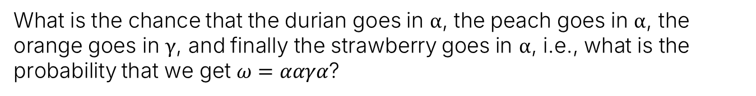
Fruit and Bins, Review #1: Chance of a Specific Outcome
Suppose we have 4 fruits that we randomly throw into 3 large bins, durian first, then peach, then orange, then strawberry.
$$α$$
$$β$$
$$γ$$
1
3
2
4
What is the chance that the durian goes in $α$, the peach goes in $α$, the orange goes in $γ$, and finally the strawberry goes in $α$, i.e., what is the probability that we get $ω=ααγα$?

Slide 6


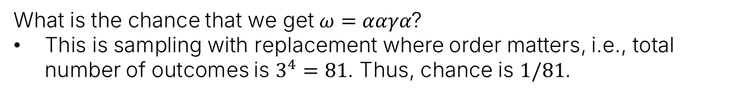
Fruit and Bins, Review #1: Chance of a Specific Outcome
Suppose we have 4 fruits that we randomly throw into 3 large bins, durian first, then peach, then orange, then strawberry.
$$\left|Ω\right|=81$$
$$α$$
$$β$$
$$γ$$
4
1
3
$$ω: ααγα$$
$$P\left(ω\right)=1/81$$
2
4
What is the chance that we get $ω=ααγα$?
This is sampling with replacement where order matters, i.e., total number of outcomes is $3^{4}=81$. Thus, chance is $1/81$.

Slide 7


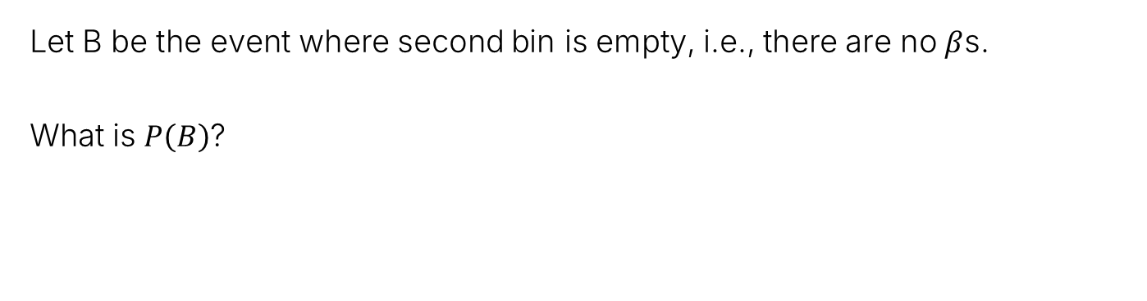
Fruit and Bins, Review #2: Chance of an Event
Suppose we have 4 fruits that we randomly throw into 3 large bins, durian first, then peach, then orange, then strawberry.
$$\left|Ω\right|=81$$
$$α$$
$$β$$
$$γ$$
Let B be the event where second bin is empty, i.e., there are no $β$s.
What is $P\left(B\right)$?

Slide 8
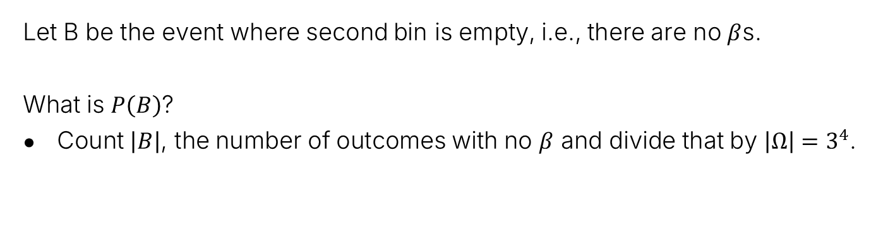
Fruit and Bins, Review #2: Chance of an Event
Suppose we have 4 fruits that we randomly throw into 3 large bins, durian first, then peach, then orange, then strawberry.
$$\left|Ω\right|=81$$
$$α$$
$$β$$
$$γ$$
Let B be the event where second bin is empty, i.e., there are no $β$s.
What is $P\left(B\right)$?
Count $\left|B\right|$, the number of outcomes with no $β$ and divide that by ${\left|Ω\right|=3}^{4}$.

Slide 9
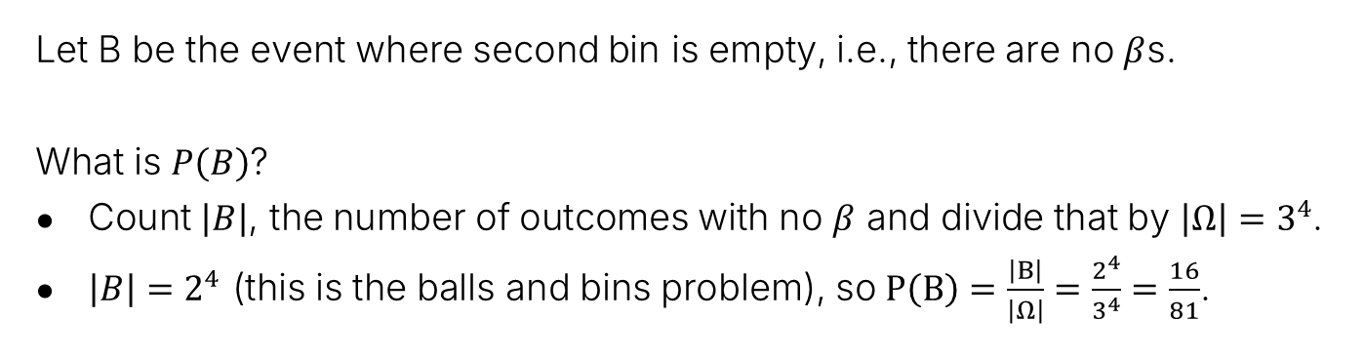
Fruit and Bins, Review #2: Chance of an Event
Suppose we have 4 fruits that we randomly throw into 3 large bins, durian first, then peach, then orange, then strawberry.
$$\left|Ω\right|=81$$
$$α$$
$$β$$
$$γ$$
Let B be the event where second bin is empty, i.e., there are no $β$s.
What is $P\left(B\right)$?
Count $\left|B\right|$, the number of outcomes with no $β$ and divide that by ${\left|Ω\right|=3}^{4}$.
$\left|B\right|=2^{4}$ (this is the balls and bins problem), so $P\left(B\right)=\frac{\left|B\right|}{\left|Ω\right|}=\frac{2^{4}}{3^{4}}=\frac{16}{81}$.

Slide 10
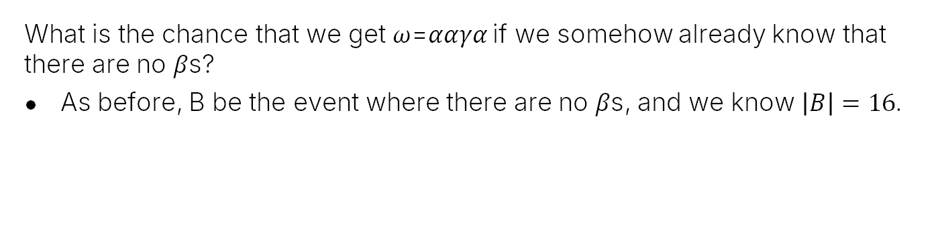
Fruit and Bins: Conditional Probability of an Outcome
Suppose we have 4 fruits that we randomly throw into 3 large bins, durian first, then peach, then orange, then strawberry.
$$\left|Ω\right|=81$$
$$α$$
$$β$$
$$γ$$
What is the chance that we get 𝜔=𝛼𝛼𝛾𝛼 if we somehow already know that there are no 𝛽s?
As before, B be the event where there are no 𝛽s, and we know $\left|B\right|=16$.

Slide 11
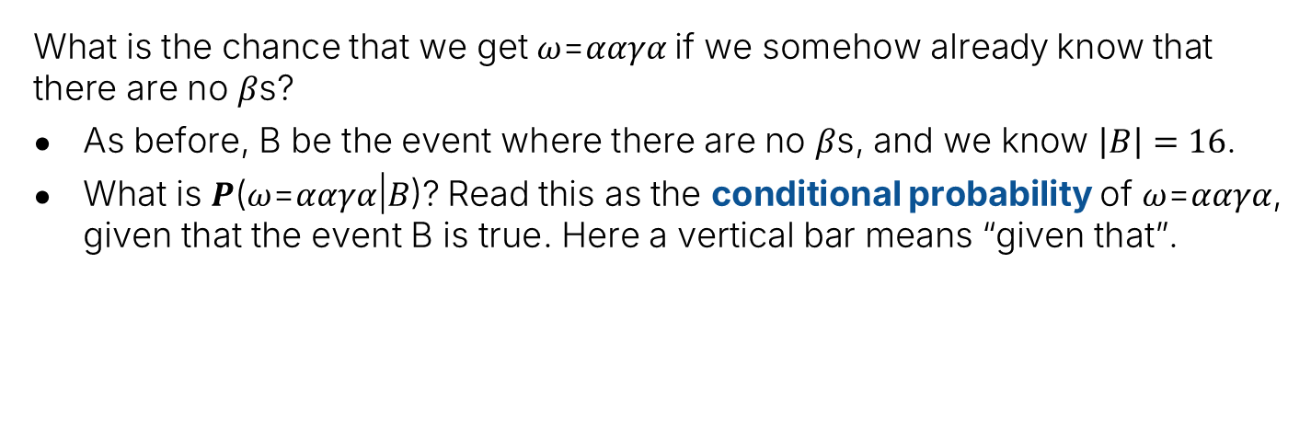


Fruit and Bins: Conditional Probability of an Outcome
Suppose we have 4 fruits that we randomly throw into 3 large bins, durian first, then peach, then orange, then strawberry.
$$\left|Ω\right|=81$$
$$α$$
$$β$$
$$γ$$
$$B$$
$$ω:ααγα$$
$$P\left(ω|B\right)= ???$$
What is the chance that we get 𝜔=𝛼𝛼𝛾𝛼 if we somehow already know that there are no 𝛽s?
As before, B be the event where there are no 𝛽s, and we know $\left|B\right|=16$.
What is 𝑷(𝜔=𝛼𝛼𝛾𝛼|𝐵)? Read this as the conditional probability of 𝜔=𝛼𝛼𝛾𝛼, given that the event B is true. Here a vertical bar means “given that”.

Slide 12
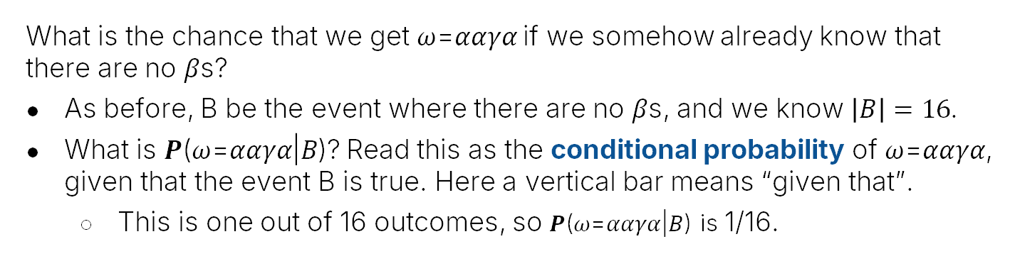
Fruit and Bins: Conditional Probability of an Outcome
Suppose we have 4 fruits that we randomly throw into 3 large bins, durian first, then peach, then orange, then strawberry.
$$\left|Ω\right|=81$$
$$α$$
$$β$$
$$γ$$
$$B$$
$$ω:ααγα$$
$$P\left(ω|B\right)= ???$$
What is the chance that we get 𝜔=𝛼𝛼𝛾𝛼 if we somehow already know that there are no 𝛽s?
As before, B be the event where there are no 𝛽s, and we know $\left|B\right|=16$.
What is 𝑷(𝜔=𝛼𝛼𝛾𝛼|𝐵)? Read this as the conditional probability of 𝜔=𝛼𝛼𝛾𝛼, given that the event B is true. Here a vertical bar means “given that”.
This is one out of 16 outcomes, so 𝑷(𝜔=𝛼𝛼𝛾𝛼|𝐵) is 1/16.

Slide 13
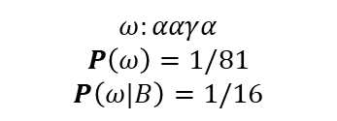

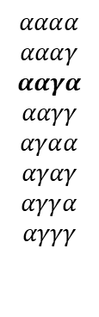


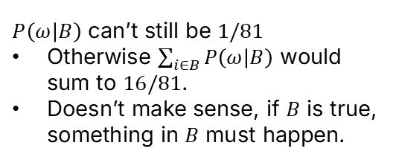

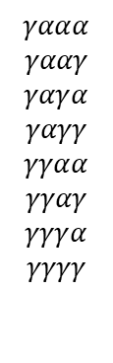
Fruit and Bins (Graphical View)
$$B$$
$$αααα$$
$$αααγ$$
$$ααγα$$
$$ααγγ$$
$$αγαα$$
$$αγαγ$$
$$αγγα$$
$$αγγγ$$
$$γααα$$
$$γααγ$$
$$γαγα$$
$$γαγγ$$
$$γγαα$$
$$γγαγ$$
$$γγγα$$
$$γγγγ$$
Let $B$ be the event where there are no $β$s. What is $|B|$? 16
$$\left|Ω\right|=81$$
$P\left(ω | B\right)$ can’t still be $1/81$
Otherwise $\sum_{i∈B}{P\left(ω | B\right)}$ would sum to $16/81$.
Doesn’t make sense, if $B$ is true, something in $B$ must happen.
$$ω:ααγα$$
$$P\left(ω\right)=1/81$$
$$P\left(ω|B\right)=1/16$$
$$Ω=$$
$$B$$

Slide 14

The Conditional Probability Formula
If $ω$ is a single outcome in $B$, the following is always true:
$$P\left(ω|B\right)=\frac{P\left(ω\right)}{P\left(B\right)}$$
For our three bins example:
$P\left(ω\right)=1/81$
$P\left(B\right)=16/81$
$P\left(ω | B\right)=\frac{1}{81}÷\frac{16}{81}=\frac{1}{16}$

Slide 15



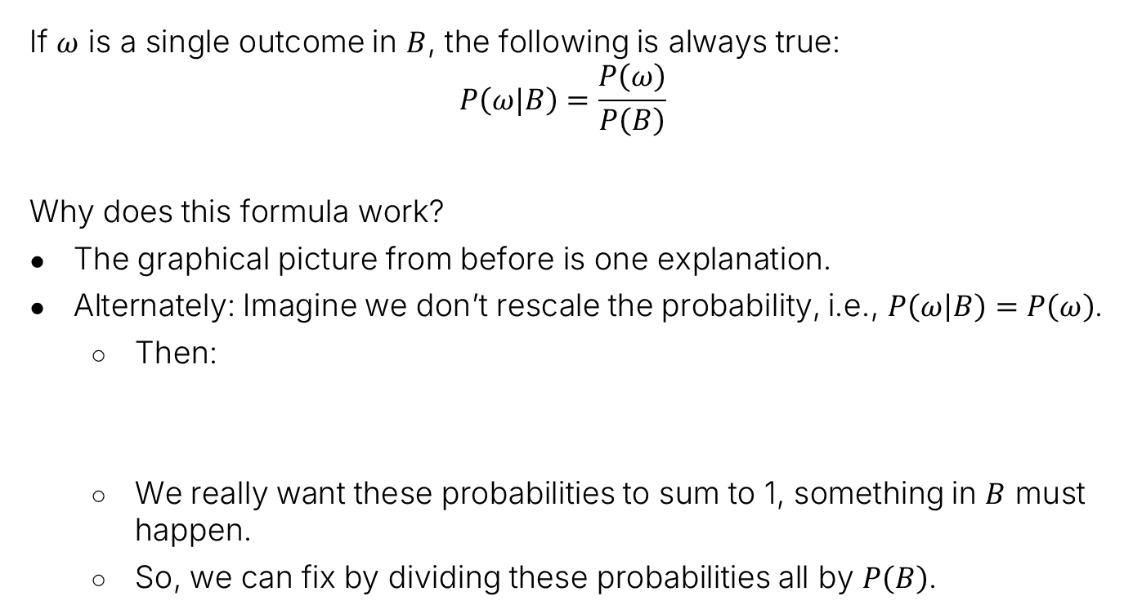



Alternate Approach: The Conditional Probability Formula
If $ω$ is a single outcome in $B$, the following is always true:
$$P\left(ω|B\right)=\frac{P\left(ω\right)}{P\left(B\right)}$$
Why does this formula work?
The graphical picture from before is one explanation.
Alternately: Imagine we don’t rescale the probability, i.e., $P\left(ω | B\right)=P\left(ω\right)$.
Then:
We really want these probabilities to sum to 1, something in $B$ must happen.
So, we can fix by dividing these probabilities all by $P\left(B\right)$.
$$Ω$$
$$B$$
$$ω$$
$$\sum_{ω∈B}{P\left(ω | B\right)}=$$
$$\sum_{ω∈B}{P\left(ω\right)}=$$
$$P\left(B\right)$$

Slide 16

The Conditional Probability Formula
If $ω$ is a single outcome in $B$, the following is always true:
$$P\left(ω|B\right)=\frac{P\left(ω\right)}{P\left(B\right)}$$
What if $ω∉B$ – what is $P\left(ω | B\right)$?

Slide 17

The Conditional Probability Formula
If $ω$ is a single outcome in $B$, the following is always true:
$$P\left(ω|B\right)=\frac{P\left(ω\right)}{P\left(B\right)}$$
What if $ω∉B$ – what is $P\left(ω | B\right)$? 0

Slide 18
Conditional Probability of an Event
Conditional Probabilities:
Conditional Probability of a Sample
Conditional Probability of an Event
Bayesian Inference
Bayes Rule and the Total Probability Rule (TPR)
Applications of Bayes and TPR
Generalized Bayes and TPR
Combinations of Events
Independence
Intersections and The Product Rule
Product Rule Applications
Unions of Events
Unions of Events (Large N)
Summary
Lecture 17, CS70 Summer 2025

Slide 19
Another Fruits and Bins Problem: Warmup #1
Again, suppose we have 4 fruits that we randomly throw into 3 large bins, durian first, then peach, then orange, then strawberry.
$$α$$
$$β$$
$$γ$$
Let A be the event where the first bin contains at least 3 fruits. What is $P(A)$?

Slide 20






Another Fruits and Bins Problem: Warmup #1
Again, suppose we have 4 fruits that we randomly throw into 3 large bins, durian first, then peach, then orange, then strawberry.
$$α$$
$$β$$
$$γ$$
Let A be the event where the first bin contains at least 3 fruits. What is $P(A)$?
This is just $8×1/81+1/81=9/81$.
Chance of 3 $α$s and 1 something else.
Chance of 4 $α$s.
A
$$βααα$$
$$αβαα$$
$$ααβα$$
$$αααβ$$
$$γααα$$
$$αγαα$$
$$αααγ$$
$$ααγα$$
$$αααα$$
$$Ω=$$

Slide 21


Another Fruits and Bins Problem: Warmup #2
Again, suppose we have 4 fruits that we randomly throw into 3 large bins, durian first, then peach, then orange, then strawberry.
$$α$$
$$β$$
$$γ$$
Let A be the event where the first bin contains at least 3 fruits, and let B be the event where the second bin is empty. What is $P\left(A∩B\right)$?
Hint: $A$ is given below.
A
$$βααα$$
$$αβαα$$
$$ααβα$$
$$αααβ$$
$$γααα$$
$$αγαα$$
$$αααγ$$
$$ααγα$$
$$αααα$$
$$Ω=$$
B
Area of interest

Slide 22


Another Fruits and Bins Problem: Warmup #2
Again, suppose we have 4 fruits that we randomly throw into 3 large bins, durian first, then peach, then orange, then strawberry.
$$α$$
$$β$$
$$γ$$
Let A be the event where the first bin contains at least 3 fruits, and let B be the event where the second bin is empty. What is $P\left(A∩B\right)$?
5/81
Answer: $A∩B$ is $A$ without the red items.
A
$$βααα$$
$$αβαα$$
$$ααβα$$
$$αααβ$$
$$γααα$$
$$αγαα$$
$$αααγ$$
$$ααγα$$
$$αααα$$
$$Ω=$$
B
Area of interest

Slide 23
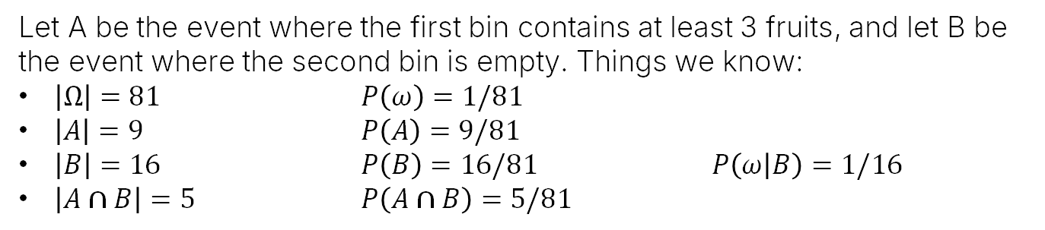
Another Fruits and Bins Problem: Summary So Far
Let A be the event where the first bin contains at least 3 fruits, and let B be the event where the second bin is empty. Things we know:
$\left|Ω\right|=81$ $P\left(ω\right)=1/81$
$\left|A\right|=9$ $P\left(A\right)=9/81$
$\left|B\right|=16$ $P\left(B\right)=16/81$ $P\left(ω | B\right)=1/16$
$\left|A∩B\right|=5$ $P\left(A∩B\right)=5/81$
$$γ$$
A
$$Ω=$$
B

Slide 24
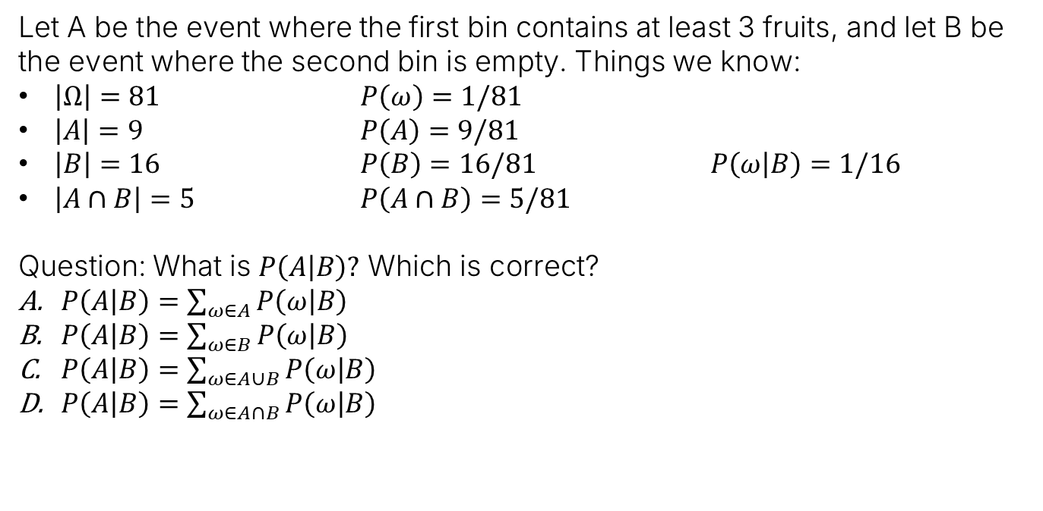
Another Fruits and Bins Problem: Conditional Probability of an Event
Let A be the event where the first bin contains at least 3 fruits, and let B be the event where the second bin is empty. Things we know:
$\left|Ω\right|=81$ $P\left(ω\right)=1/81$
$\left|A\right|=9$ $P\left(A\right)=9/81$
$\left|B\right|=16$ $P\left(B\right)=16/81$ $P\left(ω | B\right)=1/16$
$\left|A∩B\right|=5$ $P\left(A∩B\right)=5/81$
Question: What is $P\left(A | B\right)?$ Which is correct?
$P\left(A | B\right)=\sum_{ω∈A}{P\left(ω | B\right)}$
$P\left(A | B\right)=\sum_{ω∈B}{P\left(ω | B\right)}$
$P\left(A | B\right)=\sum_{ω∈A∪B}{P\left(ω | B\right)}$
$P\left(A | B\right)=\sum_{ω∈A∩B}{P\left(ω | B\right)}$
$$γ$$
A
$$Ω=$$
B

Slide 25
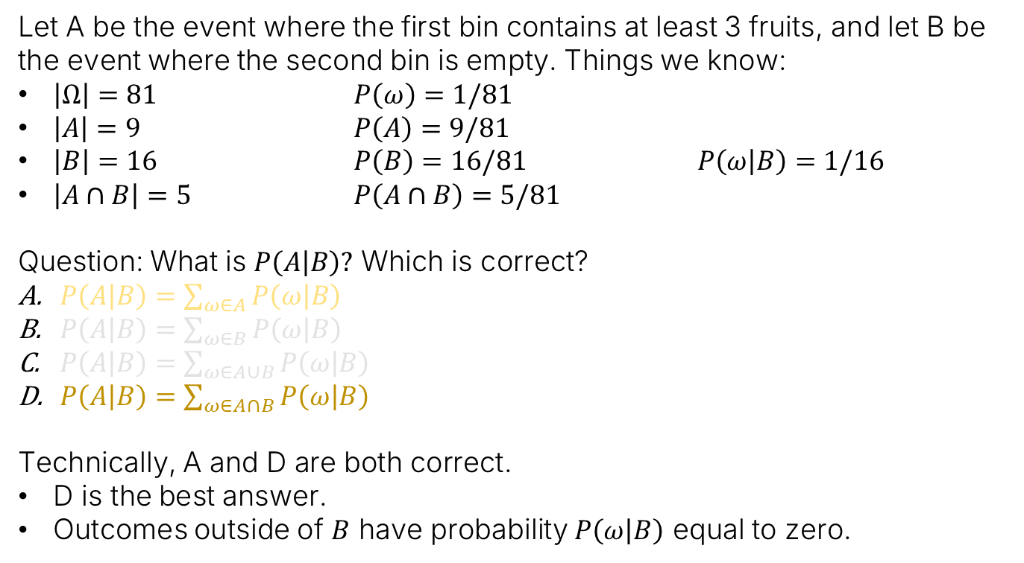
Another Fruits and Bins Problem: Conditional Probability of an Event
Let A be the event where the first bin contains at least 3 fruits, and let B be the event where the second bin is empty. Things we know:
$\left|Ω\right|=81$ $P\left(ω\right)=1/81$
$\left|A\right|=9$ $P\left(A\right)=9/81$
$\left|B\right|=16$ $P\left(B\right)=16/81$ $P\left(ω | B\right)=1/16$
$\left|A∩B\right|=5$ $P\left(A∩B\right)=5/81$
Question: What is $P\left(A | B\right)?$ Which is correct?
$P\left(A | B\right)=\sum_{ω∈A}{P\left(ω | B\right)}$
$P\left(A | B\right)=\sum_{ω∈B}{P\left(ω | B\right)}$
$P\left(A | B\right)=\sum_{ω∈A∪B}{P\left(ω | B\right)}$
$P\left(A | B\right)=\sum_{ω∈A∩B}{P\left(ω | B\right)}$
Technically, A and D are both correct.
D is the best answer.
Outcomes outside of $B$ have probability $P\left(ω | B\right)$ equal to zero.
$$γ$$
A
$$Ω=$$
B
Area of interest

Slide 26
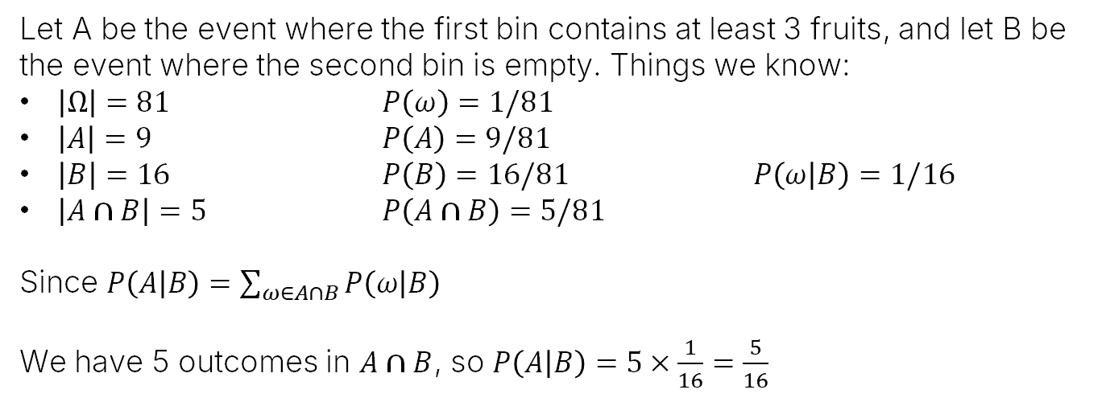
Another Fruits and Bins Problem: Conditional Probability of an Event
Let A be the event where the first bin contains at least 3 fruits, and let B be the event where the second bin is empty. Things we know:
$\left|Ω\right|=81$ $P\left(ω\right)=1/81$
$\left|A\right|=9$ $P\left(A\right)=9/81$
$\left|B\right|=16$ $P\left(B\right)=16/81$ $P\left(ω | B\right)=1/16$
$\left|A∩B\right|=5$ $P\left(A∩B\right)=5/81$
Since $P\left(A | B\right)=\sum_{ω∈A∩B}{P\left(ω | B\right)}$
We have 5 outcomes in $A∩B$, so $P\left(A | B\right)=5×\frac{1}{16}=\frac{5}{16}$
$$γ$$
A
$$Ω=$$
B
Area of interest

Slide 27
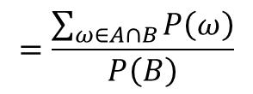

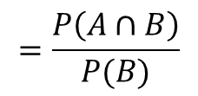
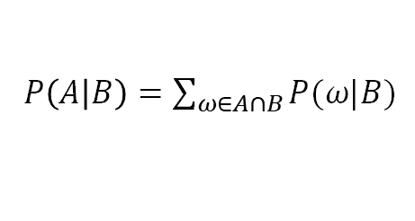


Formula for Conditional Probability of Events
We usually write this equation $P\left(A | B\right)=\sum_{ω∈A∩B}{P\left(ω | B\right)}$ differently.
$$=\sum_{ω∈A∩B}{\frac{P\left(ω\right)}{P\left(B\right)}}$$
$P\left(A | B\right)=\sum_{ω∈A∩B}{P(ω|B)}$
$$γ$$
$$=\frac{\sum_{ω∈A∩B}{P\left(ω\right)}}{P\left(B\right)}$$
$$=\frac{P\left(A∩B\right)}{P(B)}$$
Or simply:
$$P\left(A | B\right)=\frac{P\left(A∩B\right)}{P\left(B\right)}$$
A
$$Ω=$$
B
Area of interest

Slide 28
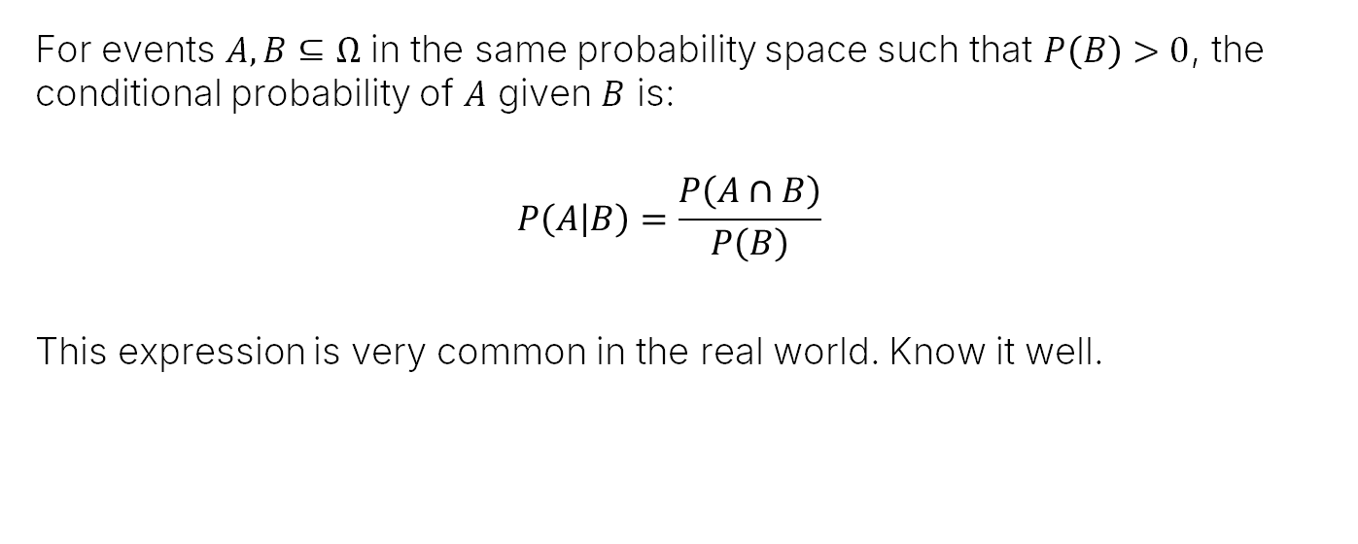
Definition 14.1 from the Notes
For events $A, B⊆Ω$ in the same probability space such that $P\left(B\right)>0$, the conditional probability of $A$ given $B$ is:
$$P\left(A | B\right)=\frac{P\left(A∩B\right)}{P\left(B\right)}$$
This expression is very common in the real world. Know it well.

Slide 29

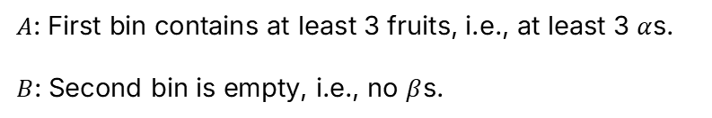



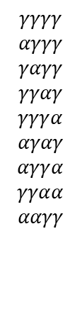






Fruit and Bins (Optional Supporting Picture)
$A$: First bin contains at least 3 fruits, i.e., at least 3 $α$s.
$B$: Second bin is empty, i.e., no $β$s.
$$A$$
$$βααα$$
$$αβαα$$
$$ααβα$$
$$αααβ$$
$$B$$
$$γγγγ$$
$$αγγγ$$
$$γαγγ$$
$$γγαγ$$
$$γγγα$$
$$αγαγ$$
$$αγγα$$
$$γγαα$$
$$ααγγ$$
$$γααα$$
$$αγαα$$
$$αααγ$$
$$ααγα$$
$$αααα$$
$$P\left(A | B\right)=\frac{P\left(A∩B\right)}{P(B)}=\frac{5}{16}$$
$$\left|A\right|=9$$
$$γααγ$$
$$γαγα$$
$$\left|Ω\right|=81$$
A
$$\left|B\right|=16$$
Won’t discuss this slide in lecture.
$$Ω=$$
B
$$A∩B$$

Slide 30
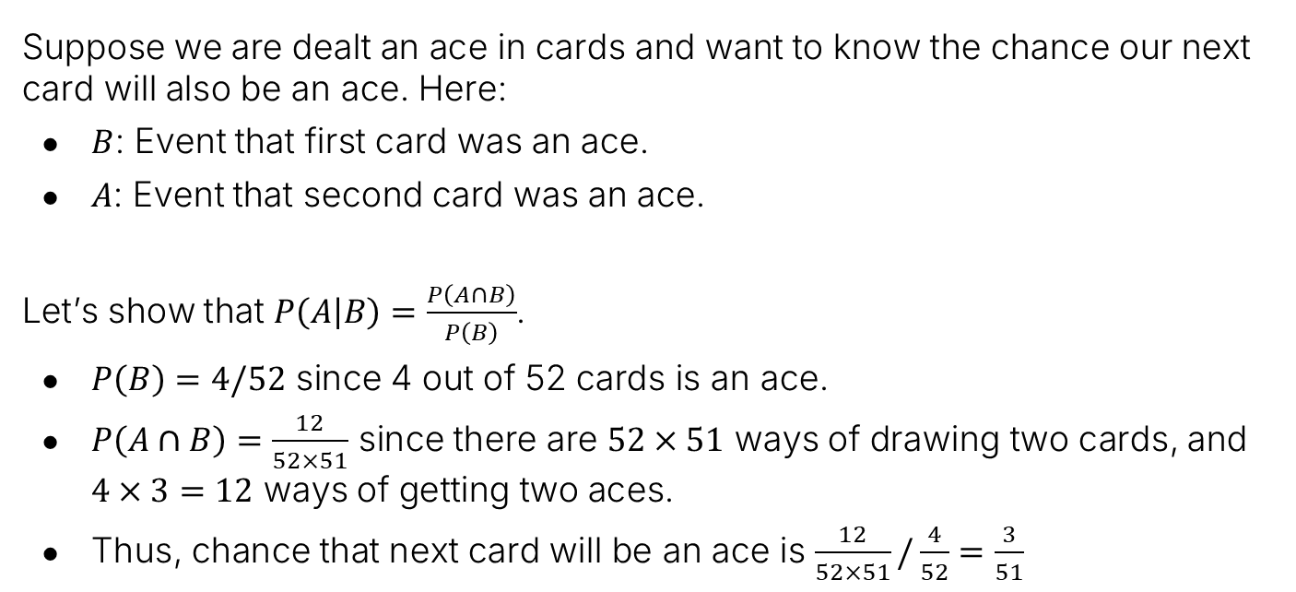

Example Using Conditional Probability Formula: Dealing Cards
Suppose we are dealt an ace in cards and want to know the chance our next card will also be an ace. Here:
$B$: Event that first card was an ace.
$A$: Event that second card was an ace.
Let’s show that $P\left(A | B\right)=\frac{P\left(A∩B\right)}{P\left(B\right)}$.
$P\left(B\right)=4/52$ since 4 out of 52 cards is an ace.
$P\left(A∩B\right)=\frac{12}{52×51}$ since there are $52×51$ ways of drawing two cards, and $4×3=12$ ways of getting two aces.
Thus, chance that next card will be an ace is $\frac{12}{52×51}/\frac{4}{52}=\frac{3}{51}$
Can also reason directly: One ace is gone, so 3 out of 51 cards are aces, so $P\left(A | B\right)=3/51$
Notes:
Seems simpler as just 4/52*3/51/4/52

Slide 31

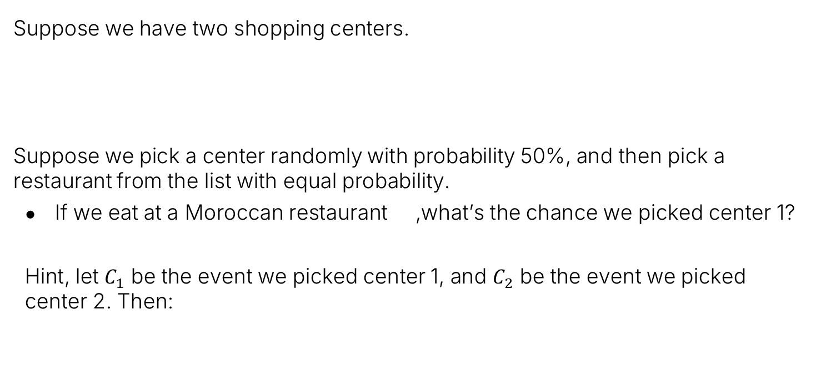
Back to the Shopping Center Puzzle
Suppose we have two shopping centers.
Suppose we pick a center randomly with probability 50%, and then pick a restaurant from the list with equal probability.
If we eat at a Moroccan restaurant ,what’s the chance we picked center 1?
Hint, let $C_{1}$ be the event we picked center 1, and $C_{2}$ be the event we picked center 2. Then:
Shopping center 1:
3 Indian restaurants
2 Moroccan restaurants
Shopping center 2:
1 Indian restaurant
1 Moroccan restaurant
$$P\left(C_{1}\right| )=\frac{P\left(C_{1}∩ \right)}{P\left( \right)}$$

Slide 32











Back to the Shopping Center Puzzle
Suppose we have two shopping centers.
Suppose we pick a center randomly with probability 50%, and then pick a restaurant from the list with equal probability.
If we eat at a Moroccan restaurant ,what’s the chance we picked center 1?
Shopping center 1:
3 Indian restaurants
2 Moroccan restaurants
Shopping center 2:
1 Indian restaurant
1 Moroccan restaurant
$$P\left(C_{1}\right| )=\frac{P\left(C_{1}∩ \right)}{P\left( \right)}$$
$$C_{1}$$
$$C_{2}$$
$$=\frac{1/10+1/10}{1/10+1/10+1/4}$$
$$1/10$$
$$1/10$$
$$1/10$$
$$Ω=$$
$$1/4$$
$$1/4$$
$$=\frac{2/10}{9/20}=\frac{4}{9}$$
$$1/10$$
$$1/10$$
$$P\left(C_{1}\right)=0.5$$
$$P\left(C_{2}\right)=0.5$$

Slide 33
Bayes Rule and the Total Probability Rule (TPR)
Conditional Probabilities:
Conditional Probability of a Sample
Conditional Probability of an Event
Bayesian Inference
Bayes Rule and the Total Probability Rule (TPR)
Applications of Bayes and TPR
Generalized Bayes and TPR
Combinations of Events
Independence
Intersections and The Product Rule
Product Rule Applications
Unions of Events
Unions of Events (Large N)
Summary
Lecture 17, CS70 Summer 2025

Slide 34
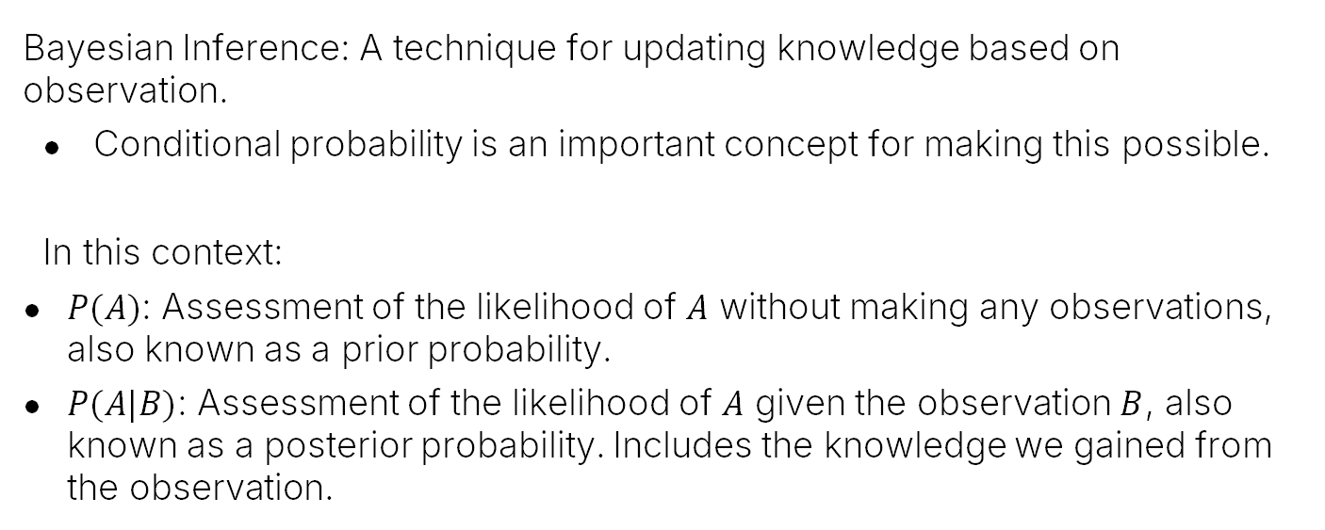
Bayesian Inference
Bayesian Inference: A technique for updating knowledge based on observation.
Conditional probability is an important concept for making this possible.
In this context:
$P(A)$: Assessment of the likelihood of $A$ without making any observations, also known as a prior probability.
$P(A|B)$: Assessment of the likelihood of $A$ given the observation $B$, also known as a posterior probability. Includes the knowledge we gained from the observation.

Slide 35

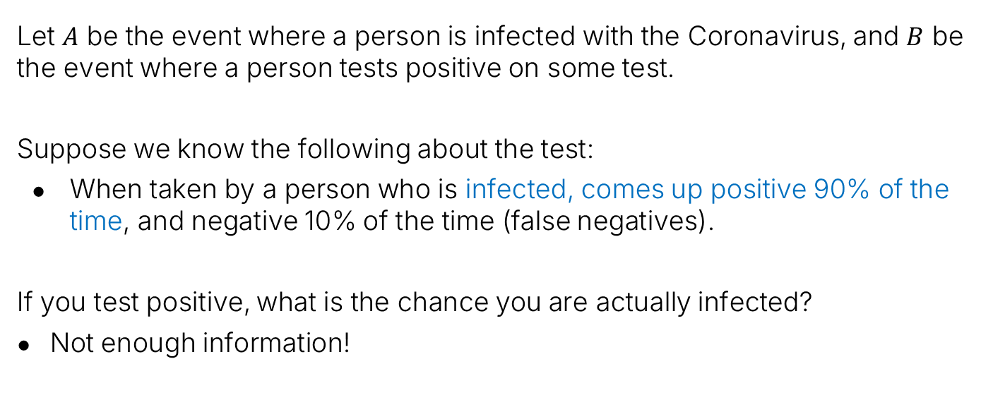
Motivating Example: Coronavirus Testing
Let $A$ be the event where a person is infected with the Coronavirus, and $B$ be the event where a person tests positive on some test.
Suppose we know the following about the test:
When taken by a person who is infected, comes up positive 90% of the time, and negative 10% of the time (false negatives).
If you test positive, what is the chance you are actually infected?
Not enough information!
$A$: Infected
$B$: Tests Positive

Slide 36

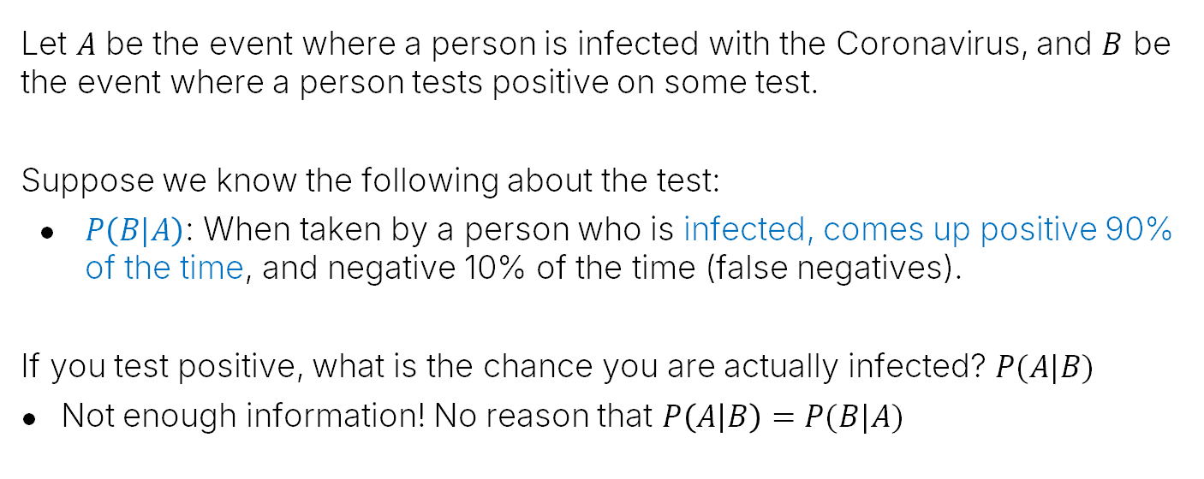
In Terms of Conditional Probability
Let $A$ be the event where a person is infected with the Coronavirus, and $B$ be the event where a person tests positive on some test.
Suppose we know the following about the test:
$P\left(B|A\right)$: When taken by a person who is infected, comes up positive 90% of the time, and negative 10% of the time (false negatives).
If you test positive, what is the chance you are actually infected? $P(A|B)$
Not enough information! No reason that $P\left(A | B\right)=P(B|A)$
$$P\left(B|A\right)=0.9$$
$A$: Infected
$B$: Tests Positive

Slide 37
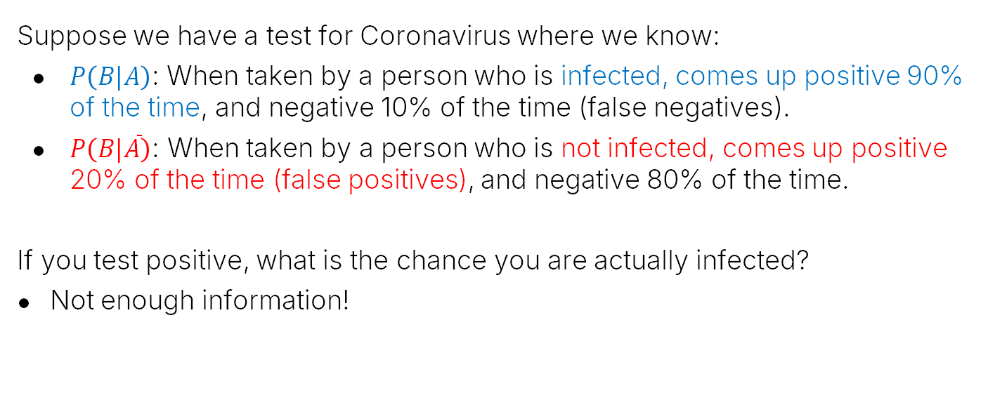

What If We Know the False Positive Rate?
Suppose we have a test for Coronavirus where we know:
$P\left(B|A\right)$: When taken by a person who is infected, comes up positive 90% of the time, and negative 10% of the time (false negatives).
$P\left(B|\overline{A}\right)\text{:}$ When taken by a person who is not infected, comes up positive 20% of the time (false positives), and negative 80% of the time.
If you test positive, what is the chance you are actually infected?
Not enough information!
$$P\left(B|A\right)=0.9$$
$$P\left(B|\overline{A}\right)=0.2$$
$A$: Infected
$B$: Tests Positive

Slide 38

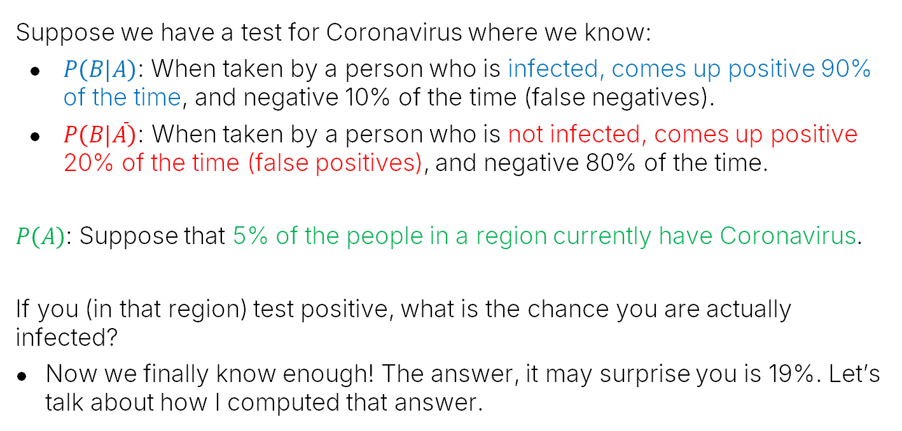
Example: Coronavirus Testing
Suppose we have a test for Coronavirus where we know:
$P\left(B|A\right)$: When taken by a person who is infected, comes up positive 90% of the time, and negative 10% of the time (false negatives).
$P\left(B|\overline{A}\right)\text{:}$ When taken by a person who is not infected, comes up positive 20% of the time (false positives), and negative 80% of the time.
$P\left(A\right)$: Suppose that 5% of the people in a region currently have Coronavirus.
If you (in that region) test positive, what is the chance you are actually infected?
Now we finally know enough! The answer, it may surprise you is 19%. Let’s talk about how I computed that answer.
$$P\left(A\right)=0.05$$
$$P\left(B|A\right)=0.9$$
$$P\left(B|\overline{A}\right)=0.2$$
$A$: Infected
$B$: Tests Positive

Slide 39

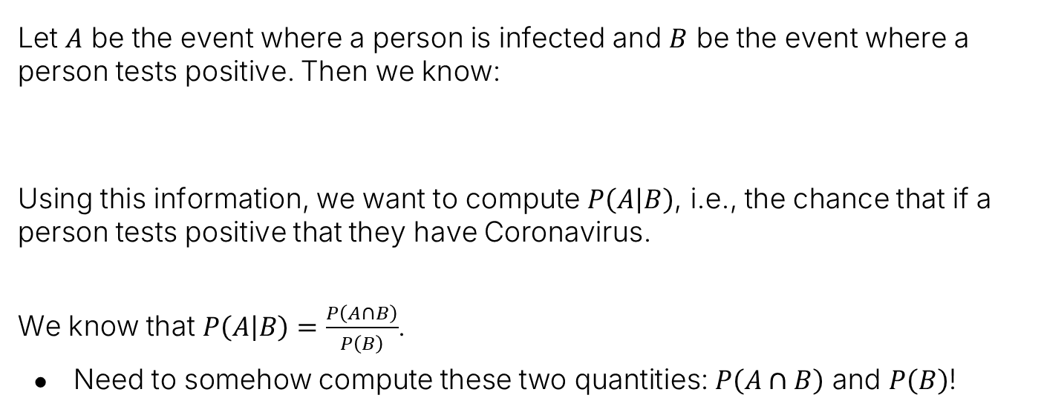



Example: Coronavirus Testing
Let $A$ be the event where a person is infected and $B$ be the event where a person tests positive. Then we know:
Using this information, we want to compute $P\left(A | B\right)$, i.e., the chance that if a person tests positive that they have Coronavirus.
We know that $P\left(A | B\right)=\frac{P\left(A∩B\right)}{P\left(B\right)}$.
Need to somehow compute these two quantities: $P\left(A∩B\right)$ and $P\left(B\right)$!
$$P\left(A\right)=0.05$$
$$P\left(B|A\right)=0.9$$
$$P\left(B|\overline{A}\right)=0.2$$
$A$: Infected
$B$: Tests Positive

Slide 40
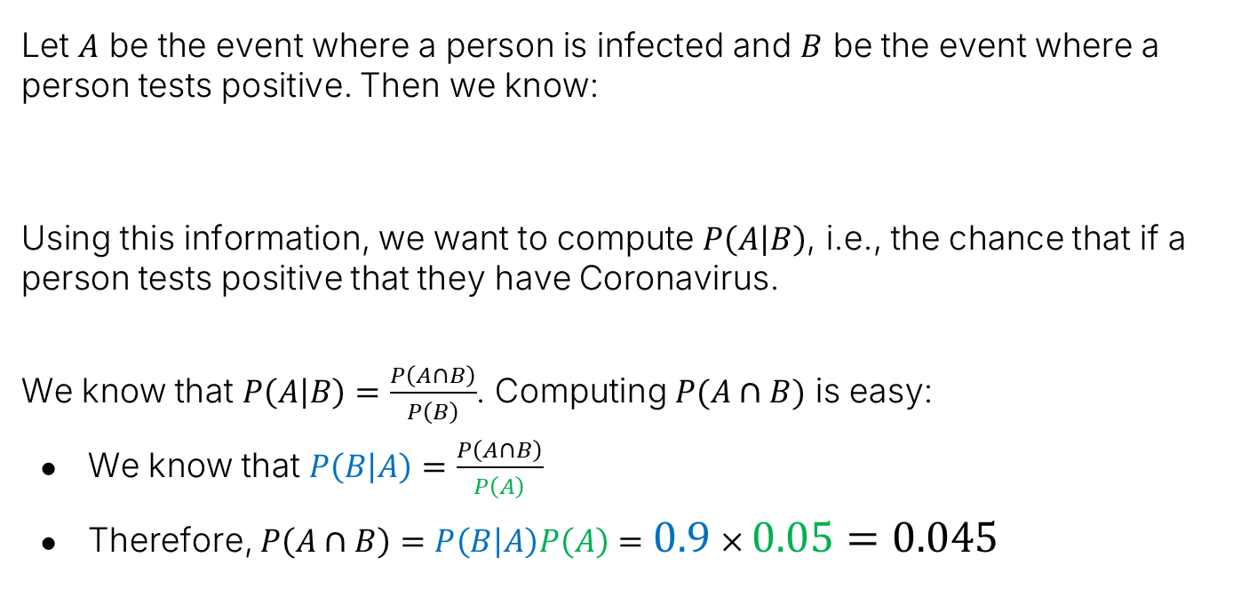
Example: Coronavirus Testing
Let $A$ be the event where a person is infected and $B$ be the event where a person tests positive. Then we know:
Using this information, we want to compute $P\left(A | B\right)$, i.e., the chance that if a person tests positive that they have Coronavirus.
We know that $P\left(A | B\right)=\frac{P\left(A∩B\right)}{P\left(B\right)}$. Computing $P(A∩B)$ is easy:
We know that $P\left(B | A\right)=\frac{P\left(A∩B\right)}{P\left(A\right)}$
Therefore, $P\left(A∩B\right)=P\left(B | A\right)P\left(A\right)=0.9×0.05=0.045$
$$P\left(A\right)=0.05$$
$$P\left(B|A\right)=0.9$$
$$P\left(B|\overline{A}\right)=0.2$$
$A$: Infected
$B$: Tests Positive

Slide 41

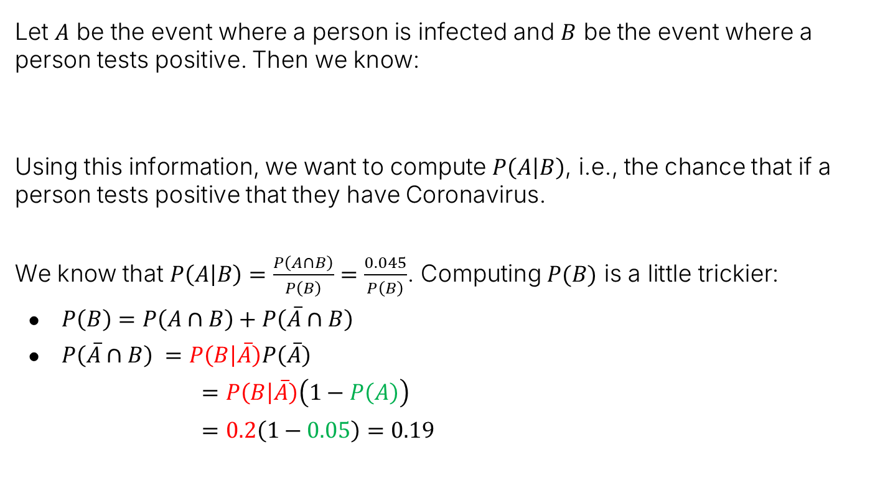





Example: Coronavirus Testing
Let $A$ be the event where a person is infected and $B$ be the event where a person tests positive. Then we know:
Using this information, we want to compute $P\left(A | B\right)$, i.e., the chance that if a person tests positive that they have Coronavirus.
We know that $P\left(A | B\right)=\frac{P\left(A∩B\right)}{P\left(B\right)}=\frac{0.045}{P\left(B\right)}$. Computing $P(B)$ is a little trickier:
$P\left(B\right)=P\left(A∩B\right)+P\left(\overline{A}∩B\right)$
$P\left(\overline{A}∩B\right) =P\left(B | \overline{A}\right)P\left(\overline{A}\right)$
$=P\left(B | \overline{A}\right)\left(1−P\left(A\right)\right)$
$=0.2\left(1−0.05\right)=0.19$
$$P\left(A\right)=0.05$$
$$P\left(B|A\right)=0.9$$
$$P\left(B|\overline{A}\right)=0.2$$
$$P\left(A∩B\right)=0.045$$
A
$$Ω=$$
B
$$\overline{A}∩B$$
$$A∩B$$

Slide 42
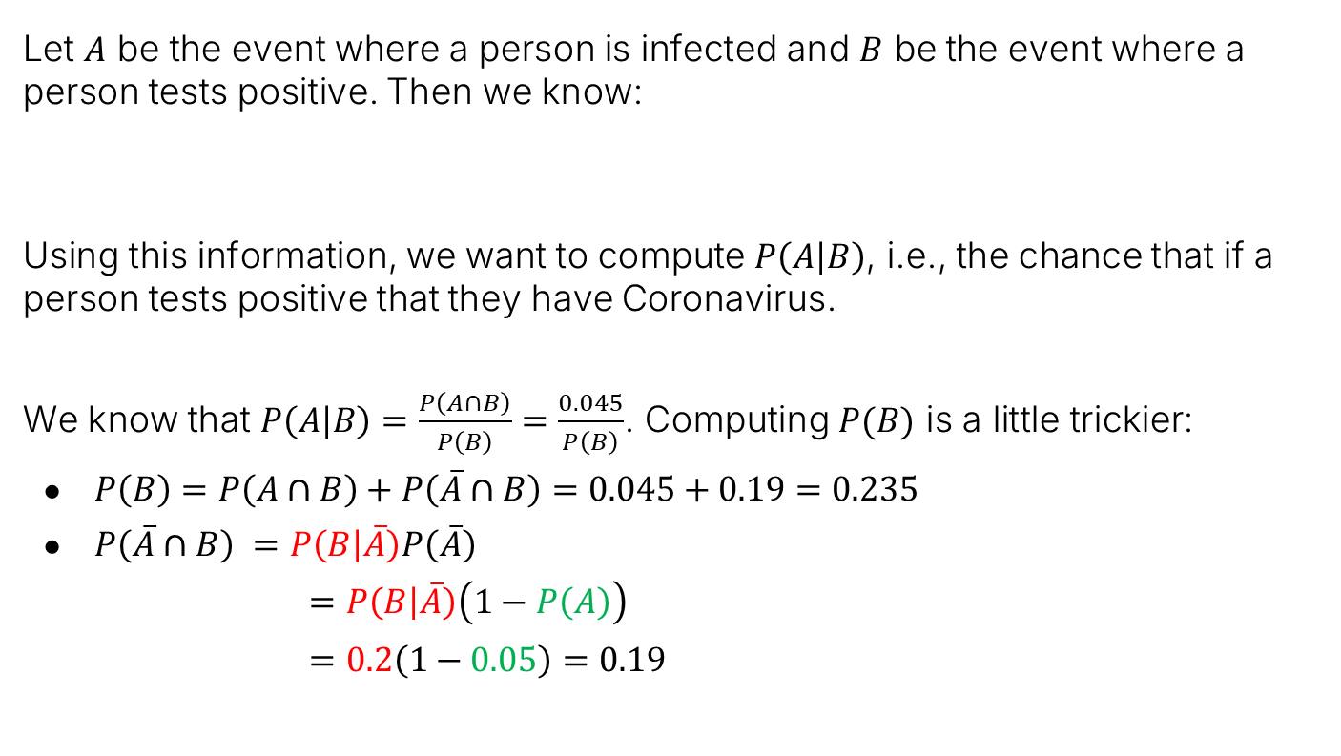
Example: Coronavirus Testing
Let $A$ be the event where a person is infected and $B$ be the event where a person tests positive. Then we know:
Using this information, we want to compute $P\left(A | B\right)$, i.e., the chance that if a person tests positive that they have Coronavirus.
We know that $P\left(A | B\right)=\frac{P\left(A∩B\right)}{P\left(B\right)}=\frac{0.045}{P\left(B\right)}$. Computing $P(B)$ is a little trickier:
$P\left(B\right)=P\left(A∩B\right)+P\left(\overline{A}∩B\right)=0.045+0.19=0.235$
$P\left(\overline{A}∩B\right) =P\left(B | \overline{A}\right)P\left(\overline{A}\right)$
$=P\left(B | \overline{A}\right)\left(1−P\left(A\right)\right)$
$=0.2\left(1−0.05\right)=0.19$
$$P\left(A\right)=0.05$$
$$P\left(B|A\right)=0.9$$
$$P\left(B|\overline{A}\right)=0.2$$
$$P\left(A∩B\right)=0.045$$
A
$$Ω=$$
B
$$\overline{A}∩B$$
$$A∩B$$

Slide 43
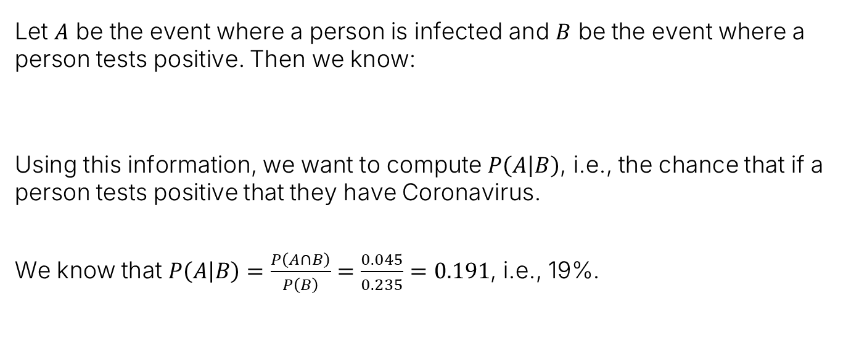
Example: Coronavirus Testing
Let $A$ be the event where a person is infected and $B$ be the event where a person tests positive. Then we know:
Using this information, we want to compute $P\left(A | B\right)$, i.e., the chance that if a person tests positive that they have Coronavirus.
We know that $P\left(A | B\right)=\frac{P\left(A∩B\right)}{P\left(B\right)}=\frac{0.045}{0.235}=0.191$, i.e., 19%.
$$P\left(A\right)=0.05$$
$$P\left(B|A\right)=0.9$$
$$P\left(B|\overline{A}\right)=0.2$$
$$P\left(A∩B\right)=0.045$$
A
$$Ω=$$
B
$$\overline{A}∩B$$
$$A∩B$$

Slide 44
Example: Coronavirus Testing
Let $A$ be the event where a person is infected and $B$ be the event where a person tests positive. Then we know:
Using this information, we want to compute $P\left(A | B\right)$, i.e., the chance that if a person tests positive that they have Coronavirus.
We know that $P\left(A | B\right)=\frac{P\left(A∩B\right)}{P\left(B\right)}=\frac{0.045}{0.235}=0.191$, i.e., 19%.
$$P\left(A\right)=0.05$$
$$P\left(B|A\right)=0.9$$
$$P\left(B|\overline{A}\right)=0.2$$
$$P\left(A∩B\right)=0.045$$
In other words, even though the test has a 90% true positive rate and only a 20% false negative rate, if we get a positive result, we only have a 19% chance of having Coronavirus.
A
$$Ω=$$
B
$$\overline{A}∩B$$
$$A∩B$$

Slide 45

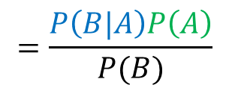

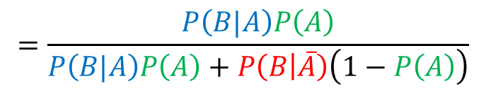


…Or Entirely Symbolically
We can also write what we’ve just done symbolically. Given $P\left(A\right)$, $P\left(B|A\right)$, $P\left(B|\overline{A}\right)$, we can compute $P\left(A | B\right)$ as follows:
We know that $P\left(A | B\right)=$
$$\frac{P\left(A∩B\right)}{P\left(B\right)}$$
$$=\frac{P\left(B|A\right)P\left(A\right)}{P(B)}$$
$$=\frac{P\left(B|A\right)P\left(A\right)}{P\left(A∩B\right)+P\left(\overline{A}∩B\right)}$$
$$=\frac{P\left(B|A\right)P\left(A\right)}{P\left(B|A\right)P\left(A\right)+P\left(\overline{A}∩B\right)}$$
$$=\frac{P\left(B|A\right)P\left(A\right)}{P\left(B|A\right)P\left(A\right)+P\left(B | \overline{A}\right)\left(1−P\left(A\right)\right)}$$
Note: Formulas are great. Memorizing formulas not so much. Remember where this comes from.

Slide 46






…Or Entirely Symbolically
We can also write what we’ve just done symbolically. Given $P\left(A\right)$, $P\left(B|A\right)$, $P\left(B|\overline{A}\right)$, we can compute $P\left(A | B\right)$ as follows:
We know that $P\left(A | B\right)=$
Example:
$$\frac{P\left(B|A\right)P\left(A\right)}{P\left(B\right)}=\frac{P\left(B|A\right)P\left(A\right)}{P\left(B|A\right)P\left(A\right)+P\left(B | \overline{A}\right)\left(1−P\left(A\right)\right)}$$
$$P\left(A\right)=0.05$$
$$P\left(B|A\right)=0.9$$
$$P\left(B|\overline{A}\right)=0.2$$
$$P\left(A | B\right)=\frac{0.9×0.05}{0.9×0.05+0.2×\left(1−0.05\right)}=0.191$$

Slide 47



Bayes Rule and the Total Probability Rule
We’ve just derived two commonly used formulas:
Bayes Rule:
Total Probability Rule:
$$P\left(A | B\right)=\frac{P\left(B|A\right)P\left(A\right)}{P\left(B\right)}$$
$$P\left(B\right)=P\left(B|A\right)P\left(A\right)+P\left(B | \overline{A}\right)\left(1−P\left(A\right)\right)$$
Note: this is just $P\left(\overline{A}\right)$

Slide 48
Applications of Bayes and TPR
Conditional Probabilities:
Conditional Probability of a Sample
Conditional Probability of an Event
Bayesian Inference
Bayes Rule and the Total Probability Rule (TPR)
Applications of Bayes and TPR
Generalized Bayes and TPR
Combinations of Events
Independence
Intersections and The Product Rule
Product Rule Applications
Unions of Events
Unions of Events (Large N)
Summary
Lecture 17, CS70 Summer 2025

Slide 49






Example: Applying the Total Probability Rule
Suppose you are trying to enter a country and there are two immigration officers A and Nota. Let $B$ be the event where you are allowed entry. Let $A$ be the event where you are interviewed by officer A, and $\overline{A}$ is the event you are interview by Nota.
Suppose officer A will let you in with probability 20% and Nota with probability 70%. Suppose that you will be assigned officer A with probability 60% and officer Nota with probability 40%. What is $P\left(B\right)?$
$$P\left(B\right)=P\left(A | B_{X}\right)P\left(B_{X}\right)+P\left(A | B_{Y}\right)P\left(B_{Y}\right)=0.6×0.2+0.4×0.7=0.4$$
$$P\left(B\right)=P\left(B|A\right)P\left(A\right)+P\left(B | \overline{A}\right)\left(1−P\left(A\right)\right)$$
$$P\left(B | \overline{A}\right)=0.7$$
$$P\left(B | A\right)=0.2$$

Slide 50

Example: Applying the Total Probability Rule
Suppose you are trying to enter a country and there are two immigration officers A and Nota. Let $B$ be the event where you are allowed entry. Let $A$ be the event where you are interviewed by officer A, and $\overline{A}$ is the event you are interview by Nota.
Suppose officer A will let you in with probability 20% and Nota with probability 70%. Suppose that you will be assigned officer A with probability 60% and officer Nota with probability 40%. What is $P\left(B\right)?$
$$P\left(B\right)=0.2×0.6+0.7×0.4=0.4P\left(A | B_{X}\right)P\left(B_{X}\right)+P\left(A | B_{Y}\right)P\left(B_{Y}\right)=0.6×0.2+0.4×0.7=0.4$$
$$P\left(B\right)=P\left(B|A\right)P\left(A\right)+P\left(B | \overline{A}\right)\left(1−P\left(A\right)\right)$$
$$P\left(B | \overline{A}\right)=0.7$$
$$P\left(B | A\right)=0.2$$

Slide 51

Shopping Center Puzzle Using Bayes Rule
Suppose we have two shopping centers.
Suppose we pick a center randomly with probability 50%, and then pick a restaurant from the list with equal probability.
If we eat at a Moroccan restaurant ,what’s the chance we picked center 1?
Shopping center 1:
3 Indian restaurants
2 Moroccan restaurants
Shopping center 2:
1 Indian restaurant
1 Moroccan restaurant
$$P\left(C_{1}\right| )=\frac{P\left( | C_{1} \right)P(C_{1})}{P\left( \right)}$$

Slide 52

Shopping Center Puzzle Using Bayes Rule
Suppose we have two shopping centers.
Suppose we pick a center randomly with probability 50%, and then pick a restaurant from the list with equal probability.
If we eat at a Moroccan restaurant ,what’s the chance we picked center 1?
Shopping center 1:
3 Indian restaurants
2 Moroccan restaurants
Shopping center 2:
1 Indian restaurant
1 Moroccan restaurant
$$P\left(C_{1}\right| )=\frac{P\left( | C_{1} \right)P(C_{1})}{P\left( \right)}$$
$$=\frac{0.4×0.5}{P\left( \right)}$$

Slide 53



Shopping Center Puzzle Using Bayes Rule
Suppose we have two shopping centers.
Suppose we pick a center randomly with probability 50%, and then pick a restaurant from the list with equal probability.
If we eat at a Moroccan restaurant ,what’s the chance we picked center 1?
Shopping center 1:
3 Indian restaurants
2 Moroccan restaurants
Shopping center 2:
1 Indian restaurant
1 Moroccan restaurant
$$P\left(C_{1}\right| )=\frac{P\left( | C_{1} \right)P(C_{1})}{P\left( \right)}$$
$$=\frac{0.4×0.5}{P\left( \right)}$$
$$=\frac{0.4×0.5}{0.4×0.5+0.5×0.5}$$
$$=\frac{0.2}{0.45}=4/9$$
$$=\frac{0.2}{0.20+0.25}$$

Slide 54
Generalized Bayes and TPR
Conditional Probabilities:
Conditional Probability of a Sample
Conditional Probability of an Event
Bayesian Inference
Bayes Rule and the Total Probability Rule (TPR)
Applications of Bayes and TPR
Generalized Bayes and TPR
Combinations of Events
Independence
Intersections and The Product Rule
Product Rule Applications
Unions of Events
Unions of Events (Large N)
Summary
Lecture 17, CS70 Summer 2025

Slide 55

Multiple Events
Suppose we have more than 2 shopping centers:
To handle such situations, let’s define a “partition of an event”.
We say that an event A is partitioned into n events $A_{1},…,A_{n}$ if:
$A=A_{1}∪A_{2}∪…∪A_{n}$
$A_{i}∪A_{j}=∅$ for all $i≠j$. That is, the events are mutually exclusive.
For the example, above we have three events, one for each shopping center.
Shopping center 1:
3 Indian restaurants
2 Moroccan restaurants
Shopping center 2:
1 Indian restaurant
1 Moroccan restaurant
Shopping center 3:
1 Indian restaurant
1 Moroccan restaurant

Slide 56


Total Probability Rule
Our TPR (total probability rule) for events A and B was:
When considering a partition $A_{1},…,A_{n}$ of the sample space $Ω$. The TPR for an event B is:
Question: Why are these two formulas basically saying the same thing?
$$P\left(B\right)=P\left(B|A\right)P\left(A\right)+P\left(B | \overline{A}\right)\left(1−P\left(A\right)\right)$$
$$P\left(B\right)=\sum_{i=1}^{n}{P\left(B∩A_{i}\right)}$$

Slide 57


Total Probability Rule
Partitions $Ω$ into two events, $A_{1}=A$ and $A_{2}=\overline{A}$
Our TPR (total probability rule) for events A and B was:
When considering a partition $A_{1},…,A_{n}$ of the sample space $Ω$. The TPR for an event B is:
Can also write this as:
$$P\left(B\right)=P\left(B|A\right)P\left(A\right)+P\left(B | \overline{A}\right)\left(1−P\left(A\right)\right)$$
$$P\left(B\right)=\sum_{i=1}^{n}{P\left(B∩A_{i}\right)}$$
$$P\left(B\right)=\sum_{i=1}^{n}{P\left(B | A_{i}\right)P\left(A_{i}\right)}$$

Slide 58



Bayes Rule
For two events A and B, Bayes rule was:
When considering a partition $A_{1},…,A_{n}$ of the sample space $Ω$, Bayes Rule is:
In both cases, you can naturally replace $P(B)$ by the TPR.
$$P\left(A | B\right)=\frac{P\left(B|A\right)P\left(A\right)}{P\left(B\right)}$$
$$P\left(A_{i} | B\right)=\frac{P\left(B|A_{i}\right)P\left(A_{i}\right)}{P\left(B\right)}$$

Slide 59

Bayes Rule
For two events A and B, Bayes rule was:
When considering a partition $A_{1},…,A_{n}$ of the sample space $Ω$, Bayes Rule is:
In both cases, you can naturally replace $P(B)$ by the TPR.
For partitions of space into $A$ and $\overline{A}$, $P\left(B\right)=P\left(B|A\right)P\left(A\right)+P\left(B | \overline{A}\right)\left(1−P\left(A\right)\right)$
For partitions into $A_{1},…,A_{n}$, $P\left(B\right)=\sum_{i=1}^{n}{P\left(B | A_{i}\right)P\left(A_{i}\right)}$
$$P\left(A | B\right)=\frac{P\left(B|A\right)P\left(A\right)}{P\left(B\right)}$$
$$P\left(A_{i} | B\right)=\frac{P\left(B|A_{i}\right)P\left(A_{i}\right)}{P\left(B\right)}$$

Slide 60
Independence
Conditional Probabilities:
Conditional Probability of a Sample
Conditional Probability of an Event
Bayesian Inference
Bayes Rule and the Total Probability Rule (TPR)
Applications of Bayes and TPR
Generalized Bayes and TPR
Combinations of Events
Independence
Intersections and The Product Rule
Product Rule Applications
Unions of Events
Unions of Events (Large N)
Summary
Lecture 17, CS70 Summer 2025

Slide 61

Independence
Earlier, we talked about how the probability of two events is sometimes the product of their individual probabilities.
For example, consider rolling a weighted four-sided die twice, where the probability of a 1 is $5/8$.
Here, $A_{1}$ is the event that the first die is a 1, and we know that $P\left(A_{1}\right)=5/8$.
$A_{2}$ is the event that the second die is a 1, and we know that $P\left(A_{2}\right)=5/8$.
We said that the probability of both events happening was $P\left(A_{1}∩A_{2}\right)=\frac{5}{8}×\frac{5}{8}=\frac{25}{64}$.
What is notable about these two events is that they are independent!
The outcome of each roll does not affect the other.

Slide 62




Independence More Formally
Two events A and B are said to be independent if:
$$P\left(A∩B\right)=P\left(A\right)×P\left(B\right)$$
Let’s consider what this implies about $P\left(A | B\right)$.
That is, knowing B tells us literally nothing new about A.
$$P\left(A | B\right)=\frac{P\left(A∩B\right)}{P\left(B\right)}$$
$$=\frac{P\left(A\right)×P(B)}{P\left(B\right)}$$
$$=P(A)$$

Slide 63

Mutual Independence
We can also define the mutual independence of more than 2 events. Let’s start with 3 events: $A_{1}$, $A_{2}$, and $A_{3}$.
These 3 events are mutually independent if all of the following are true:
$$P\left(A_{1}∩A_{2}\right)=P\left(A_{1}\right)×P\left(A_{2}\right)$$
$$P\left(A_{1}∩A_{3}\right)=P\left(A_{1}\right)×P\left(A_{3}\right)$$
$$P\left(A_{2}∩A_{3}\right)=P\left(A_{2}\right)×P\left(A_{3}\right)$$
$$P\left(A_{1}∩A_{2}∩A_{3}\right)=P\left(A_{1}\right)×P\left(A_{2}\right)×P\left(A_{3}\right)$$

Slide 64


Coin Flipping
Example: Imagine we flip a fair coin twice. Define the events below:
$A_{1}$: First flip is heads.
$A_{2}$: Second flip is heads.
$A_{3}$: Both flips are the same.
Questions:
Are these events pairwise independent?
Are they mutually independent (satisfy all four constraints below)?
$$P\left(A_{1}∩A_{2}\right)=P\left(A_{1}\right)×P\left(A_{2}\right)$$
$$P\left(A_{1}∩A_{3}\right)=P\left(A_{1}\right)×P\left(A_{3}\right)$$
$$P\left(A_{2}∩A_{3}\right)=P\left(A_{2}\right)×P\left(A_{3}\right)$$
$$P\left(A_{1}∩A_{2}∩A_{3}\right)=P\left(A_{1}\right)×P\left(A_{2}\right)×P\left(A_{3}\right)$$

Slide 65

Coin Flipping
Example: Imagine we flip a fair coin twice. Define the events below:
$A_{1}$: First flip is heads.
$A_{2}$: Second flip is heads.
$A_{3}$: Both flips are the same.
Questions:
Are these events pairwise independent? Yes!
Knowing first flip is heads says nothing about second being heads (and vice versa).
Knowing first flip heads says nothing about both flips being same (and v-v).
Knowing second flip heads says nothing about both flips being same (and v-v).
Are they mutually independent (satisfy all four constraints)?

Slide 66

Coin Flipping
Example: Imagine we flip a fair coin twice. Define the events below:
$A_{1}$: First flip is heads.
$A_{2}$: Second flip is heads.
$A_{3}$: Both flips are the same.
Questions:
Are these events pairwise independent? Yes!
Are they mutually independent (satisfy all four constraints)?
No. For example, if you know first and second flips are heads, you know that both flips are the same.

Slide 67

Generalizing to 4 Events
We can expand our definition of mutually independent. For four events, we’d have 11 constraints: Six pairwise, four three-way, one four-way.
$$P\left(A_{1}∩A_{2}\right)=P\left(A_{1}\right)×P\left(A_{2}\right)$$
$$P\left(A_{1}∩A_{3}\right)=P\left(A_{1}\right)×P\left(A_{3}\right)$$
$$P\left(A_{1}∩A_{4}\right)=P\left(A_{1}\right)×P\left(A_{4}\right)$$
$$P\left(A_{2}∩A_{3}\right)=P\left(A_{2}\right)×P\left(A_{3}\right)$$
$$P\left(A_{2}∩A_{4}\right)=P\left(A_{2}\right)×P\left(A_{4}\right)$$
$$P\left(A_{3}∩A_{4}\right)=P\left(A_{3}\right)×P\left(A_{4}\right)$$
$$P\left(A_{1}∩A_{2}∩A_{3}\right)=P\left(A_{1}\right)×P\left(A_{2}\right)×P\left(A_{3}\right)$$
$$P\left(A_{1}∩A_{2}∩A_{4}\right)=P\left(A_{1}\right)×P\left(A_{2}\right)×P\left(A_{4}\right)$$
$$P\left(A_{1}∩A_{3}∩A_{4}\right)=P\left(A_{1}\right)×P\left(A_{3}\right)×P\left(A_{4}\right)$$
$$P\left(A_{2}∩A_{3}∩A_{4}\right)=P\left(A_{2}\right)×P\left(A_{3}\right)×P\left(A_{4}\right)$$
$$P\left(A_{1}∩A_{2}∩A_{3}∩A_{4}\right)=P\left(A_{1}\right)×P\left(A_{2}\right)×P\left(A_{3}\right)×P\left(A_{4}\right)$$

Slide 68

Generalizing to N Events
We can expand our definition of mutually independent. For N events, we have $2^{n}−n−1$: $\left({n \atop 2}\right)$ pairwise, $\left({n \atop 3}\right)$ three-way, $\left({n \atop 4}\right)$four-way,…
Can represent with compact notation that is a bit awkward. Define $I$ to be the set of all subsets of $\{1, …, n\}$ with size $\left|I\right|≥2$. Then:
$$P\left(\bigcap_{i∈I}{A_{i}}\right)=\prod_{i∈I}{P(A_{i})}$$
The notes give an even more awkward definition (definition 14.5) in terms of each event and its complement. We won’t cover this. It represents the exact same idea.

Slide 69
Intersections and The Product Rule
Conditional Probabilities:
Conditional Probability of a Sample
Conditional Probability of an Event
Bayesian Inference
Bayes Rule and the Total Probability Rule (TPR)
Applications of Bayes and TPR
Generalized Bayes and TPR
Combinations of Events
Independence
Intersections and The Product Rule
Product Rule Applications
Unions of Events
Unions of Events (Large N)
Summary
Lecture 17, CS70 Summer 2025

Slide 70


Why Care About Intersections of Events?
In engineering, we often care about the probability of the intersection (or unions) of events. Example, if $A_{1},…A_{n}$ are all the things that have to go right, chance of success is $P(\bigcap_{i=1}^{n}{A_{i})}$.

Slide 71

What if Events Aren’t Independent?
Suppose we want to compute $P(\bigcap_{i=1}^{n}{A_{i})}$, but the events are not independent?
We can’t just multiply $P\left(A\right)$ by $P\left(B\right)$.
Example: $A$: Both heads, $B$: First coin heads. $P\left(A∩B\right)≠1/4×1/2$
If there are only two events, we can take advantage of our definition of conditional probability:
$$P\left(A∩B\right)=P\left(A\right)×P\left(B | A\right)$$
Coin example above:
$P\left(A∩B\right)=1/4×1$
This is because $P\left(B | A\right)=1$.

Slide 72

What if Events Aren’t Independent?
Suppose we want to compute $P(\bigcap_{i=1}^{n}{A_{i})}$, but the events are not independent?
For two events: $P\left(A∩B\right)=P\left(A\right)×P\left(B | A\right)$
For events $A_{1},…,A_{n}$:
$$P\left(\bigcap_{i=1}^{n}{A_{i}}\right)=P\left(A_{1}\right)×P\left(A_{2} | A_{1}\right)×P\left(???\right)×$$
What do you think is the next term?

Slide 73

What if Events Aren’t Independent?
Suppose we want to compute $P(\bigcap_{i=1}^{n}{A_{i})}$, but the events are not independent?
For two events: $P\left(A∩B\right)=P\left(A\right)×P\left(B | A\right)$
For n events $A_{1},…,A_{n}$, we have the Product Rule:
$$P\left(\bigcap_{i=1}^{n}{A_{i}}\right)=P\left(A_{1}\right)×P\left(A_{2} | A_{1}\right)×P\left(A_{3}|A_{1}∩A_{2}\right)×…$$
Next term is $P\left(A_{3} | A_{1}∩A_{2}\right)$.
Why?
$P\left(A_{1}\right)×P\left(A_{2} | A_{1}\right)=P\left(A_{1}∩A_{2}\right)$
$P\left(A_{1}\right)×P\left(A_{2} | A_{1}\right)×P\left(A_{3}|A_{1}∩A_{2}\right)=P\left(A_{1}∩A_{2}\right)×P\left(A_{3}|A_{1}∩A_{2}\right)=P\left(A_{1}∩A_{2}∩A_{3}\right)$

Slide 74

What if Events Aren’t Independent?
Suppose we want to compute $P(\bigcap_{i=1}^{n}{A_{i})}$, but the events are not independent?
For two events: $P\left(A∩B\right)=P\left(A\right)×P\left(B | A\right)$
For n events $A_{1},…,A_{n}$, we have the Product Rule:
$$P\left(\bigcap_{i=1}^{n}{A_{i}}\right)=P\left(A_{1}\right)×P\left(A_{2} | A_{1}\right)×P\left(A_{3}|A_{1}∩A_{2}\right)×…×P\left(A_{n−1} | ∩_{i=1}^{n−2}A_{i}\right)×P\left(A_{n} | ∩_{i=1}^{n−1}A_{i}\right)$$
If we keep going, we get the expression above.
This makes intuitive sense, but let’s prove that it is true.

Slide 75

Product Rule Proof
For n events $A_{1},…,A_{n}$, we have the Product Rule:
$$P\left(\bigcap_{i=1}^{n}{A_{i}}\right)=P\left(A_{1}\right)×P\left(A_{2} | A_{1}\right)×P\left(A_{3}|A_{1}∩A_{2}\right)×…×P\left(A_{n−1} | ∩_{i=1}^{n−2}A_{i}\right)×P\left(A_{n} | ∩_{i=1}^{n−1}A_{i}\right)$$
Proof by induction. Base Case: $n=1$
Trivially: $P\left(A_{1}\right)=P\left(A_{1}\right)$

Slide 76

Product Rule Proof
For n events $A_{1},…,A_{n}$, we have the Product Rule:
$$P\left(\bigcap_{i=1}^{n}{A_{i}}\right)=P\left(A_{1}\right)×P\left(A_{2} | A_{1}\right)×P\left(A_{3}|A_{1}∩A_{2}\right)×…×P\left(A_{n−1} | ∩_{i=1}^{n−2}A_{i}\right)×P\left(A_{n} | ∩_{i=1}^{n−1}A_{i}\right)$$
Proof by induction. Assume inductive hypothesis for $n−1$ and prove it holds for $n$.
Assume $P\left(\bigcap_{i=1}^{n−1}{A_{i}}\right)=P\left(A_{1}\right)×P\left(A_{2} | A_{1}\right)×…×P\left(A_{n−1} | ∩_{i=1}^{n−2}A_{i}\right)$
We know $P\left(\bigcap_{i=1}^{n}{A_{i}}\right)=P\left(A_{n}∩\left(\bigcap_{i=1}^{n−1}{A_{i}}\right)\right)$
Why?

Slide 77


Product Rule Proof
For n events $A_{1},…,A_{n}$, we have the Product Rule:
$$P\left(\bigcap_{i=1}^{n}{A_{i}}\right)=P\left(A_{1}\right)×P\left(A_{2} | A_{1}\right)×P\left(A_{3}|A_{1}∩A_{2}\right)×…×P\left(A_{n−1} | ∩_{i=1}^{n−2}A_{i}\right)×P\left(A_{n} | ∩_{i=1}^{n−1}A_{i}\right)$$
Proof by induction. Assume inductive hypothesis for $n−1$ and prove it holds for $n$.
Assume $P\left(\bigcap_{i=1}^{n−1}{A_{i}}\right)=P\left(A_{1}\right)×P\left(A_{2} | A_{1}\right)×…×P\left(A_{n−1} | ∩_{i=1}^{n−2}A_{i}\right)$
We know $P\left(\bigcap_{i=1}^{n}{A_{i}}\right)=P\left(A_{n}∩\left(\bigcap_{i=1}^{n−1}{A_{i}}\right)\right)$
$=P(A_{n}|\bigcap_{i=1}^{n−1}{A_{i}}$)$×P\left(\bigcap_{i=1}^{n−1}{A_{i}}\right)$
Why?

Slide 78



Product Rule Proof
For n events $A_{1},…,A_{n}$, we have the Product Rule:
$$P\left(\bigcap_{i=1}^{n}{A_{i}}\right)=P\left(A_{1}\right)×P\left(A_{2} | A_{1}\right)×P\left(A_{3}|A_{1}∩A_{2}\right)×…×P\left(A_{n−1} | ∩_{i=1}^{n−2}A_{i}\right)×P\left(A_{n} | ∩_{i=1}^{n−1}A_{i}\right)$$
Proof by induction. Assume inductive hypothesis for $n−1$ and prove it holds for $n$.
Assume $P\left(\bigcap_{i=1}^{n−1}{A_{i}}\right)=P\left(A_{1}\right)×P\left(A_{2} | A_{1}\right)×…×P\left(A_{n−1} | ∩_{i=1}^{n−2}A_{i}\right)$
We know $P\left(\bigcap_{i=1}^{n}{A_{i}}\right)=P\left(A_{n}∩\left(\bigcap_{i=1}^{n−1}{A_{i}}\right)\right)$
$=P(A_{n}|\bigcap_{i=1}^{n−1}{A_{i}}$)$×P\left(\bigcap_{i=1}^{n−1}{A_{i}}\right)$
$=P(A_{n}|\bigcap_{i=1}^{n−1}{A_{i}}$)$×P\left(A_{1}\right)×P\left(A_{2} | A_{1}\right)×…×P\left(A_{n−1} | ∩_{i=1}^{n−2}A_{i}\right)$
QED

Slide 79
Product Rule Applications
Conditional Probabilities:
Conditional Probability of a Sample
Conditional Probability of an Event
Bayesian Inference
Bayes Rule and the Total Probability Rule (TPR)
Applications of Bayes and TPR
Generalized Bayes and TPR
Combinations of Events
Independence
Intersections and The Product Rule
Product Rule Applications
Unions of Events
Unions of Events (Large N)
Summary
Lecture 17, CS70 Summer 2025

Slide 80

Example One: Chance of a Flush in Poker
The chain rule makes some probability calculations easier. Consider trying to calculate the probability of a heart flush. Recall that a flush is all 5 cards having the same suit.
Using our new framework, if $A$ is the event where we get a heart flush, and $A_{i}$ is the event where the i^{th} draw is a heart:
$$P\left(A\right)=P\left(\bigcap_{i=1}^{5}{A_{i}}\right)$$
Example Flushes: {A♥, 2♥, 5♥, K♥, Q♥}
{5♥, A♥, 2♥, Q♥, K♥}

Slide 81

Example One: Chance of a Flush in Poker
If $A$ is the event where we get a heart flush, and $A_{i}$ is the event where the i^{th} draw is a heart:
$$P\left(A\right)=\bigcap_{i=1}^{5}{A_{i}}$$
We can write this using the product rule as:
$$P\left(A\right)=P\left(A_{1}\right)×P\left(A_{2} | A_{1}\right)×…×P\left(A_{5} | \bigcap_{i}^{4}{A_{i}}\right)$$
We have that $P\left(A_{1}\right)=\frac{13}{52}=\frac{1}{4}$.
What about $P(A_{2}|A_{1})$?
Example Flushes: {A♥, 2♥, 5♥, K♥, Q♥}
{5♥, A♥, 2♥, Q♥, K♥}

Slide 82

Example One: Chance of a Flush in Poker
If $A$ is the event where we get a heart flush, and $A_{i}$ is the event where the i^{th} draw is a heart:
$$P\left(A\right)=\bigcap_{i=1}^{5}{A_{i}}$$
We can write this using the product rule as:
$$P\left(A\right)=P\left(A_{1}\right)×P\left(A_{2} | A_{1}\right)×…×P\left(A_{5} | \bigcap_{i}^{4}{A_{i}}\right)$$
We have that $P\left(A_{1}\right)=\frac{13}{52}=\frac{1}{4}$.
What about $P(A_{2}|A_{1})$? $P\left(A_{2} | A_{1}\right)=\frac{12}{51}$
Example Flushes: {A♥, 2♥, 5♥, K♥, Q♥}
{5♥, A♥, 2♥, Q♥, K♥}

Slide 83

Example One: Chance of a Flush in Poker
If $A$ is the event where we get a heart flush, and $A_{i}$ is the event where the i^{th} draw is a heart:
$$P\left(A\right)=\bigcap_{i=1}^{5}{A_{i}}$$
We can write this using the product rule as:
$$P\left(A\right)=P\left(A_{1}\right)×P\left(A_{2} | A_{1}\right)×…×P\left(A_{5} | \bigcap_{i}^{4}{A_{i}}\right)$$
$$P\left(A\right)=\frac{13}{52}×\frac{12}{51}×\frac{11}{50}×\frac{10}{49}×\frac{9}{48}=0.005$$
Easier than counting number of flushes and dividing by number of hands (?)
Example Flushes: {A♥, 2♥, 5♥, K♥, Q♥}
{5♥, A♥, 2♥, Q♥, K♥}

Slide 84

Example Two: Monty Hall
Can think of Monty Hall in terms of the product rule.
Let:
$C_{i}$ be the event that contestant chooses door i.
$P_{i}$ be the event that the prize is behind door i.
$H_{i}$ be the event that the host shows the goat behind door i.

Slide 85

Example Two: Monty Hall
Can think of Monty Hall in terms of the product rule.
Let:
$C_{i}$ be the event that contestant chooses door i.
$P_{i}$ be the event that the prize is behind door i.
$H_{i}$ be the event that the host shows the goat behind door i.
Example: $P\left(C_{1}∩P_{2}∩H_{3}\right)=P\left(C_{1}\right)×P\left(P_{2} | C_{1}\right)×P\left(H_{3} | C_{1}∩P_{2}\right)$
$P\left(C_{1}\right)=\frac{1}{3}$

Slide 86

Example Two: Monty Hall
Can think of Monty Hall in terms of the product rule.
Let:
$C_{i}$ be the event that contestant chooses door i.
$P_{i}$ be the event that the prize is behind door i.
$H_{i}$ be the event that the host shows the goat behind door i.
Example: $P\left(C_{1}∩P_{2}∩H_{3}\right)=P\left(C_{1}\right)×P\left(P_{2} | C_{1}\right)×P\left(H_{3} | C_{1}∩P_{2}\right)$
$P\left(C_{1}\right)=\frac{1}{3}$, $P\left(P_{2} | C_{1}\right)=\frac{1}{3}$

Slide 87

Example Two: Monty Hall
Can think of Monty Hall in terms of the product rule.
Let:
$C_{i}$ be the event that contestant chooses door i.
$P_{i}$ be the event that the prize is behind door i.
$H_{i}$ be the event that the host shows the goat behind door i.
Example: $P\left(C_{1}∩P_{2}∩H_{3}\right)=P\left(C_{1}\right)×P\left(P_{2} | C_{1}\right)×P\left(H_{3} | C_{1}∩P_{2}\right)$
$P\left(C_{1}\right)=\frac{1}{3}$, $P\left(P_{2} | C_{1}\right)=\frac{1}{3}$, $P\left(H_{3} | C_{1}∩P_{2}\right)=1$
Thus, $P\left(C_{1}∩P_{2}∩H_{3}\right)=1/9$
See notes for more exploration of this idea.

Slide 88

Example Three: Coin Tosses
As an example of a degenerate case, let’s consider 3 independent coin tosses using the product rule.
Let $A$ be the event that all three tosses are heads.
$$P\left(A\right)=P\left(A_{1}\right)×$$

Slide 89

Example Three: Coin Tosses
As an example of a degenerate case, let’s consider 3 independent coin tosses using the product rule.
Let $A$ be the event that all three tosses are heads.
$$P\left(A\right)=P\left(A_{1}\right)×P\left(A_{2} | A_{1}\right)×$$

Slide 90




Example Three: Coin Tosses
As an example of a degenerate case, let’s consider 3 independent coin tosses using the product rule.
Let $A$ be the event that all three tosses are heads.
$$P\left(A\right)=P\left(A_{1}\right)×P\left(A_{2} | A_{1}\right)×P\left(A_{3} | A_{2}∩A_{1}\right)$$
$$=P\left(A_{1}\right)×P\left(A_{2}\right)×P\left(A_{3}\right)$$
$$=\frac{1}{2}×\frac{1}{2}×\frac{1}{2}$$
$$=\frac{1}{8}$$

Slide 91
Unions of Events
Conditional Probabilities:
Conditional Probability of a Sample
Conditional Probability of an Event
Bayesian Inference
Bayes Rule and the Total Probability Rule (TPR)
Applications of Bayes and TPR
Generalized Bayes and TPR
Combinations of Events
Independence
Intersections and The Product Rule
Product Rule Applications
Unions of Events
Unions of Events (Large N)
Summary
Lecture 17, CS70 Summer 2025

Slide 92

The Three Four-Sided Dice Game
Suppose we roll three fair four-sided dice.
We win if we get at least one 4.
Claim: The probability of winning is 75%
$P\left(A\right)=P\left(A_{1}∪A_{2}∪A_{3}\right)=P\left(A_{1}\right)+P\left(A_{2}\right)+P\left(A_{3}\right)=3×\frac{1}{4}=\frac{3}{4}$
Is this claim correct?

Slide 93

The Three Four-Sided Dice Game
Suppose we roll three fair four-sided dice.
We win if we get at least one 4.
Claim: The probability of winning is 75%
$P\left(A\right)=P\left(A_{1}∪A_{2}∪A_{3}\right)=P\left(A_{1}\right)+P\left(A_{2}\right)+P\left(A_{3}\right)=3×\frac{1}{4}=\frac{3}{4}$
Is this claim correct? No!
Imagine we roll four fair four-sided dice.
This argument would imply the chance of winning is $4×\frac{1}{4}=1$
Or that the probability of winning with 6 dice is 1.5.

Slide 94
Overlapping Events
The issue is that the events are not disjoint.
Two events are disjoint if they share no sample points.
Consider the sample space for three die four-sided die rolls:
111 112 113 114
121 122 123 124
131 132 133 134
141 142 143 144
211 212 213 214
221 222 223 224
231 232 233 234
241 242 243 244
311 312 313 314
321 322 323 324
331 332 333 334
341 342 343 344
411 412 413 414
421 422 423 424
431 432 433 434
441 442 443 444

Slide 95

Overlapping Events
The issue is that the events are not disjoint.
Two events are disjoint if they share no sample points.
Consider the sample space for three die four-sided die rolls:
$A_{1}$ is the event where first die is 4.
111 112 113 114
121 122 123 124
131 132 133 134
141 142 143 144
211 212 213 214
221 222 223 224
231 232 233 234
241 242 243 244
311 312 313 314
321 322 323 324
331 332 333 334
341 342 343 344
411 412 413 414
421 422 423 424
431 432 433 434
441 442 443 444

Slide 96


Overlapping Events
The issue is that the events are not disjoint.
Two events are disjoint if they share no sample points.
Consider the sample space for three die four-sided die rolls:
$A_{1}$ is the event where first die is 4.
$A_{2}$ is the event where second die is 4.
111 112 113 114
121 122 123 124
131 132 133 134
141 142 143 144
211 212 213 214
221 222 223 224
231 232 233 234
241 242 243 244
311 312 313 314
321 322 323 324
331 332 333 334
341 342 343 344
411 412 413 414
421 422 423 424
431 432 433 434
441 442 443 444
$$P\left(A_{1}∪A_{2}\right)≠P\left(A_{1}\right)+P\left(A_{2}\right)$$
Some points are in both events, so adding probabilities double counts some of the points!

Slide 97

Solution: Use Inclusion-Exclusion Formula from Counting Lecture
We’ll need to use the inclusion-exclusion formula from the counting lecture.
Reminder, this formula told us about the size of the union of arbitrary subsets of the same finite set A. Specifically:
$$\left|A_{1}∪…∪A_{n}\right|=\sum_{k=1}^{n}{{\left(−1\right)}^{k−1}}\sum_{S⊆\left\{1,…,n\right\}:\left|S\right|=k}{\left|\bigcap_{i∈S}{A_{i}}\right|}$$
Reminder: This big scary formula is very intuitive.
Won’t cover from scratch today – review counting lecture
Recall that for $n=2$: $\left|A_{1}∪A_{2}\right|=\left|A_{1}\right|+\left|A_{2}\right|−|A_{1}∩A_{2}|$

Slide 98

Using the Principle of Inclusion-Exclusion in the Context of Probability
The PIE formula lets us count the size of the intersection of several potentially overlapping subsets:
$$\left|A_{1}∪…∪A_{n}\right|=\sum_{k=1}^{n}{{\left(−1\right)}^{k−1}}\sum_{S⊆\left\{1,…,n\right\}:\left|S\right|=k}{\left|\bigcap_{i∈S}{A_{i}}\right|}$$
Naturally, we can use this to compute the probability of the intersection of events.
$$P\left(\left|A_{1}∪…∪A_{n}\right|\right)=\sum_{k=1}^{n}{{\left(−1\right)}^{k−1}}\sum_{S⊆\left\{1,…,n\right\}:\left|S\right|=k}{P\left(\left|\bigcap_{i∈S}{A_{i}}\right|\right)}$$

Slide 99
Using the PIE for Three Fair Four-Sided Dice
Suppose we roll three fair four-sided dice.
We win if we get at least one 4.
$$P\left(A_{1}∪A_{2}∪A_{3}\right)$$
$$=P\left(A_{1}\right)+P\left(A_{2}\right)+P\left(A_{3}\right)$$
$$−P\left(A_{1}∩A_{2}\right)−P\left(A_{1}∩A_{3}\right)−P\left(A_{2}∩A_{3}\right)$$
$$+P\left(A_{1}∩A_{2}∩A_{3}\right)$$

Slide 100

Using the PIE for Three Fair Four-Sided Dice
Suppose we roll three fair four-sided dice.
We win if we get at least one 4.
What is $P\left(A_{1}∩A_{2}\right)$?
$$P\left(A_{1}∪A_{2}∪A_{3}\right)$$
$$=1/4+1/4+1/4$$
$$−P\left(A_{1}∩A_{2}\right)−P\left(A_{1}∩A_{3}\right)−P\left(A_{2}∩A_{3}\right)$$
$$+P\left(A_{1}∩A_{2}∩A_{3}\right)$$

Slide 101

Using the PIE for Three Fair Four-Sided Dice
Suppose we roll three fair four-sided dice.
We win if we get at least one 4.
What is $P\left(A_{1}∩A_{2}\right)$? Probability of getting two fours on independent die rolls, so $1/4×1/4=1/16$
$$P\left(A_{1}∪A_{2}∪A_{3}\right)$$
$$=1/4+1/4+1/4$$
$$−1/16−1/16−1/16$$
$$+P\left(A_{1}∩A_{2}∩A_{3}\right)$$

Slide 102

Using the PIE for Three Fair Four-Sided Dice
Suppose we roll three fair four-sided dice.
We win if we get at least one 4.
What is $P\left(A_{1}∩A_{2}∩A_{3}\right)$?
$$P\left(A_{1}∪A_{2}∪A_{3}\right)$$
$$=1/4+1/4+1/4$$
$$−1/16−1/16−1/16$$
$$+P\left(A_{1}∩A_{2}∩A_{3}\right)$$

Slide 103

Using the PIE for Three Fair Four-Sided Dice
Suppose we roll three fair four-sided dice.
We win if we get at least one 4.
What is $P\left(A_{1}∩A_{2}∩A_{3}\right)$? $1/64$
$$P\left(A_{1}∪A_{2}∪A_{3}\right)$$
$$=1/4+1/4+1/4$$
$$−1/16−1/16−1/16$$
$$+1/64$$

Slide 104

Using the PIE for Three Fair Four-Sided Dice
Suppose we roll three fair four-sided dice.
We win if we get at least one 4.
Overall probability is: $\frac{3}{4}−\frac{3}{16}+\frac{1}{64}=\frac{48}{64}−\frac{12}{64}+\frac{1}{64}=\frac{37}{64}$
This all worked because $P\left(\bigcap_{i}{A_{i}}\right)=\prod_{i}{P\left(A_{i}\right)}$ for independent events, which let us easily compute values like $P\left(A_{1}∩A_{2}∩A_{3}\right)$.
$$P\left(A_{1}∪A_{2}∪A_{3}\right)$$
$$=1/4+1/4+1/4$$
$$−1/16−1/16−1/16$$
$$+1/64$$

Slide 105

Visualization of our Usage of the PIE
Let’s see a visual picture.
First, we added $P\left(A_{1}\right)+P\left(A_{2}\right)+P\left(A_{3}\right)$, giving us $48/64$.
However, we’ve double counted and triple counted some points!
111 112 113 114
121 122 123 124
131 132 133 134
141 142 143 144
211 212 213 214
221 222 223 224
231 232 233 234
241 242 243 244
311 312 313 314
321 322 323 324
331 332 333 334
341 342 343 344
411 412 413 414
421 422 423 424
431 432 433 434
441 442 443 444
0 0 0 1
0 0 0 1
0 0 0 1
1 1 1 2
0 0 0 1
0 0 0 1
0 0 0 1
1 1 1 2
0 0 0 1
0 0 0 1
0 0 0 1
1 1 1 2
1 1 1 2
1 1 1 2
1 1 1 2
2 2 2 3
Sample points
Times each point is counted

Slide 106

Visualization of our Usage of the PIE
First we added $P\left(A_{1}\right)+P\left(A_{2}\right)+P\left(A_{3}\right)$, giving us $48/64$.
So then we subtracted $P\left(A_{1}∩A_{2}\right)=4/64$ to avoid double counting $A_{1}∩A_{2}$.
111 112 113 114
121 122 123 124
131 132 133 134
141 142 143 144
211 212 213 214
221 222 223 224
231 232 233 234
241 242 243 244
311 312 313 314
321 322 323 324
331 332 333 334
341 342 343 344
411 412 413 414
421 422 423 424
431 432 433 434
441 442 443 444
0 0 0 1
0 0 0 1
0 0 0 1
1 1 1 2
0 0 0 1
0 0 0 1
0 0 0 1
1 1 1 2
0 0 0 1
0 0 0 1
0 0 0 1
1 1 1 2
1 1 1 2
1 1 1 2
1 1 1 2
1 1 1 2
Sample points
Times each point is counted

Slide 107

Visualization of our Usage of the PIE
First we added $P\left(A_{1}\right)+P\left(A_{2}\right)+P\left(A_{3}\right)$, giving us $48/64$.
So then we subtracted $P\left(A_{1}∩A_{2}\right)=4/64$ to avoid double counting $A_{1}∩A_{2}$.
Then we subtracted $P\left(A_{2}∩A_{3}\right)=4/64$ to avoid double counting $A_{2}∩A_{3}$.
111 112 113 114
121 122 123 124
131 132 133 134
141 142 143 144
211 212 213 214
221 222 223 224
231 232 233 234
241 242 243 244
311 312 313 314
321 322 323 324
331 332 333 334
341 342 343 344
411 412 413 414
421 422 423 424
431 432 433 434
441 442 443 444
0 0 0 1
0 0 0 1
0 0 0 1
1 1 1 1
0 0 0 1
0 0 0 1
0 0 0 1
1 1 1 1
0 0 0 1
0 0 0 1
0 0 0 1
1 1 1 1
1 1 1 2
1 1 1 2
1 1 1 2
1 1 1 1
Sample points
Times each point is counted
Note the bottom right point is now added three times and subtracted two times.

Slide 108

Visualization of our Usage of the PIE
First we added $P\left(A_{1}\right)+P\left(A_{2}\right)+P\left(A_{3}\right)$, giving us $48/64$.
So then we subtracted $P\left(A_{1}∩A_{2}\right)=4/64$ to avoid double counting $A_{1}∩A_{2}$.
Then we subtracted $P\left(A_{2}∩A_{3}\right)=4/64$ to avoid double counting $A_{2}∩A_{3}$.
Then we subtracted $P\left(A_{1}∩A_{3}\right)=4/64$ to avoid double counting $A_{1}∩A_{3}$.
111 112 113 114
121 122 123 124
131 132 133 134
141 142 143 144
211 212 213 214
221 222 223 224
231 232 233 234
241 242 243 244
311 312 313 314
321 322 323 324
331 332 333 334
341 342 343 344
411 412 413 414
421 422 423 424
431 432 433 434
441 442 443 444
0 0 0 1
0 0 0 1
0 0 0 1
1 1 1 1
0 0 0 1
0 0 0 1
0 0 0 1
1 1 1 1
0 0 0 1
0 0 0 1
0 0 0 1
1 1 1 1
1 1 1 1
1 1 1 1
1 1 1 1
1 1 1 0
Sample points
Times each point is counted
Note the bottom right point is now added three times and subtracted three times.

Slide 109

Visualization of our Usage of the PIE
First we added $P\left(A_{1}\right)+P\left(A_{2}\right)+P\left(A_{3}\right)$, giving us $48/64$.
So then we subtracted $P\left(A_{1}∩A_{2}\right)=4/64$ to avoid double counting $A_{1}∩A_{2}$.
Then we subtracted $P\left(A_{2}∩A_{3}\right)=4/64$ to avoid double counting $A_{2}∩A_{3}$.
Then we subtracted $P\left(A_{1}∩A_{3}\right)=4/64$ to avoid double counting $A_{1}∩A_{3}$.
Lastly, we add back in $P\left(A_{1}∩A_{2}∩A_{3}\right)$, giving us $\frac{48−4−4−4+1}{64}=\frac{37}{64}$
111 112 113 114
121 122 123 124
131 132 133 134
141 142 143 144
211 212 213 214
221 222 223 224
231 232 233 234
241 242 243 244
311 312 313 314
321 322 323 324
331 332 333 334
341 342 343 344
411 412 413 414
421 422 423 424
431 432 433 434
441 442 443 444
0 0 0 1
0 0 0 1
0 0 0 1
1 1 1 1
0 0 0 1
0 0 0 1
0 0 0 1
1 1 1 1
0 0 0 1
0 0 0 1
0 0 0 1
1 1 1 1
1 1 1 1
1 1 1 1
1 1 1 1
1 1 1 1
Sample points
Times each point is counted

Slide 110

Exercise: Union of Independent Events
Just like the notes, I’ve gone through and computed $P\left(A_{1}∪A_{2}∪A_{3}\right)$ using the PIE.
The notes don’t mention it, but there is a much simpler way to compute this union that takes more direct advantage of the fact that these three events are independent.
See if you can figure it out.
$$P\left(A_{1}∪A_{2}∪A_{3}\right)$$
$$=P\left(A_{1}\right)+P\left(A_{2}\right)+P\left(A_{3}\right)$$
$$−P\left(A_{1}∩A_{2}\right)−P\left(A_{1}∩A_{3}\right)−P\left(A_{2}∩A_{3}\right)$$
$$+P\left(A_{1}∩A_{2}∩A_{3}\right)$$

Slide 111
Unions of Events (Large N)
Conditional Probabilities:
Conditional Probability of a Sample
Conditional Probability of an Event
Bayesian Inference
Bayes Rule and the Total Probability Rule (TPR)
Applications of Bayes and TPR
Generalized Bayes and TPR
Combinations of Events
Independence
Intersections and The Product Rule
Product Rule Applications
Unions of Events
Unions of Events (Large N)
Summary
Lecture 17, CS70 Summer 2025

Slide 112

The Principle of Inclusion/Exclusion
Mathematically, we can use PIE to compute the probability of intersections.
Practically, this becomes challenging even for modestly sized values of $n$.
Example: Suppose we have 100 events and want to compute the probability of their union.
Have to add (or subtract) every pairwise, three-way, four-way, etc. probability.
From the counting lecture, we know there are $2^{n}−1$ such terms, because $\left({n \atop 1}\right)+\left({n \atop 2}\right)+…+\left({n \atop n}\right)=2^{n}−1$
$2^{100}$ is too long to wait for an answer
Note: Age of the universe is $≈2^{59}$ seconds

Slide 113

Inclusion-Exclusion: Mutually Exclusive Events
This isn’t a problem if our events are mutually exclusive, i.e., $P\left(A_{i}∩A_{j}\right)=0$ for all $i≠j$, or equivalently $A_{i}∩A_{j}=∅$ for all $i≠j$.
We’ve actually already used this fact before.
Example: Computing the probability of a flush.
$A_{\text{1}}$: ♠ flush, $A_{2}$: ♥ flush, $A_{3}$: ♦ flush, $A_{4}$: ♣ flush
Flushes in different suits are clearly disjoint!
$P\left(A_{1}∪A_{2}∪A_{3}∪A_{4}\right)=P\left(A_{1}\right)+P\left(A_{2}\right)+P\left(A_{3}\right)+P\left(A_{4}\right)$

Slide 114

Inclusion-Exclusion: Approximation
For non-mutually exclusive events, we can also truncate the summation:
$$P\left(\left|A_{1}∪…∪A_{n}\right|\right)=\sum_{k=1}^{n_{s}}{{\left(−1\right)}^{k−1}}\sum_{S⊆\left\{1,…,n\right\}:\left|S\right|=k}{P\left(\left|\bigcap_{i∈S}{A_{i}}\right|\right)}$$
Let $n_{s}<n$ be the maximum value of $k$ through which we sum.
If $n_{s}$ is odd, the computed value is an overestimate.
If $n_{s}$ is even, the computed value is an underestimate.
Example: For our dice game with 3 four sided-dice:
$n_{s}=1$, $P\left(\left|A_{1}∪A_{2}∪A_{3}\right|\right)≈P\left(A_{1}\right)+P\left(A_{2}\right)+P\left(A_{3}\right)$ [overestimate]
$n_{s}=2$, $P\left(\left|A_{1}∪A_{2}∪A_{3}\right|\right)≈P\left(A_{1}\right)+P\left(A_{2}\right)+P\left(A_{3}\right)$
$$−P\left(A_{1}∩A_{2}\right)−P\left(A_{2}∩A_{3}\right)−P(A_{1}∩A_{3})$$
[underestimate]

Slide 115

Inclusion-Exclusion: Approximation
For non-mutually exclusive events, we can also truncate the summation:
$$P\left(\left|A_{1}∪…∪A_{n}\right|\right)=\sum_{k=1}^{n_{s}}{{\left(−1\right)}^{k−1}}\sum_{S⊆\left\{1,…,n\right\}:\left|S\right|=k}{P\left(\left|\bigcap_{i∈S}{A_{i}}\right|\right)}$$
Let $n_{s}<n$ be the maximum value of $k$ through which we sum.
If $n_{s}$ is odd, the computed value is an overestimate.
If $n_{s}$ is even, the computed value is an underestimate.
As $n_{s}$ grows, the quality of our estimate gets better.

Slide 116

Inclusion-Exclusion: The Union Bound
The union bound (also called Boole’s inequality) comes from a special case of our approximation, specifically the case where $n_{s}=1$.
Example, for the dice game, just summing $P\left(A_{1}\right)+P\left(A_{2}\right)+P\left(A_{3}\right)$.
The union bound states:
$$P\left(\left|A_{1}∪…∪A_{n}\right|\right)≤\sum_{i=1}^{n}{P\left(A_{i}\right)}$$
Proving this is given as an exercise in the notes.
Can also go further and prove that as you increase $n_{s}$, you switch between overestimates to underestimates, and they just keep getting better.

Slide 117
Summary
Conditional Probabilities:
Conditional Probability of a Sample
Conditional Probability of an Event
Bayesian Inference
Bayes Rule and the Total Probability Rule (TPR)
Applications of Bayes and TPR
Generalized Bayes and TPR
Combinations of Events
Independence
Intersections and The Product Rule
Product Rule Applications
Unions of Events
Unions of Events (Large N)
Summary
Lecture 17, CS70 Summer 2025

Slide 118
Summary of the Lecture 17
We covered three distinct topics:
Defining the conditional probability of outcomes and events.
Bayesian inference:
Especially important: Total Probability Rule and Bayes Rule
Combinations of events
Easy when the events are independent.
Intersections of non-independent events: Use product rule.
Unions of non-independent events: Can use principle of inclusion/exclusion, though it blows up exponentially. Truncate for an approximation.
Unions of independent events: Didn’t explicitly discuss, but these are easy to compute without the PIE. See the slide “Exercise: Union of Independent Events”

