Slide 1
Definition of a Random Variable
Random Variables
The Idea and Definition
Random Variables and Events
The Distribution of a Random Variable
Expectation
Common Distributions
Bernoulli Distribution
Binomial Distribution
Geometric Distribution
Poisson Distribution
Summary
Lecture 19, CS70 Summer 2025

Slide 2
Measure Experiment Outcomes
Sample spaces can be big – three 4-sided die rolls:
… and overly detailed. Often interested in some measurement on the outcome.
Example: How many 4s were rolled?
111 → 0 142 → 1
434 → 2 444 → 3
111 112 113 114
121 122 123 124
131 132 133 134
141 142 143 144
211 212 213 214
221 222 223 224
231 232 233 234
241 242 243 244
311 312 313 314
321 322 323 324
331 332 333 334
341 342 343 344
411 412 413 414
421 422 423 424
431 432 433 434
441 442 443 444
64 different outcomes
4 possible values of interest (0..3)

Slide 3

Measure Experiment Outcomes
Sample spaces can be big – handing papers back randomly to 100 students:
… and overly detailed. Often interested in some measurement on the outcome.
Example: How many students received their own paper?
23, 58, 92, 37, 21, … , 42 → 0
72, 2, 28, 33, 91, … , 78 → 1
72, 2, 15, 4, 82, … , 99 → 2
1, 2, 3, 4, 5, 6, … , 100 → 100
23, 58, 92, 37, 21, … , 42
72, 2, 28, 33, 91, … , 78
72, 2, 15, 4, 82, … , 99
1, 2, 3, 4, 5, 6, … , 100
…
$100!≈9.33×{10}^{157}$ different outcomes
101 possible values of interest (0..100)

Slide 4
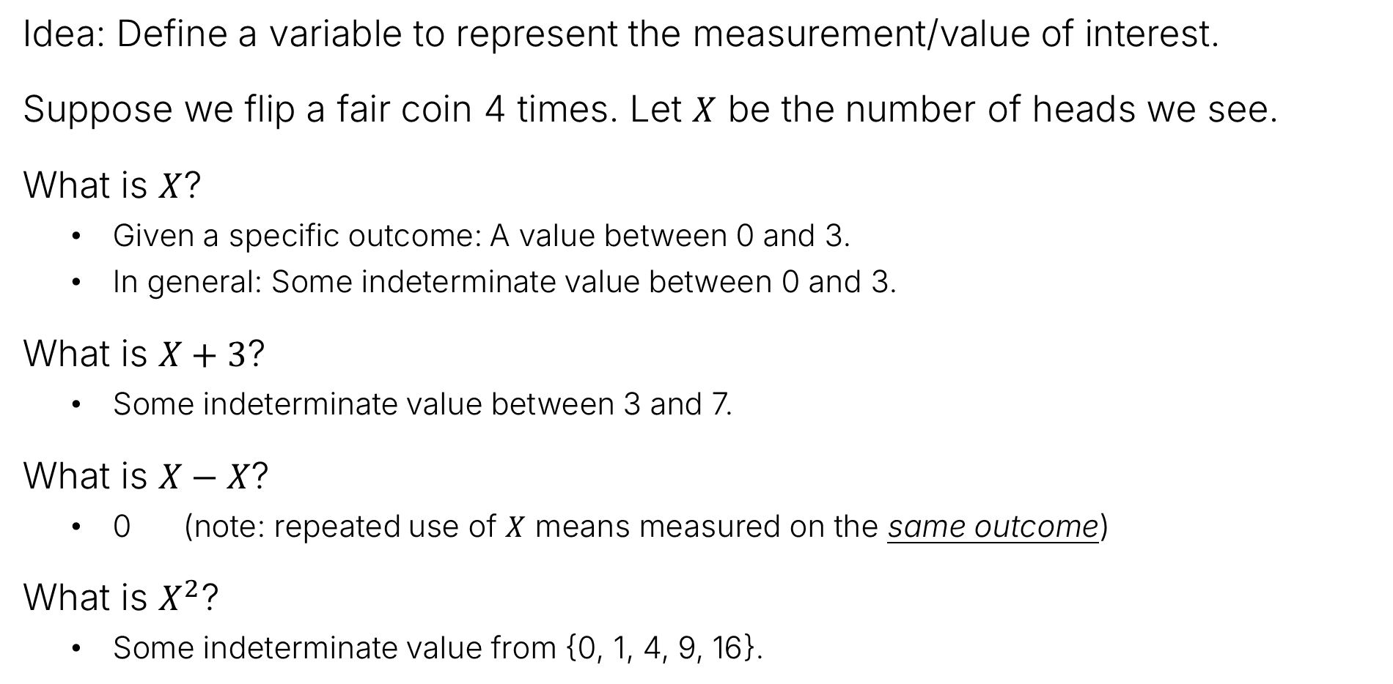
Random Variables: Informally
Idea: Define a variable to represent the measurement/value of interest.
Suppose we flip a fair coin 4 times. Let $X$ be the number of heads we see.
What is $X$?
Given a specific outcome: A value between 0 and 3.
In general: Some indeterminate value between 0 and 3.
What is $X+3$?
Some indeterminate value between 3 and 7.
What is $X−X$?
0 (note: repeated use of $X$ means measured on the same outcome)
What is $X^{2}$?
Some indeterminate value from {0, 1, 4, 9, 16}.

Slide 5
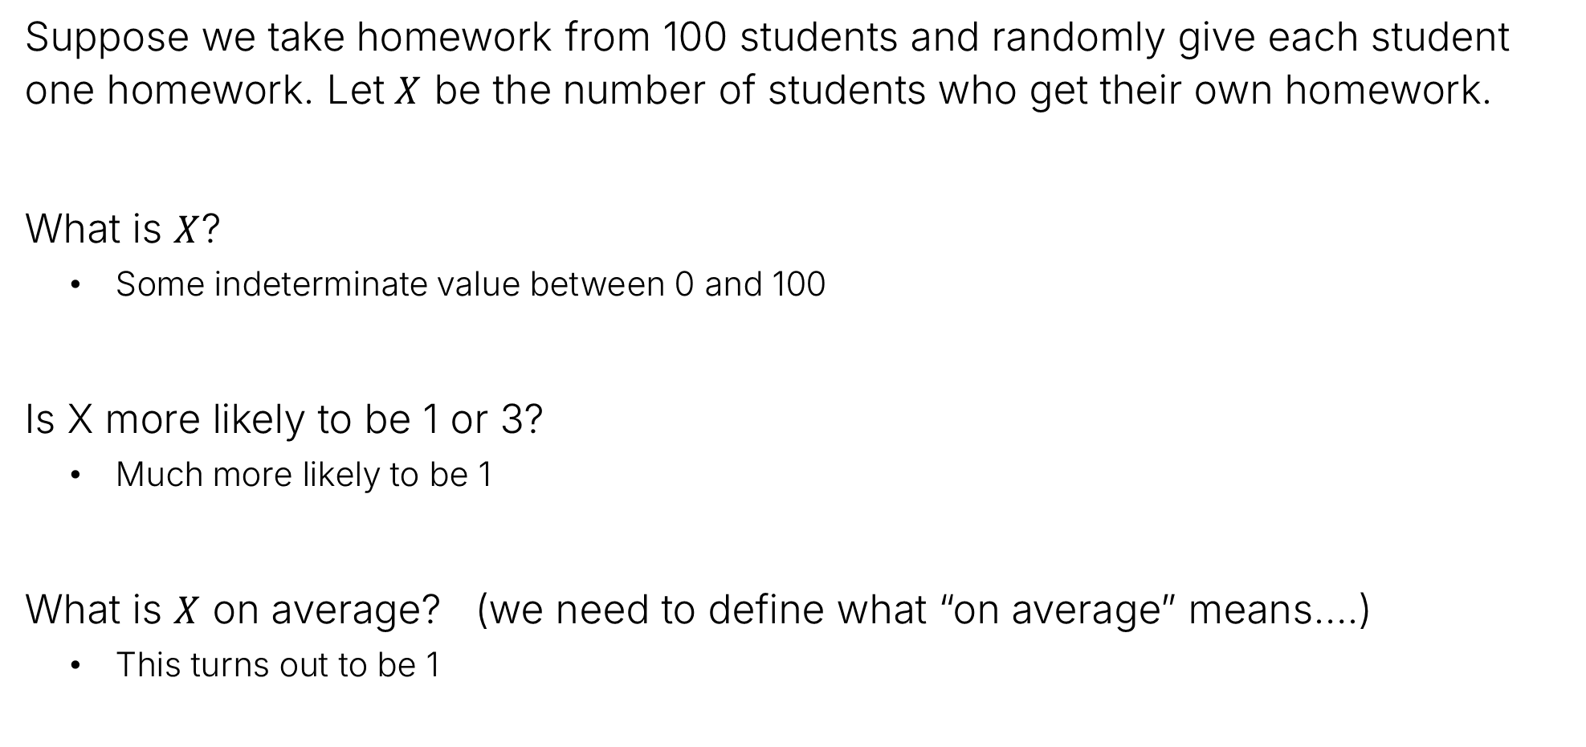
Random Variables: Informally
Suppose we take homework from 100 students and randomly give each student one homework. Let $X$ be the number of students who get their own homework.
What is $X$?
Some indeterminate value between 0 and 100
Is X more likely to be 1 or 3?
Much more likely to be 1
What is $X$ on average? (we need to define what “on average” means….)
This turns out to be 1

Slide 6
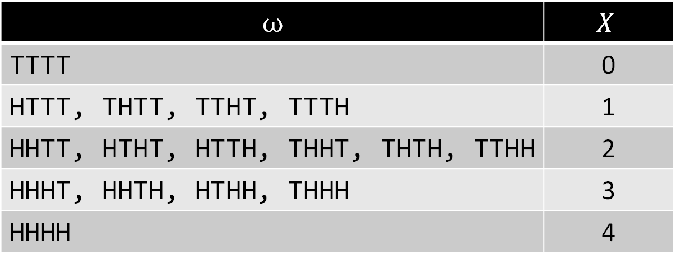

Random Variables: Informally
Suppose we flip a fair coin 4 times. Let $X$ be the number of heads we see.
Consider all outcomes – each results in a specific value for $X$:
$$ω$$ | $$X$$
TTTT | 0
HTTT, THTT, TTHT, TTTH | 1
HHTT, HTHT, HTTH, THHT, THTH, TTHH | 2
HHHT, HHTH, HTHH, THHH | 3
HHHH | 4

Slide 7



Random Variable: Formally
A Random Variable X on a sample space is a function that maps $Ω→ℝ$, i.e., $X(ω)$ is a real number for every $ω∈Ω$.
Example, for coin flips: $X\left(TTTT\right)=0$, $X\left(HHTH\right)=3$, …
$$ω∈Ω$$
$$0∈ℝ$$
$$ω$$ | $$X$$
TTTT | 0
HTTT, THTT, TTHT, TTTH | 1
HHTT, HTHT, HTTH, THHT, THTH, TTHH | 2
HHHT, HHTH, HTHH, THHH | 3
HHHH | 4
So despite the name, a random variable is really a function.

Slide 8

Formal Random Variable Example 2
Imagine rolling two six sided dice. Let X be their sum.
$X\left(\left(1, 1\right)\right)=2$
6
2
5
4
3
2
1
1
2
3
4
5
6

Slide 9

Formal Random Variable Example 2
Imagine rolling two six-sided dice. Let X be their sum.
$X\left(\left(1, 2\right)\right)=3$ and $X\left(\left(2,1\right)\right)=3$
6
3
2 | 3
5
4
3
2
1
1
2
3
4
5
6

Slide 10

Formal Random Variable Example 2
Imagine rolling two six-sided dice. Let X be their sum.
The domain of $X$ is the set of all tuples of integers $(i, j)$ where $1≤i,j≤6$.
The range of $X$ is $\left\{2, 3, 4, 5, 6, 7, 8, 9, 10, 11, 12\right\}$.
6
7 | 8 | 9 | 10 | 11 | 12
6 | 7 | 8 | 9 | 10 | 11
5 | 6 | 7 | 8 | 9 | 10
4 | 5 | 6 | 7 | 8 | 9
3 | 4 | 5 | 6 | 7 | 8
2 | 3 | 4 | 5 | 6 | 7
5
4
3
2
1
1
2
3
4
5
6

Slide 11
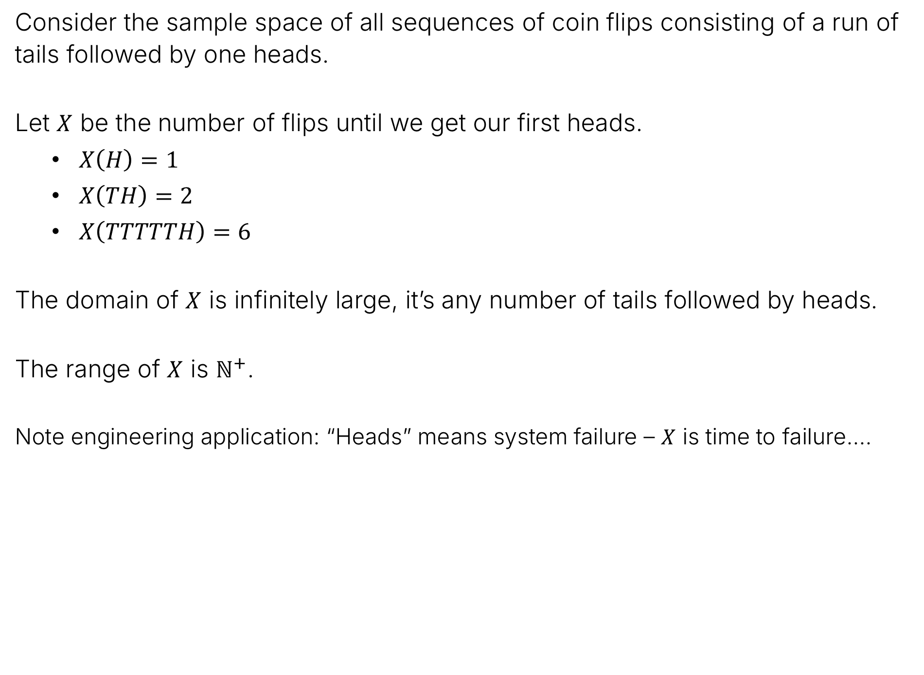
Formal Random Variable Example 3
Consider the sample space of all sequences of coin flips consisting of a run of tails followed by one heads.
Let $X$ be the number of flips until we get our first heads.
$X\left(H\right)=1$
$X\left(TH\right)=2$
$X\left(TTTTTH\right)=6$
The domain of $X$ is infinitely large, it’s any number of tails followed by heads.
The range of $X$ is $ℕ^{+}$.
Note engineering application: “Heads” means system failure – $X$ is time to failure….

Slide 12
Random Variables and Events
Random Variables
The Idea and Definition
Random Variables and Events
The Distribution of a Random Variable
Expectation
Common Distributions
Bernoulli Distribution
Binomial Distribution
Geometric Distribution
Poisson Distribution
Summary
Lecture 19, CS70 Summer 2025

Slide 13

Random Variables and Events
Let $y$ be any number in the range of a random variable $X$. Consider the set:
$$A_{y}=\left\{ω∈Ω:X\left(ω\right)=y\right\}$$
Observation: This set is an event in the sample space, because it a subset of $Ω$.
Sometimes called the “pre-image of $y$”

Slide 14


Random Variables and Events
Let $y$ be any number in the range of a random variable $X$. Consider the set:
$$A_{y}=\left\{ω∈Ω:X\left(ω\right)=y\right\}$$
6
7 | 8 | 9 | 10 | 11 | 12
6 | 7 | 8 | 9 | 10 | 11
5 | 6 | 7 | 8 | 9 | 10
4 | 5 | 6 | 7 | 8 | 9
3 | 4 | 5 | 6 | 7 | 8
2 | 3 | 4 | 5 | 6 | 7
Observation: This set $A_{y}$ is an event in the sample space, because it a subset of $Ω$.
Example for two dice:
$A_{9}=\{ω∈Ω :X\left(ω\right)=9\}$
Samples in this event: (6, 3), (5, 4), (4, 5), (3, 6)
5
4
3
2
1
1
2
3
4
5
6

Slide 15


Random Variables and Events
Let $a$ be any number in the range of a random variable $X$. Consider the set:
$$A_{y}=\left\{ω∈Ω:X\left(ω\right)=y\right\}$$
6
7 | 8 | 9 | 10 | 11 | 12
6 | 7 | 8 | 9 | 10 | 11
5 | 6 | 7 | 8 | 9 | 10
4 | 5 | 6 | 7 | 8 | 9
3 | 4 | 5 | 6 | 7 | 8
2 | 3 | 4 | 5 | 6 | 7
Observation: This set $A_{y}$ is an event in the sample space, because it a subset of $Ω$.
Example for two dice:
$A_{9}=\{ω∈Ω :X\left(ω\right)=9\}$
Other ways to “name” this event:
$X^{−1}\left(9\right)$
$X=9$ (we’ll use this in our class)
5
4
3
2
1
1
2
3
4
5
6

Slide 16



Random Variables and Events
Let $a$ be any number in the range of a random variable $X$. Consider the set:
$$A_{y}=\left\{ω∈Ω:X\left(ω\right)=y\right\}$$
6
7 | 8 | 9 | 10 | 11 | 12
6 | 7 | 8 | 9 | 10 | 11
5 | 6 | 7 | 8 | 9 | 10
4 | 5 | 6 | 7 | 8 | 9
3 | 4 | 5 | 6 | 7 | 8
2 | 3 | 4 | 5 | 6 | 7
5
$$\left\{ω∈Ω :X\left(ω\right)=9\right\}$$
4
$$X^{−1}\left(9\right)$$
3
$$A_{9}$$
All four of these are different ways of referring to the same event.
2
1
$$X=9$$
1
2
3
4
5
6

Slide 17
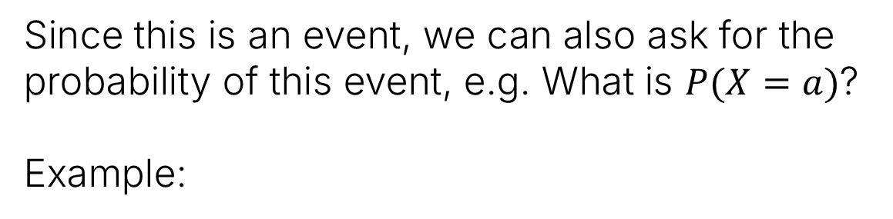
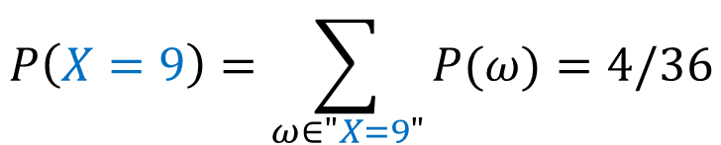
Random Variables and Events
Let $a$ be any number in the range of a random variable $X$. Consider the set:
$$A_{y}=\left\{ω∈Ω:X\left(ω\right)=y\right\}$$
6
7 | 8 | 9 | 10 | 11 | 12
6 | 7 | 8 | 9 | 10 | 11
5 | 6 | 7 | 8 | 9 | 10
4 | 5 | 6 | 7 | 8 | 9
3 | 4 | 5 | 6 | 7 | 8
2 | 3 | 4 | 5 | 6 | 7
Since this is an event, we can also ask for the probability of this event, e.g. What is $P(X=a)$?
Example:
5
4
$$P\left(X=9\right)=\sum_{ω∈"X=9"}{P(ω)}=4/36$$
3
2
1
1
2
3
4
5
6

Slide 18
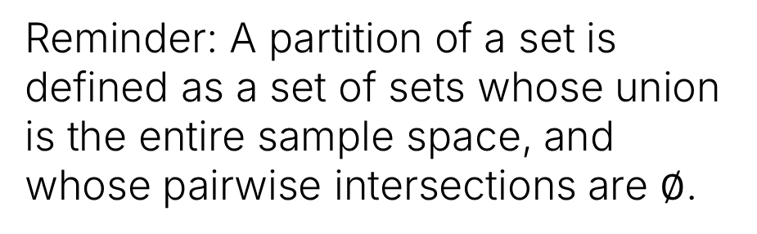




Random Variables and Partitions
A random variable $X$ partitions the sample space into events. Why?
The domain of $X$ is the entire sample space.
$X$ is a function, so every sample is assigned to exactly one set.
6
7 | 8 | 9 | 10 | 11 | 12
6 | 7 | 8 | 9 | 10 | 11
5 | 6 | 7 | 8 | 9 | 10
4 | 5 | 6 | 7 | 8 | 9
3 | 4 | 5 | 6 | 7 | 8
2 | 3 | 4 | 5 | 6 | 7
$$X=12$$
5
4
3
$$X=9$$
2
Reminder: A partition of a set is defined as a set of sets whose union is the entire sample space, and whose pairwise intersections are $∅$.
1
1
2
3
4
5
6
$$X=6$$

Slide 19
The Distribution of a Random Variable
Random Variables
The Idea and Definition
Random Variables and Events
The Distribution of a Random Variable
Expectation
Common Distributions
Bernoulli Distribution
Binomial Distribution
Geometric Distribution
Poisson Distribution
Summary
Lecture 19, CS70 Summer 2025

Slide 20
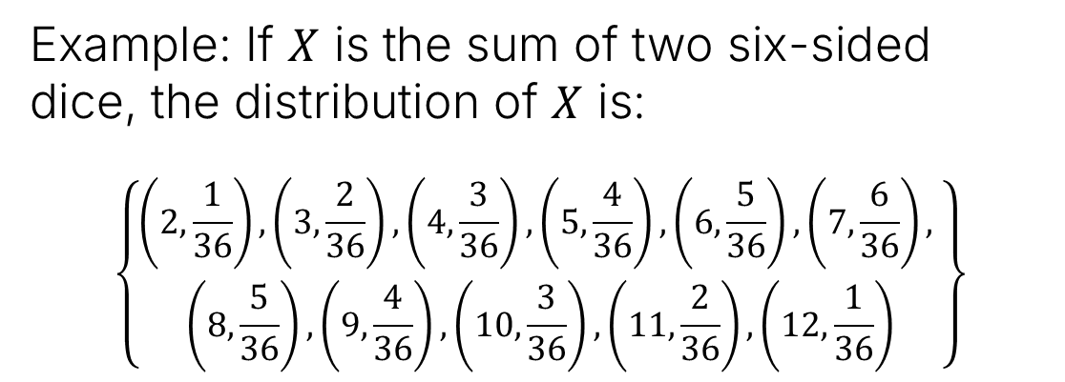

Distribution of a Random Variable
The distribution of a random variable $X$ is the collection of values
$$\left\{\left(a,P\left(X=a\right)\right):a∈range\left(X\right)\right\}$$
7 | 8 | 9 | 10 | 11 | 12
6 | 7 | 8 | 9 | 10 | 11
5 | 6 | 7 | 8 | 9 | 10
4 | 5 | 6 | 7 | 8 | 9
3 | 4 | 5 | 6 | 7 | 8
2 | 3 | 4 | 5 | 6 | 7
Example: If $X$ is the sum of two six-sided dice, the distribution of $X$ is:
$$\left\{\begin{aligned}\left(2,\frac{1}{36}\right), \left(3,\frac{2}{36}\right),\left(4,\frac{3}{36}\right),\left(5,\frac{4}{36}\right),\left(6,\frac{5}{36}\right), \left(7,\frac{6}{36}\right), \\ \left(8,\frac{5}{36}\right), \left(9,\frac{4}{36}\right), \left(10,\frac{3}{36}\right), \left(11,\frac{2}{36}\right), \left(12,\frac{1}{36}\right)\end{aligned}\right\}$$
6
5
4
3
2
1
1
2
3
4
5
6

Slide 21
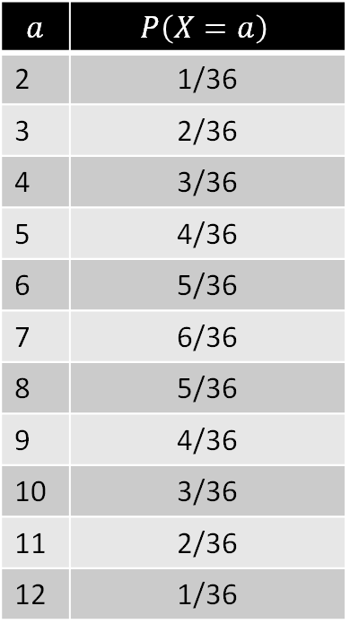
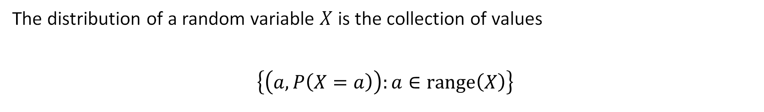
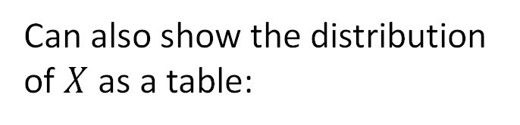
Distribution of a Random Variable
The distribution of a random variable $X$ is the collection of values
$$\left\{\left(a,P\left(X=a\right)\right):a∈range\left(X\right)\right\}$$
7 | 8 | 9 | 10 | 11 | 12
6 | 7 | 8 | 9 | 10 | 11
5 | 6 | 7 | 8 | 9 | 10
4 | 5 | 6 | 7 | 8 | 9
3 | 4 | 5 | 6 | 7 | 8
2 | 3 | 4 | 5 | 6 | 7
Can also show the distribution of $X$ as a table:
$$a$$ | $$P\left(X=a\right)$$
2 | 1/36
3 | 2/36
4 | 3/36
5 | 4/36
6 | 5/36
7 | 6/36
8 | 5/36
9 | 4/36
10 | 3/36
11 | 2/36
12 | 1/36
6
5
4
3
2
1
1
2
3
4
5
6

Slide 22
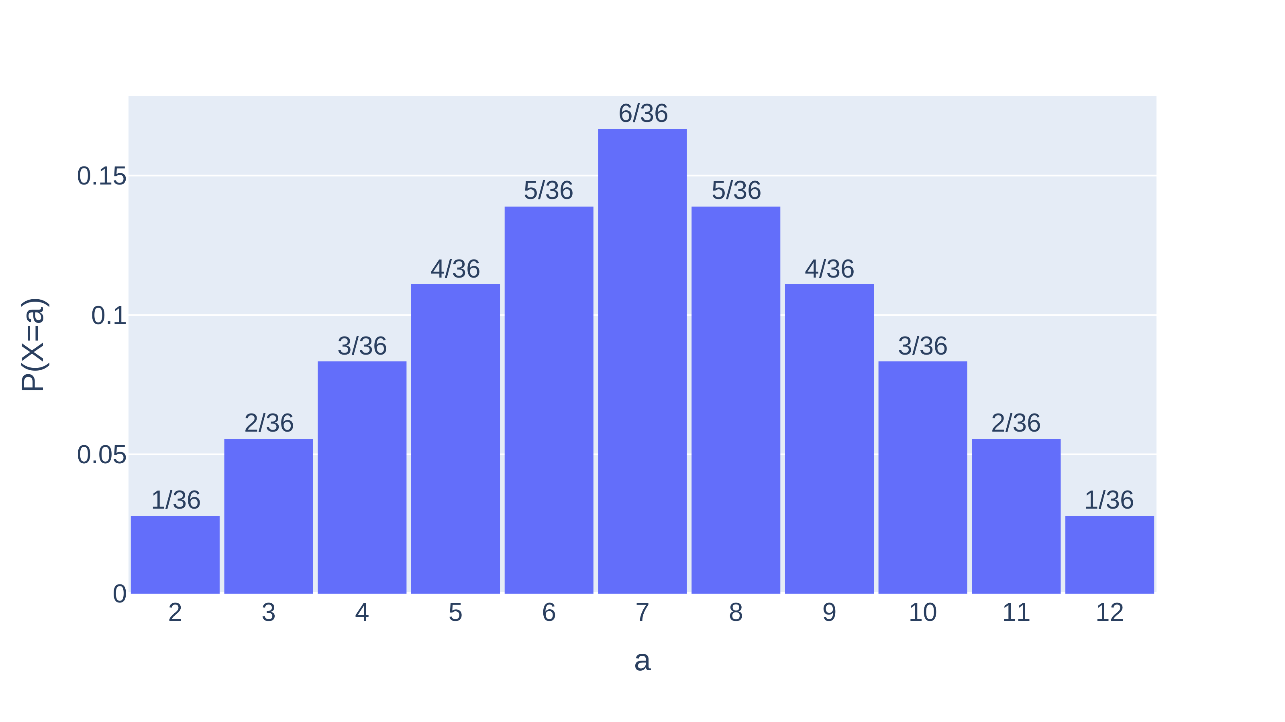
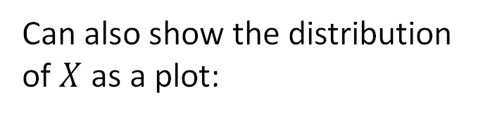
Distribution of a Random Variable
The distribution of a random variable $X$ is the collection of values
$$\left\{\left(a,P\left(X=a\right)\right):a∈range\left(X\right)\right\}$$
Can also show the distribution of $X$ as a plot:
6
7 | 8 | 9 | 10 | 11 | 12
6 | 7 | 8 | 9 | 10 | 11
5 | 6 | 7 | 8 | 9 | 10
4 | 5 | 6 | 7 | 8 | 9
3 | 4 | 5 | 6 | 7 | 8
2 | 3 | 4 | 5 | 6 | 7
5
4
3
2
1
1
2
3
4
5
6

Slide 23
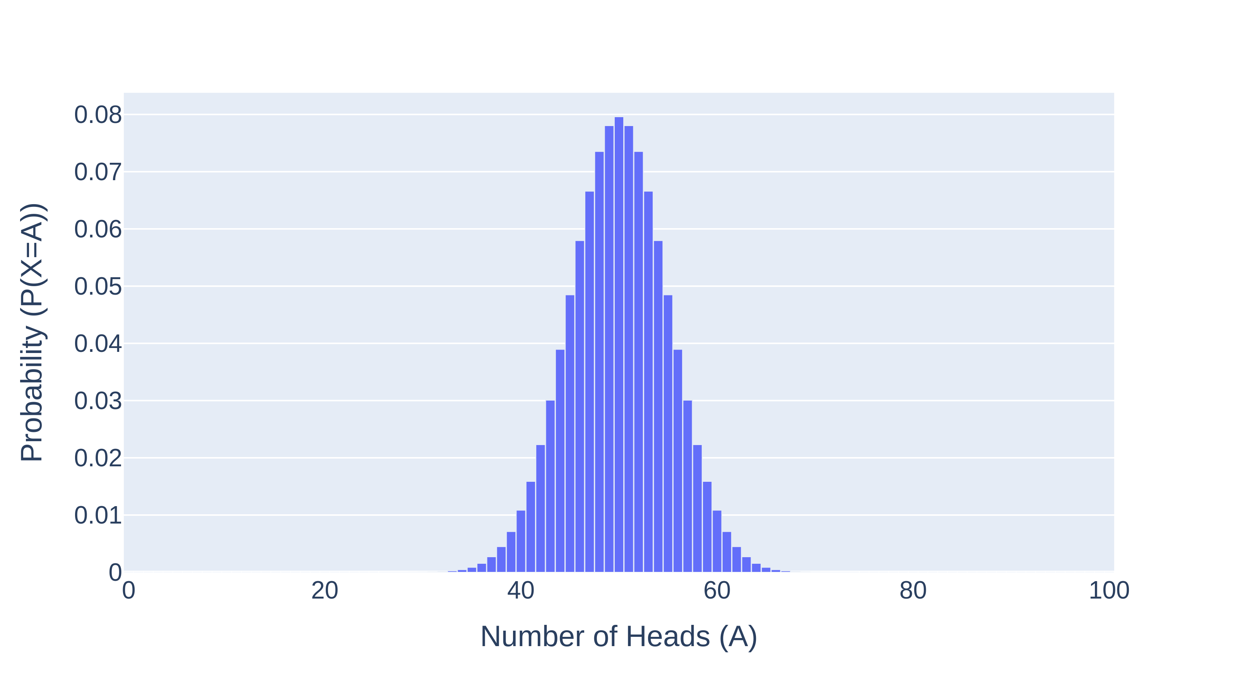



Distribution Example 2: Tossing 100 Coins
Toss 100 coins. Let $X$ be the number of heads.
Reminder: $X$ is a function that maps samples to reals, e.g., $X\left(HHH…H\right)=100$
Distribution of $X$:
$$=\frac{\left({100 \atop a}\right)}{2^{100}}$$
$$P\left(X=a\right)=\frac{\# outcomes with a heads}{\left|Ω\right|}$$

Slide 24
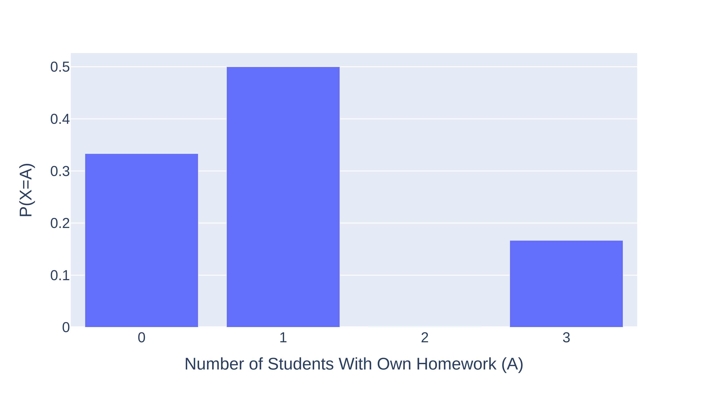


Distribution Example 3: Handing Back Assignments
Random Experiment: Suppose we take homework from 3 students, and randomly give each student one homework. Let $X$ be the number of students who get their own homework.
$$Ω=\{123, 132, 213, 231, 312, 321\}$$
$$X$$
3
1
1
0
0
1

Slide 25
The Expectation of a Random Variable
Random Variables
The Idea and Definition
Random Variables and Events
The Distribution of a Random Variable
Expectation
Common Distributions
Bernoulli Distribution
Binomial Distribution
Geometric Distribution
Poisson Distribution
Summary
Lecture 19, CS70 Summer 2025

Slide 26
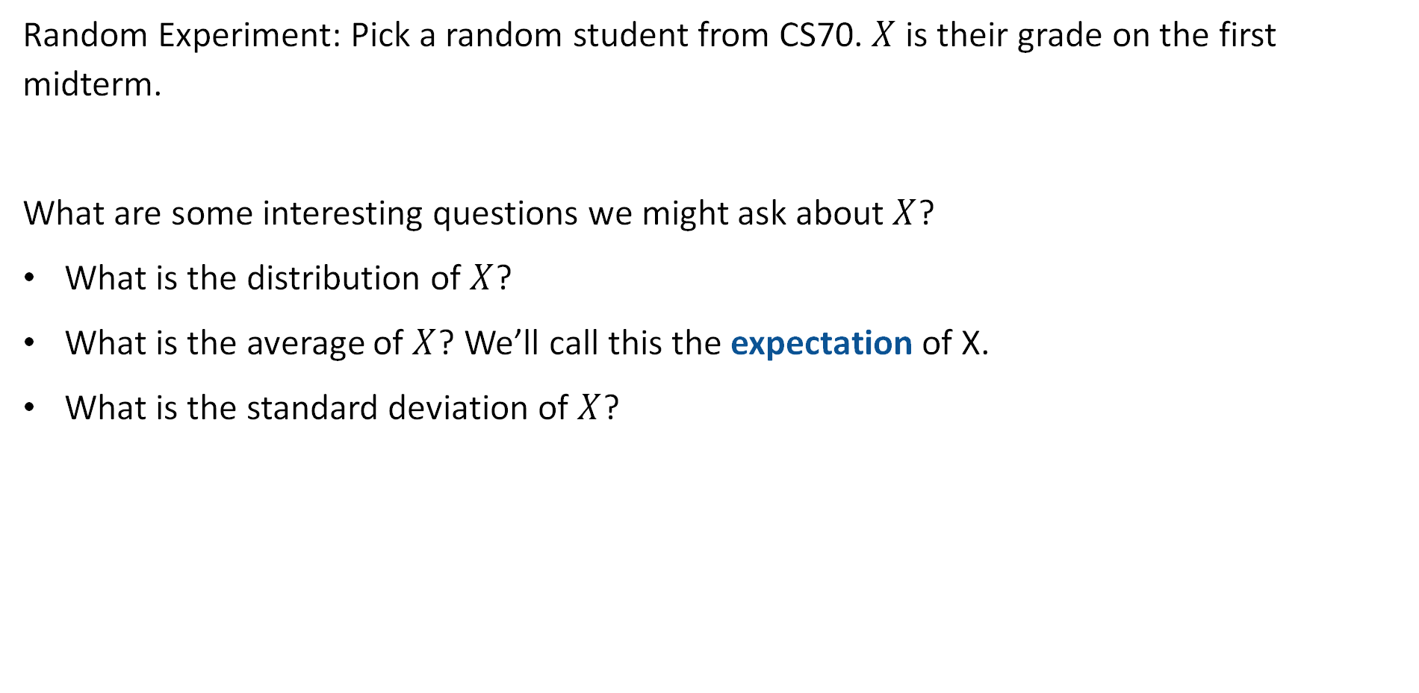
Distributions and Expectation
Random Experiment: Pick a random student from CS70. $X$ is their grade on the first midterm.
What are some interesting questions we might ask about $X$?
What is the distribution of $X$?
What is the average of $X$? We’ll call this the expectation of X.
What is the standard deviation of $X$?

Slide 27

Expectation Informally
Let’s do a little experiment and flip 4 coins. Let $X$ be the number of heads. We’ll count:
How many times we get each value $a$ from $\{0, 1, 2, 3, 4\}$.
The average of the values we get.
https://joshh.ug/cs70/four_coin_flips_expectation_simulator.html

Slide 28
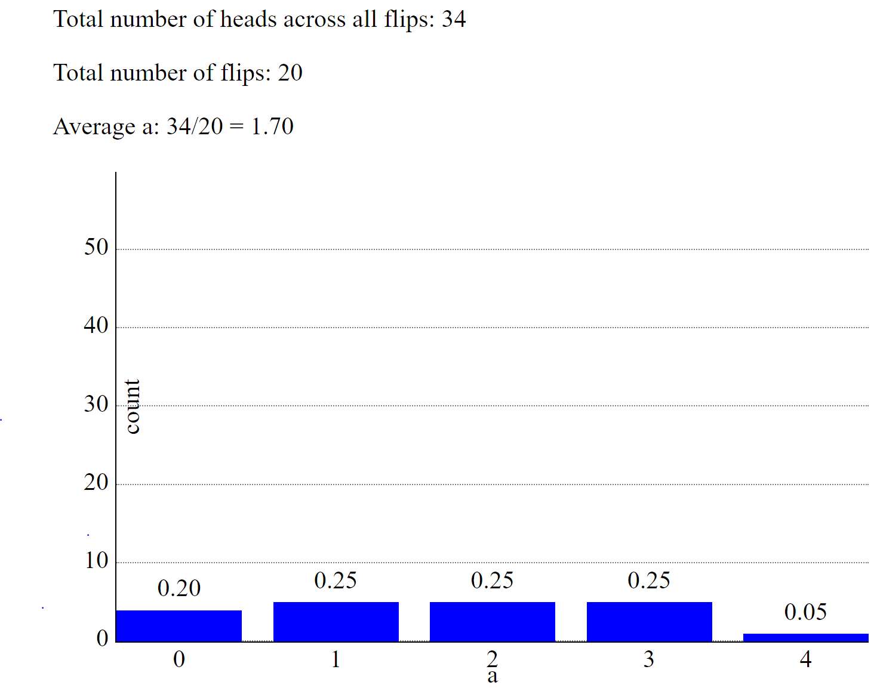
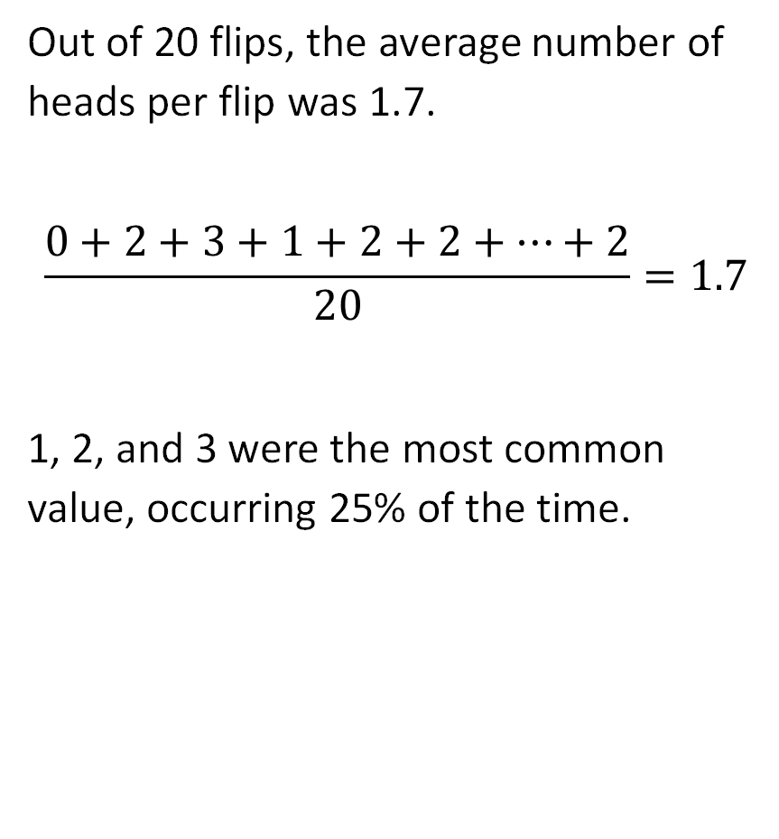
Simulation Results (Done Previously)
Out of 20 flips, the average number of heads per flip was 1.7.
$$\frac{0+2+3+1+2+2+…+2}{20}=1.7$$
1, 2, and 3 were the most common value, occurring 25% of the time.

Slide 29
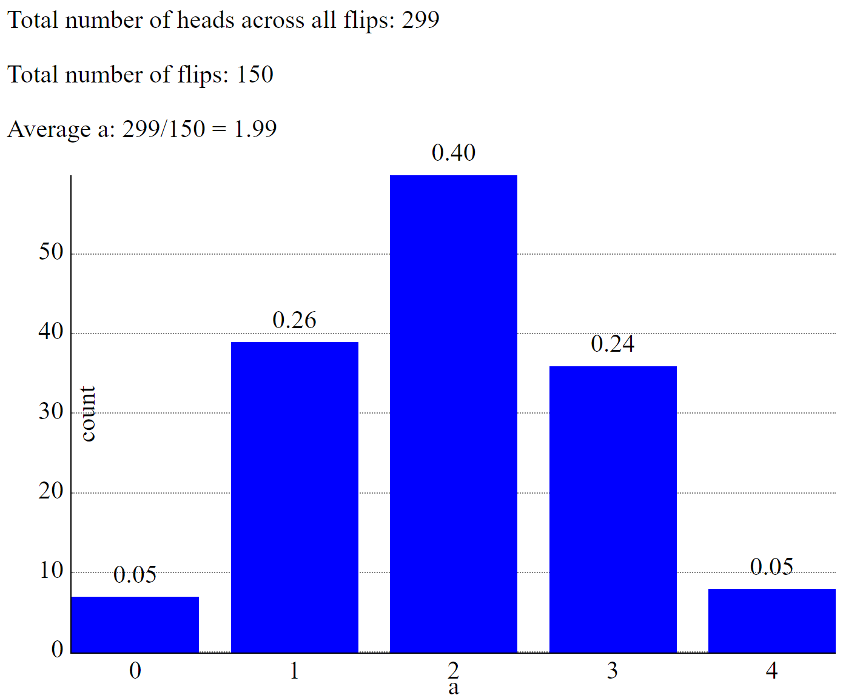
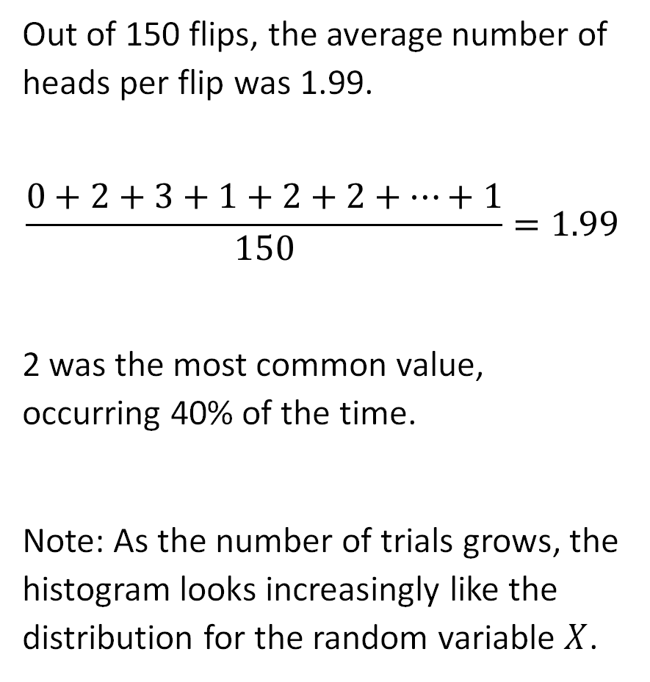
Simulation Results (Done Previously)
Out of 150 flips, the average number of heads per flip was 1.99.
$$\frac{0+2+3+1+2+2+…+1}{150}=1.99$$
2 was the most common value, occurring 40% of the time.
Note: As the number of trials grows, the histogram looks increasingly like the distribution for the random variable $X$.

Slide 30
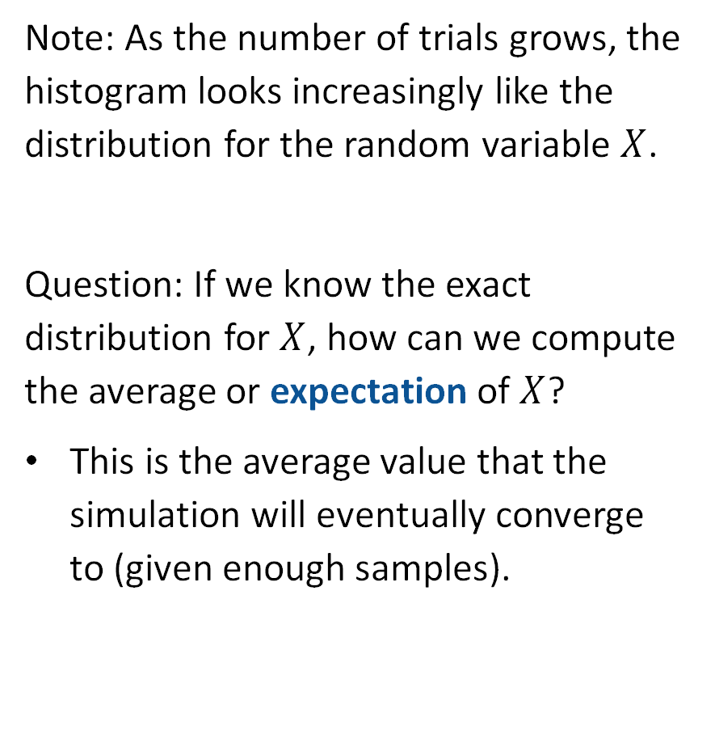
Simulation Results (Done Previously)
Note: As the number of trials grows, the histogram looks increasingly like the distribution for the random variable $X$.
Question: If we know the exact distribution for $X$, how can we compute the average or expectation of $X$?
This is the average value that the simulation will eventually converge to (given enough samples).

Slide 31
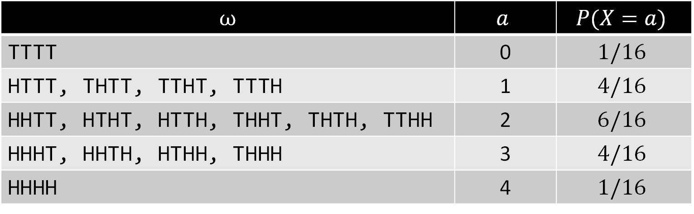





Expectation (Formally)
The expectation of a random variable is defined as:
$$E\left[X\right]=\sum_{a∈range(X)}{a×P\left(X=a\right)}$$
Example: Flipping four coins.
$E\left[X\right]=0×1/16$
$$+4×1/16$$
$$+3×4/16$$
$$+2×6/16$$
$$+1×4/16$$
$$ω$$ | $$a$$ | $$P(X=a)$$
TTTT | 0 | $$1/16$$
HTTT, THTT, TTHT, TTTH | 1 | $$4/16$$
HHTT, HTHT, HTTH, THHT, THTH, TTHH | 2 | $$6/16$$
HHHT, HHTH, HTHH, THHH | 3 | $$4/16$$
HHHH | 4 | $$1/16$$

Slide 32





Expectation (Formally)
The expectation of a random variable is defined as:
$$E\left[X\right]=\sum_{a∈range(X)}{a×P\left(X=a\right)}$$
Example: Flipping four coins.
$E\left[X\right]=0$
$$+4/16$$
$$+12/16$$
$$+12/16$$
$$+4/16$$
$$ω$$ | $$a$$ | $$P(X=a)$$
TTTT | 0 | $$1/16$$
HTTT, THTT, TTHT, TTTH | 1 | $$4/16$$
HHTT, HTHT, HTTH, THHT, THTH, TTHH | 2 | $$6/16$$
HHHT, HHTH, HTHH, THHH | 3 | $$4/16$$
HHHH | 4 | $$1/16$$

Slide 33

Expectation (Formally)
The expectation of a random variable is defined as:
$$E\left[X\right]=\sum_{a∈range(X)}{a×P\left(X=a\right)}$$
Example: Flipping four coins.
$E\left[X\right]=32/16=2$
$$ω$$ | $$a$$ | $$P(X=a)$$
TTTT | 0 | $$1/16$$
HTTT, THTT, TTHT, TTTH | 1 | $$4/16$$
HHTT, HTHT, HTTH, THHT, THTH, TTHH | 2 | $$6/16$$
HHHT, HHTH, HTHH, THHH | 3 | $$4/16$$
HHHH | 4 | $$1/16$$

Slide 34

Why Does the Experimental Average Converge to the Expectation?
The expectation is defined as:
$$E\left[X\right]=\sum_{a∈range(X)}{a×P\left(X=a\right)}$$
And given the outcome of $N$ random experiments, the experimental average is:
$$\frac{X_{1}+X_{2}+X_{3}+…+X_{N}}{N}$$
Why does the experimental average converge to the expectation?

Slide 35
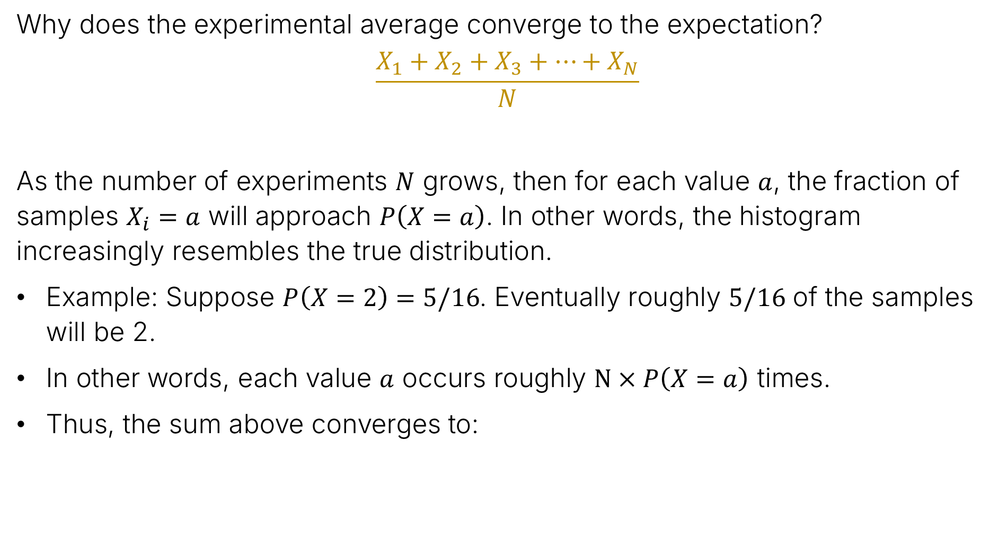
Why Does the Experimental Average Converge to the Expectation?
Why does the experimental average converge to the expectation?
$$\frac{X_{1}+X_{2}+X_{3}+…+X_{N}}{N}$$
As the number of experiments $N$ grows, then for each value $a$, the fraction of samples $X_{i}=a$ will approach $P\left(X=a\right)$. In other words, the histogram increasingly resembles the true distribution.
Example: Suppose $P\left(X=2\right)=5/16$. Eventually roughly $5/16$ of the samples will be 2.
In other words, each value $a$ occurs roughly $N×P\left(X=a\right)$ times.
Thus, the sum above converges to:
$$\frac{0×N×P\left(X=0\right)+1×N×P\left(X=1\right)+2×N×P\left(X=2\right)+…}{N}$$

Slide 36


Why Does the Experimental Average Converge to the Expectation?
Why does the experimental average converge to the expectation?
$$\frac{X_{1}+X_{2}+X_{3}+…+X_{N}}{N}$$
As the number of experiments $N$ grows, then the sum above converges to:
Dividing out $N$, we get:
Which is just our formula for expectation:
$$\frac{0×N×P\left(X=0\right)+1×N×P\left(X=1\right)+2×N×P\left(X=2\right)+…}{N}$$
$$0×P\left(X=0\right)+1×P\left(X=1\right)+2×P\left(X=2\right)+…$$
$$E\left[X\right]=\sum_{a∈range(X)}{a×P\left(X=a\right)}$$

Slide 37





Alternate Equivalent Definition
The expectation is:
$$E\left[X\right]=\sum_{a∈range(X)}{a×P\left(X=a\right)}$$
We can also write this expression in terms of a sum over all outcomes $ω∈Ω$.
$$=\sum_{a∈range(X)}{\left(a×\sum_{ω:X\left(ω\right)=a}{P\left(ω\right)}\right)}$$
$$=\sum_{a∈range(X)}{\sum_{ω:X\left(ω\right)=a}{a×P(ω)}}$$
$$=\sum_{a∈range(X)}{\sum_{ω:X\left(ω\right)=a}{X\left(ω\right)×P(ω)}}$$
$$=\sum_{ω∈Ω}{X\left(ω\right)×P\left(ω\right)}$$

Slide 38
Bernoulli Random Variables
Random Variables
The Idea and Definition
Random Variables and Events
The Distribution of a Random Variable
Expectation
Common Distributions
Bernoulli Distribution
Binomial Distribution
Geometric Distribution
Poisson Distribution
Summary
Lecture 19, CS70 Summer 2025

Slide 39

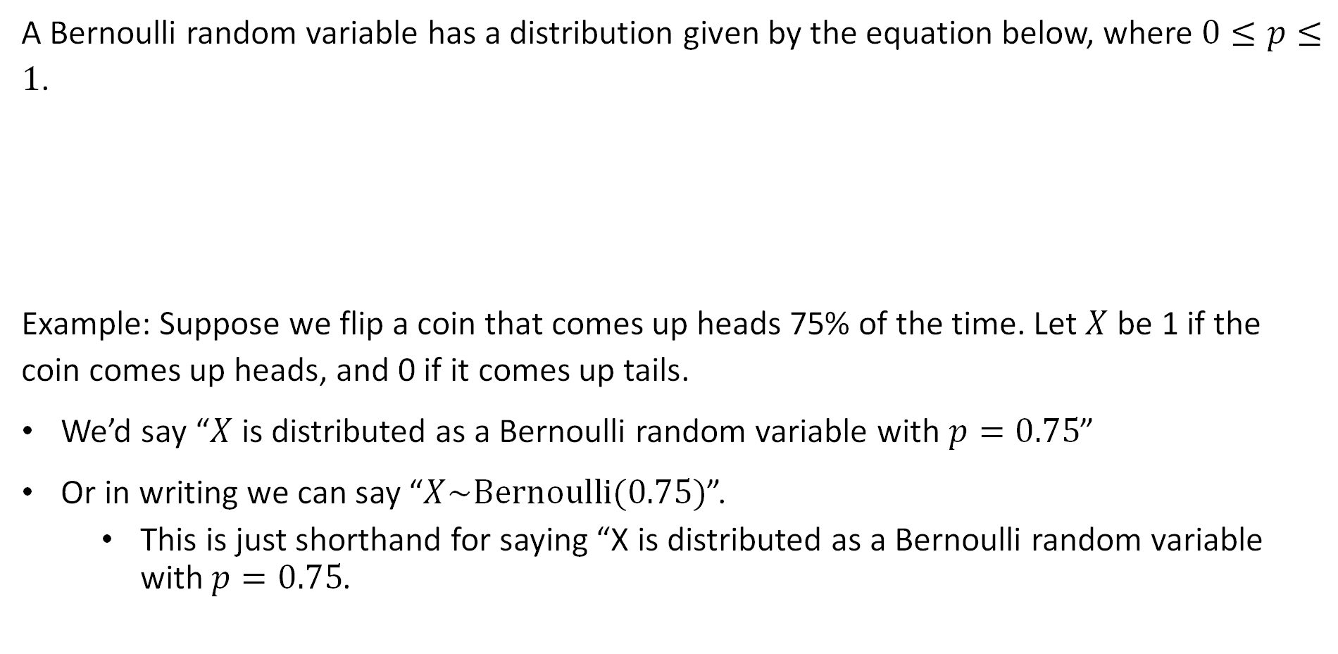
Bernoulli Random Variable
A Bernoulli random variable has a distribution given by the equation below, where $0≤p≤1$.
Example: Suppose we flip a coin that comes up heads 75% of the time. Let $X$ be 1 if the coin comes up heads, and 0 if it comes up tails.
We’d say “$X$ is distributed as a Bernoulli random variable with $p=0.75$”
Or in writing we can say “$X\sim Bernoulli(0.75)$”.
  This is just shorthand for saying “X is distributed as a Bernoulli random variable with $p=0.75$.
$$P\left(X=a\right)=\left\{\begin{aligned}p, if a=1 \\ 1−p, if a=0\end{aligned}\right.$$

Slide 40

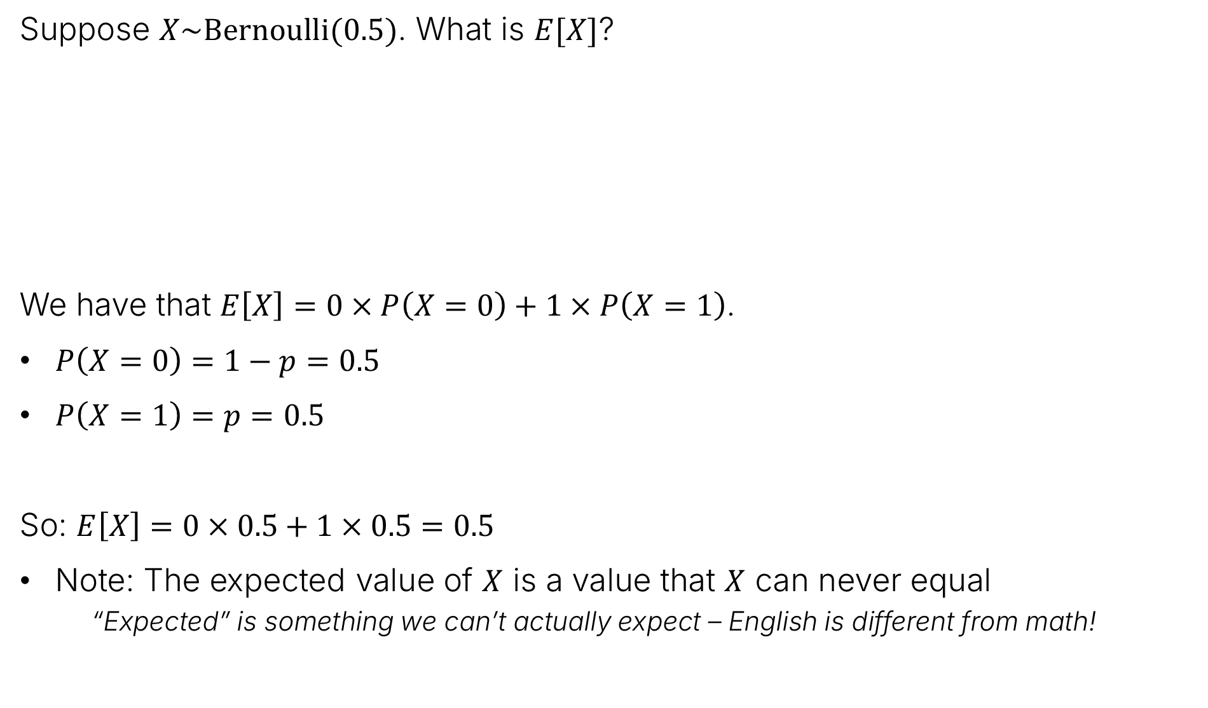

Bernoulli Random Variables and Expectation
Suppose $X\sim Bernoulli(0.5)$. What is $E[X]$?
We have that $E\left[X\right]=0×P\left(X=0\right)+1×P\left(X=1\right)$.
$P\left(X=0\right)=1−p=0.5$
$P\left(X=1\right)=p=0.5$
So: $E\left[X\right]=0×0.5+1×0.5=0.5$
Note: The expected value of $X$ is a value that $X$ can never equal
  “Expected” is something we can’t actually expect – English is different from math!
$$E\left[X\right]=\sum_{a∈range(X)}{a×P\left(X=a\right)}$$
$$P\left(X=a\right)=\left\{\begin{aligned}p, if a=1 \\ 1−p, if a=0\end{aligned}\right.$$

Slide 41
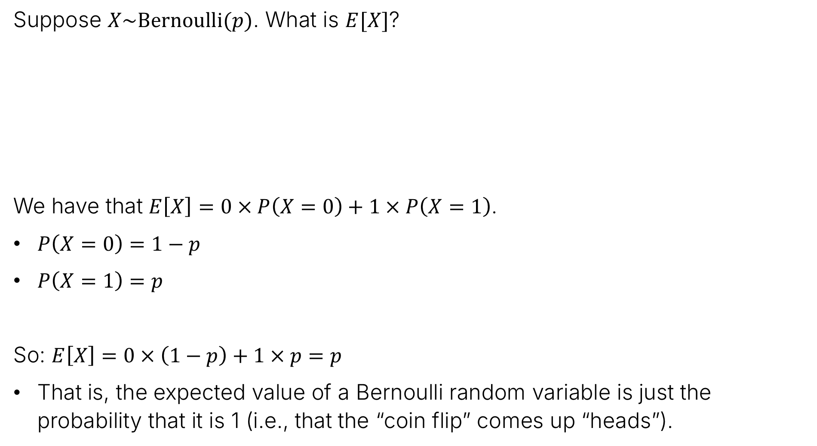
Bernoulli Random Variables and Expectation
Suppose $X\sim Bernoulli(p)$. What is $E[X]$?
We have that $E\left[X\right]=0×P\left(X=0\right)+1×P\left(X=1\right)$.
$P\left(X=0\right)=1−p$
$P\left(X=1\right)=p$
So: $E\left[X\right]=0×\left(1−p\right)+1×p=p$
That is, the expected value of a Bernoulli random variable is just the probability that it is 1 (i.e., that the “coin flip” comes up “heads”).
$$E\left[X\right]=\sum_{a∈range(X)}{a×P\left(X=a\right)}$$
$$P\left(X=a\right)=\left\{\begin{aligned}p, if a=1 \\ 1−p, if a=0\end{aligned}\right.$$

Slide 42

The Sum of Two Bernoulli Random Variables
Suppose $X_{1}\sim Bernoulli(p)$ and $X_{2}\sim Bernoulli\left(p\right)$. Suppose they are independent.
Let $Y=X_{1}+X_{2}$.
What is the distribution of $Y$?
What is $E\left[Y\right]$?

Slide 43
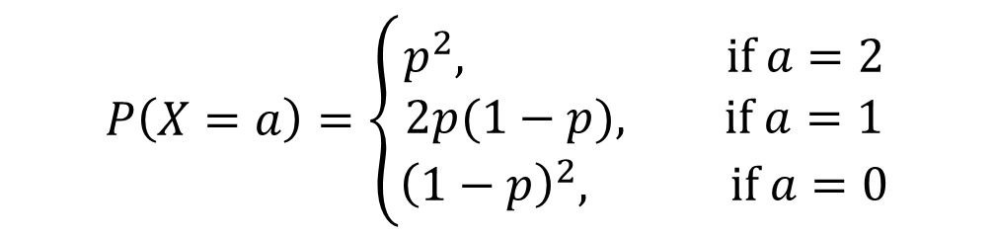
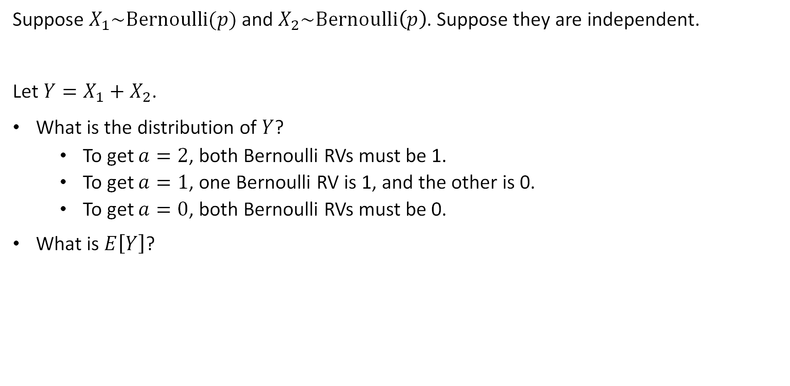
The Sum of Two Bernoulli Random Variables
Suppose $X_{1}\sim Bernoulli(p)$ and $X_{2}\sim Bernoulli\left(p\right)$. Suppose they are independent.
Let $Y=X_{1}+X_{2}$.
What is the distribution of $Y$?
  To get $a=2$, both Bernoulli RVs must be 1.
  To get $a=1$, one Bernoulli RV is 1, and the other is 0.
  To get $a=0$, both Bernoulli RVs must be 0.
What is $E\left[Y\right]$?
$$P\left(X=a\right)=\left\{\begin{aligned}p^{2}, if a=2 \\ 2p(1−p), if a=1 \\ {\left(1−p\right)}^{2}, if a=0\end{aligned}\right.$$

Slide 44

The Sum of Two Bernoulli Random Variables
Suppose $X_{1}\sim Bernoulli(p)$ and $X_{2}\sim Bernoulli\left(p\right)$. Suppose they are independent.
Let $Y=X_{1}+X_{2}$.
What is the distribution of $Y$?
  To get $a=2$, both Bernoulli RVs must be 1.
  To get $a=1$, one Bernoulli RV is 1, and the other is 0.
  To get $a=0$, both Bernoulli RVs must be 0.
What is $E\left[Y\right]$?
  $$E\left[Y\right]=2×p^{2}+1×2p\left(1−p\right)+0×{\left(1−p\right)}^{2}$$
$$P\left(X=a\right)=\left\{\begin{aligned}p^{2}, if a=2 \\ 2p(1−p), if a=1 \\ {\left(1−p\right)}^{2}, if a=0\end{aligned}\right.$$
  $$=2p^{2}+2p−2p^{2}$$
  $$=2p$$

Slide 45
Binomial Random Variables
Random Variables
The Idea and Definition
Random Variables and Events
The Distribution of a Random Variable
Expectation
Common Distributions
Bernoulli Distribution
Binomial Distribution
Geometric Distribution
Poisson Distribution
Summary
Lecture 19, CS70 Summer 2025

Slide 46

Binomial Distribution
The Binomial distribution models counting the number of heads if we flip $n$ coins that come up heads with probability $p$.
Let’s work out the distribution by considering a specific example. Suppose that $X\sim Binomial(n=5,p)$
$P\left(HHTHT\right)=p⋅p⋅\left(1−p\right)⋅p⋅\left(1−p\right)=p^{3}{\left(1−p\right)}^{2}$
$P\left(TTHHH\right)=\left(1−p\right)⋅\left(1−p\right)⋅p⋅p⋅p=p^{3}{\left(1−p\right)}^{2}$

Slide 47


Binomial Distribution
The Binomial distribution models counting the number of heads if we flip $n$ coins that come up heads with probability $p$.
Let’s work out the distribution by considering a specific example. Suppose that $X\sim Binomial(n=5,p)$
$P\left(HHTHT\right)=p⋅p⋅\left(1−p\right)⋅p⋅\left(1−p\right)=p^{3}{\left(1−p\right)}^{2}$
$P\left(TTHHH\right)=\left(1−p\right)⋅\left(1−p\right)⋅p⋅p⋅p=p^{3}{\left(1−p\right)}^{2}$
$P\left(X=3\right)=\left(\# of sequences with 3 heads\right)p^{3}{\left(1−p\right)}^{2}$
$$=\left({5 \atop 3}\right)p^{3}{\left(1−p\right)}^{2}$$

Slide 48



Binomial Distribution
The Binomial distribution models counting the number of heads if we flip $n$ coins that come up heads with probability $p$.
Let’s work out the distribution by considering a specific example. Suppose that $X\sim Binomial(n=5,p)$
$P\left(X=i\right)=\left(\# of sequences with i heads\right)p^{i}{\left(1−p\right)}^{5−i}$
$$=\left({5 \atop i}\right)p^{i}{\left(1−p\right)}^{5−i}$$
for $i = 0, 1, 2, 3, 4, 5$

Slide 49



Binomial Distribution
The Binomial distribution models counting the number of heads if we flip $n$ coins that come up heads with probability $p$.
Let’s work out the distribution by considering a specific example. Suppose that $X\sim Binomial(n,p)$
$P\left(X=i\right)=\left(\# of sequences with i heads\right)p^{i}{\left(1−p\right)}^{n−i}$
$$=\left({n \atop i}\right)p^{i}{\left(1−p\right)}^{n−i}$$
for $i = 0, 1, 2, …,n$

Slide 50


Binomial Distribution
The Binomial distribution models counting the number of heads if we flip $n$ coins that come up heads with probability $p$.
Suppose that $X\sim Binomial(n,p)$
$P\left(X=i\right)=\left({n \atop i}\right)p^{i}{\left(1−p\right)}^{n−i}$
Exercise: Verify that $\sum_{i=0}^{n}{\left({n \atop i}\right)p^{i}{\left(1−p\right)}^{n−i}}=1$.
We’ll cover the expectation of a Binomial RV next lecture.
You can do it using the usual sum, but that’s much messier than the nicer approach from the next lecture.
for $i = 0, 1, 2, …, n$

Slide 51
Geometric Random Variables
Random Variables
The Idea and Definition
Random Variables and Events
The Distribution of a Random Variable
Expectation
Common Distributions
Bernoulli Distribution
Binomial Distribution
Geometric Distribution
Poisson Distribution
Summary
Lecture 19, CS70 Summer 2025

Slide 52

Geometric Distribution
Imagine a random experiment where we repeatedly flip a coin with a probability of heads equal to $p$ until we get heads. The flips are independent.
Let $X$ be the number of flips.
This distribution is called the geometric distribution, i.e., $X\sim Geometric\left(p\right)$
In the coin flipping example, what are the domain and range of $X$?
Domain: Any sequence of 0 or more tails, followed by a heads.
Range: Any integer greater than or equal to 1, i.e., $ℕ^{+}$
What is $P\left(X=1\right)$?
$P\left(X=1\right)=p$

Slide 53

Geometric Distribution
Imagine a random experiment where we repeatedly flip a coin with a probability of heads equal to $p$ until we get heads. The flips are independent.
Let $X$ be the number of flips.
This distribution is called the geometric distribution, i.e., $X\sim Geometric\left(p\right)$
What is $P\left(X=i\right)$?
$P\left(X=2\right)=\left(1−p\right)⋅p$
$P\left(X=3\right)={\left(1−p\right)}^{2}⋅p$
$P\left(X=i\right)={\left(1−p\right)}^{i−1}⋅p$

Slide 54







Verifying that the Probabilities Sum to 1
Imagine a random experiment where we repeatedly flip a coin with a probability of heads equal to $p$ until we get heads. The flips are independent.
Let $X$ be the number of flips.
This distribution is called the geometric distribution, i.e., $X\sim Geometric\left(p\right)$
$P\left(X=i\right)={\left(1−p\right)}^{i−1}p$ for $i=1,2,…$
Let’s verify that the probabilities sum to 1.
$$\sum_{n=0}^{∞}{r^{n}=\frac{1}{1−r}}$$
$$\sum_{i=1}^{∞}{P\left(X=i\right)=}\sum_{i=1}^{∞}{{\left(1−p\right)}^{i−1}p}$$
$$=p\sum_{i=1}^{∞}{{\left(1−p\right)}^{i−1}}$$
$$=\frac{p}{p}$$
$$=\frac{p}{1−\left(1−p\right)}$$
$$=1$$

Slide 55




Expectation of a Geometric Random Variable
If $X\sim Geometric\left(p\right)$, what is $E\left[X\right]$? This is a fun one.
$P\left(X=i\right)={\left(1−p\right)}^{i−1}p$ for $i=1,2,…$
$$E\left[X\right]=p+2\left(1−p\right)p+3{\left(1−p\right)}^{2}p+…$$
First, multiply both sides by $\left(1−p\right)$
$$\left(1−p\right)E\left[X\right]=$$
$$(1−p)p+2{\left(1−p\right)}^{2}p+3{\left(1−p\right)}^{3}p+…$$
Then, subtract the bottom equation from the top:
$$E\left[X\right]−\left(1−p\right)E\left[X\right]$$
$$=p+2\left(1−p\right)p+3{\left(1−p\right)}^{2}p+…$$
$$−\left(1−p\right)p −2{\left(1−p\right)}^{2}p−…$$
This is just $\sum_{i=1}^{∞}{P(X=i)}$
$$pE\left[X\right]=p+\left(1−p\right)p+{\left(1−p\right)}^{2}p+…$$
$$pE\left[X\right]=1$$
$$E\left[X\right]=1/p$$

Slide 56

Expectation of a Geometric Random Variable
If $X\sim Geometric\left(p\right)$, what is $E\left[X\right]$? This is a fun one.
$P\left(X=i\right)={\left(1−p\right)}^{i−1}p$ for $i=1,2,…$
$E\left[X\right]=1/p$
In this week’s discussion, you’ll get a chance to build some deeper intuition with geometric random variables, including the “memoryless” property.

Slide 57
Poisson Random Variables
Random Variables
The Idea and Definition
Random Variables and Events
The Distribution of a Random Variable
Expectation
Common Distributions
Bernoulli Distribution
Binomial Distribution
Geometric Distribution
Poisson Distribution
Summary
Lecture 19, CS70 Summer 2025

Slide 58


Poisson Distribution
Suppose we want to know how many alpha particles will be emitted by a radiation source. Let $X$ be the number of emissions per unit time.
Assumptions:
The average number of emissions is $λ$ alpha particles per unit time.
Emissions in disjoint time intervals are independent, e.g. if 2 particles were emitted in the interval [0, 2], this tells us absolutely nothing about how many were emitted in the interval [2.1, 4].
If assumptions hold, $X\sim Poisson(λ)$.
$$P\left(X=i\right)=\frac{λ^{i}}{i!}e^{−λ}, for i=0, 1, 2, …$$

Slide 59





Poisson Distribution Example
Suppose we want to know how many alpha particles will be emitted by a radiation source. Let $X$ be the number of emissions per unit time.
Suppose we model this radiation source as $X\sim Poisson(λ)$, where $λ=2$ emissions per minute.
What is the probability of seeing 3 emissions in any given minute?
$$P\left(X=i\right)=\frac{λ^{i}}{i!}e^{−λ}, for i=0, 1, 2, …$$
$$P\left(X=3\right)=\frac{2^{3}}{3!}e^{−2}$$
$$=\frac{8}{6}e^{−2}$$
$$≈18.04\%$$

Slide 60

Useful Poisson Distribution Facts
The Poisson distribution comes from the large $n$ limit for Binomial RVs.
That is, can think of $\frac{λ^{i}}{i!}e^{−λ}$ as arising from an infinite number of Bernoulli trials.
We’ll cover this in the next lecture. For today it’s just magic.
The expected value of a Poisson random variable is $λ$.
This is by design! $λ$ was defined as the average number of events per unit time.
If we add independent $X\sim Poisson\left(λ\right)$ and $Y\sim Poisson\left(μ\right)$, and $Z=X+Y$, then $Z\sim Poisson(λ+μ)$.
We’re not equipped to prove this yet. This will come next lecture.

Slide 61



Poisson Distribution Example 2
Suppose we have two radiation sources. We model one as $X_{1}\sim Poisson(λ_{1})$, and the other as $X_{2}\sim Poisson(λ_{2})$.
If $λ_{1}=2$ emissions per minute, and $λ_{2}=5$ emissions per minute, what is the chance that the total number of emissions in a given minute is 4 emissions?
Earlier, we said that the sum of two RVs is also Poisson. So $S=X_{1}+X_{2}$ is a random variable where $S\sim Poisson(7)$.
$$P\left(S=i\right)=\frac{λ^{i}}{i!}e^{−λ}, for i=0, 1, 2, …$$
$$P\left(S=4\right)=\frac{7^{4}}{4!}e^{−7}$$
$$≈9.1\%$$

Slide 62

Poisson Distribution Example 3
Suppose we want to know how many alpha particles will be emitted by a radiation source. Let $X$ be the number of emissions per unit time.
Suppose we model this radiation source as $X\sim Poisson(λ)$, where $λ=2$ emissions per minute.
What is the probability that we get 100 emissions in an hour?

Slide 63



Poisson Distribution Example 3
Suppose we want to know how many alpha particles will be emitted by a radiation source. Let $X$ be the number of emissions per unit time.
Suppose we model this radiation source as $X\sim Poisson(λ)$, where $λ=2$ emissions per minute.
What is the probability that we get 100 emissions in an hour?
Need to convert our units. 2 emissions per minute is 120 emissions per hour.
  Can we really just multiply like this? Yes! Reason: Next lecture.
Let $Y$ be $X$, but in units of emissions per hour. Then $Y\sim Poisson(120)$.
$$P\left(Y=i\right)=\frac{λ^{i}}{i!}e^{−λ}$$
$$P\left(Y=100\right)=\frac{{120}^{100}}{100!}e^{−120}$$
$$≈0.6\%$$

Slide 64



Poisson Distribution Example 3 (Alternate Solution)
Suppose we want to know how many alpha particles will be emitted by a radiation source. Let $X$ be the number of emissions per unit time.
Suppose we model this radiation source as $X\sim Poisson(λ)$, where $λ=2$ emissions per minute.
What is the probability that we get 100 emissions in an hour?
The number of emissions per hour can be thought of as the sum of 60 independent RVs that are $\sim Poisson(λ)$.
Let $S$ be this sum. Then $S\sim Poisson(120)$.
$$P\left(S=i\right)=\frac{λ^{i}}{i!}e^{−λ}$$
$$P\left(S=100\right)=\frac{{120}^{100}}{100!}e^{−120}$$
$$≈0.6\%$$

Slide 65
Summary
Random Variables
The Idea and Definition
Random Variables and Events
The Distribution of a Random Variable
Expectation
Common Distributions
Bernoulli Distribution
Binomial Distribution
Geometric Distribution
Poisson Distribution
Summary
Lecture 19, CS70 Summer 2025

Slide 66

Summary
Today we introduced the concept of a random variable.
A function that maps outcomes to real numbers, e.g., $X$(HHHH)=4.
A random variable partitions a sample space. Each event in the partition is just the set of samples that yield a specific value.
The distribution of a random variable $X$ is the set of all values in the range of $X$, along with the probability of those values.
The expectation of a random variable is the weighted (by probability) sum of values of $X$
  This is also the limit of the average value if we average over a larger and larger number of random experiments with that RV.

Slide 67

Summary
We saw four important RVs:
Bernoulli: Biased coin flips.
Binomial: The sum of $n$ biased coin flips.
Geometric: The number of times we flip a coin before we get the first heads.
Poisson: A model for the number of events when:
  We know the average number of events per unit time.
  Knowing the number of events in some time interval tells us absolutely nothing about the number of events in a disjoint time interval.
  We’ll relate this back to Binomial RVs in the next lecture.

