Slide 1
Coupon Collector and Expectation
Coupon Collector and Expectation
Variance
Derivation and Definition
Properties of Variance
Example Variance Calculations
Sums of Random Variables
Covariance
Covariance and Independence
Lecture 21, CS70 Summer 2025

Slide 2
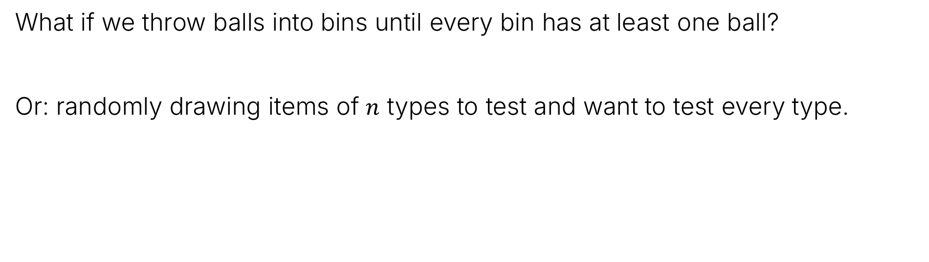
Back to Balls and Bins
What if we throw balls into bins until every bin has at least one ball?
Or: randomly drawing items of $n$ types to test and want to test every type.
Took 10 throws for 6 bins this time.
In general: What’s the distribution?
How many throws before 50% probability of all bins having a ball?
What’s the expected value?

Slide 3
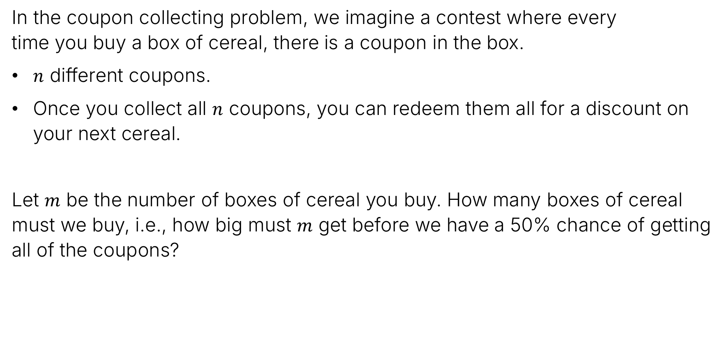
Problem Restatement – Coupon Collecting
In the coupon collecting problem, we imagine a contest where every time you buy a box of cereal, there is a coupon in the box.
$n$ different coupons.
Once you collect all $n$ coupons, you can redeem them all for a discount on your next cereal.
Let $m$ be the number of boxes of cereal you buy. How many boxes of cereal must we buy, i.e., how big must $m$ get before we have a 50% chance of getting all of the coupons?

Slide 4
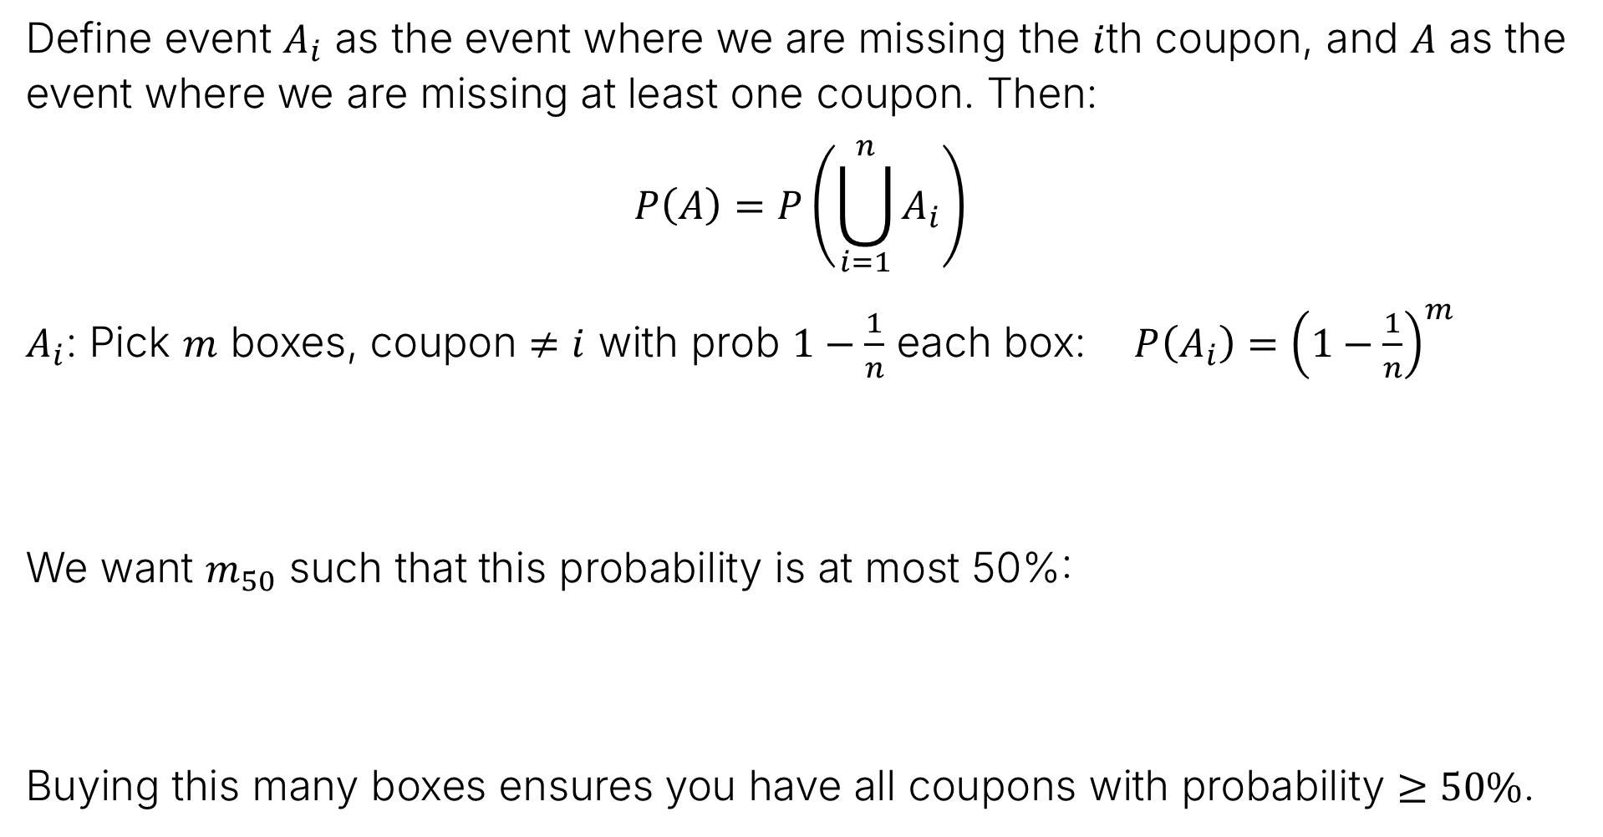



Coupon Collector: Union Bound for Probability of Missing a Coupon
Define event $A_{i}$ as the event where we are missing the $i$th coupon, and $A$ as the event where we are missing at least one coupon. Then:
$$P\left(A\right)=P\left(\bigcup_{i=1}^{n}{A_{i}}\right)$$
$A_{i}$: Pick $m$ boxes, coupon $≠i$ with prob $1−\frac{1}{n}$ each box: ${P\left(A_{i}\right)=\left(1−\frac{1}{n}\right)}^{m}$
We want $m_{50}$ such that this probability is at most 50%:
Buying this many boxes ensures you have all coupons with probability $≥50\%$.
$$P\left(A\right)≤n{\left(1−\frac{1}{n}\right)}^{m}$$
$$0.5=n{\left(1−\frac{1}{n}\right)}^{m_{50}}$$
$$\frac{\ln\left(0.5\right)−ln⁡(n)}{\ln\left(1−\frac{1}{n}\right)}=m_{50}$$

Slide 5
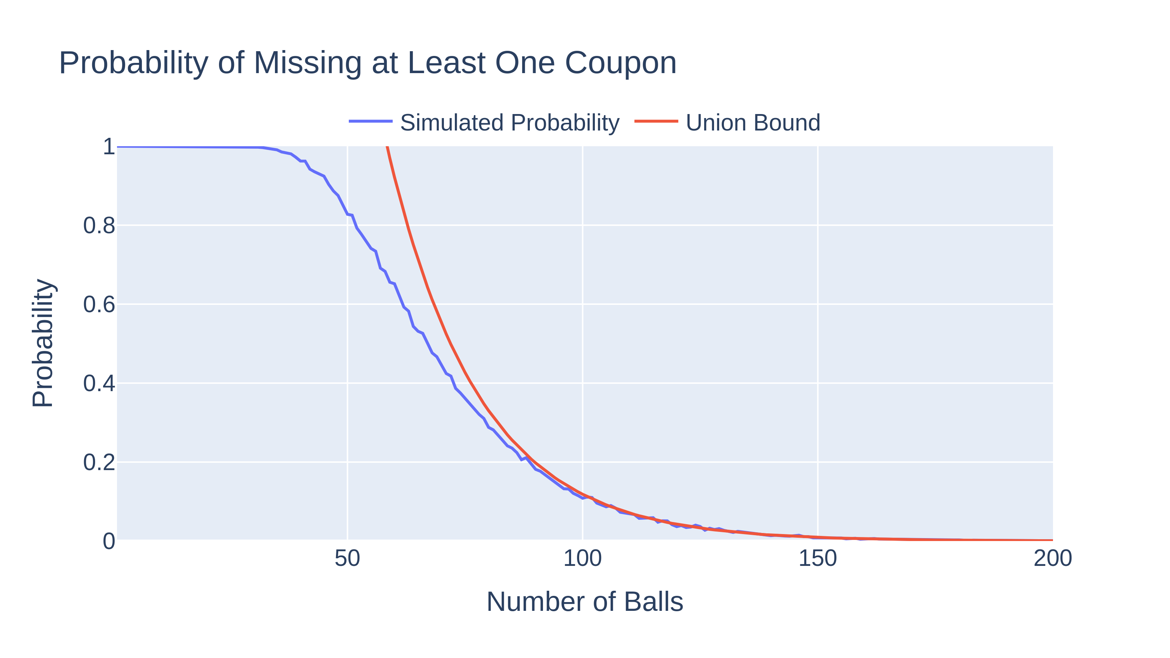


Coupon Collector: Union Bound vs. Empirical Result
We can see this upper bound overlaid on experiments with $n=20$.
$$\frac{\ln\left(0.5\right)−ln⁡(20)}{\ln\left(1−\frac{1}{20}\right)}≈72$$
P(72) ~ 50%
P(67) ~ 50.1%
For $n=20$ bins
Can also show that with $n\ln{n}+n$boxes, missing one with prob $≤e^{−1}≈0.3679$…

Slide 6
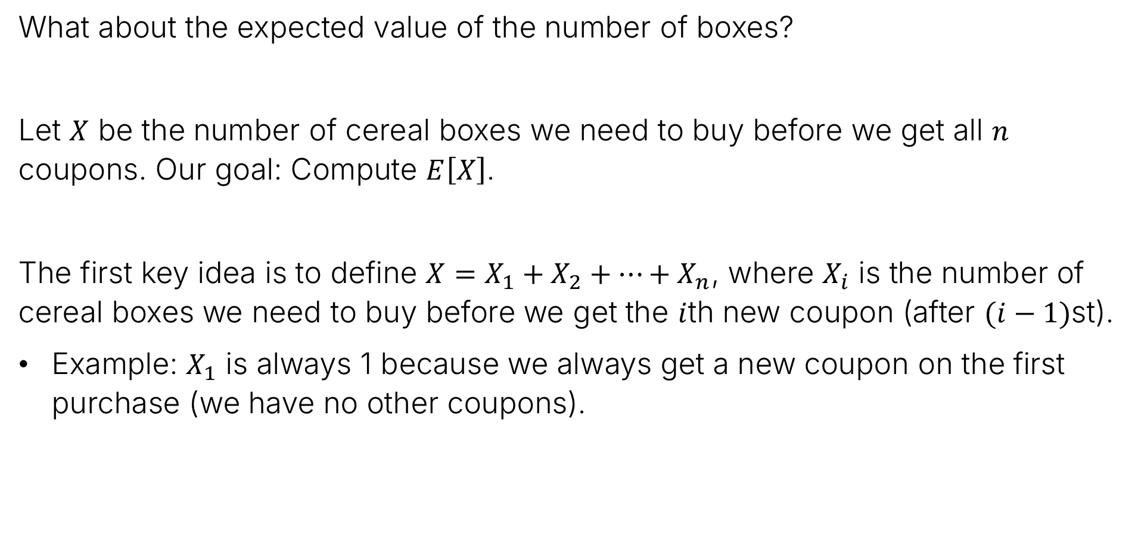
Expected Value
What about the expected value of the number of boxes?
Let $X$ be the number of cereal boxes we need to buy before we get all $n$ coupons. Our goal: Compute $E\left[X\right]$.
The first key idea is to define $X=X_{1}+X_{2}+…+X_{n}$, where $X_{i}$ is the number of cereal boxes we need to buy before we get the $i$th new coupon (after $(i−1)$st).
Example: $X_{1}$ is always 1 because we always get a new coupon on the first purchase (we have no other coupons).

Slide 7
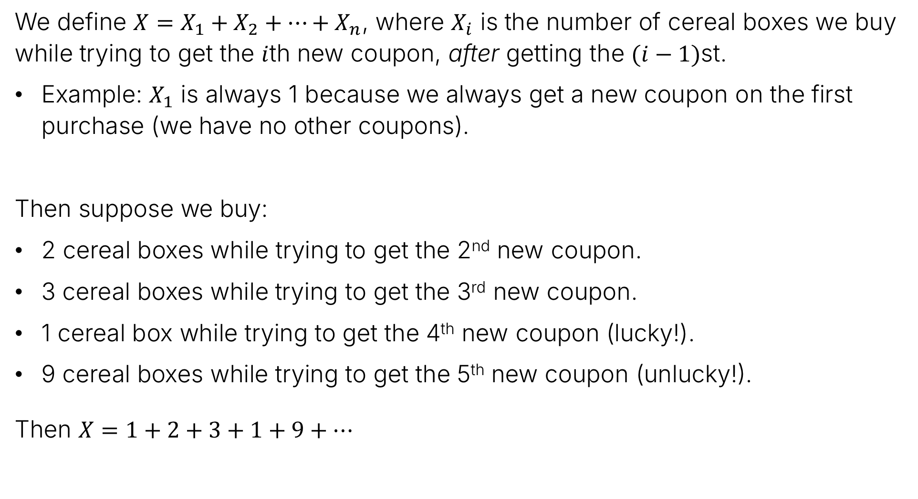
Expected Value
We define $X=X_{1}+X_{2}+…+X_{n}$, where $X_{i}$ is the number of cereal boxes we buy while trying to get the $i$th new coupon, after getting the $(i−1)$st.
Example: $X_{1}$ is always 1 because we always get a new coupon on the first purchase (we have no other coupons).
Then suppose we buy:
2 cereal boxes while trying to get the 2nd new coupon.
3 cereal boxes while trying to get the 3rd new coupon.
1 cereal box while trying to get the 4th new coupon (lucky!).
9 cereal boxes while trying to get the 5th new coupon (unlucky!).
Then $X=1+2+3+1+9+…$

Slide 8
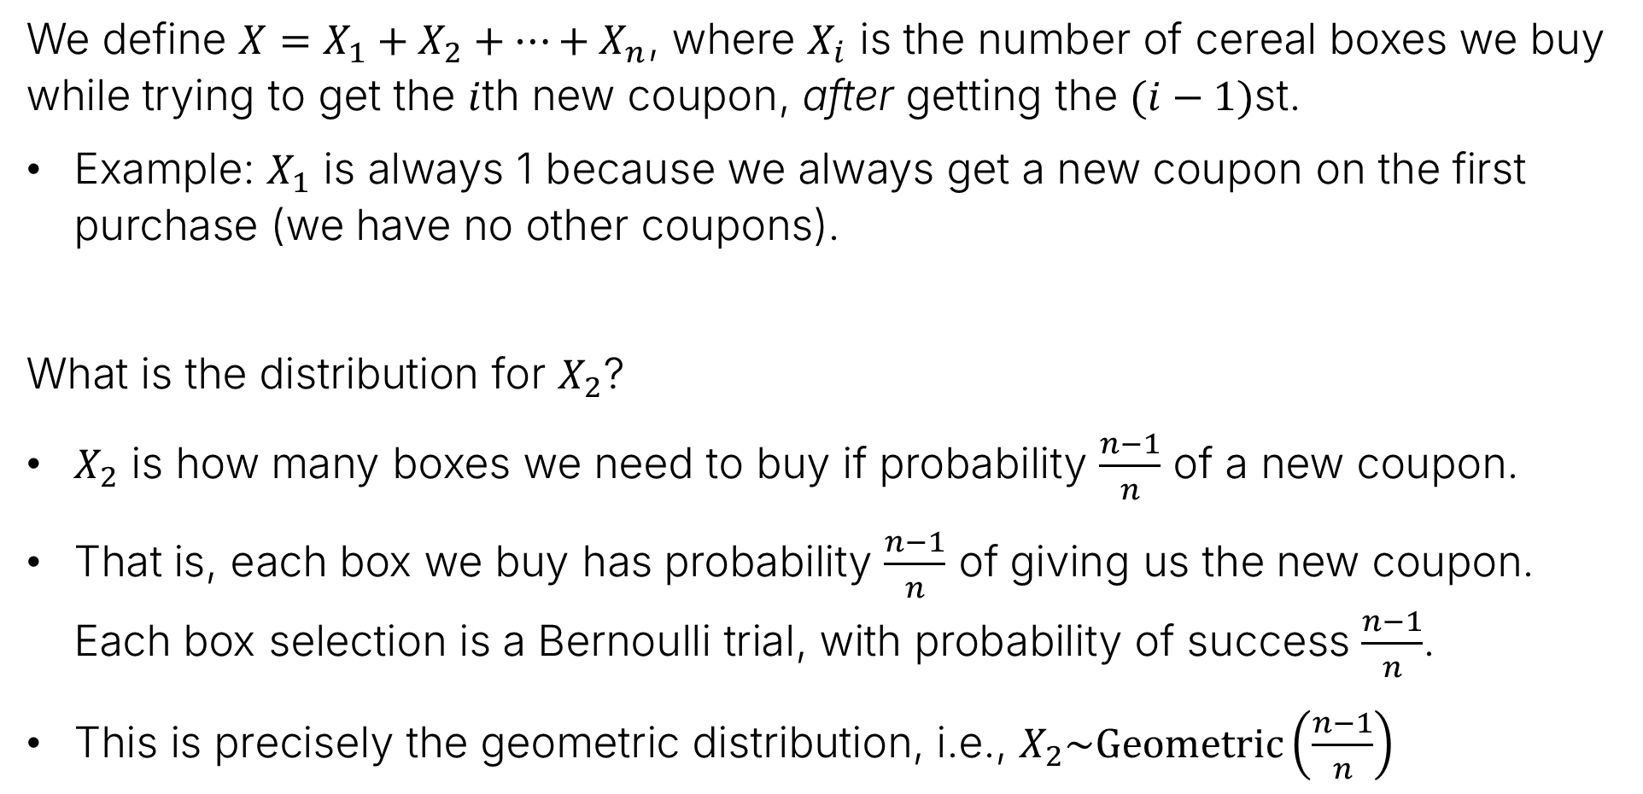
Expected Value
We define $X=X_{1}+X_{2}+…+X_{n}$, where $X_{i}$ is the number of cereal boxes we buy while trying to get the $i$th new coupon, after getting the $(i−1)$st.
Example: $X_{1}$ is always 1 because we always get a new coupon on the first purchase (we have no other coupons).
What is the distribution for $X_{2}$?
$X_{2}$ is how many boxes we need to buy if probability $\frac{n−1}{n}$ of a new coupon.
That is, each box we buy has probability $\frac{n−1}{n}$ of giving us the new coupon. Each box selection is a Bernoulli trial, with probability of success $\frac{n−1}{n}$.
This is precisely the geometric distribution, i.e., $X_{2}\sim Geometric\left(\frac{n−1}{n}\right)$

Slide 9

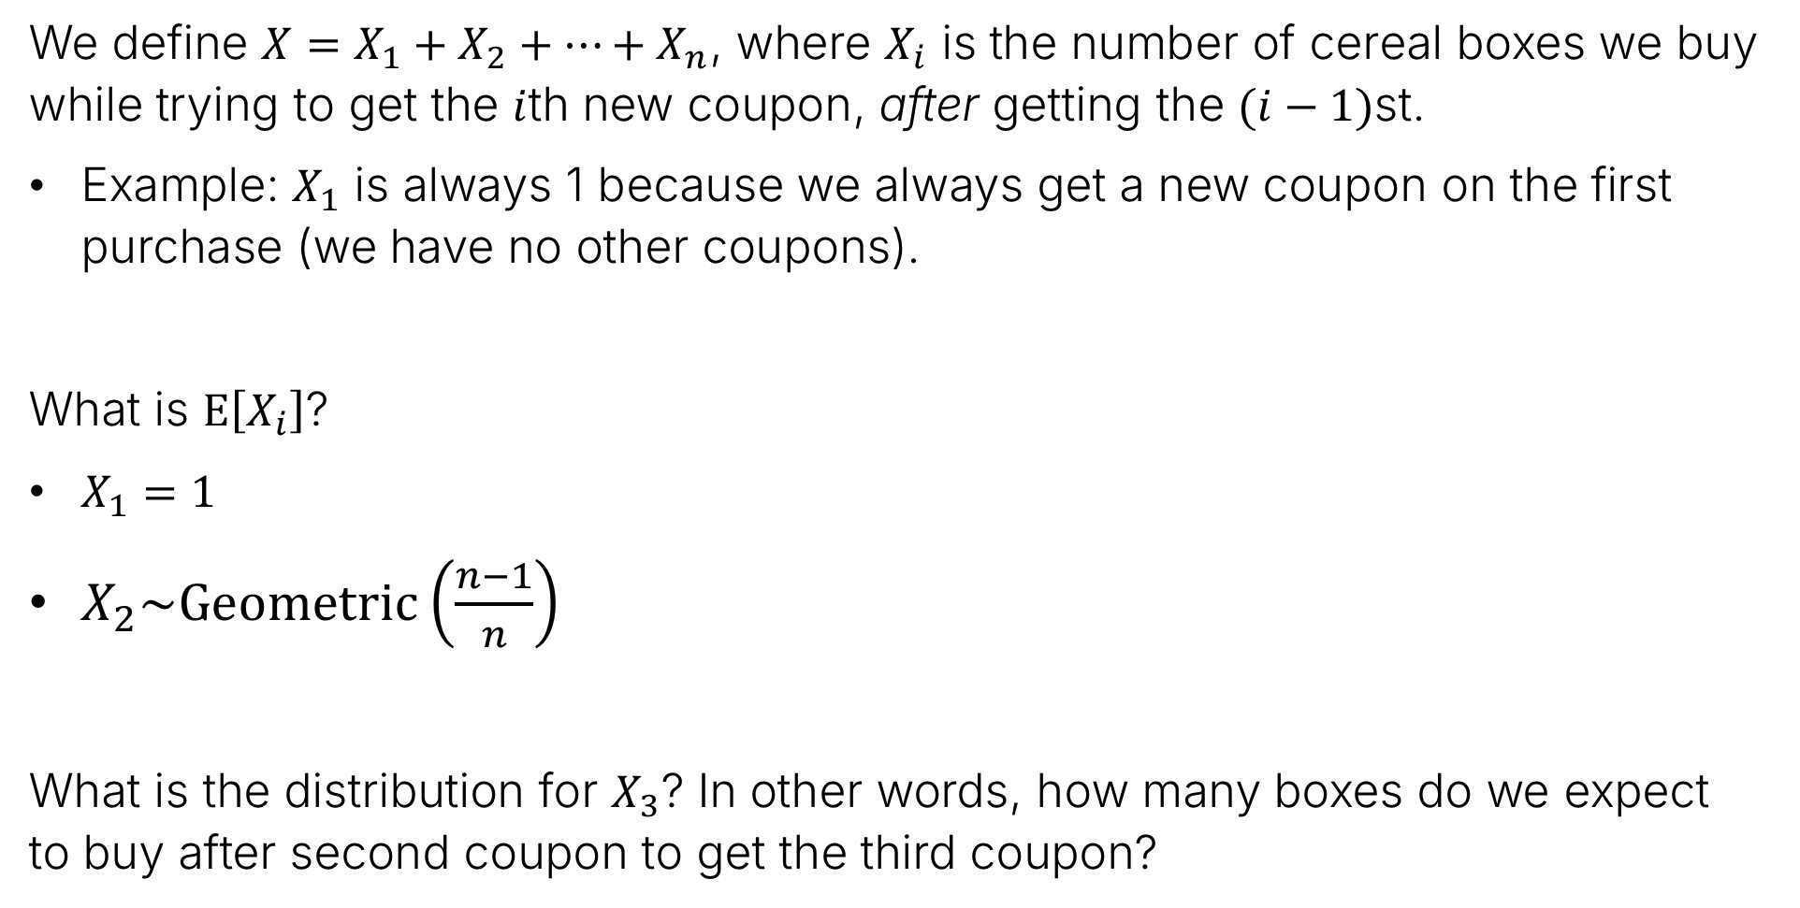
Expected Value
We define $X=X_{1}+X_{2}+…+X_{n}$, where $X_{i}$ is the number of cereal boxes we buy while trying to get the $i$th new coupon, after getting the $(i−1)$st.
Example: $X_{1}$ is always 1 because we always get a new coupon on the first purchase (we have no other coupons).
What is $E\left[X_{i}\right]$?
$X_{1}=1$
$X_{2}\sim Geometric\left(\frac{n−1}{n}\right)$
What is the distribution for $X_{3}$? In other words, how many boxes do we expect to buy after second coupon to get the third coupon?
$$⇒ E\left[X_{2}\right]=\frac{n}{n−1}$$

Slide 10
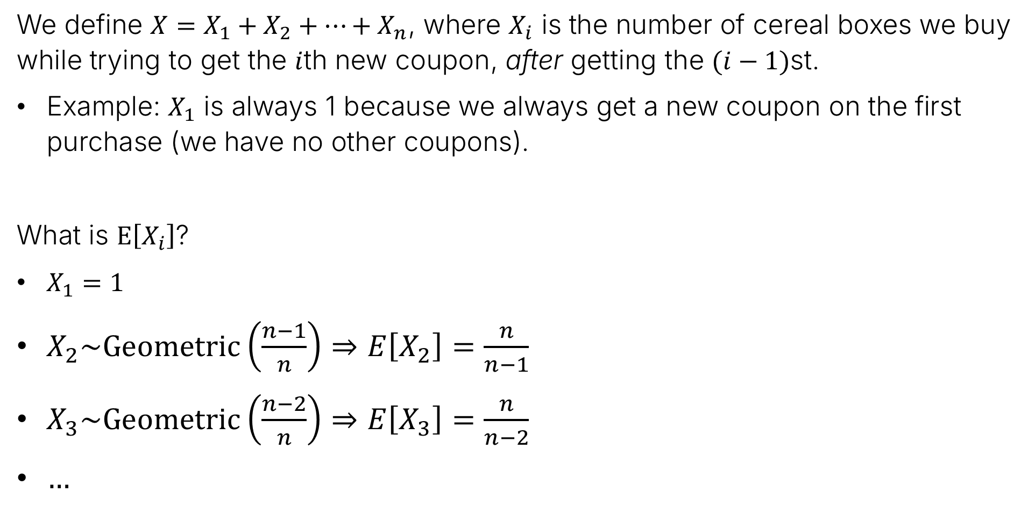
Expected Value
We define $X=X_{1}+X_{2}+…+X_{n}$, where $X_{i}$ is the number of cereal boxes we buy while trying to get the $i$th new coupon, after getting the $(i−1)$st.
Example: $X_{1}$ is always 1 because we always get a new coupon on the first purchase (we have no other coupons).
What is $E\left[X_{i}\right]$?
$X_{1}=1$
$X_{2}\sim Geometric\left(\frac{n−1}{n}\right)⇒E\left[X_{2}\right]=\frac{n}{n−1}$
$X_{3}\sim Geometric\left(\frac{n−2}{n}\right)⇒E\left[X_{3}\right]=\frac{n}{n−2}$
$…$

Slide 11
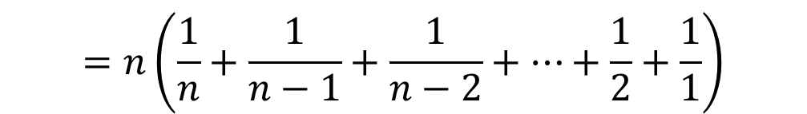

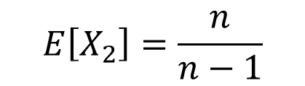

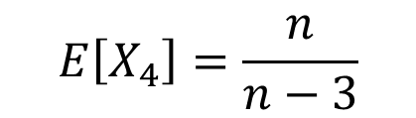
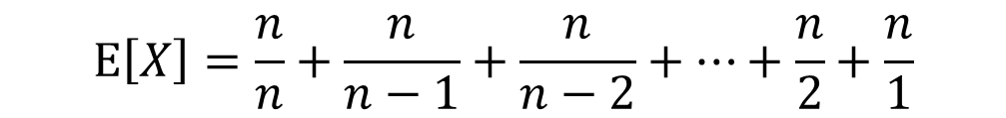
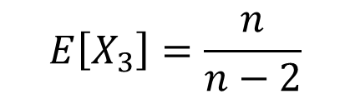
Expected Value
We define $X=X_{1}+X_{2}+…+X_{n}$, where $X_{i}$ is the number of cereal boxes we buy while trying to get the $i$th new coupon, after getting the $(i−1)$st.
$E\left[X\right]=E\left[X_{1}\right]+E\left[X_{2}\right]+E\left[X_{3}\right]+…+E\left[X_{n}\right]$
$$E\left[X_{1}\right]=1$$
$$E\left[X_{2}\right]=\frac{n}{n−1}$$
$$E\left[X_{3}\right]=\frac{n}{n−2}$$
$$E\left[X_{4}\right]=\frac{n}{n−3}$$
…
$$E\left[X\right]=\frac{n}{n}+\frac{n}{n−1}+\frac{n}{n−2}+…+\frac{n}{2}+\frac{n}{1}$$
$$=n\left(\frac{1}{n}+\frac{1}{n−1}+\frac{1}{n−2}+…+\frac{1}{2}+\frac{1}{1}\right)$$

Slide 12
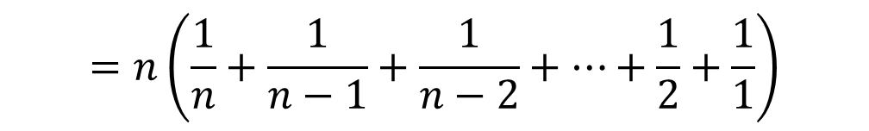
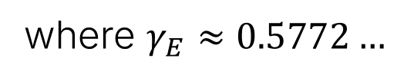
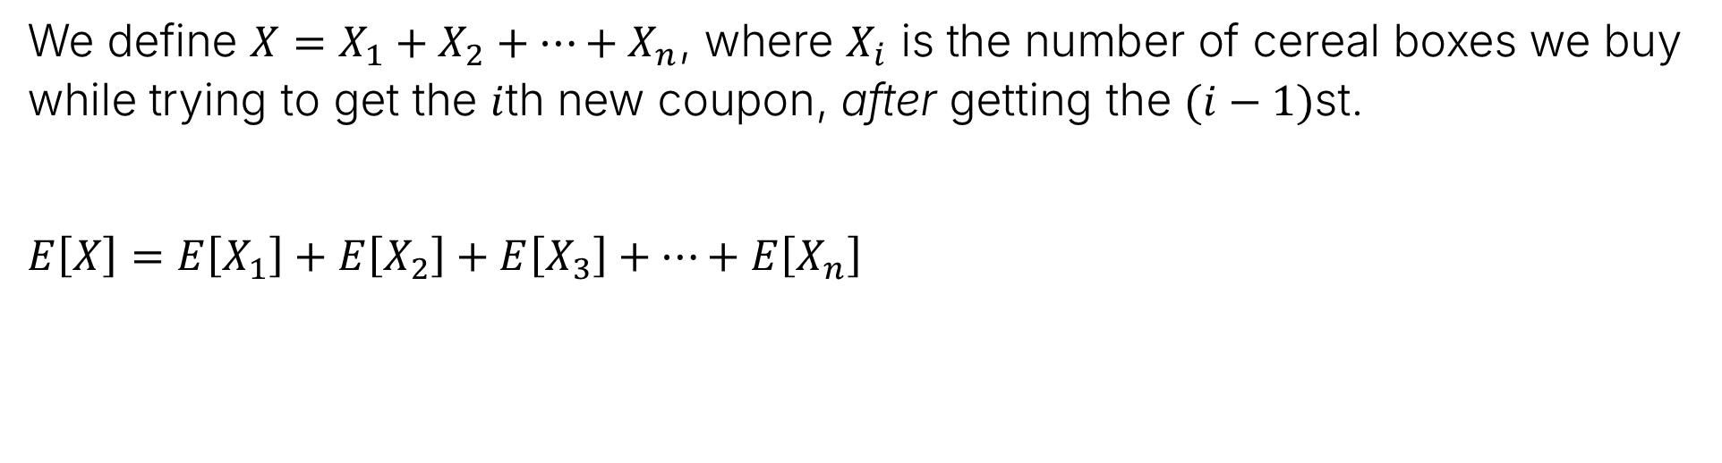

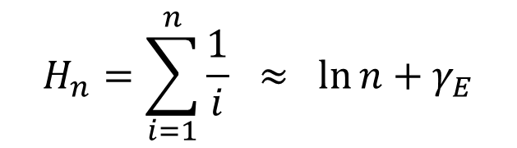

Expected Value
We define $X=X_{1}+X_{2}+…+X_{n}$, where $X_{i}$ is the number of cereal boxes we buy while trying to get the $i$th new coupon, after getting the $(i−1)$st.
$E\left[X\right]=E\left[X_{1}\right]+E\left[X_{2}\right]+E\left[X_{3}\right]+…+E\left[X_{n}\right]$
$$=n\left(\frac{1}{n}+\frac{1}{n−1}+\frac{1}{n−2}+…+\frac{1}{2}+\frac{1}{1}\right)$$
This is the $n$th “Harmonic Number”
$$H_{n}=\sum_{i=1}^{n}{\frac{1}{i}} ≈\ln{n+γ_{E}}$$
where $γ_{E}≈0.5772…$
The Euler–Mascheroni constant
... Yes, that Euler. He got around…
$$E\left[X\right]=nH_{n}≈n(\ln{n+γ_{E})}$$

Slide 13

Expected Value
We define $X=X_{1}+X_{2}+…+X_{n}$, where $X_{i}$ is the number of cereal boxes we buy while trying to get the $i$th new coupon, after getting the $(i−1)$st.
$$E\left[X\right]≈n(\ln{n+γ_{E})}$$
Example: $n=20$ gives us $≈20(\ln{20+0.5772)}≈71.5$

Slide 14


Union Bound Approximations and E[X] as Sum of Geometric RVs
Expected number of cereal boxes to get all coupons: $E\left[X\right]≈n(\ln{n+γ_{E})}≈71.5$
$$m_{50}=71.9$$
$$m_{36.79}≈79.9$$
P(72) ~ 50%
P(80) ~ 36.79%
P(67) ~ 50.1%
P(74) ~ 37.5%
For $n=20$ bins

Slide 15
Variance Derivation and Definition
Coupon Collector and Expectation
Variance
Derivation and Definition
Properties of Variance
Example Variance Calculations
Sums of Random Variables
Covariance
Covariance and Independence
Lecture 21, CS70 Summer 2025

Slide 16
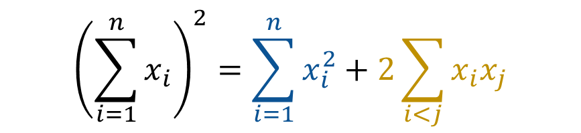

Before We Get Going
There’s a random math fact we’ll need later, namely that
Example: ${\left(500+a+b+c\right)}^{2}={500}^{2}+a^{2}+b^{2}+c^{2}$
$${\left(\sum_{i=1}^{n}{x_{i}}\right)}^{2}=\sum_{i=1}^{n}{x_{i}^{2}}+2\sum_{i<j}{x_{i}x_{j}}$$
$$+1000a+1000b+1000c+2ab+2ac+2bc$$

Slide 17
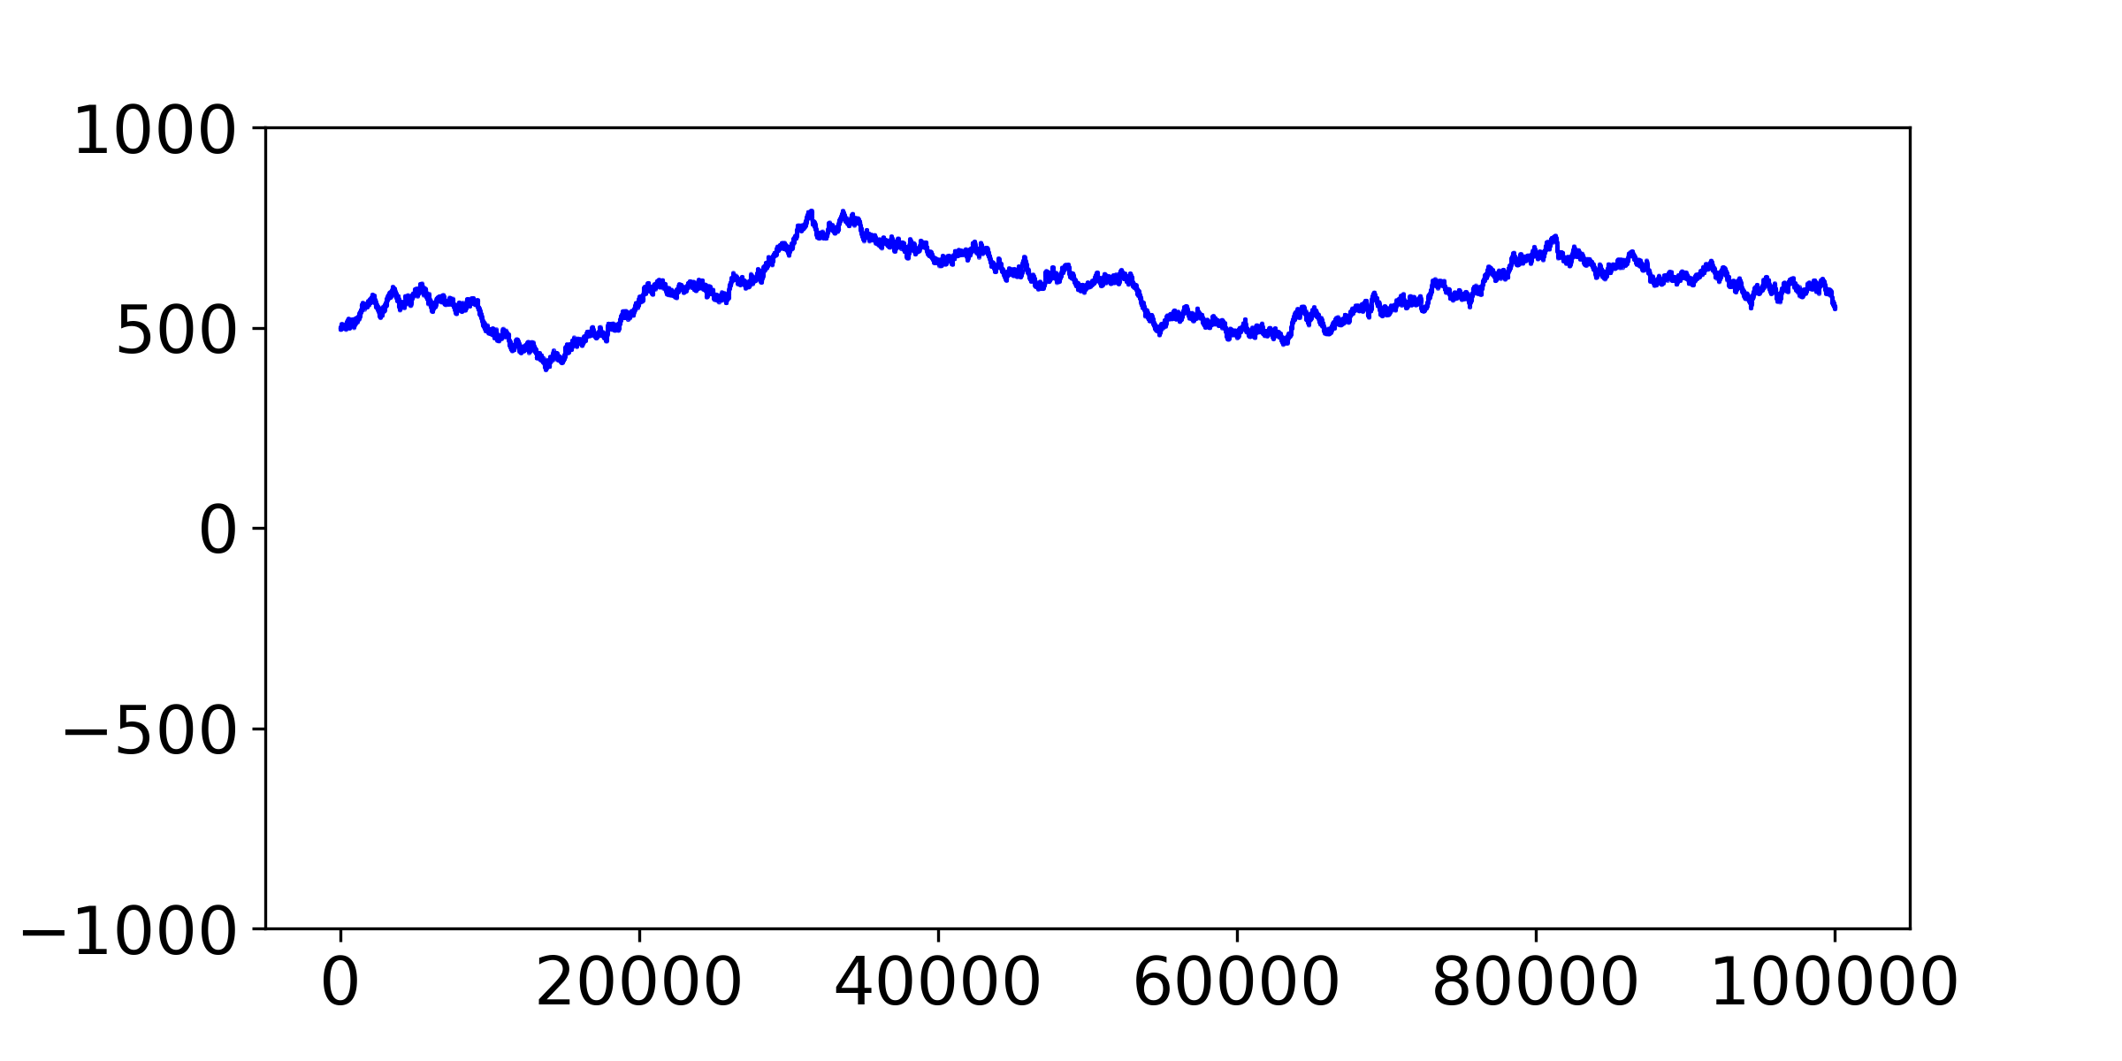
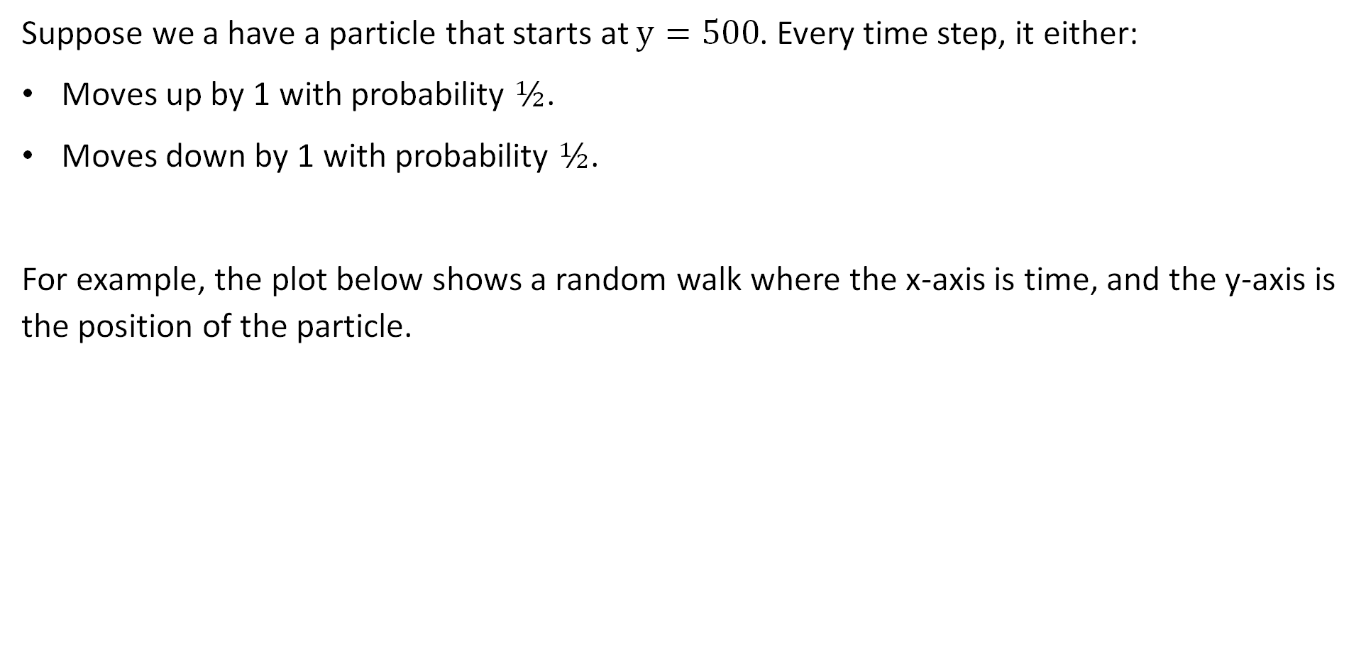
Motivation: Random Walks
Suppose we a have a particle that starts at $y=500$. Every time step, it either:
Moves up by 1 with probability $½$.
Moves down by 1 with probability $½$.
For example, the plot below shows a random walk where the x-axis is time, and the y-axis is the position of the particle.

Slide 18
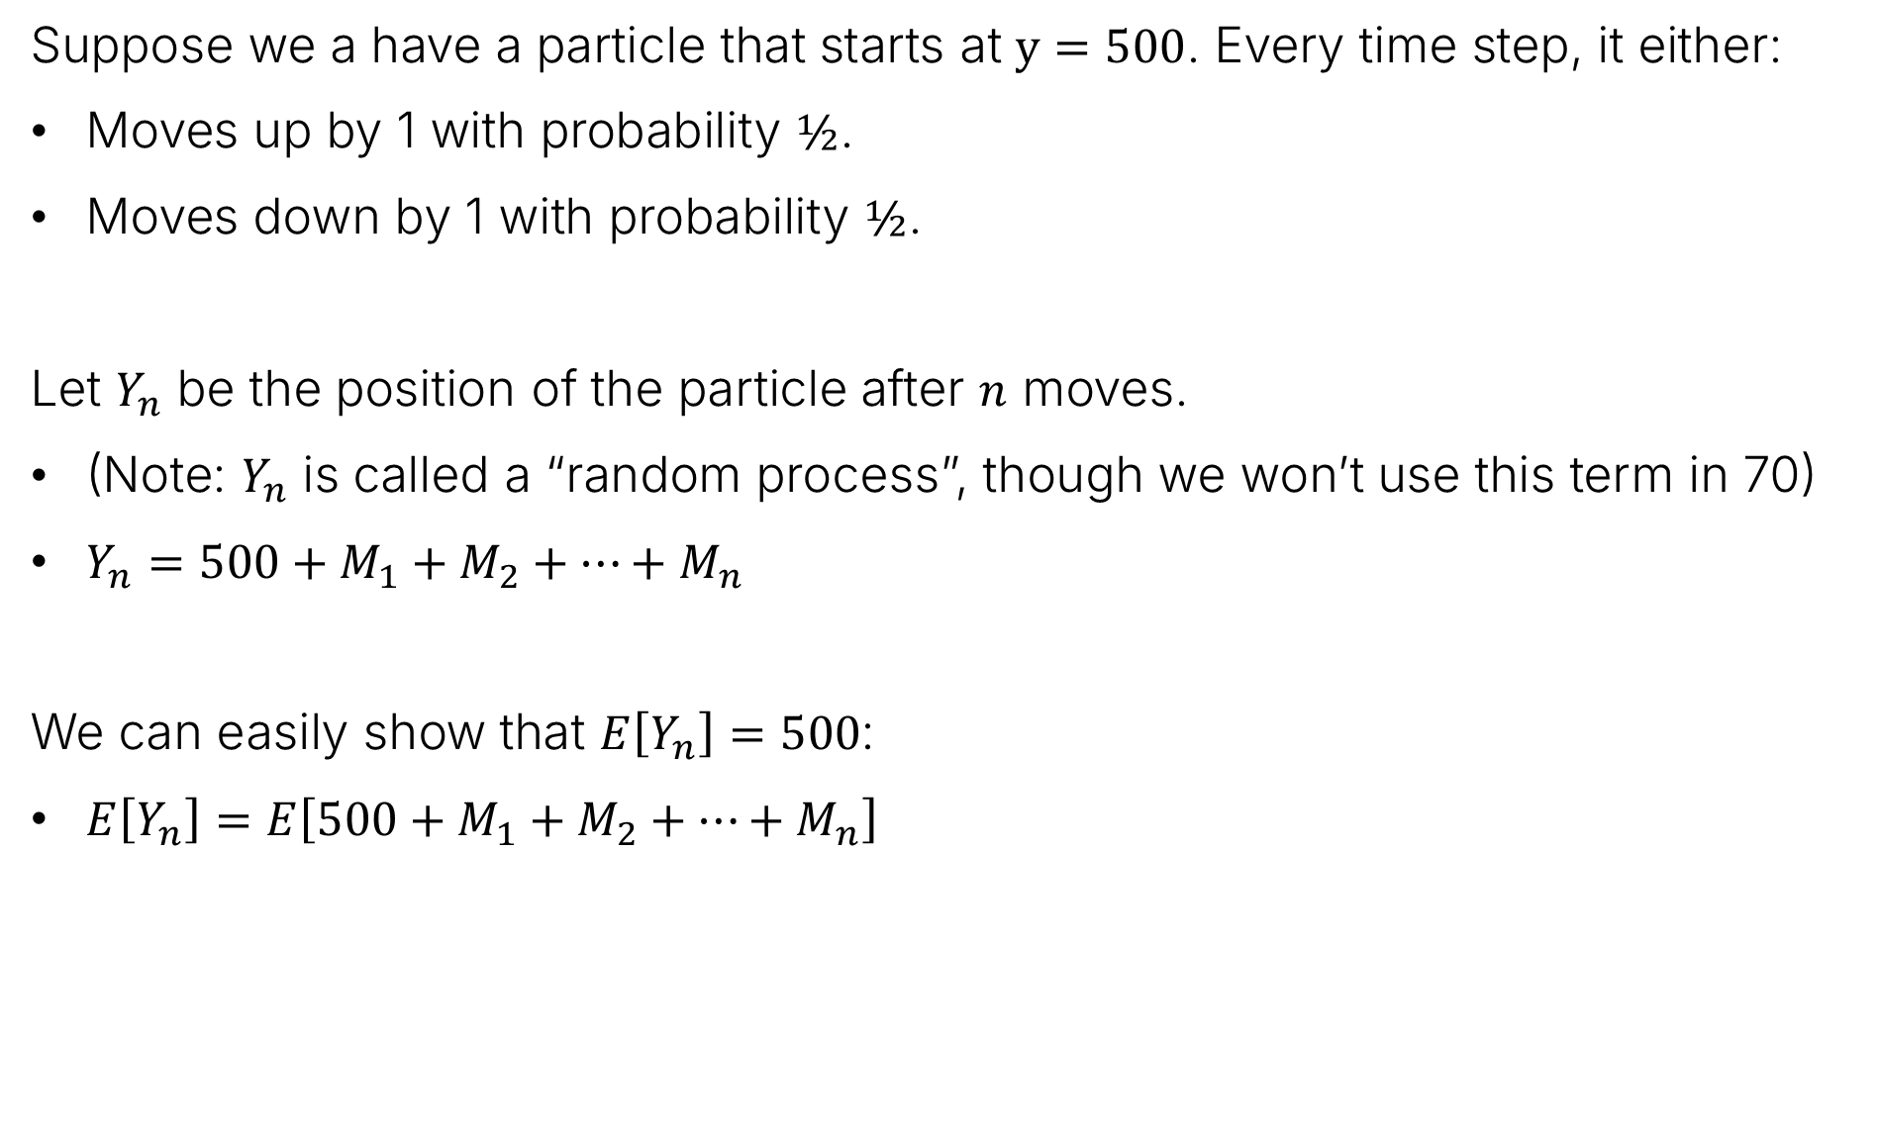
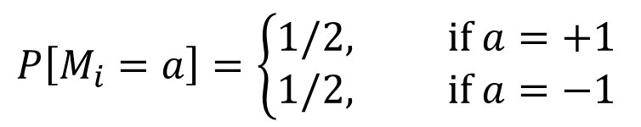


Motivation: Random Walks
Suppose we a have a particle that starts at $y=500$. Every time step, it either:
Moves up by 1 with probability $½$.
Moves down by 1 with probability $½$.
Let $Y_{n}$ be the position of the particle after $n$ moves.
(Note: $Y_{n}$ is called a “random process”, though we won’t use this term in 70)
$Y_{n}=500+M_{1}+M_{2}+…+M_{n}$
We can easily show that $E\left[Y_{n}\right]=500$:
$E\left[Y_{n}\right]=E\left[500+M_{1}+M_{2}+…+M_{n}\right]$
$$P\left[M_{i}=a\right]=\left\{\begin{aligned}1/2, if a=+1 \\ 1/2, if a=−1\end{aligned}\right.$$
$$=500+nE\left[M_{1}\right]$$
$$=500+n×0=500$$

Slide 19

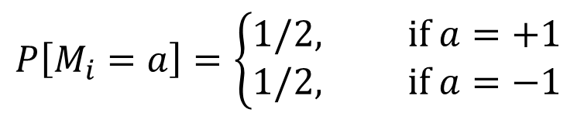
Motivation: Random Walks
Suppose we a have a particle that starts at $y=500$. Every time step, it either:
Moves up by 1 with probability $½$.
Moves down by 1 with probability $½$.
Let $Y_{n}$ be the position of the particle after $n$ moves. $E\left[Y_{n}\right]=500$.
$$P\left[M_{i}=a\right]=\left\{\begin{aligned}1/2, if a=+1 \\ 1/2, if a=−1\end{aligned}\right.$$

Slide 20
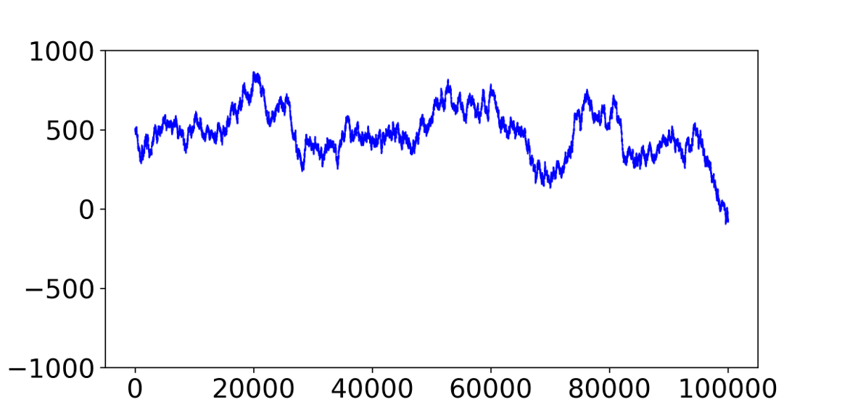

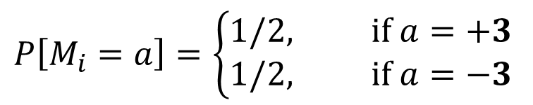
Motivation: Random Walks
Suppose we a have a particle that starts at $y=500$. Every time step, it either:
Moves up by 3 with probability $½$.
Moves down by 3 with probability $½$.
Let $Y_{n}$ be the position of the particle after $n$ moves. $E\left[Y_{n}\right]=500$.
$$P\left[M_{i}=a\right]=\left\{\begin{aligned}1/2, if a=+3 \\ 1/2, if a=−3\end{aligned}\right.$$

Slide 21

Motivation: Random Walks
Both of our random walks have an expected value of 500.
… but our random walk with a larger step size swings more widely.
If we only use the expectation to summarize the random variable, we completely miss this important difference.

Slide 22
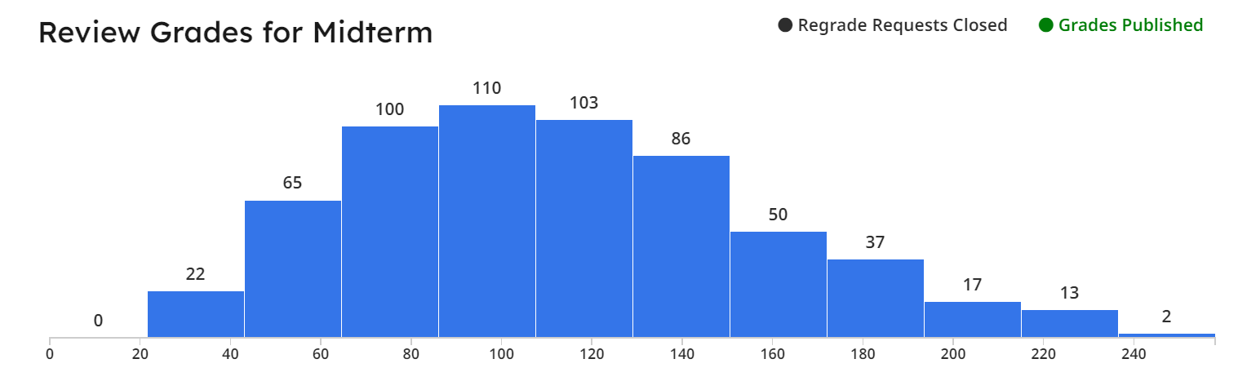
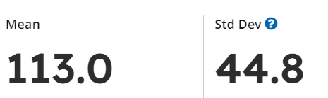
Measuring Dispersion
We’d like to measure the dispersion (or spread) of a distribution.
One summary statistic for dispersion is the standard deviation.
Warning: Easy to misinterpret this – a student taking an exam is not a r.v. or outcome
But selecting a random student’s grade out of the class is
Probability theory vs statistics…

Slide 23
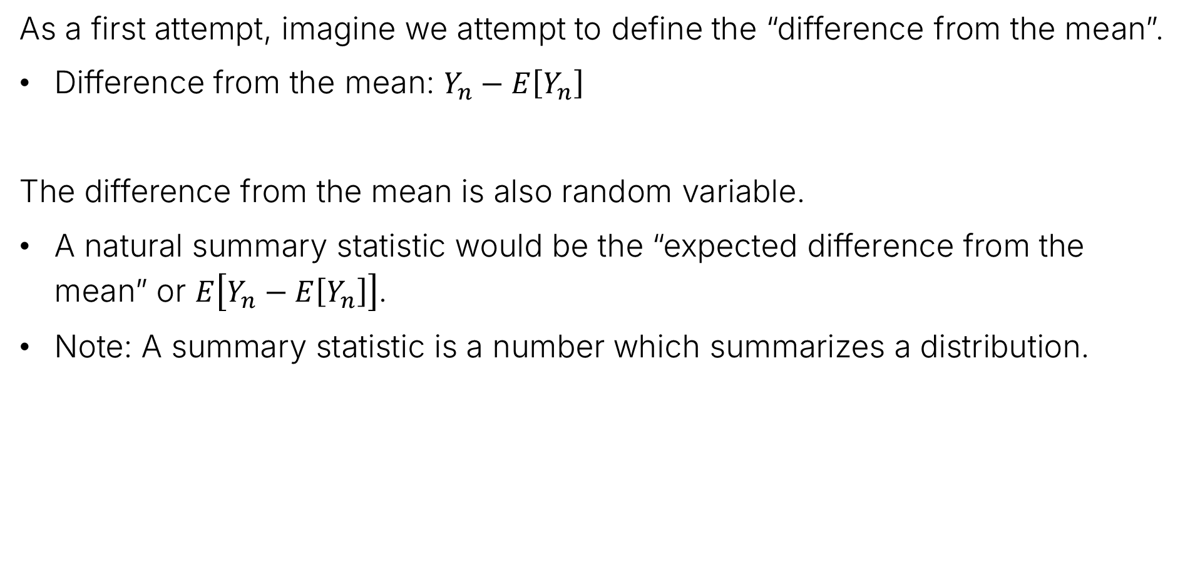
Attempt One: $E\left[Y_{n}−E\left[Y_{n}\right]\right]$
As a first attempt, imagine we attempt to define the “difference from the mean”.
Difference from the mean: $Y_{n}−E\left[Y_{n}\right]$
The difference from the mean is also random variable.
A natural summary statistic would be the “expected difference from the mean” or $E\left[Y_{n}−E\left[Y_{n}\right]\right]$.
Note: A summary statistic is a number which summarizes a distribution.

Slide 24
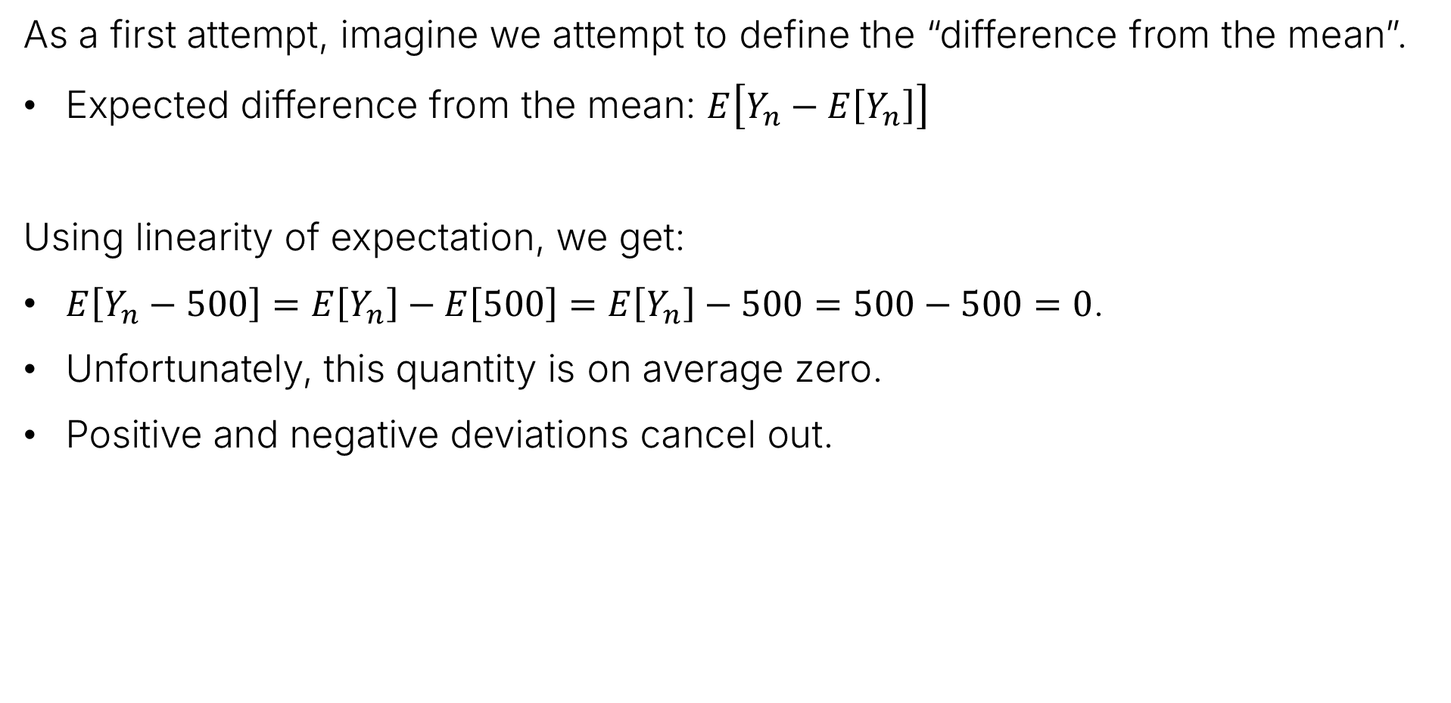
Attempt One: $E\left[Y_{n}−E\left[Y_{n}\right]\right]$
As a first attempt, imagine we attempt to define the “difference from the mean”.
Expected difference from the mean: $E\left[Y_{n}−E\left[Y_{n}\right]\right]$
Using linearity of expectation, we get:
$E\left[Y_{n}−500\right]=E\left[Y_{n}\right]−E\left[500\right]=E\left[Y_{n}\right]−500=500−500=0$.
Unfortunately, this quantity is on average zero.
Positive and negative deviations cancel out.

Slide 25
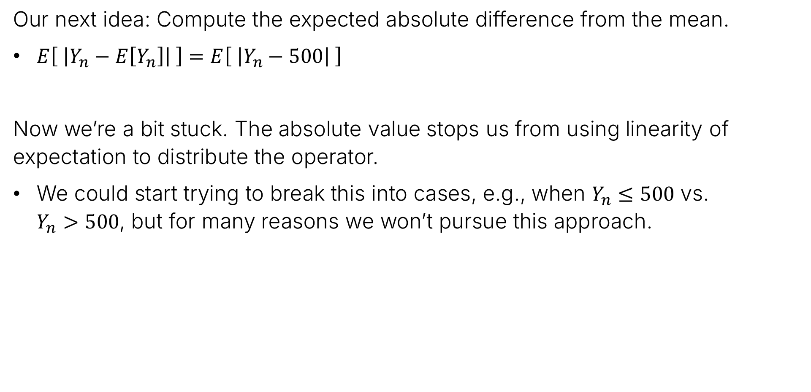
Attempt Two: $E\left[ \left|Y_{n}−E\left[Y_{n}\right]\right| \right]$
Our next idea: Compute the expected absolute difference from the mean.
$E\left[ \left|Y_{n}−E\left[Y_{n}\right]\right| \right]=E\left[ \left|Y_{n}−500\right| \right]$
Now we’re a bit stuck. The absolute value stops us from using linearity of expectation to distribute the operator.
We could start trying to break this into cases, e.g., when $Y_{n}≤500$ vs. $Y_{n}>500$, but for many reasons we won’t pursue this approach.

Slide 26

Attempt Three: $E\left[{\left(Y_{n}−E\left[Y_{n}\right]\right)}^{2}\right]$
An alternate way to convert the distance into a positive value is to square it.
That is, let’s compute the expected squared difference between $Y_{n}$ and $E\left[Y_{n}\right]$.
Using linearity of expectation, we can try to compute this quantity.
$E\left[{\left(Y_{n}−E\left[Y_{n}\right]\right)}^{2}\right]=E\left[{\left(Y_{n}−500\right)}^{2}\right]=E\left[Y_{n}^{2}−1000Y_{n}+250,000\right]$
$=E\left[Y_{n}^{2}\right]−1000E\left[Y_{n}\right]+250,000$
Need to compute this somehow.
$$=E\left[Y_{n}^{2}\right]−500,000+250,000=E\left[Y_{n}^{2}\right]−250,000$$

Slide 27



Attempt Three: $E\left[{\left(Y_{n}−E\left[Y_{n}\right]\right)}^{2}\right]$
Using linearity of expectation, compute expected squared difference from mean.
$E\left[{\left(Y_{n}−E\left[Y_{n}\right]\right)}^{2}\right]=E\left[Y_{n}^{2}\right]−250,000$
To compute $E\left[Y_{n}^{2}\right]$, we can write $E\left[Y_{n}^{2}\right]=E\left[{\left({500+M}_{1}+M_{2}+…+M_{n}\right)}^{2}\right]$
$=E[{500}^{2}+M_{1}^{2}+M_{2}^{2}+…M_{n}^{2}$
$$+1000M_{1}+1000M_{2}+…+1000M_{n}$$
Need to compute these
$${+2M}_{1}M_{2}+…+2M_{n−1}M_{n}]$$

Slide 28
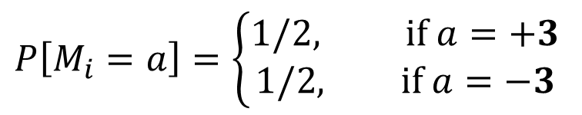

Math Interlude
What are $E\left[M_{1}^{2}\right]$, $E\left[M_{1}\right]$, and $E\left[M_{1}M_{2}\right]$?
$$P\left[M_{i}=a\right]=\left\{\begin{aligned}1/2, if a=+3 \\ 1/2, if a=−3\end{aligned}\right.$$

Slide 29
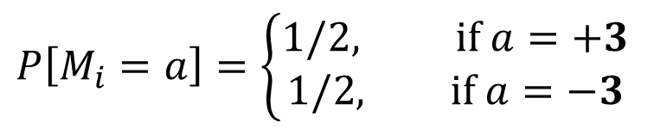
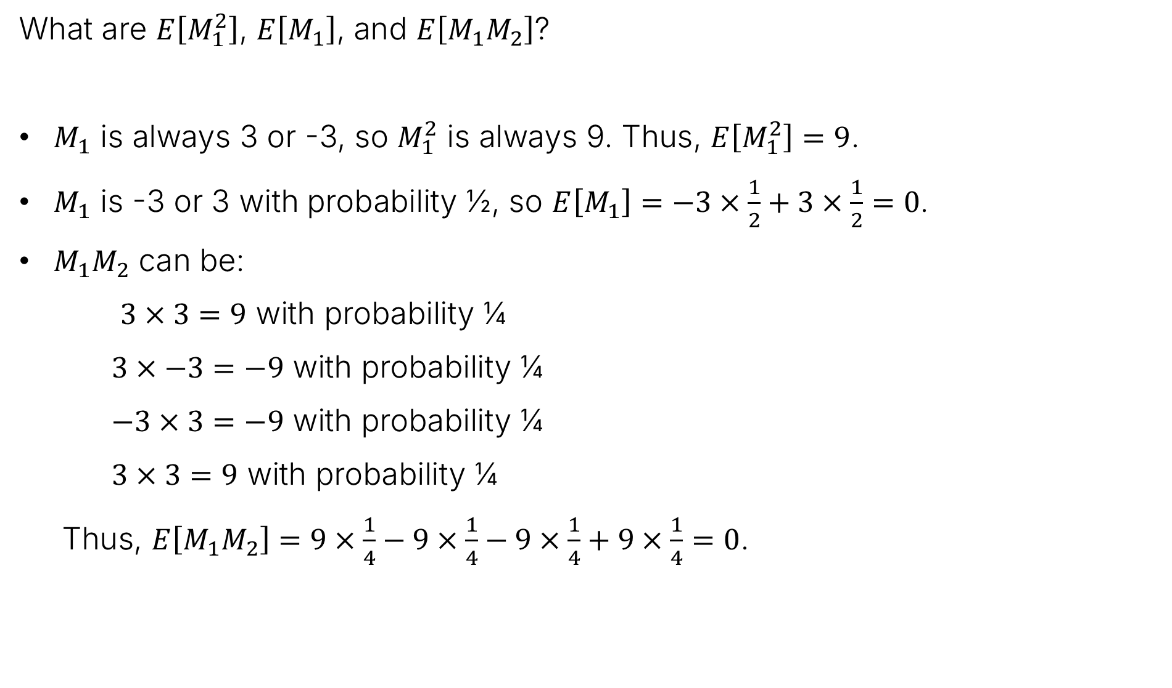
Math Interlude
What are $E\left[M_{1}^{2}\right]$, $E\left[M_{1}\right]$, and $E\left[M_{1}M_{2}\right]$?
$M_{1}$ is always 3 or -3, so $M_{1}^{2}$ is always 9. Thus, $E\left[M_{1}^{2}\right]=9$.
$M_{1}$ is -3 or 3 with probability ½, so $E\left[M_{1}\right]=−3×\frac{1}{2}+3×\frac{1}{2}=0$.
$M_{1}M_{2}$ can be:
$3×3=9$ with probability ¼
$3×−3=−9$ with probability ¼
$−3×3=−9$ with probability ¼
$3×3=9$ with probability ¼
Thus, $E\left[M_{1}M_{2}\right]=9×\frac{1}{4}−9×\frac{1}{4}−9×\frac{1}{4}+9×\frac{1}{4}=0$.
$$P\left[M_{i}=a\right]=\left\{\begin{aligned}1/2, if a=+3 \\ 1/2, if a=−3\end{aligned}\right.$$

Slide 30





Attempt Three: $E\left[{\left(Y_{n}−E\left[Y_{n}\right]\right)}^{2}\right]$
Using linearity of expectation, we can try to compute this quantity.
$E\left[{\left(Y_{n}−E\left[Y_{n}\right]\right)}^{2}\right]=E\left[Y_{n}^{2}\right]−250,000$
To compute $E\left[Y_{n}^{2}\right]$, we can write $E\left[Y_{n}^{2}\right]=E\left[{\left({500+M}_{1}+M_{2}+…+M_{n}\right)}^{2}\right]$
$=E[{500}^{2}+M_{1}^{2}+M_{2}^{2}+…M_{n}^{2}$
$$E\left[M_{i}^{2}\right]=9$$
$$+1000M_{1}+1000M_{2}+…+1000M_{n}$$
$$E\left[M_{i}\right]=0$$
$${+2M}_{1}M_{2}+…+2M_{n−1}M_{n}]$$
$$E\left[M_{i}M_{j}\right]=0$$
$$=250,000+9n$$

Slide 31


Attempt Three: $E\left[{\left(Y_{n}−E\left[Y_{n}\right]\right)}^{2}\right]$
An alternate way to convert the distance into a positive value is to square it.
That is, let’s compute the expected squared difference between $Y_{n}$ and $E\left[Y_{n}\right]$.
Using linearity of expectation, we can try to compute this quantity.
$E\left[{\left(Y_{n}−E\left[Y_{n}\right]\right)}^{2}\right]=E\left[{\left(Y_{n}−500\right)}^{2}\right]=E\left[Y_{n}^{2}−1000Y_{n}+250,000\right]$
$=E\left[Y_{n}^{2}\right]−1000E\left[Y_{n}\right]+250,000$
Took some deeper thought. This is $250,000+9n$
$$=E\left[Y_{n}^{2}\right]−500,000+250,000=E\left[Y_{n}^{2}\right]−250,000$$
$$=250,000+9n−250,000$$
$$=9n$$

Slide 32
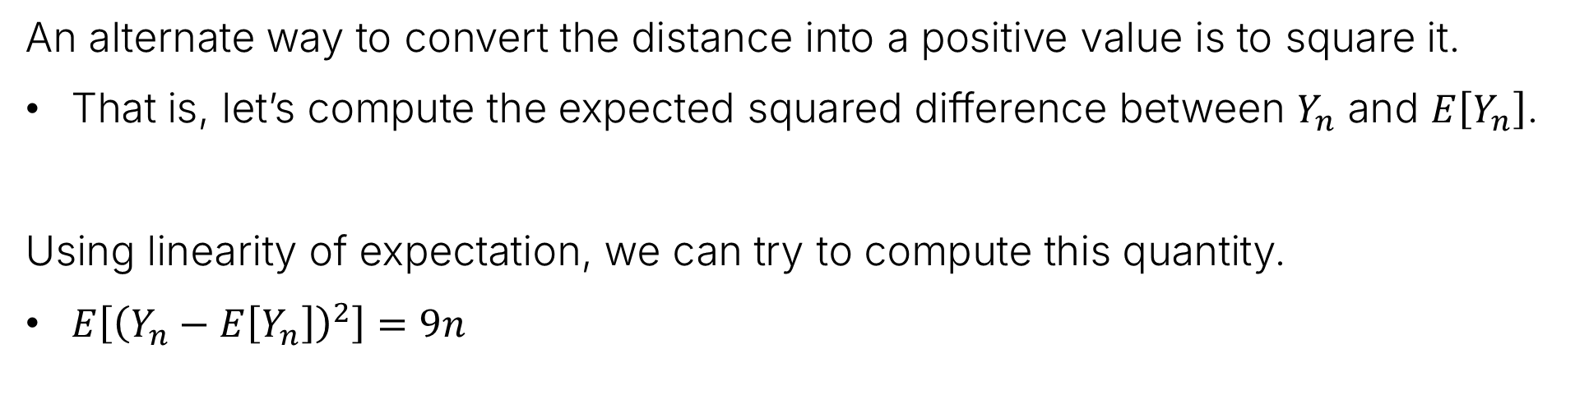
Attempt Three: $E\left[{\left(Y_{n}−E\left[Y_{n}\right]\right)}^{2}\right]$
An alternate way to convert the distance into a positive value is to square it.
That is, let’s compute the expected squared difference between $Y_{n}$ and $E\left[Y_{n}\right]$.
Using linearity of expectation, we can try to compute this quantity.
$E\left[{\left(Y_{n}−E\left[Y_{n}\right]\right)}^{2}\right]=9n$
That is, on average, we can expect that by time step $n$, the squared distance of the particle from 500 will be around $9n$.
We called this the “expected squared difference from the mean”.
This quantity is commonly known as the “variance” of the random variable.

Slide 33

Variance
The variance of a random variable $X$ is defined as:
$$Var\left(X\right)=E\left[{\left(X−E\left[X\right]\right)}^{2}\right]$$
Note, we sometimes use $μ=E\left[X\right]$ to avoid messy nested brackets, i.e.,
$$Var\left(X\right)=E\left[{\left(X−μ\right)}^{2}\right]$$

Slide 34
Properties of Variance
Coupon Collector and Expectation
Variance
Derivation and Definition
Properties of Variance
Example Variance Calculations
Sums of Random Variables
Covariance
Covariance and Independence
Lecture 21, CS70 Summer 2025

Slide 35

Variance Property 1
Variance is defined as $Var\left(X\right)=E\left[{\left(X−E\left[X\right]\right)}^{2}\right]$
Useful Property 1: Can write variance as: $Var\left(X\right)=E\left[X^{2}\right]−E{\left[X\right]}^{2}$
Proof: Let $μ=E\left[X\right]$, then $Var\left(X\right)=E\left[{\left(X−μ\right)}^{2}\right]$
$$=E[X^{2}−2Xμ+μ^{2}]$$
$$=E\left[X^{2}\right]−2μE\left[X\right]+{E[μ}^{2}]$$
$$=E\left[X^{2}\right]−2μ^{2}+μ^{2}$$
$$=E\left[X^{2}\right]−μ^{2}$$
$$=E\left[X^{2}\right]−E{\left[X\right]}^{2}$$

Slide 36

Variance Property 2
Suppose we have a random variable $X$ whose variance is $Var\left(X\right)$. Then $Var\left(cX\right)=c^{2}Var(x)$.
Proof:$Var\left(cX\right)=E\left[{\left(cX\right)}^{2}\right]−(E{\left[cX\right])}^{2}$ (by useful property 1)
$$=E\left[{\left(cX\right)}^{2}\right]−{\left(cE\left[X\right]\right)}^{2}$$
$$=E\left[{\left(cX\right)}^{2}\right]−c^{2}E{\left[X\right]}^{2}$$
$$=E\left[c^{2}X^{2}\right]−c^{2}E{\left[X\right]}^{2}$$
$$=c^{2}E\left[X^{2}\right]−c^{2}E{\left[X\right]}^{2}$$
$$=c^{2}Var(X)$$

Slide 37

Variance Property 3
Suppose we have a random variable $X$ whose variance is $Var\left(X\right)$. Then $Var\left(c+X\right)=Var(X)$.
Proof:$Var\left(c+X\right)$
$=E\left[{\left(c+X−E\left[c+X\right]\right)}^{2}\right]$ (by basic definition)
$$=E\left[{\left(c+X−E\left[c]−E[X\right]\right)}^{2}\right]$$
$$=E\left[{\left(c+X−c−E\left[X\right]\right)}^{2}\right]$$
$$=E\left[{\left(X−E\left[X\right]\right)}^{2}\right]$$
$$=Var(X)$$
Recall basic definition: $Var\left(X\right)=E\left[{\left(X−E\left[X\right]\right)}^{2}\right]$
Notes:
$=𝔼\left[{\left(c+X−𝔼\left[c+X\right]\right)}^{2}\right]$ (by basic definition)

Slide 38
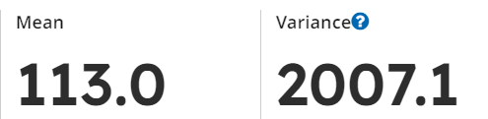

Variance and Standard Deviation
Variance is not in the same units as the original random variable.
Example: If $X$ is a midterm score for a randomly selected student, then $Var(X)$ is given in points squared.
The most natural correction is just to compute the square root of the variance. This is called the standard deviation (stdev for short).
Variance of 2007.1 points squared: less intuitive than stdev of 44.8 points.
Often use $σ$ as symbol for stdev
Warning again: data-driven (statistics) vs model-driven (probability theory) is different. Statistics has population variance, sample variance (biased and unbiased), … not as “clean” as probability.

Slide 39

Useful Properties So Far
Basic definition of variance: $Var\left(X\right)=E\left[{\left(X−E\left[X\right]\right)}^{2}\right]$
Useful property 1: Can rewrite as $Var\left(X\right)=E\left[X^{2}\right]−E{\left[X\right]}^{2}$
Useful property 2: $Var\left(cX\right)=c^{2}Var(X)$
Useful property 3: $Var\left(c+X\right)=Var(X)$
Units of variance are squared units of $X$. Can use square root of variance (standard deviation) instead.

Slide 40
Example Variance Calculations
Coupon Collector and Expectation
Variance
Derivation and Definition
Properties of Variance
Example Variance Calculations
Sums of Random Variables
Covariance
Covariance and Independence
Lecture 21, CS70 Summer 2025

Slide 41

Computing the Variance of a Random Variable
When computing the variance of a random variable $X$, we need two quantities:
The expectation $E\left[X\right]$.
The expectation of $X^{2}$, i.e., $E\left[X^{2}\right]$
Often, but not always, $E\left[X^{2}\right]$ requires some cleverness to compute.

Slide 42

Example 1: Bernoulli RV
Suppose $X\sim Bernoulli(p)$. Recall that $E\left[X\right]=p$.
Then $Var\left(X\right)=E\left[X^{2}\right]−E{\left[X\right]}^{2}$
Since $X$ is always 0 or 1, we have that $X^{2}=X$, therefore $E\left[X^{2}\right]=E\left[X\right]=p$.
The variance is therefore $Var\left(X\right)=p−E{\left[X\right]}^{2}=p−p^{2}$
Often this is written in the form $p\left(1−p\right)$
Observation, if we pick $p=1$ (always heads), then the variance is 0.
This makes sense! If the RV isn’t actually random, there should be no variance.
Similarly, if $p$ is close to 0 or 1, the variance is low, usually get same flip.

Slide 43



Example 2: Rolling a Fair Six-Sided Die
Recall that if $X$ is the result of rolling a fair six-sided die, we have that $E\left[X\right]=7/2$.
To compute variance, we just need $E\left[X^{2}\right]$. This is straightforward:
$$E\left[X^{2}\right]=\frac{1}{6}×1^{2}+\frac{1}{6}×2^{2}+\frac{1}{6}×3^{2}+\frac{1}{6}×4^{2}+\frac{1}{6}×5^{2}+\frac{1}{6}×6^{2}$$
$$=\frac{1}{6}×\left(1^{2}+2^{2}+3^{2}+4^{2}+5^{2}+6^{2}\right)$$
$$=\frac{91}{6}$$

Slide 44



Example 2: Rolling a Fair Six-Sided Die
Recall that if $X$ is the result of rolling a fair six-sided die, we have that $E\left[X\right]=7/2$. We also just computed $E\left[X^{2}\right]=91/6$
The variance of a six-sided die roll is given by $Var\left(x\right)=E\left[X^{2}\right]−E{\left[X\right]}^{2}$
We’ll use this result later today for multiple rolls.
$$=\frac{91}{6}−{\left(\frac{7}{2}\right)}^{2}$$
$$=\frac{35}{12}≈2.92$$

Slide 45

Example 3: Fixed Points of Permutation
Let $X_{n}$ be the number of students who receive their own homework if we take homeworks from every student and hand them back randomly.
Earlier we showed that $E\left[X_{n}\right]=1$.
How dispersed is this? Do we expect to sometimes get $X_{n}=10$, $X_{n}=20$?
As before let $X_{n}=I_{1}+I_{2}+…+I_{n}$, where $I_{i}$ means student $i$ got their homework back.
To compute variance, we already have $E\left[X_{n}\right]$. We just need $E\left[X_{n}^{2}\right]$.

Slide 46






Example 3: Fixed Points of Permutation
$X_{n}=I_{1}+I_{2}+…+I_{n}$, where $I_{i}$ means student $i$ got their homework back.
We need $E\left[X_{n}^{2}\right]$. To get this, we compute $E\left[X_{n}^{2}\right]=E\left[{\left(I_{1}+I_{2}+…+I_{n}\right)}^{2}\right]$. Using the same formula from before, we have that:
What is $E\left[I_{i}^{2}\right]$?
$$E\left[X_{n}^{2}\right]=E\left[{\left(I_{1}+I_{2}+…+I_{n}\right)}^{2}\right]=\sum_{i=1}^{n}{E[I_{i}^{2}]}+2\sum_{i<j}{E\left[I_{i}I_{j}\right]}$$
$$P\left(I_{i}^{2}=1\right)=P\left(I_{i}=1\right)=\frac{1}{n}$$
$$\sum_{i=1}^{n}{E[I_{i}^{2}]}=1$$
$$E\left[I_{i}^{2}\right]=\frac{1}{n}×1=\frac{1}{n} ⟹$$
$$P\left(I_{i}^{2}=0\right)=P\left(I_{i}=0\right)=\frac{n−1}{n}$$

Slide 47


Example 3: Fixed Points of Permutation
$X_{n}=I_{1}+I_{2}+…+I_{n}$, where $I_{i}$ means student $i$ got their homework back.
We need $E\left[X_{n}^{2}\right]$. To get this, we compute $E\left[X_{n}^{2}\right]=E\left[{\left(I_{1}+I_{2}+…+I_{n}\right)}^{2}\right]$. Using the same formula from before, we have that:
What is $E\left[I_{i}I_{j}\right]$?
$$E\left[X_{n}^{2}\right]=E\left[{\left(I_{1}+I_{2}+…+I_{n}\right)}^{2}\right]=1+2\sum_{i<j}{E\left[I_{i}I_{j}\right]}$$

Slide 48

Example 3: Fixed Points of Permutation
$X_{n}=I_{1}+I_{2}+…+I_{n}$, where $I_{i}$ means student $i$ got their homework back.
We need $E\left[X_{n}^{2}\right]$. To get this, we compute $E\left[X_{n}^{2}\right]=E\left[{\left(I_{1}+I_{2}+…+I_{n}\right)}^{2}\right]$. Using the same formula from before, we have that:
But only one of these terms is non-zero: $1×1×P\left(I_{i}=1, I_{j}=1\right)$
$$E\left[X_{n}^{2}\right]=E\left[{\left(I_{1}+I_{2}+…+I_{n}\right)}^{2}\right]=1+2\sum_{i<j}{E\left[I_{i}I_{j}\right]}$$
$$E\left[I_{i}I_{j}\right]=0×0×P\left(I_{i}=0, I_{j}=0\right)+0×1×P\left(I_{i}=0, I_{j}=1\right)+$$
$$+1×0×P\left(I_{i}=1, I_{j}=0\right)+1×1×P\left(I_{i}=1, I_{j}=1\right)$$

Slide 49




Example 3: Fixed Points of Permutation
$X_{n}=I_{1}+I_{2}+…+I_{n}$, where $I_{i}$ means student $i$ got their homework back.
We need $E\left[X_{n}^{2}\right]$. To get this, we compute $E\left[X_{n}^{2}\right]=E\left[{\left(I_{1}+I_{2}+…+I_{n}\right)}^{2}\right]$. Using the same formula from before, we have that:
$I_{i}$ and $I_{j}$ are indicators, so for the non-zero term:
$$E\left[X_{n}^{2}\right]=E\left[{\left(I_{1}+I_{2}+…+I_{n}\right)}^{2}\right]=1+2\sum_{i<j}{E\left[I_{i}I_{j}\right]}$$
$$E\left[I_{i}I_{j}\right]$$
$$=1×1×P\left(I_{i}=1, I_{j}=1\right)$$
$$=P\left(i and j get their own homework back\right)$$
$$=\frac{\left(n−2\right)!}{n!} = \frac{1}{n(n−1)}$$

Slide 50


Example 3: Fixed Points of Permutation
$X_{n}=I_{1}+I_{2}+…+I_{n}$, where $I_{i}$ means student $i$ got their homework back.
We need $E\left[X_{n}^{2}\right]$. To get this, we compute $E\left[X_{n}^{2}\right]=E\left[{\left(I_{1}+I_{2}+…+I_{n}\right)}^{2}\right]$. Using the same formula from before, we have that:
$I_{i}$ and $I_{j}$ are indicators, so for the non-zero term :
$$E\left[X_{n}^{2}\right]=E\left[{\left(I_{1}+I_{2}+…+I_{n}\right)}^{2}\right]=1+2\sum_{i<j}{\frac{1}{n(n−1)}}$$
$$E\left[I_{i}I_{j}\right]$$
$$=1×1×P\left(I_{i}=1, I_{j}=1\right)$$
$$=P\left(i and j get their own homework back\right)$$
$$=\frac{\left(n−2\right)!}{n!} = \frac{1}{n(n−1)}$$

Slide 51





Example 3: Fixed Points of Permutation
$X_{n}=I_{1}+I_{2}+…+I_{n}$, where $I_{i}$ means student $i$ got their homework back.
We need $E\left[X_{n}^{2}\right]$. To get this, we compute $E\left[X_{n}^{2}\right]=E\left[{\left(I_{1}+I_{2}+…+I_{n}\right)}^{2}\right]$. Using the same formula from before, we have that:
What is $2\sum_{i<j}{\frac{1}{n\left(n−1\right)}}$? There are $\left({n \atop 2}\right)$ pairs $\{i,j\}$, each with one ordering $i<j$, so
$$E\left[X_{n}^{2}\right]=E\left[{\left(I_{1}+I_{2}+…+I_{n}\right)}^{2}\right]=1+2\sum_{i<j}{\frac{1}{n\left(n−1\right)}}$$
$$2\sum_{i<j}{\frac{1}{n\left(n−1\right)}}=2\left({n \atop 2}\right)×\frac{1}{n(n−1)}$$
$$=2\frac{n\left(n−1\right)}{2}×\frac{1}{n(n−1)}$$
$$=1$$

Slide 52

Example 3: Fixed Points of Permutation
$X_{n}=I_{1}+I_{2}+…+I_{n}$, where $I_{i}$ means student $i$ got their homework back.
We need $E\left[X_{n}^{2}\right]$. To get this, we compute $E\left[X_{n}^{2}\right]=E\left[{\left(I_{1}+I_{2}+…+I_{n}\right)}^{2}\right]$. Using the same formula from before, we have that:
After all that work, we’ve learned that $E\left[X_{n}^{2}\right]=2$
$$E\left[X_{n}^{2}\right]=E\left[{\left(I_{1}+I_{2}+…+I_{n}\right)}^{2}\right]=1+1=2$$

Slide 53


Example 3: Fixed Points of Permutation
Let $X_{n}$ be the number of students who receive their own homework if we take homeworks from every student and hand them back randomly.
Last time we showed that $E\left[X_{n}\right]=1$.
How dispersed is this? Do we expect to sometimes get $X_{n}=10$, $X_{n}=20$?
To compute variance, we know $E\left[X_{n}\right]=1$. We now know $E\left[X_{n}^{2}\right]=2$.
What is $Var\left(X_{n}\right)$?
$$Var\left(X_{n}\right)=E\left[X_{n}^{2}\right]−E{\left[X_{n}\right]}^{2}$$
$=2−1$
$=1$

Slide 54

Example 3: Fixed Points of Permutation
Let $X_{n}$ be the number of students who receive their own homework if we take homeworks from every student and hand them back randomly.
Last time we showed that $E\left[X_{n}\right]=1$.
And we also know that $Var\left(X_{n}\right)=1$.
How dispersed is this? Do we expect to sometimes get $X_{n}=10$, $X_{n}=20$?
We don’t expect to get a value near 10, no matter how big $n$gets.
On average, the number of students who gets their homework back is 1.
And the variance (and standard deviation) is 1.
If we were to run a bunch of experiments, the average difference from our observation and the mean (1) would be 1.

Slide 55


Example(s) 4: Geometric and Poisson Random Variables
If $X\sim Geometric(p)$, then $Var(X)$ is given
If $X\sim Poisson(λ)$, then $Var\left(X\right)=λ$
The proofs are in the notes – study them there!
The proof for geometric is especially worth going through. Uses a super-cool calculus trick…
$Var\left(X\right)=\frac{1−p}{p^{2}}$

Slide 56

Quick Note
The notes also discuss the uniform distribution.
$$X\sim Uniform\left(n\right)$$
Means that $X$ takes on values from the set $\{1, 2, 3, …, n\}$ with equal probability.
The notes give the mean and variance of the uniform distribution without proof. I won’t state them here. This slide just exists to make sure you don’t miss this in the notes (note 16, page 4).

Slide 57
Sums of Independent Random Variables
Coupon Collector and Expectation
Variance
Derivation and Definition
Properties of Variance
Example Variance Calculations
Sums of Random Variables
Covariance
Covariance and Independence
Lecture 21, CS70 Summer 2025

Slide 58


Sums of Independent Random Variables
In a previous lecture we already saw that if we have independent random variables $X\sim Poisson\left(λ\right)$ and $Y\sim Poisson\left(μ\right)$, and $S=X+Y$, then $S\sim Poisson\left(λ+μ\right)$.
What about the variance of the sum?
In general, summing random variables is a complicated business.
It’s a notable property that two Poisson RVs sum to be Poisson as well.
Not (always) true for the sum of Bernoulli, Binomial, Geometric.
As an example, consider summing $n$ rolls of fair six-sided dice (next slide).
$$Var\left(S\right)=λ+μ$$

Slide 59

From https://mathworld.wolfram.com/Dice.html
Note: The operation that is happening here is called “convolution”. We won’t discuss today.

Slide 60

Expected Value and Standard Deviation vs. N
$$n$$ | $$E[X]$$ | $$σ\left(X\right)$$
1 | 3.5 | 1.71
2 | 7 | 2.41
3 | 10.5 | 2.96
4 | 14 | 3.42
5 | 17.5 | 3.82

Slide 61

Expected Value and Standard Deviation vs. N
$$n$$ | $$E[X]$$ | $$σ\left(X\right)$$
1 | 3.5 | 1.71
2 | 7 | 2.41
3 | 10.5 | 2.96
4 | 14 | 3.42
5 | 17.5 | 3.82
Two interesting observations as $n$, the number of random variables summed together, increases:
The mean increases (linearly).
The distribution concentrates around the mean, i.e., the standard deviation grows relatively slow.
In fact, $σ\left(n\right)≈1.7\sqrt{n}$, or equivalently $Var\left(n\right)≈2.92n$

Slide 62

Expectation and Sums of Independent Random Variables
While we can’t say concisely say much about the distribution of the sum of two independent random variables, we can reason about the expectation and variance of the sum.
We already know that $E\left[X+Y\right]=E\left[X\right]+E\left[Y\right]$.
Example: Flipping 100 fair coins yields an average of 50 heads.
But what about their variance?
Example: We saw empirically with dice that rolling 4 dice gives 4 times the variance (or 2 times the standard deviation).
Let’s investigate further.

Slide 63




Expectation and Sums of Independent Random Variables
Claim: If X and Y are independent, then $Var\left(X+Y\right)=Var\left(X\right)+Var\left(Y\right)$.
We need to consider $Var\left(X+Y\right)=E\left[{\left(X+Y\right)}^{2}\right]−{\left(E\left[X+Y\right]\right)}^{2}$
$${\left(E\left[X\right]+E\left[Y\right]\right)}^{2}$$
$$E\left[{\left(X+Y\right)}^{2}\right]=E\left[X^{2}+2XY+Y^{2}\right]$$
$${\left(E\left[X+Y\right]\right)}^{2}=$$
$$=E\left[X^{2}\right]+2E[XY]+E\left[Y^{2}\right]$$
$$=E{\left[X\right]}^{2}+2E\left[X\right]E\left[Y\right]+{E\left[Y\right]}^{2}$$
With these two quantities expanded, we can write:
$$Var\left(X+Y\right)=E\left[{\left(X+Y\right)}^{2}\right]−{\left(E\left[X+Y\right]\right)}^{2}$$
$$=E\left[X^{2}\right]−E{\left[X\right]}^{2}+2E\left[XY\right]−2E\left[X\right]E\left[Y\right]+E\left[Y^{2}\right]−E{\left[Y\right]}^{2}$$
$$=Var\left(X\right)+2E\left[XY\right]−2E\left[X\right]E\left[Y\right]+Var(Y)$$
To deal with this, let’s take a detour.

Slide 64





Expectation and Sums of Independent Random Variables
Lemma: If X and Y are independent, then $E\left[XY\right]=E\left[X\right] E\left[Y\right]$.
Proof:
$$E\left[XY\right]=\sum_{a}{\sum_{b}{ab×P\left(X=a,Y=b\right)}}$$
Example term for rolling a four-sided and six-sided die:
$$2×5×P(D_{4}=2,D_{6}=5)$$
$$=2×5×P\left(D_{4}=2\right)×\left(D_{6}=5\right)$$
$=2×5×\frac{1}{4}×\frac{1}{6}$
$=\left(2×\frac{1}{4}\right)×\left(5×\frac{1}{6}\right)$
$$=\sum_{a}{\sum_{b}{ab×P\left(X=a)×P(Y=b\right)}}$$
$$=\left(\sum_{a}{a}×P\left(X=a\right)\right)×\left(\sum_{b}{b×P\left(Y=b\right)}\right)$$
$$=E\left[X\right] E[Y]$$

Slide 65

Expectation and Sums of Independent Random Variables
Claim: If X and Y are independent, then $Var\left(X+Y\right)=Var\left(X\right)+Var\left(Y\right)$.
We need to consider $Var\left(X+Y\right)=E\left[{\left(X+Y\right)}^{2}\right]−{\left(E\left[X+Y\right]\right)}^{2}$
$$Var\left(X+Y\right)=E\left[{\left(X+Y\right)}^{2}\right]−{\left(E\left[X+Y\right]\right)}^{2}$$
$$=E\left[X^{2}\right]−E{\left[X\right]}^{2}+2E\left[XY\right]−2E\left[X\right]E\left[Y\right]+E\left[Y^{2}\right]−E{\left[Y\right]}^{2}$$
$$=Var\left(X\right)+2E\left[XY\right]−2E\left[X\right]E\left[Y\right]+Var(Y)$$
We just showed $E\left[XY\right]=E\left[X\right]E\left[Y\right]$
$$=Var(X)+Var(Y)$$
Requires independence of X and Y

Slide 66



Summing i.i.d. Random Variables – Example 1
If we have $n$ random variables $X_{i}$ that are independent and identically distributed, and $S=X_{1}+…+X_{n}$, then we have that:
$E\left[S\right]=n E\left[X\right]$
$Var\left(S\right)=n Var(X)$
Example: For rolling one six-sided die and $n$ six-sided dice, we have:
$E\left[X_{i}\right]=\frac{7}{2}$
$Var\left(X_{i}\right)=\frac{35}{12}≈2.92$
$σ\left(X_{i}\right)≈1.7$
$E\left[S\right]=\frac{7}{2}n$
$Var\left(S\right)=\frac{35}{12}n≈2.92n$
$σ\left(S\right)≈1.7\sqrt{n}$

Slide 67




Summing i.i.d. Random Variables – Example 2 (Bernoulli $→$ Binomial)
If we have $n$ random variables $X_{i}$ that are independent and identically distributed, and $S=X_{1}+…+X_{n}$, then we have that:
$E\left[S\right]=n E\left[X_{1}\right]$
$Var\left(S\right)=n Var(X_{1})$
Example: For $X_{1} \sim Bernoulli\left(p\right)$:
$E\left[X_{1}\right]=p$
$Var\left(X_{1}\right)=p(1−p)$
For $S \sim Binomial\left(n,p\right)$:
$E\left[S\right]=np$
$Var\left(S\right)=np(1−p)$

Slide 68
Covariance
Coupon Collector and Expectation
Variance
Derivation and Definition
Properties of Variance
Example Variance Calculations
Sums of Random Variables
Covariance
Covariance and Independence
Lecture 21, CS70 Summer 2025

Slide 69

Covariance
Earlier we showed that:
If $X$ and $Y$ are independent, then these black terms canceled out. But what if they are not independent?
In that case, the variance of the sum will depend on this term. This term (excluding the factor of 2) is called the covariance.
$$Var\left(X+Y\right)=E\left[{\left(X+Y\right)}^{2}\right]−{\left(E\left[X+Y\right]\right)}^{2}$$
$$=Var\left(X\right)+2E\left[XY\right]−2E\left[X\right]E\left[Y\right]+Var(Y)$$

Slide 70

Covariance Definition
The covariance of two random variable $X$ and $Y$ is defined as:
$$cov\left(X, Y\right)=E\left[XY\right]−E\left[X\right] E\left[Y\right]$$
We already know a couple of facts about the covariance:
$Var\left(X+Y\right)=Var\left(X\right)+Var\left(Y\right)+2cov(X,Y)$
If $X$ and $Y$ are independent, then $cov\left(X,Y\right)=0$. The converse is not true.

Slide 71

Covariance Intuitively
Suppose we have a normal playing card deck. Let $R_{1}$ be 1 if the first card is a red card (♥ or ♦), let $B_{2}$ be 1 if the second card is a black card (♠ or ♣).
The covariance is given by $cov\left(R_{1}, B_{2}\right)=E\left[R_{1}B_{2}\right]−E\left[R_{1}\right] E\left[B_{2}\right]$
$E\left[R_{1}\right]=1/2$
$E\left[B_{2}\right]=1/2$
Then we have:
$E\left[R_{1}B_{2}\right]=0×0×P\left(R_{1}=0,B_{2}=0\right)+$
$$0×1×P\left(R_{1}=0,B_{2}=1\right)+$$
$$1×0×P\left(R_{1}=1,B_{2}=0\right)+$$
$$1×1×P\left(R_{1}=1,B_{2}=1\right)$$

Slide 72






Covariance Intuitively
Suppose we have a normal playing card deck. Let $R_{1}$ be 1 if the first card is a red card (♥ or ♦), let $B_{2}$ be 1 if the second card is a black card (♠ or ♣).
The covariance is given by $cov\left(R_{1}, B_{2}\right)=E\left[R_{1}B_{2}\right]−E\left[R_{1}\right]𝔼\left[B_{2}\right]$
$E\left[R_{1}\right]=1/2$
$E\left[B_{2}\right]=1/2$
Then we have:
$E\left[R_{1}B_{2}\right]=1×1×P\left(R_{1}=1,B_{2}=1\right)$
$$P\left(R_{1}=1,B_{2}=1\right)=$$
$$P\left(B_{2}=1|R_{1}=1\right)×$$
$$P\left(R_{1}=1\right)$$
$$=26/51×26/52$$
$$=13/51$$

Slide 73


Covariance Intuitively
Suppose we have a normal playing card deck. Let $R_{1}$ be 1 if the first card is a red card (♥ or ♦), let $B_{2}$ be 1 if the second card is a black card (♠ or ♣).
The covariance is given by $cov\left(R_{1}, B_{2}\right)=E\left[R_{1}B_{2}\right]−E\left[R_{1}\right] E\left[B_{2}\right]$
$E\left[R_{1}\right]=1/2$
$E\left[B_{2}\right]=1/2$
$E\left[R_{1}B_{2}\right]=13/51$
Thus, we have $cov\left(R_{1}, B_{2}\right)=13/51−1/2×1/2$
The positive covariance means that the random variables tend to move together, e.g., if $R_{1}$ is 1, $B_{2}$ more likely to be 1 as well.
$$≈0.0049$$

Slide 74


Covariance Intuitively (Example 2)
Suppose we have a normal playing card deck. Let $R_{1}$ be 1 if the first card is a red card (♥ or ♦), let $R_{2}$ be 1 if the second card is also a red card.
The covariance is given by $cov\left(R_{1}, R_{2}\right)=E\left[R_{1}R_{2}\right]−E\left[R_{1}\right] E\left[R_{2}\right]$
$E\left[R_{1}\right]=1/2$
$E\left[R_{2}\right]=1/2$
$E\left[R_{1}R_{2}\right]=25/102$ (not shown)
Thus, we have $cov\left(R_{1}, R_{2}\right)=25/102−1/2×1/2$
The negative covariance means that the random variables tend to move apart, e.g., if $R_{1}$ is 1, $R_{2}$ is less likely to be 1.
$$≈−0.0049$$

Slide 75
Covariance and Independence
Coupon Collector and Expectation
Variance
Derivation and Definition
Properties of Variance
Example Variance Calculations
Sums of Random Variables
Covariance
Covariance and Independence
Lecture 22, CS70 Summer 2025

Slide 76

Example 1
Suppose we have two random variables with joint distribution given by:
Question 1: Are $X$ and $Y$ independent?
X
Y
-1
0
1
1
0 | 1/5 | 0
1/5 | 1/5 | 1/5
0 | 1/5 | 0
0
-1

Slide 77

Example 1
Suppose we have two random variables with joint distribution given by:
Question 1: Are $X$ and $Y$ independent?
No, knowing something about one value tells you about the other.
Example, if we know $x=0$, then $y$could be anything, whereas if $x=1$, we know $y$ is 0.
Or in terms of specific probabilities: $P\left(X=1, Y=1\right)≠P\left(X=1\right)×P\left(Y=1\right)$
X
Y
-1
0
1
1
0 | 1/5 | 0
1/5 | 1/5 | 1/5
0 | 1/5 | 0
0
-1

Slide 78

Example 1
Suppose we have two random variables with joint distribution given by:
Question 2: What is $cov\left(X, Y\right)=E\left[XY\right]−E\left[X\right] E\left[Y\right]$?
X
Y
-1
0
1
1
0 | 1/5 | 0
1/5 | 1/5 | 1/5
0 | 1/5 | 0
0
-1

Slide 79

Example 1
Suppose we have two random variables with joint distribution given by:
Question 2: What is $cov\left(X, Y\right)=E\left[XY\right]−E\left[X\right] E\left[Y\right]$?
$E\left[XY\right]=0$, at least one variable is always zero.
$E\left[X\right]=−1×1/5+1×1/5=0$
$E\left[Y\right]=−1×1/5+1×1/5=0$
Even though covariance is zero, variables are not independent!
X
Y
-1
0
1
1
0 | 1/5 | 0
1/5 | 1/5 | 1/5
0 | 1/5 | 0
0
-1

Slide 80
Example 2
Suppose we have two random variables with joint distribution given by:
Questions:
Are these variables independent?
Is their covariance negative, zero, or positive?
W
Z
-1
0
1
1
1/7 | 1/7 | 0
1/7 | 1/7 | 1/7
0 | 1/7 | 1/7
0
-1

Slide 81

Example 2
Suppose we have two random variables with joint distribution given by:
Questions:
Are these variables independent?
No! If $W$ = 1, $Z$ can’t be 1
$P\left(W=1, Z=1\right)≠P\left(W=1\right)×P\left(Z=1\right)$
W
Z
-1
0
1
1
1/7 | 1/7 | 0
1/7 | 1/7 | 1/7
0 | 1/7 | 1/7
0
-1

Slide 82


Example 2
Suppose we have two random variables with joint distribution given by:
Questions:
Is their covariance negative, zero, or positive?
Negative, tend to move in opposite directions.
Or in terms of the actual values: $cov\left(W,Z\right)=E\left[WZ\right]−E\left[W\right] E\left[Z\right]$
W
Z
-1
0
1
1
1/7 | 1/7 | 0
1/7 | 1/7 | 1/7
0 | 1/7 | 1/7
0
-1
$$=−\frac{2}{7}−0⋅0$$

Slide 83

Summary
Key Discoveries of the Day
For the coupon collector problem $X=X_{1}+X_{2}+…+X_{n}$ where $X_{i} \sim Geometric$
$E\left[X\right]≈n(\ln{n+γ_{E})}$
$Var\left(X\right)=E\left[{\left(X−E\left[X\right]\right)}^{2}\right]$
$Var\left(X\right)=E\left[X^{2}\right]−E{\left[X\right]}^{2}$
$σ\left(X\right)=\sqrt{Var(X)}$
$Var\left(X+Y\right)=Var\left(X\right)+2E\left[XY\right]−2E\left[X\right]E\left[Y\right]+Var\left(Y\right)$
$cov\left(X, Y\right)=E\left[XY\right]−E\left[X\right] E\left[Y\right]$
If $X$ and $Y$ independent:
$E\left[XY\right]=E\left[X\right] E\left[Y\right]$
$cov\left(X, Y\right)=0$
$Var\left(X+Y\right)=Var\left(X\right)+Var\left(Y\right)$

