Slide 1
Estimating p for X~Bernoulli(p)
Estimating p for X~Bernoulli(p)
Markov’s Inequality
Chebyshev’s Inequality
The Chebyshev Bound for Coin Flips
Weak Law of Large Numbers
Back to Polling
Lecture 23, CS70 Summer 2025

Slide 2
Motivating Problem of the Day
Zaphod Beeblebrox is running for President of the Universe.
We want to estimate how many people will vote for Zaphod.
One approach: Ask random people.
As long as we ask enough of them, we’ll get an accurate result.
But how many people do we need to ask?

Slide 3
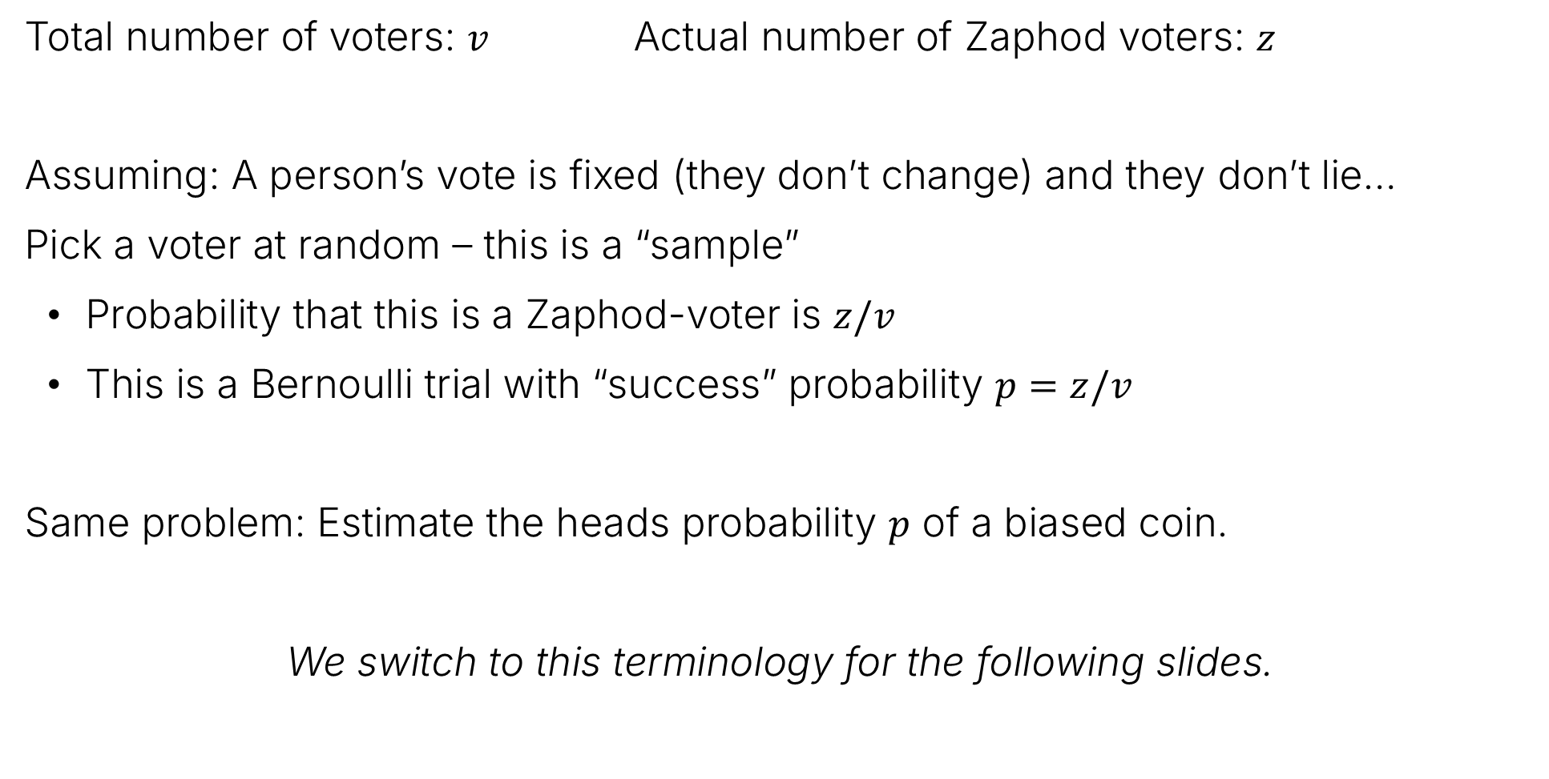
Motivating Problem of the Day: Samples and Coin Tosses
Total number of voters: $v$ Actual number of Zaphod voters: $z$
Assuming: A person’s vote is fixed (they don’t change) and they don’t lie…
Pick a voter at random – this is a “sample”
Probability that this is a Zaphod-voter is $z/v$
This is a Bernoulli trial with “success” probability $p=z/v$
Same problem: Estimate the heads probability $p$ of a biased coin.
We switch to this terminology for the following slides.

Slide 4
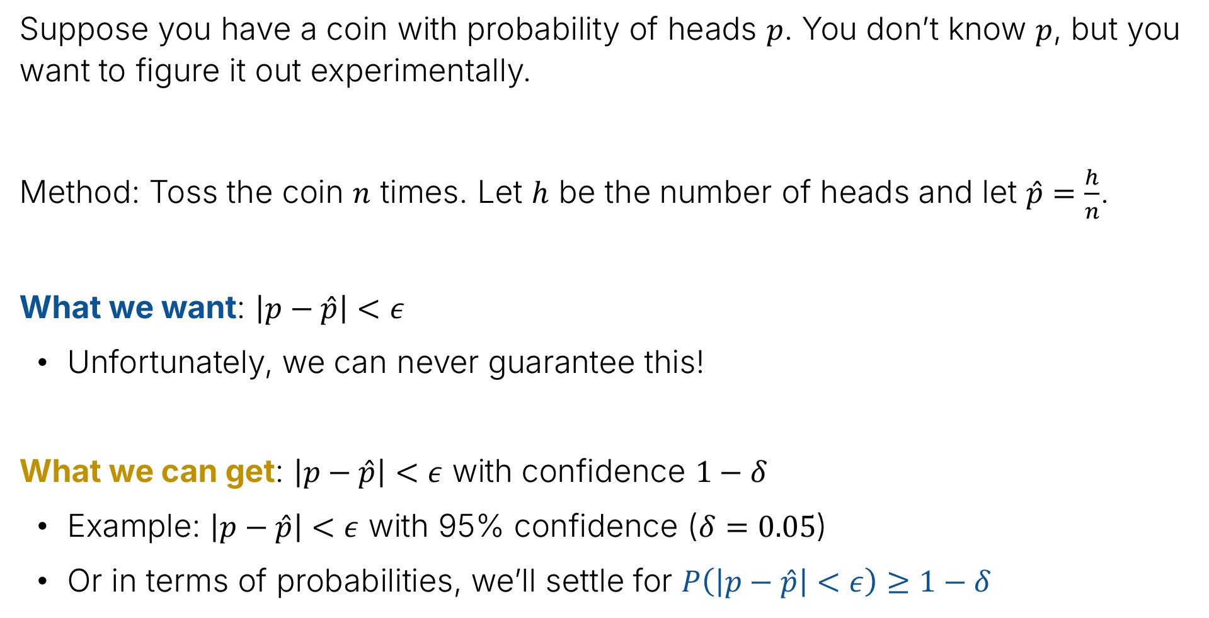
Experimental Procedure for Determining $p$
Suppose you have a coin with probability of heads $p$. You don’t know $p$, but you want to figure it out experimentally.
Method: Toss the coin $n$ times. Let $h$ be the number of heads and let $\hat{p}=\frac{h}{n}$.
What we want: $\left|p−\hat{p}\right|<ε$
Unfortunately, we can never guarantee this!
What we can get: $\left|p−\hat{p}\right|<ε$ with confidence $1−δ$
Example: $\left|p−\hat{p}\right|<ε$ with 95% confidence ($δ=0.05$)
Or in terms of probabilities, we’ll settle for $P\left(\left|p−\hat{p}\right|<ε\right)≥1−δ$

Slide 5
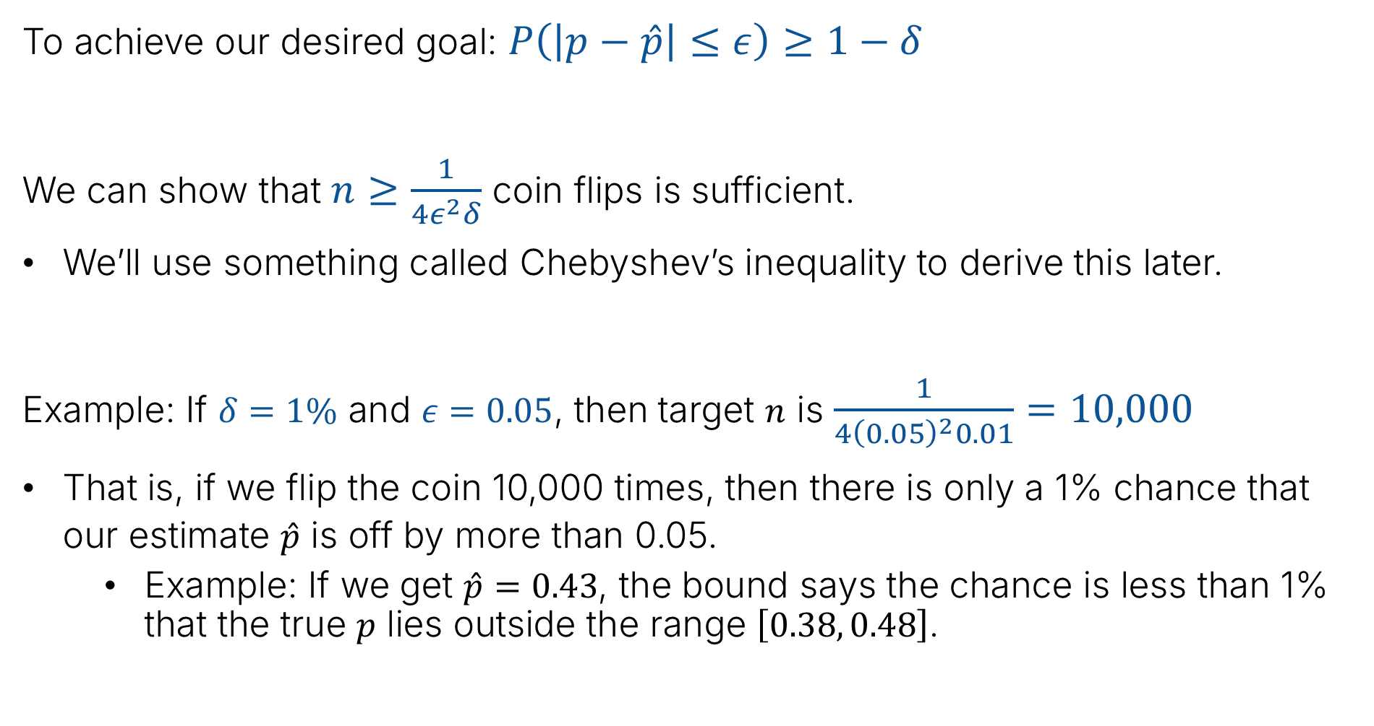
Today’s Answer (Spoiler)
To achieve our desired goal: $P\left(\left|p−\hat{p}\right|≤ε\right)≥1−δ$
We can show that $n≥\frac{1}{4ε^{2}δ}$ coin flips is sufficient.
We’ll use something called Chebyshev’s inequality to derive this later.
Example: If $δ=1\%$ and $ε=0.05$, then target $n$ is $\frac{1}{4{\left(0.05\right)}^{2}0.01}=10,000$
That is, if we flip the coin 10,000 times, then there is only a 1% chance that our estimate $\hat{p}$ is off by more than 0.05.
Example: If we get $\hat{p}=0.43$, the bound says the chance is less than 1% that the true $p$ lies outside the range $\left[0.38, 0.48\right]$.

Slide 6
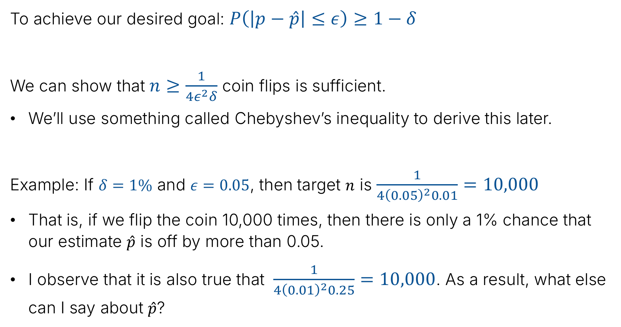
Today’s Answer (Spoiler)
To achieve our desired goal: $P\left(\left|p−\hat{p}\right|≤ε\right)≥1−δ$
We can show that $n≥\frac{1}{4ε^{2}δ}$ coin flips is sufficient.
We’ll use something called Chebyshev’s inequality to derive this later.
Example: If $δ=1\%$ and $ε=0.05$, then target $n$ is $\frac{1}{4{\left(0.05\right)}^{2}0.01}=10,000$
That is, if we flip the coin 10,000 times, then there is only a 1% chance that our estimate $\hat{p}$ is off by more than 0.05.
I observe that it is also true that $\frac{1}{4{\left(0.01\right)}^{2}0.25}=10,000$. As a result, what else can I say about $\hat{p}$?

Slide 7
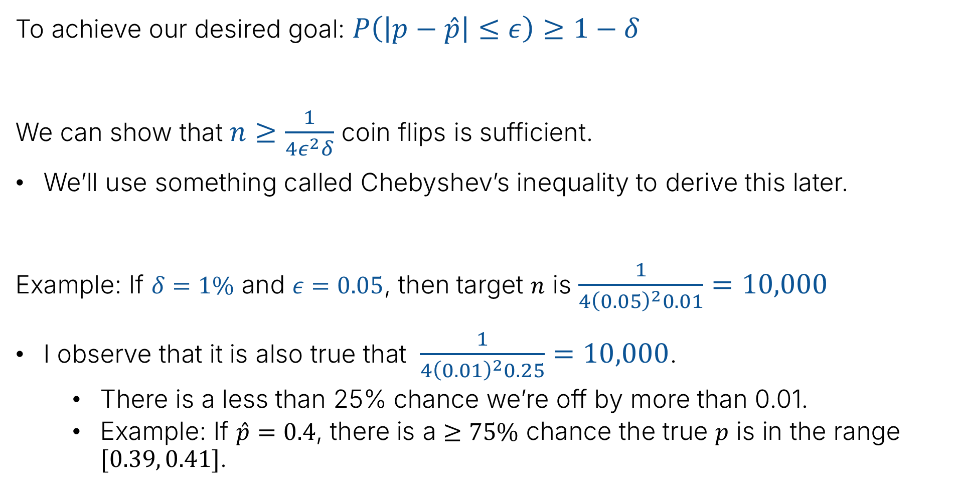
Today’s Answer (Spoiler)
To achieve our desired goal: $P\left(\left|p−\hat{p}\right|≤ε\right)≥1−δ$
We can show that $n≥\frac{1}{4ε^{2}δ}$ coin flips is sufficient.
We’ll use something called Chebyshev’s inequality to derive this later.
Example: If $δ=1\%$ and $ε=0.05$, then target $n$ is $\frac{1}{4{\left(0.05\right)}^{2}0.01}=10,000$
I observe that it is also true that $\frac{1}{4{\left(0.01\right)}^{2}0.25}=10,000$.
There is a less than 25% chance we’re off by more than 0.01.
Example: If $\hat{p}=0.4$, there is a $≥75\%$ chance the true $p$ is in the range $[0.39, 0.41]$.

Slide 8
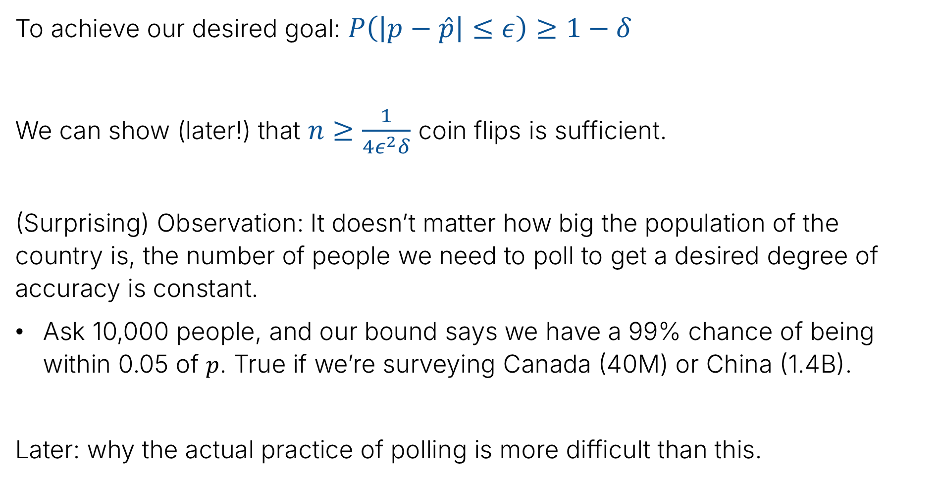
In Terms of Election Polling
To achieve our desired goal: $P\left(\left|p−\hat{p}\right|≤ε\right)≥1−δ$
We can show (later!) that $n≥\frac{1}{4ε^{2}δ}$ coin flips is sufficient.
(Surprising) Observation: It doesn’t matter how big the population of the country is, the number of people we need to poll to get a desired degree of accuracy is constant.
Ask 10,000 people, and our bound says we have a 99% chance of being within 0.05 of $p$. True if we’re surveying Canada (40M) or China (1.4B).
Later: why the actual practice of polling is more difficult than this.

Slide 9
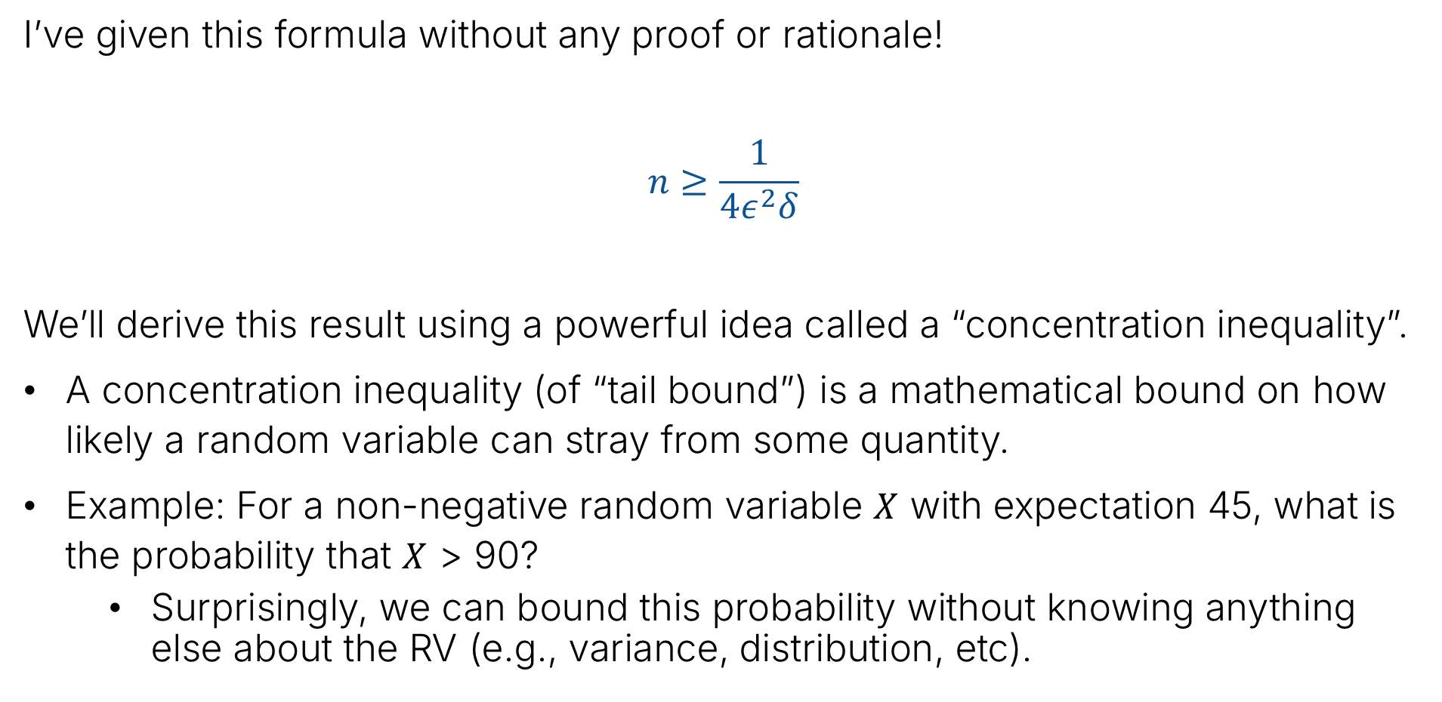
Deriving this Expression and Concentration Inequalities
I’ve given this formula without any proof or rationale!
$$n≥\frac{1}{4ε^{2}δ}$$
We’ll derive this result using a powerful idea called a “concentration inequality”.
A concentration inequality (of “tail bound”) is a mathematical bound on how likely a random variable can stray from some quantity.
Example: For a non-negative random variable $X$ with expectation 45, what is the probability that $X$ > 90?
Surprisingly, we can bound this probability without knowing anything else about the RV (e.g., variance, distribution, etc).

Slide 10
Markov’s Inequality
Estimating p for X~Bernoulli(p)
Markov’s Inequality
Chebyshev’s Inequality
The Chebyshev Bound for Coin Flips
Weak Law of Large Numbers
Back to Polling
Lecture 23, CS70 Summer 2025

Slide 11

Thought Experiment 1
Imagine that $n=100$ students take a midterm with average score $μ=45$.
Let individual scores be $s_{1},…,s_{n}$ , so $μ=\frac{1}{n}\sum_{i=1}^{n}{s_{i}}$
Can all 100 students score greater than $μ=45$ on the midterm?

Slide 12

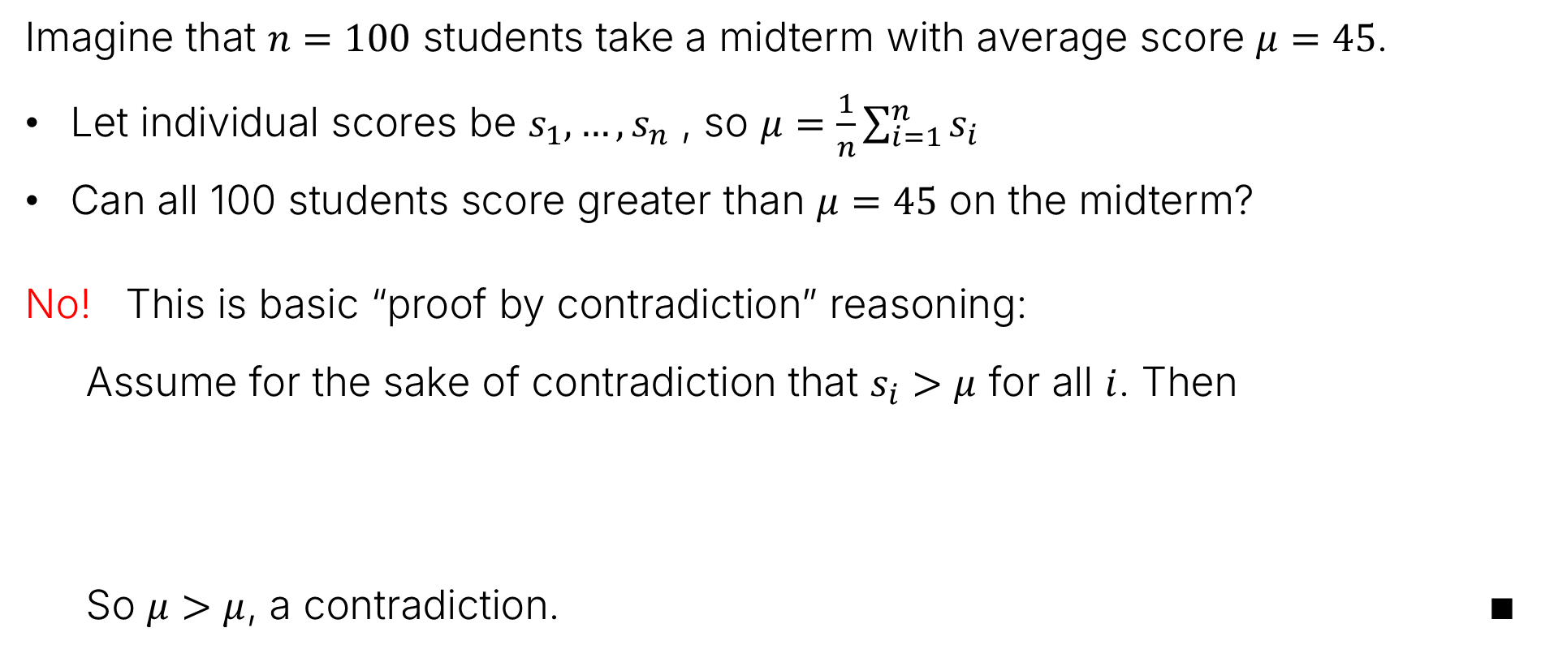


Thought Experiment 1
Imagine that $n=100$ students take a midterm with average score $μ=45$.
Let individual scores be $s_{1},…,s_{n}$ , so $μ=\frac{1}{n}\sum_{i=1}^{n}{s_{i}}$
Can all 100 students score greater than $μ=45$ on the midterm?
No! This is basic “proof by contradiction” reasoning:
Assume for the sake of contradiction that $s_{i}>μ$ for all $i$. Then
So $μ>μ$, a contradiction. $∎$
$$μ=\frac{1}{n}\sum_{i=1}^{n}{s_{i}}$$
$$>\frac{1}{n}\sum_{i=1}^{n}{μ}$$
$$=\frac{1}{n}nμ=μ$$
The “Lake Wobegon Theorem”

Slide 13

Thought Experiment 2
Imagine that $n=100$ students take a midterm with average score $μ=45$.
Let individual scores be $s_{1},…,s_{n}$ , so $μ=\frac{1}{n}\sum_{i=1}^{n}{s_{i}}$
Can $\frac{n}{2}=50$ students score greater than $2μ=90$ on the midterm?

Slide 14

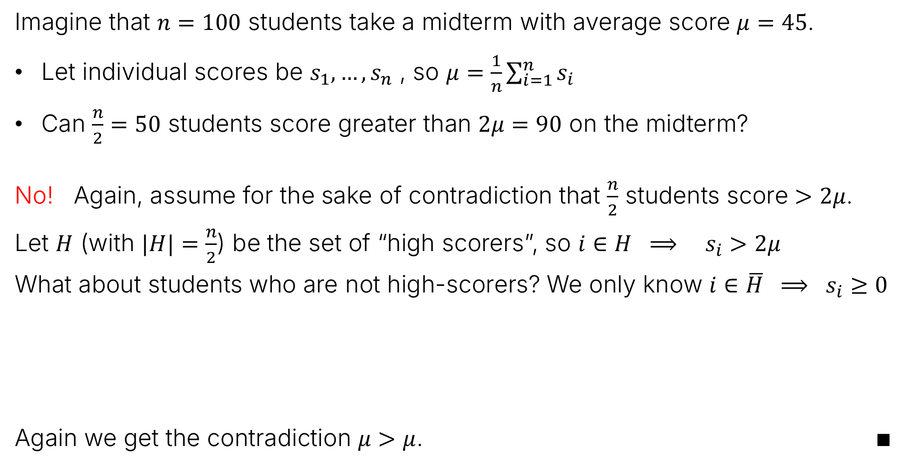
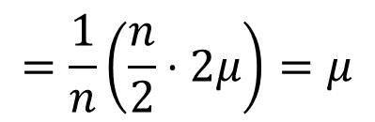


Thought Experiment 2
Imagine that $n=100$ students take a midterm with average score $μ=45$.
Let individual scores be $s_{1},…,s_{n}$ , so $μ=\frac{1}{n}\sum_{i=1}^{n}{s_{i}}$
Can $\frac{n}{2}=50$ students score greater than $2μ=90$ on the midterm?
No! Again, assume for the sake of contradiction that $\frac{n}{2}$ students score $>2μ$.
Let $H$ (with $|H|=\frac{n}{2}$) be the set of “high scorers”, so $i∈H ⟹ s_{i}>2μ$
What about students who are not high-scorers? We only know $i∈\overline{H} ⟹ s_{i}≥0$
Again we get the contradiction $μ>μ$. $∎$
$$μ=\frac{1}{n}\sum_{i=1}^{n}{s_{i}}$$
$$=\frac{1}{n}\left(\sum_{i∈H}{s_{i}}+\sum_{i∈\overline{H}}{s_{i}}\right)$$
$$>\frac{1}{n}\left(\sum_{i∈H}{2μ}+\sum_{i∈\overline{H}}{0}\right)$$
$$=\frac{1}{n}\left(\frac{n}{2}⋅2μ\right)=μ$$

Slide 15

Thought Experiment 3
Consider a non-negative random variable with $E\left[X\right]=45$.
Claim: $P(X≥90)≤\frac{1}{2}$.
Why?

Slide 16
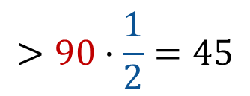
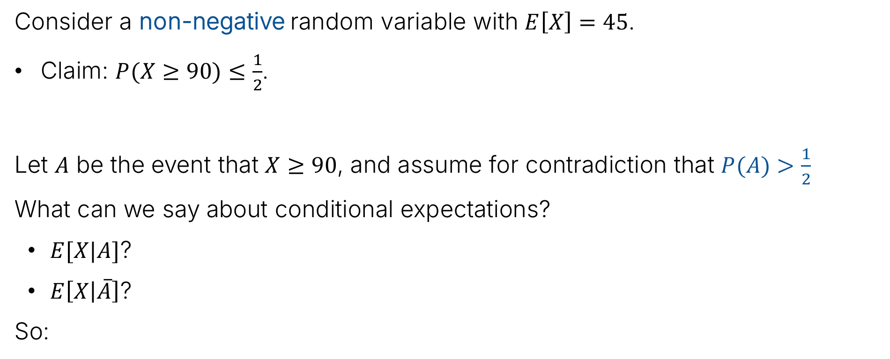



Thought Experiment 3
Consider a non-negative random variable with $E\left[X\right]=45$.
Claim: $P(X≥90)≤\frac{1}{2}$.
Let $A$ be the event that $X≥90$, and assume for contradiction that $P(A)>\frac{1}{2}$
What can we say about conditional expectations?
$E[X|A]$?
$E\left[X | \overline{A}\right]$?
So:
$$E\left[X | A\right]≥90$$
$$E\left[X | \overline{A}\right]≥0$$
$$>90⋅\frac{1}{2}=45$$
$$E\left[X\right]=E\left[X | A\right]⋅P\left(A\right)+E\left[X | \overline{A}\right]⋅P\left(\overline{A}\right)$$
$$≥90⋅P\left(A\right)+0⋅P\left(\overline{A}\right)$$
So we have $E[X]>45$, a contradiction. $∎$

Slide 17
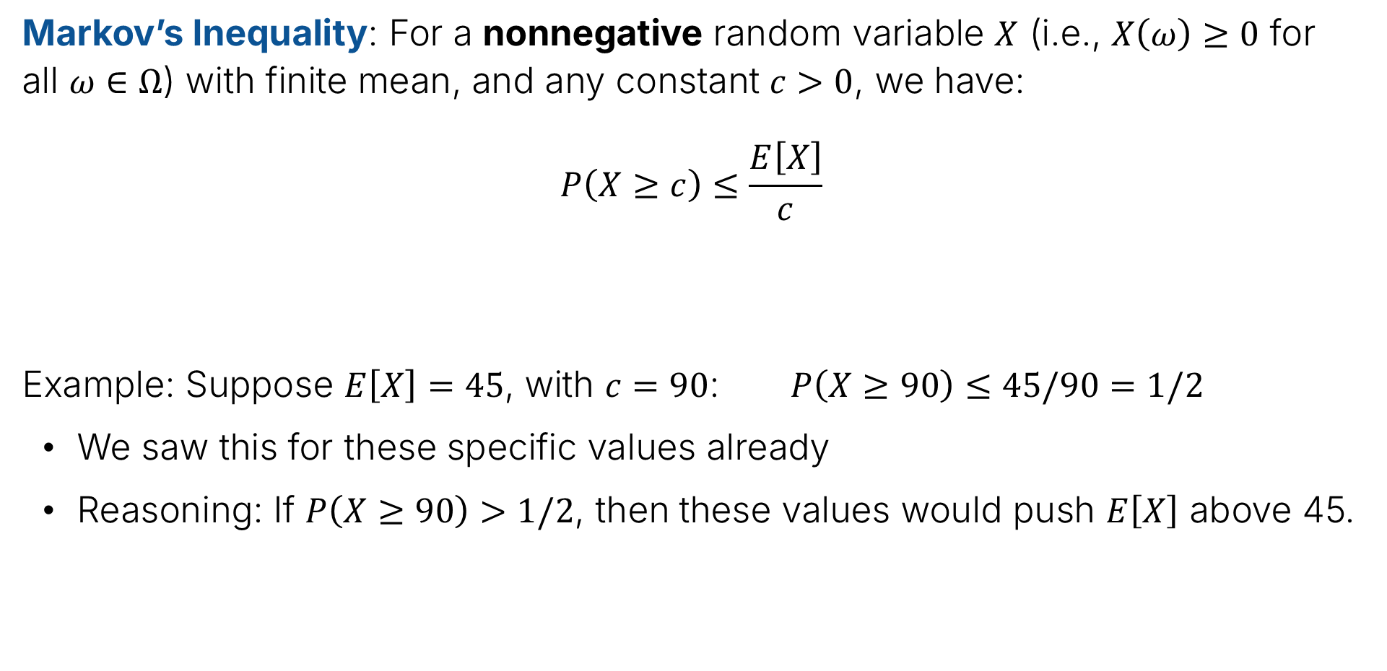
Markov’s Inequality
Markov’s Inequality: For a nonnegative random variable $X$ (i.e., $X\left(ω\right)≥0$ for all $ω∈Ω$) with finite mean, and any constant $c>0$, we have:
$$P\left(X≥c\right)≤\frac{E\left[X\right]}{c}$$
Example: Suppose $E\left[X\right]=45$, with $c=90$: $P\left(X≥90\right)≤45/90=1/2$
We saw this for these specific values already
Reasoning: If $P\left(X≥90\right)>1/2$, then these values would push $E\left[X\right]$ above 45.

Slide 18





Markov’s Inequality
Markov’s Inequality: For a nonnegative random variable $X$ (i.e., $X\left(ω\right)≥0$ for all $ω∈Ω$) with finite mean, and any constant $c>0$, we have:
$$P\left(X≥c\right)≤\frac{E\left[X\right]}{c}$$
Proof:
$$E\left[X\right]=\sum_{ω∈Ω}{X\left(ω\right)×P\left(ω\right)}$$
$$≥\sum_{ω:X\left(ω\right)≥c}{X(ω)×P\left(ω\right)}$$
Assigning all “small” outcomes to zero.
$$≥\sum_{ω:X\left(ω\right)≥c}{c×P\left(ω\right)}$$
Assigning all “large” outcomes to c.
$$=c\sum_{ω:X\left(ω\right)≥c}{P\left(ω\right)}$$
$$=c P\left(X≥c\right)$$

Slide 19

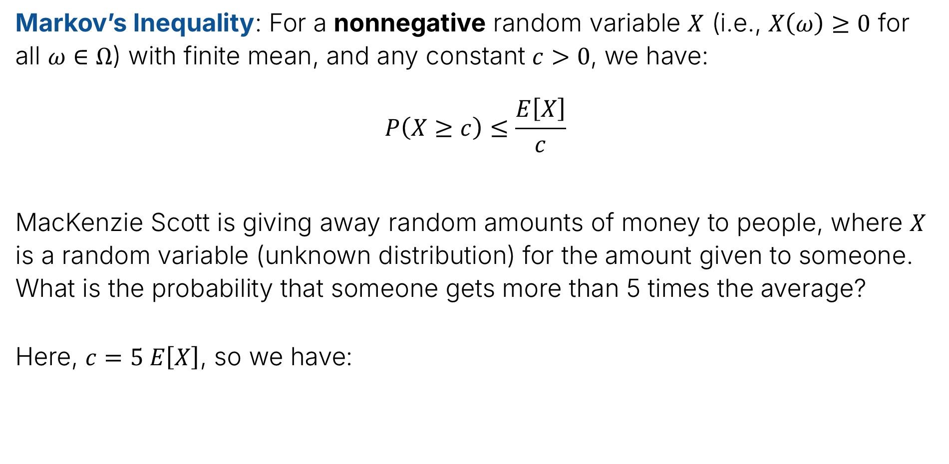


Example Using Markov’s Inequality 1: Money Giveaway
Markov’s Inequality: For a nonnegative random variable $X$ (i.e., $X\left(ω\right)≥0$ for all $ω∈Ω$) with finite mean, and any constant $c>0$, we have:
$$P\left(X≥c\right)≤\frac{E\left[X\right]}{c}$$
MacKenzie Scott is giving away random amounts of money to people, where $X$ is a random variable (unknown distribution) for the amount given to someone. What is the probability that someone gets more than 5 times the average?
Here, $c=5 E\left[X\right]$, so we have:
$$≤\frac{E\left[X\right]}{5 E\left[X\right]}$$
$$=\frac{1}{5}$$
$$P\left(X≥5 E\left[X\right]\right)$$

Slide 20

Example Using Markov’s Inequality 2: Coin Toss
Markov’s Inequality: For a nonnegative random variable $X$ (i.e., $X\left(ω\right)≥0$ for all $ω∈Ω$) with finite mean, and any constant $c>0$, we have:
$$P\left(X≥c\right)≤\frac{E\left[X\right]}{c}$$
You toss a fair coin $n$ times. Let $X$ be the number of heads. What does Markov’s Inequality tell us about the probability that $X≥\frac{3}{4}n$?
Hint: What is $E\left[X\right]$, i.e., expected number of heads for $n$ coin flips?

Slide 21
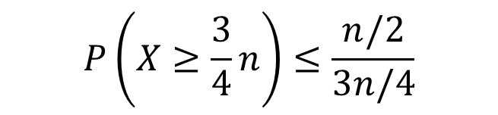




Example Using Markov’s Inequality 2: Coin Toss
Markov’s Inequality: For a nonnegative random variable $X$ (i.e., $X\left(ω\right)≥0$ for all $ω∈Ω$) with finite mean, and any constant $c>0$, we have:
$$P\left(X≥c\right)≤\frac{E\left[X\right]}{c}$$
You toss a fair coin $n$ times. Let $X$ be the number of heads. What does Markov’s Inequality tell us about the probability that $X≥\frac{3}{4}n$?
$$E\left[X\right]=n/2$$
$$P\left(X≥\frac{3}{4}n\right)≤\frac{n/2}{3n/4}$$
$$=\frac{1/2}{3/4}$$
$$=\frac{1}{2}⋅\frac{4}{3}=\frac{2}{3}$$

Slide 22


Example Using Markov’s Inequality 2: Coin Toss
Markov’s Inequality: For a nonnegative random variable $X$ (i.e., $X\left(ω\right)≥0$ for all $ω∈Ω$) with finite mean, and any constant $c>0$, we have:
$$P\left(X≥c\right)≤\frac{E\left[X\right]}{c}$$
You toss a fair coin $n$ times. Let $X$ be the number of heads. What does Markov’s Inequality tell us about the probability that $X≥\frac{3}{4}n$?
For this example, is this bound “good” or perhaps “tight”?
No, it says if you flip a coin 1,000,000 times, probability of getting 750,000 heads is less than 2/3. Actual probability is far lower.
$$P\left(X≥\frac{3}{4}n\right)≤\frac{2}{3}$$

Slide 23
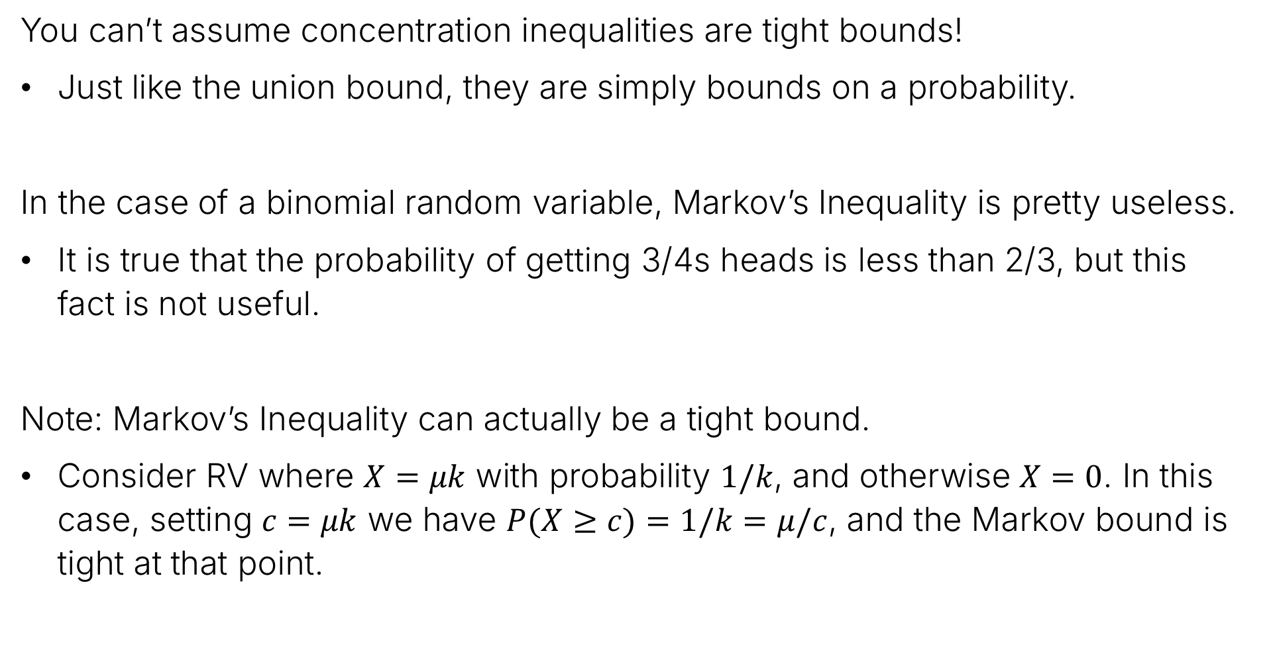
Concentration Inequalities and Bound Tightness
You can’t assume concentration inequalities are tight bounds!
Just like the union bound, they are simply bounds on a probability.
In the case of a binomial random variable, Markov’s Inequality is pretty useless.
It is true that the probability of getting 3/4s heads is less than 2/3, but this fact is not useful.
Note: Markov’s Inequality can actually be a tight bound.
Consider RV where $X=μk$ with probability $1/k$, and otherwise $X=0$. In this case, setting $c=μk$ we have $P(X≥c)=1/k=μ/c$, and the Markov bound is tight at that point.

Slide 24
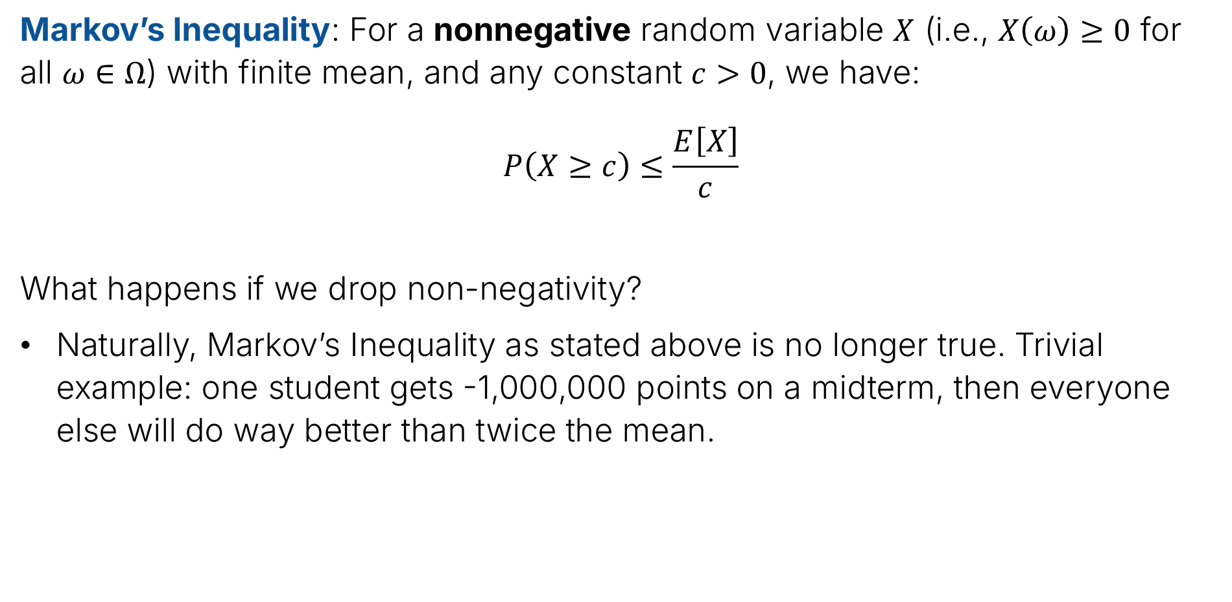
Markov’s Inequality
Markov’s Inequality: For a nonnegative random variable $X$ (i.e., $X\left(ω\right)≥0$ for all $ω∈Ω$) with finite mean, and any constant $c>0$, we have:
$$P\left(X≥c\right)≤\frac{E\left[X\right]}{c}$$
What happens if we drop non-negativity?
Naturally, Markov’s Inequality as stated above is no longer true. Trivial example: one student gets -1,000,000 points on a midterm, then everyone else will do way better than twice the mean.

Slide 25
Chebyshev’s Inequality
Estimating p for X~Bernoulli(p)
Markov’s Inequality
Chebyshev’s Inequality
The Chebyshev Bound for Coin Flips
Weak Law of Large Numbers
Back to Polling
Lecture 23, CS70 Summer 2025

Slide 26
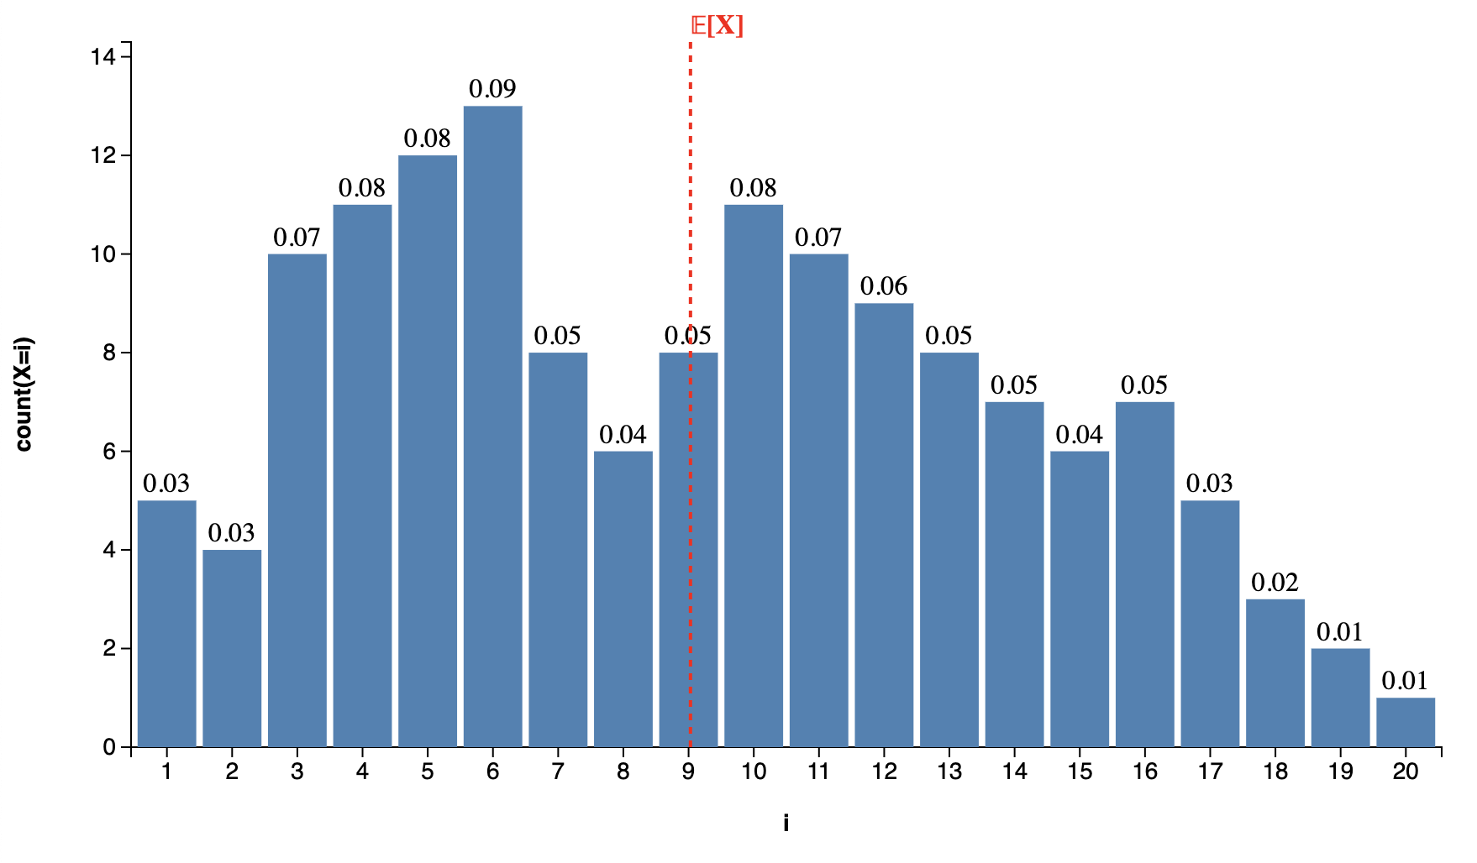
Expectations and Distributions (Visually)
Consider the distribution below.
We can think of the expectation as the “center of mass” of the distribution.
Each value has mass equal to the height of the respective bar.

Slide 27


Markov’s Inequality Visually
Markov’s inequality gives us a bound on how much mass there can be above some constant $c$. Example if $c=2 E\left[X\right]$ shown below.
$$P\left(X≥2 E\left[X\right]\right)≤1/2$$

Slide 28
Chebyshev’s Inequality Visually
Observation: It might be more useful to have an inequality that bounds the amount of mass that is far from the mean (in either direction), and allows negative values for the rv.
$$P\left(\left|X−μ\right|≥c\right)≤ ??$$

Slide 29
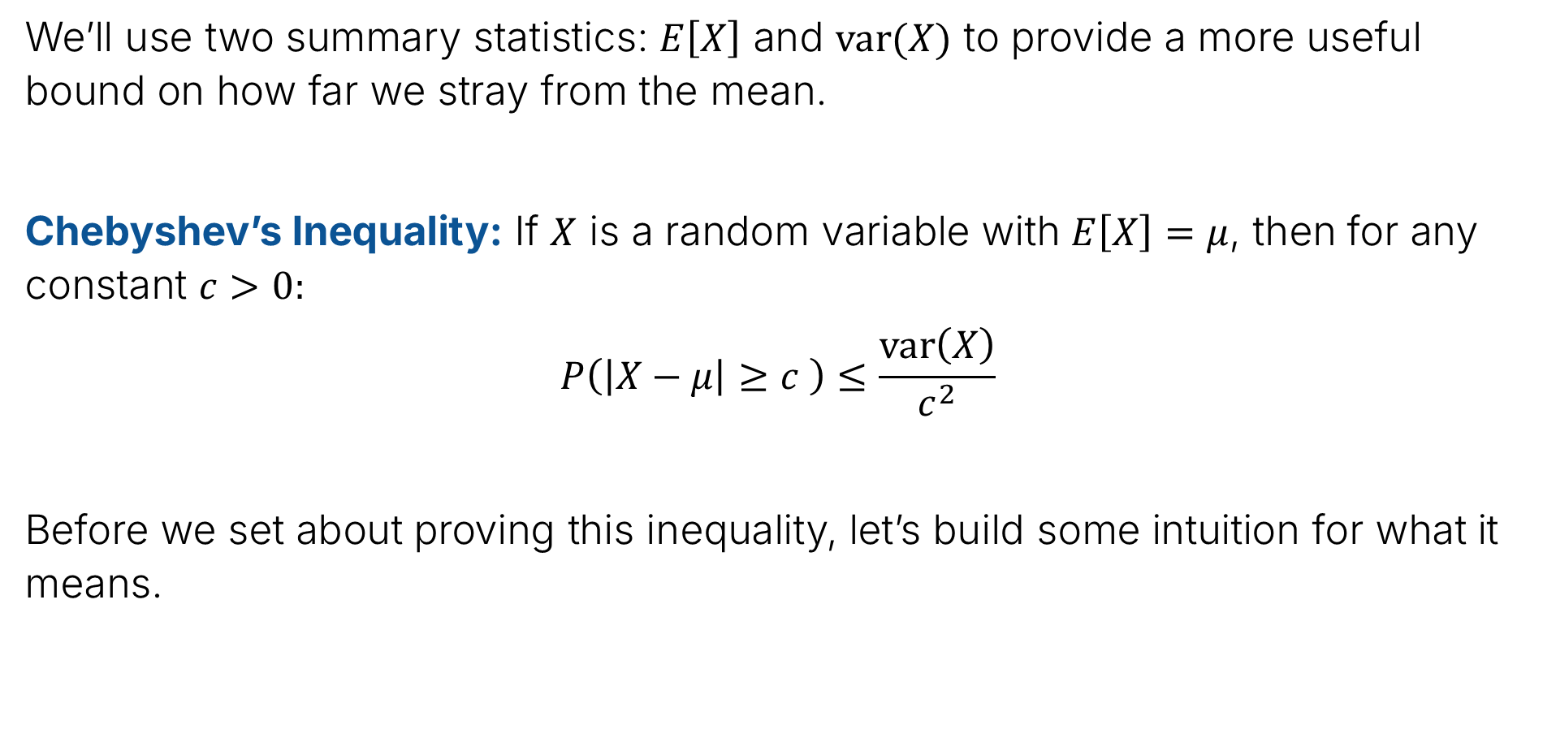
Chebyshev’s Inequality
We’ll use two summary statistics: $E\left[X\right]$ and $var(X)$ to provide a more useful bound on how far we stray from the mean.
Chebyshev’s Inequality: If $X$ is a random variable with $E\left[X\right]=μ$, then for any constant $c>0:$
$$P\left(\left|X−μ\right|≥c \right)≤\frac{var\left(X\right)}{c^{2}}$$
Before we set about proving this inequality, let’s build some intuition for what it means.

Slide 30

Chebyshev’s Inequality: Intution 1, the Alternate Form
Chebyshev’s Inequality: If $X$ is a random variable with $E\left[X\right]=μ$, then for any constant $c>0:$
$$P\left(\left|X−μ\right|≥c \right)≤\frac{var\left(X\right)}{c^{2}}$$
Suppose we pick the constant $c=kσ$, what is the upper bound?
$$P\left(\left|X−μ\right|≥kσ\right)≤ ??$$

Slide 31
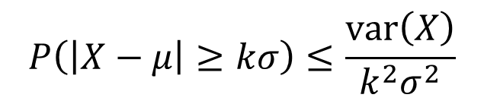




Chebyshev’s Inequality
Chebyshev’s Inequality: If $X$ is a random variable with $E\left[X\right]=μ$, then for any constant $c>0:$
$$P\left(\left|X−μ\right|≥c \right)≤\frac{var\left(X\right)}{c^{2}}$$
Suppose we pick the constant $c=kσ$, what is the upper bound?
$$P\left(\left|X−μ\right|≥kσ\right)≤\frac{var\left(X\right)}{k^{2}σ^{2}}$$
$$=\frac{σ^{2}}{k^{2}σ^{2}}$$
$$=\frac{1}{k^{2}}$$
$$P\left(\left|X−μ\right|≥kσ\right)≤\frac{1}{k^{2}}$$

Slide 32
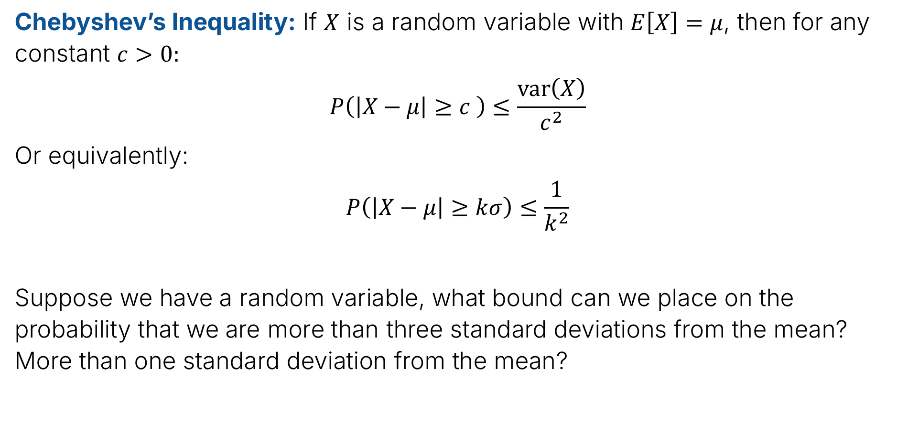
Chebyshev’s Inequality
Chebyshev’s Inequality: If $X$ is a random variable with $E\left[X\right]=μ$, then for any constant $c>0:$
$$P\left(\left|X−μ\right|≥c \right)≤\frac{var\left(X\right)}{c^{2}}$$
Or equivalently:
$$P\left(\left|X−μ\right|≥kσ\right)≤\frac{1}{k^{2}}$$
Suppose we have a random variable, what bound can we place on the probability that we are more than three standard deviations from the mean? More than one standard deviation from the mean?

Slide 33
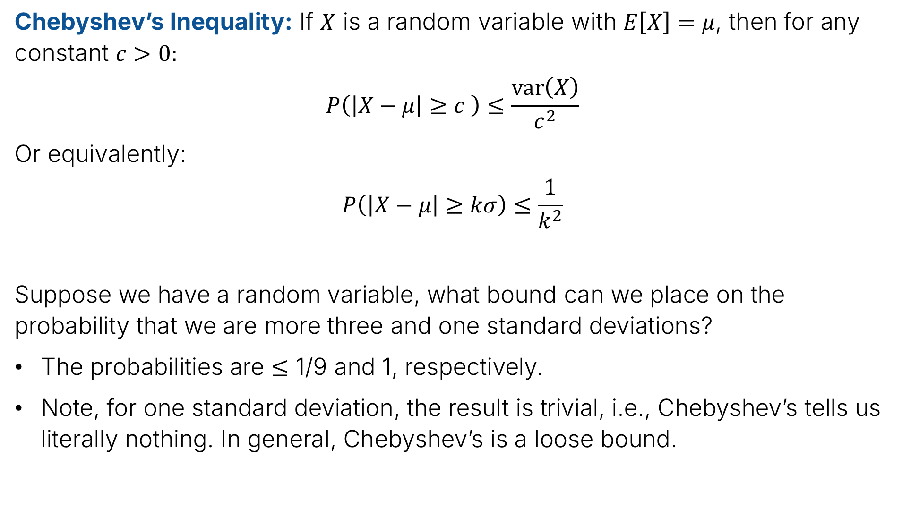
Chebyshev’s Inequality
Chebyshev’s Inequality: If $X$ is a random variable with $E\left[X\right]=μ$, then for any constant $c>0:$
$$P\left(\left|X−μ\right|≥c \right)≤\frac{var\left(X\right)}{c^{2}}$$
Or equivalently:
$$P\left(\left|X−μ\right|≥kσ\right)≤\frac{1}{k^{2}}$$
Suppose we have a random variable, what bound can we place on the probability that we are more three and one standard deviations?
The probabilities are $≤$ 1/9 and 1, respectively.
Note, for one standard deviation, the result is trivial, i.e., Chebyshev’s tells us literally nothing. In general, Chebyshev’s is a loose bound.

Slide 34
Chebyshev’s is a Loose Bound: Normal Distribution Example
There’s a distribution we’ll talk about next week called the normal distribution.
Probability that you are less than 3 standard deviations from the mean is 99.7%.
Or equivalently: Probability that are you are more than 3 standard deviations from the mean is 0.3%.
Chebyshev’s is considerably looser. It says the probability of being more than 3 standard deviations from the mean is 11.1%
Key difference: Chebyshev is true of all possible distributions. The 99.7% rule is only for the Normal.

Slide 35
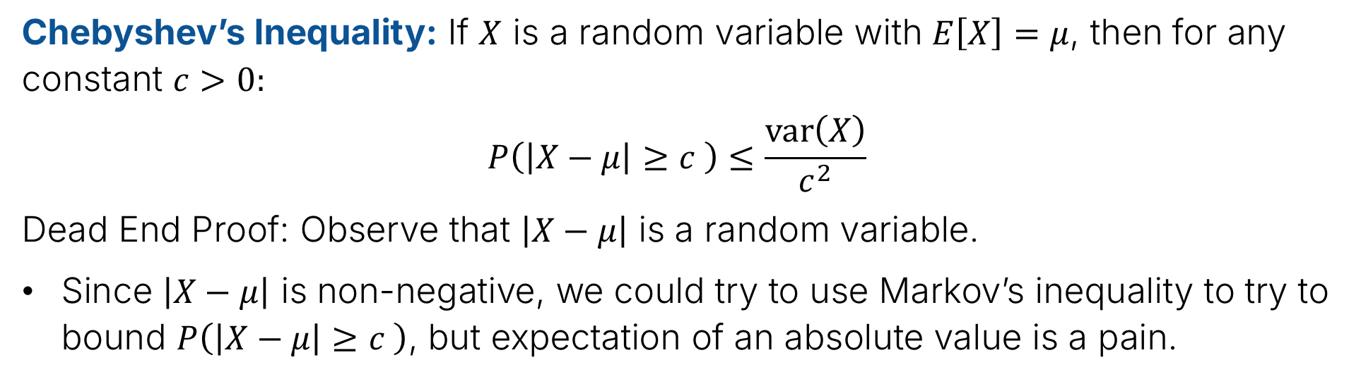
Chebyshev Proof
Chebyshev’s Inequality: If $X$ is a random variable with $E\left[X\right]=μ$, then for any constant $c>0:$
$$P\left(\left|X−μ\right|≥c \right)≤\frac{var\left(X\right)}{c^{2}}$$
Dead End Proof: Observe that $\left|X−μ\right|$ is a random variable.
Since $\left|X−μ\right|$ is non-negative, we could try to use Markov’s inequality to try to bound $P\left(\left|X−μ\right|≥c \right)$, but expectation of an absolute value is a pain.

Slide 36
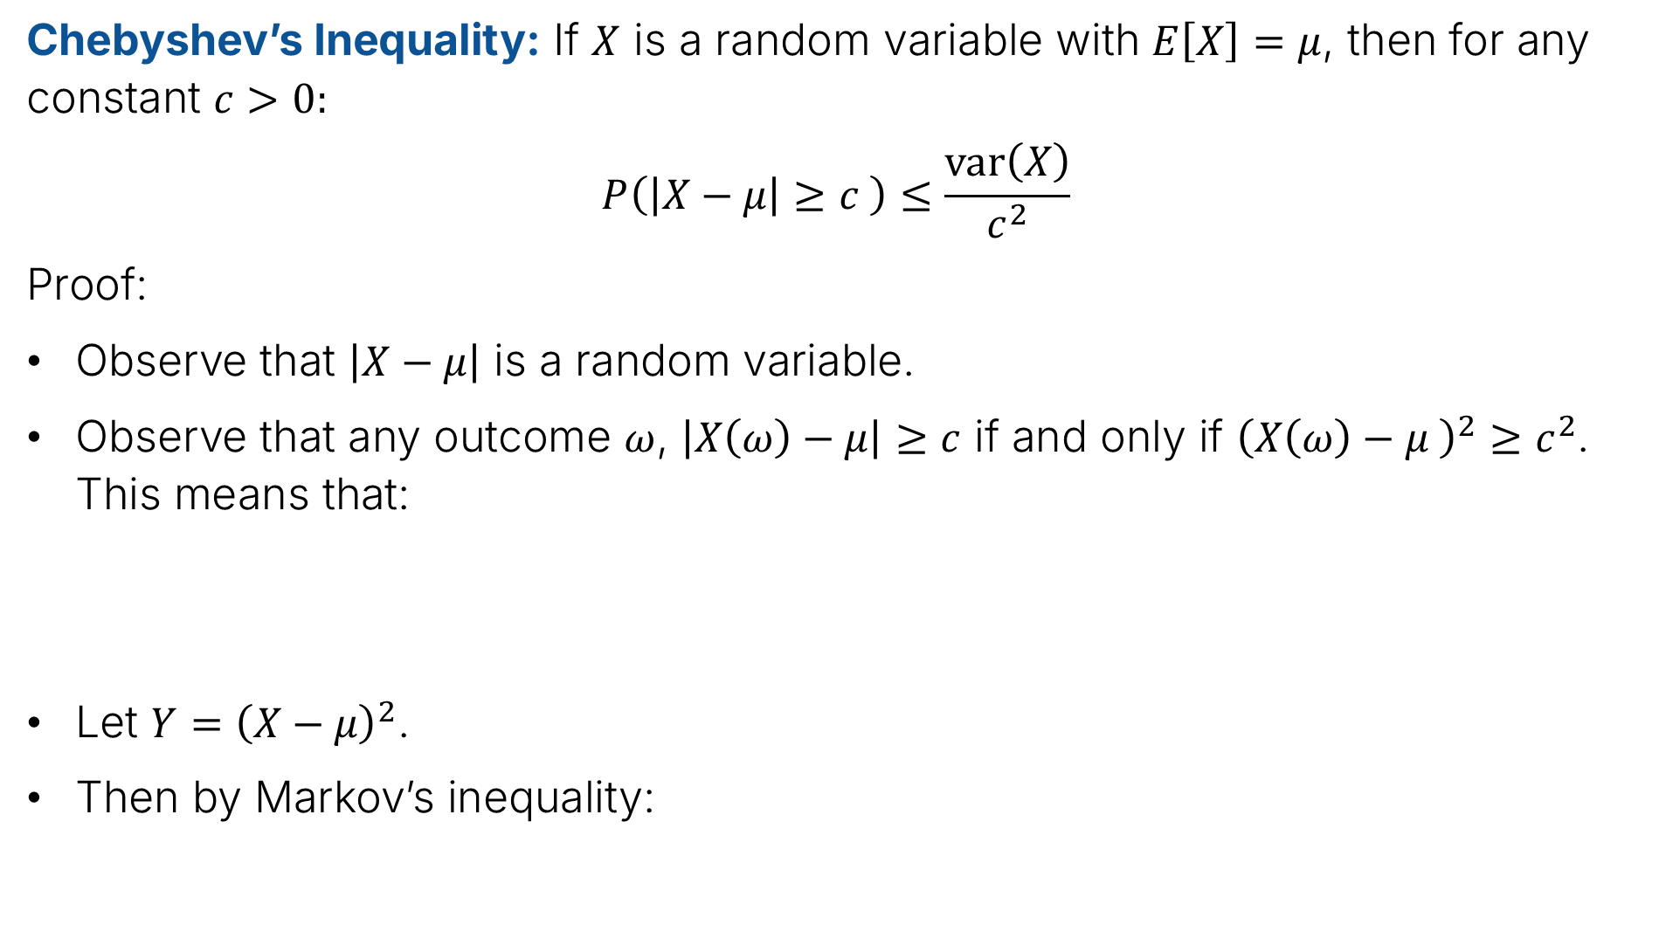
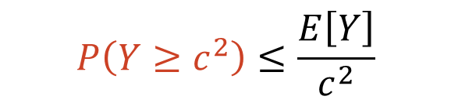
Chebyshev Proof
Chebyshev’s Inequality: If $X$ is a random variable with $E\left[X\right]=μ$, then for any constant $c>0:$
$$P\left(\left|X−μ\right|≥c \right)≤\frac{var\left(X\right)}{c^{2}}$$
Proof:
Observe that $\left|X−μ\right|$ is a random variable.
Observe that any outcome $ω$, $\left|X\left(ω\right)−μ\right|≥c$ if and only if ${\left(X\left(ω\right)−μ \right)}^{2}≥c^{2}$. This means that:
Let $Y={\left(X−μ\right)}^{2}$.
Then by Markov’s inequality:
$$P\left(\left|X−μ\right|≥c \right)=P\left({\left(X−μ\right)}^{2}≥c^{2} \right)$$
$$P\left(Y≥c^{2}\right)≤\frac{E\left[Y\right]}{c^{2}}$$

Slide 37

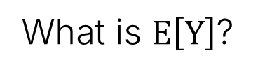
Chebyshev Proof
Chebyshev’s Inequality: If $X$ is a random variable with $E\left[X\right]=μ$, then for any constant $c>0:$
$$P\left(\left|X−μ\right|≥c \right)≤\frac{var\left(X\right)}{c^{2}}$$
Proof:
Observe that $\left|X−μ\right|$ is a random variable.
Observe that any outcome $ω$, $\left|X\left(ω\right)−μ\right|≥c$ if and only if ${\left(X\left(ω\right)−μ \right)}^{2}≥c^{2}$. This means that:
Let $Y={\left(X−μ\right)}^{2}$.
Then by Markov’s inequality:
$$P\left(\left|X−μ\right|≥c \right)=P\left({\left(X−μ\right)}^{2}≥c^{2} \right)$$
$$P\left(Y≥c^{2}\right)≤\frac{E\left[Y\right]}{c^{2}}$$
What is $E\left[Y\right]$?

Slide 38
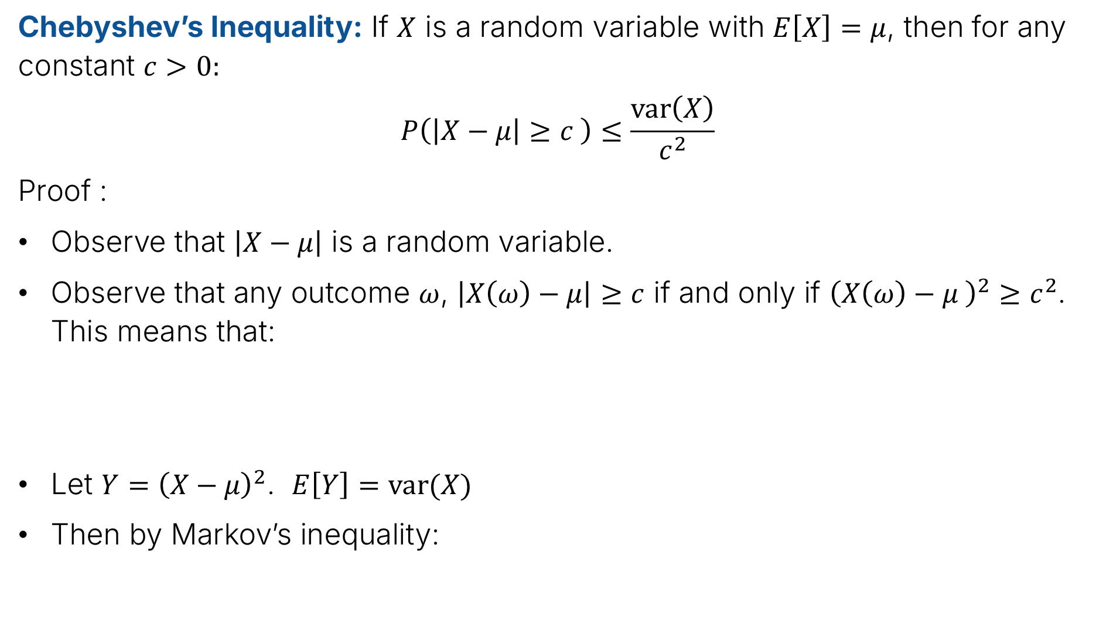

Chebyshev Proof
Chebyshev’s Inequality: If $X$ is a random variable with $E\left[X\right]=μ$, then for any constant $c>0:$
$$P\left(\left|X−μ\right|≥c \right)≤\frac{var\left(X\right)}{c^{2}}$$
Proof :
Observe that $\left|X−μ\right|$ is a random variable.
Observe that any outcome $ω$, $\left|X\left(ω\right)−μ\right|≥c$ if and only if ${\left(X\left(ω\right)−μ \right)}^{2}≥c^{2}$. This means that:
Let $Y={\left(X−μ\right)}^{2}$. $E\left[Y\right]=var(X)$
Then by Markov’s inequality:
$$P\left(\left|X−μ\right|≥c \right)=P\left({\left(X−μ\right)}^{2}≥c^{2} \right)$$
$$P\left(Y≥c^{2}\right)≤\frac{E\left[Y\right]}{c^{2}}$$
$$=\frac{var\left(X\right)}{c^{2}}$$

Slide 39

Chebyshev’s Inequality and Markov’s Inequality
Even though Markov’s Inequality is weak for understanding $X$, we were able to enhance its power by considering a new random variable $Y={\left(X−μ\right)}^{2}$ and considering bounds on this variable.
Yes! You can enhance the bound further by making up new random variables such as ${\left(X−μ\right)}^{10}$, but then you need to be able to compute $E\left[{\left(X−μ\right)}^{10}\right]$.

Slide 40
The Chebyshev Bound for Coin Flips
Estimating p for X~Bernoulli(p)
Markov’s Inequality
Chebyshev’s Inequality
The Chebyshev Bound for Coin Flips
Weak Law of Large Numbers
Back to Polling
Lecture 23, CS70 Summer 2025

Slide 41
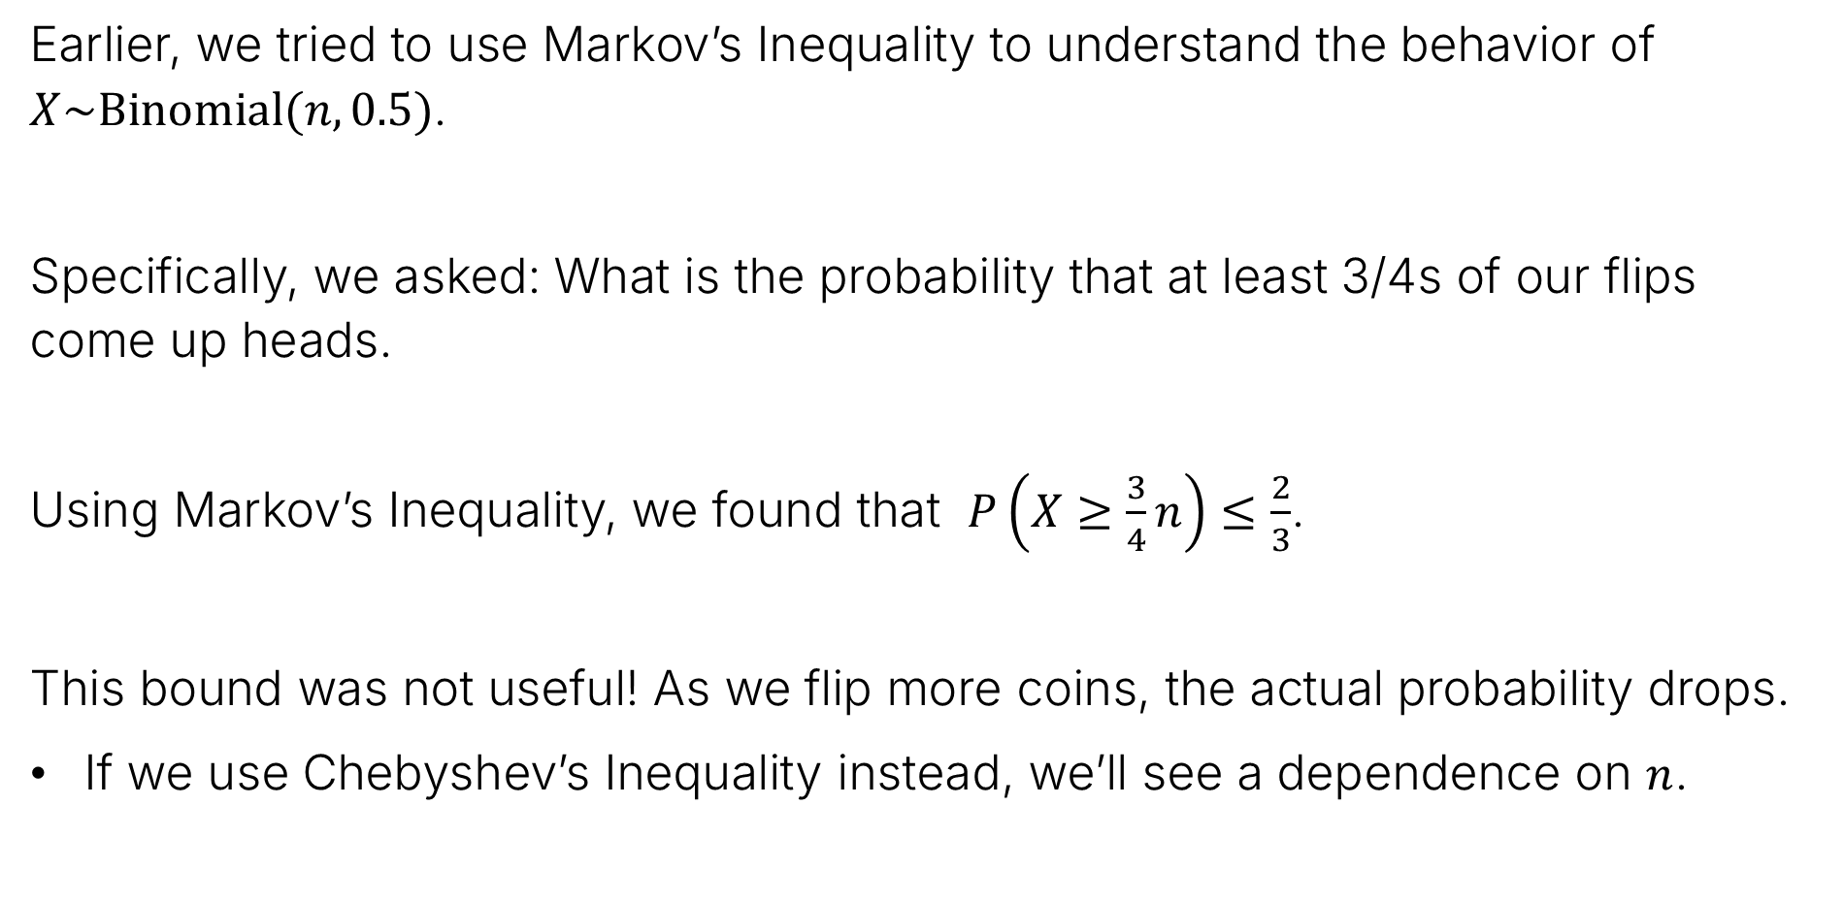
Application: Probability of Coin Toss Outcomes
Earlier, we tried to use Markov’s Inequality to understand the behavior of $X\sim Binomial(n, 0.5)$.
Specifically, we asked: What is the probability that at least 3/4s of our flips come up heads.
Using Markov’s Inequality, we found that $P\left(X≥\frac{3}{4}n\right)≤\frac{2}{3}$.
This bound was not useful! As we flip more coins, the actual probability drops.
If we use Chebyshev’s Inequality instead, we’ll see a dependence on $n$.

Slide 42


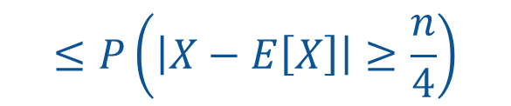







Application: Probability of Coin Toss Outcomes
For $X\sim Binomial(n, 0.5)$, let’s bound $P\left(X≥\frac{3}{4}n\right)$, using Chebyshev’s Inequality: If $X$ is a random variable with $E\left[X\right]=μ$, then for any constant $c>0:$
$$P\left(\left|X−μ\right|≥c \right)≤\frac{var\left(X\right)}{c^{2}}$$
First, we write expectation and variance:
Then, get
$$E\left[X\right]=\frac{n}{2}$$
$$var\left(X\right)=n⋅p⋅\left(1−p\right)=\frac{n}{4}$$
$$P\left(X≥\frac{3}{4}n\right)$$
into the appropriate form to apply Chebyshev:
$$P\left(X≥\frac{3}{4}n\right)=P\left(X−E\left[X\right]≥\frac{3}{4}n−E\left[X\right]\right)$$
$$=P\left(X−E\left[X\right]≥\frac{n}{4}\right)$$
$$≤P\left(\left|X−E\left[X\right]\right|≥\frac{n}{4}\right)$$
$$≤\frac{var\left(X\right)}{{\left(\frac{n}{4}\right)}^{2}}$$
$$=P\left(X−𝔼\left[X\right]≥\frac{1}{4}n\right)$$
$$=\frac{4}{n}$$

Slide 43






Application: Probability of Coin Toss Outcomes
For $X\sim Binomial(n, 0.5)$, let’s bound $P\left(X≥\frac{3}{4}n\right)$, using Chebyshev’s Inequality: If $X$ is a random variable with $E\left[X\right]=μ$, then for any constant $c>0:$
$$P\left(\left|X−μ\right|≥c \right)≤\frac{var\left(X\right)}{c^{2}}$$
First, we write expectation and variance:
Then,
$$E\left[X\right]=\frac{n}{2}$$
$$var\left(X\right)=n⋅p⋅\left(1−p\right)=\frac{n}{4}$$
$$P\left(X≥\frac{3}{4}n\right)$$
$$≤P\left(\left|X−E\left[X\right]\right|≥\frac{n}{4}\right)$$
$$=\frac{n/4}{{\left(\frac{n}{4}\right)}^{2}}$$
$$≤\frac{var\left(X\right)}{{\left(\frac{n}{4}\right)}^{2}}$$
$$=\frac{4}{n}$$

Slide 44


Application: Probability of Coin Toss Outcomes
For $X\sim Binomial(n, 0.5)$, let’s bound $P\left(X≥\frac{3}{4}n\right)$, using Chebyshev’s Inequality: If $X$ is a random variable with $E\left[X\right]=μ$, then for any constant $c>0:$
$$P\left(\left|X−μ\right|≥c \right)≤\frac{var\left(X\right)}{c^{2}}$$
Our Chebyshev bound is:
In other words, as we flip more coins, the chance of having 75% (or more) heads drops.
For n = 1,000, this bound says probability is less than or equal to 0.4%
Note: This is still a very loose bound! Actual probability is much lower.
$$P\left(X≥\frac{3}{4}n\right)≤\frac{4}{n}$$

Slide 45








Back to Estimating $p$ for a Coin
We have a coin with unknown heads probability $p$. We estimate it by tossing a coin n times.
$X$ is the number of heads. $X=X_{1}+X_{2}+…+X_{n}$.
Our empirical mean is
Goal: How big does $n$ need to be so that $P\left(\left|\hat{p}−p\right|≥ε\right)≤δ$
Observation, we can bound using Chebyshev’s inequality.
To show this, we’ll need $E[\hat{p}]$.
$$\hat{p}=\frac{X}{n}$$
$$P\left(\left|\hat{p}−p\right|≥ε\right)$$
$$=E\left[\frac{X}{n}\right]$$
$$=\frac{1}{n}E\left[X\right]$$
$$=\frac{pn}{n}$$
$$E\left[\hat{p}\right]$$
$$=p$$

Slide 46









Back to Estimating $p$ for a Coin
We have a coin with unknown heads probability $p$. We estimate it by tossing a coin n times.
$X$ is the number of heads. $X=X_{1}+X_{2}+…+X_{n}$.
Our empirical mean is
Observation, we can bound using Chebyshev’s inequality.
Since $E\left[\hat{p}\right]=p$, we have that:
So now we need to know $var\left(\hat{p}\right)$.
$$\hat{p}=\frac{X}{n}$$
$$P\left(\left|\hat{p}−p\right|≥ε\right)$$
$$P\left(\left|\hat{p}−E\left[\hat{p}\right]\right|≥ε\right)=P\left(\left|\hat{p}−p\right|≥ε\right)≤\frac{var\left(\hat{p}\right)}{ε^{2}}$$
$$var\left[\hat{p}\right]=var\left(\frac{X}{n}\right)$$
$$=\frac{var\left(X\right)}{n^{2}}$$
$$=\frac{var\left(X_{1}+…+X_{n}\right)}{n^{2}}$$
$$=\frac{n⋅var(X_{1})}{n^{2}}$$
$$=\frac{n⋅p(1−p)}{n^{2}}$$
$$=\frac{p\left(1−p\right)}{ n}$$

Slide 47


Back to Estimating $p$ for a Coin
We have a coin with unknown heads probability $p$. We estimate it by tossing a coin n times.
$X$ is the number of heads. $X=X_{1}+X_{2}+…+X_{n}$.
Our empirical mean is
Observation, we can bound using Chebyshev’s inequality.
Since $E\left[\hat{p}\right]=p$, and $var\left(\hat{p}\right)=p\left(1−p\right)/n$ we have that:
At this point, it might seem like we’re a bit stuck! The variance of $\hat{p}$ seems to depend on $p$, which is what we’re trying to estimate! Any idea how to proceed?
$$\hat{p}=\frac{X}{n}$$
$$P\left(\left|\hat{p}−p\right|≥ε\right)$$
$$P\left(\left|\hat{p}−E\left[\hat{p}\right]\right|≥ε\right)=P\left(\left|\hat{p}−p\right|≥ε\right)≤\frac{p\left(1−p\right)}{{nε}^{2}}$$

Slide 48

Back to Estimating $p$ for a Coin
We have a coin with unknown heads probability $p$. We estimate it by tossing a coin n times.
$X$ is the number of heads. $X=X_{1}+X_{2}+…+X_{n}$.
Our empirical mean is
Observation, we can bound using Chebyshev’s inequality.
Since $𝔼\left[\hat{p}\right]=p$, and $var\left(\hat{p}\right)=p\left(1−p\right)/n$ we have that:
Solution: Be conservative and replace $p\left(1−p\right)$ with its maximum possible value. What is it?
$$\hat{p}=\frac{X}{n}$$
$$P\left(\left|\hat{p}−p\right|≥ε\right)$$
$$P\left(\left|\hat{p}−E\left[\hat{p}\right]\right|≥ε\right)=P\left(\left|\hat{p}−p\right|≥ε\right)≤\frac{p\left(1−p\right)}{{nε}^{2}}$$

Slide 49


Back to Estimating $p$ for a Coin
We have a coin with unknown heads probability $p$. We estimate it by tossing a coin n times.
$X$ is the number of heads. $X=X_{1}+X_{2}+…+X_{n}$.
Our empirical mean is
Observation, we can bound using Chebyshev’s inequality.
Since $𝔼\left[\hat{p}\right]=p$, and $var\left(\hat{p}\right)=p\left(1−p\right)/n$ we have that:
Solution: Be conservative and replace $p\left(1−p\right)$ with its maximum possible value of 1/4, which we get when $p=1/2$.
$$\hat{p}=\frac{X}{n}$$
$$P\left(\left|\hat{p}−p\right|≥ε\right)$$
$$P\left(\left|\hat{p}−E\left[\hat{p}\right]\right|≥ε\right)=P\left(\left|\hat{p}−p\right|≥ε\right)≤\frac{p\left(1−p\right)}{{nε}^{2}}$$
$$≤\frac{1}{{4nε}^{2}}$$

Slide 50




Back to Estimating $p$ for a Coin
We have a coin with unknown heads probability $p$. We estimate it by tossing a coin n times.
$X$ is the number of heads. $X=X_{1}+X_{2}+…+X_{n}$.
Our empirical mean is
Using Chebychev’s inequality we have shown:
Earlier, our goal was to have our probability
To achieve this goal, we need:
$$\hat{p}=\frac{X}{n}$$
$$P\left(\left|\hat{p}−p\right|≥ε\right)≤\frac{1}{{4nε}^{2}}$$
$P\left(\left|\hat{p}−p\right|≥ε\right)$ $≤δ$
$$\frac{1}{{4nε}^{2}}≤δ$$
$$⇔ \frac{1}{{4δε}^{2}}≤n$$

Slide 51
Weak Law of Large Numbers
Estimating p for X~Bernoulli(p)
Markov’s Inequality
Chebyshev’s Inequality
The Chebyshev Bound for Coin Flips
Weak Law of Large Numbers
Back to Polling
Lecture 23, CS70 Summer 2025

Slide 52

Weak Law of Large Numbers
As a quick detour before wrapping up today, let’s talk about the Weak Law of Large Numbers.
If $X_{1}, X_{2}, X_{3},…$ are independent and identically distributed (i.i.d.) random variables with $E\left[X_{i}\right]=μ$, and $var\left(X_{i}\right)=σ^{2}<∞$, then for every $ε>0$, we have that:
$$\lim_{n→∞}{P\left(\left|\frac{X_{1}+X_{2}+…+X_{n} }{n}−μ\right|≥ε\right)=0}$$
Informal interpretation: As we run the same experiment over and over, the difference between the empirical average and the expectation converges to zero.

Slide 53

Weak Law of Large Numbers
If $X_{1}, X_{2}, X_{3},…$ are independent and identically distributed (i.i.d.) random variables with $E\left[X_{i}\right]=μ$, and $var\left(X_{i}\right)=σ^{2}<∞$, then for every $ε>0$, we have that:
$$\lim_{n→∞}{P\left(\left|\frac{X_{1}+X_{2}+…+X_{n} }{n}−μ\right|≥ε\right)=0}$$
Proof: Let $σ^{2}=var\left(X_{i}\right)$. Let $S_{n}=X_{1}+…+X_{n}$. Let $Y_{n}=S_{n}/n$
Questions:
What is $E\left[Y_{n}\right]$?
What is $var\left(Y_{n}\right)$?

Slide 54





Weak Law of Large Numbers
If $X_{1}, X_{2}, X_{3},…$ are independent and identically distributed (i.i.d.) random variables with $E\left[X_{i}\right]=μ$, and $var\left(X_{i}\right)=σ^{2}<∞$, then for every $ε>0$, we have that:
$$\lim_{n→∞}{P\left(\left|\frac{X_{1}+X_{2}+…+X_{n} }{n}−μ\right|≥ε\right)=0}$$
Proof: Let $σ^{2}=var\left(X_{i}\right)$. Let $S_{n}=X_{1}+…+X_{n}$. Let $Y_{n}=S_{n}/n$
Questions:
What is $E\left[Y_{n}\right]$? $E\left[Y_{n}\right]=E\left[(X_{1}+…+X_{n})/n\right]=\left(E\left[X_{1}\right]+…+E\left[X_{n}\right]\right)/n=μn/n=μ$
What is $var\left(Y_{n}\right)$?
$$var\left(Y_{n}\right)=var\left(\frac{X_{1}+…+X_{n}}{n}\right)$$
$$=\frac{var\left(X_{1}+…+X_{n}\right) }{n^{2}}$$
$$=\frac{σ^{2}}{n}$$
$$=\frac{n var\left(X_{i}\right)}{n^{2}}$$

Slide 55




Weak Law of Large Numbers
If $X_{1}, X_{2}, X_{3},…$ are independent and identically distributed (i.i.d.) random variables with $E\left[X_{i}\right]=μ$, and $var\left(X_{i}\right)=σ^{2}<∞$, then for every $ε>0$, we have that:
$$\lim_{n→∞}{P\left(\left|\frac{X_{1}+X_{2}+…+X_{n} }{n}−μ\right|≥ε\right)=0}$$
Proof: Let $σ^{2}=var\left(X_{i}\right)$. Let $S_{n}=X_{1}+…+X_{n}$. Let $Y_{n}=S_{n}/n$
$E\left[Y_{n}\right]=μ$
$var\left(Y_{n}\right)=σ^{2}/n$
Chebyshev’s inequality tells us:
$$P\left(\left|Y_{n}−μ\right|≥ε\right)≤\frac{var\left(Y_{n}\right)}{ε^{2}}$$
$$=\frac{σ^{2}}{{nε}^{2}}$$
$$\lim_{n→∞}{\frac{σ^{2}}{{nε}^{2}}=0}$$
So:

Slide 56
Back to Polling
Estimating p for X~Bernoulli(p)
Markov’s Inequality
Chebyshev’s Inequality
The Chebyshev Bound for Coin Flips
Weak Law of Large Numbers
Back to Polling
Lecture 23, CS70 Summer 2025

Slide 57

Back to the Polling Problem
Total number of voters: $v$ Actual number of Zaphod voters: $z$
Assuming: A person’s vote is fixed (they don’t change) and they don’t lie…
Pick a voter at random – this is a “sample”
Probability that this is a Zaphod-voter is $z/v$
This is a Bernoulli trial with “success” probability $p=z/v$
Randomly sample $n≥\frac{1}{4ε^{2}δ}$ voters to get $P\left(\left|p−\hat{p}\right|≤ε\right)≥1−δ$

Slide 58

Back to the Polling Problem
Total number of voters: $v$ Actual number of Zaphod voters: $z$
Randomly sample $n≥\frac{1}{4ε^{2}δ}$ voters to get $P\left(\left|p−\hat{p}\right|≤ε\right)≥1−δ$
How can this go wrong? … or: Why aren’t polls always right (or at least better)?
Are you really randomly sampling voters?
What list are you using? Do all voters have phones? Do all answer their phones?
Do people answer honestly?
Do people never change their mind?
Did you just get unlucky? (probability $δ>0$ of the bound not holding!)
Reminder: Real life is messy. We don’t live in ideal mathematical models…

