Slide 1
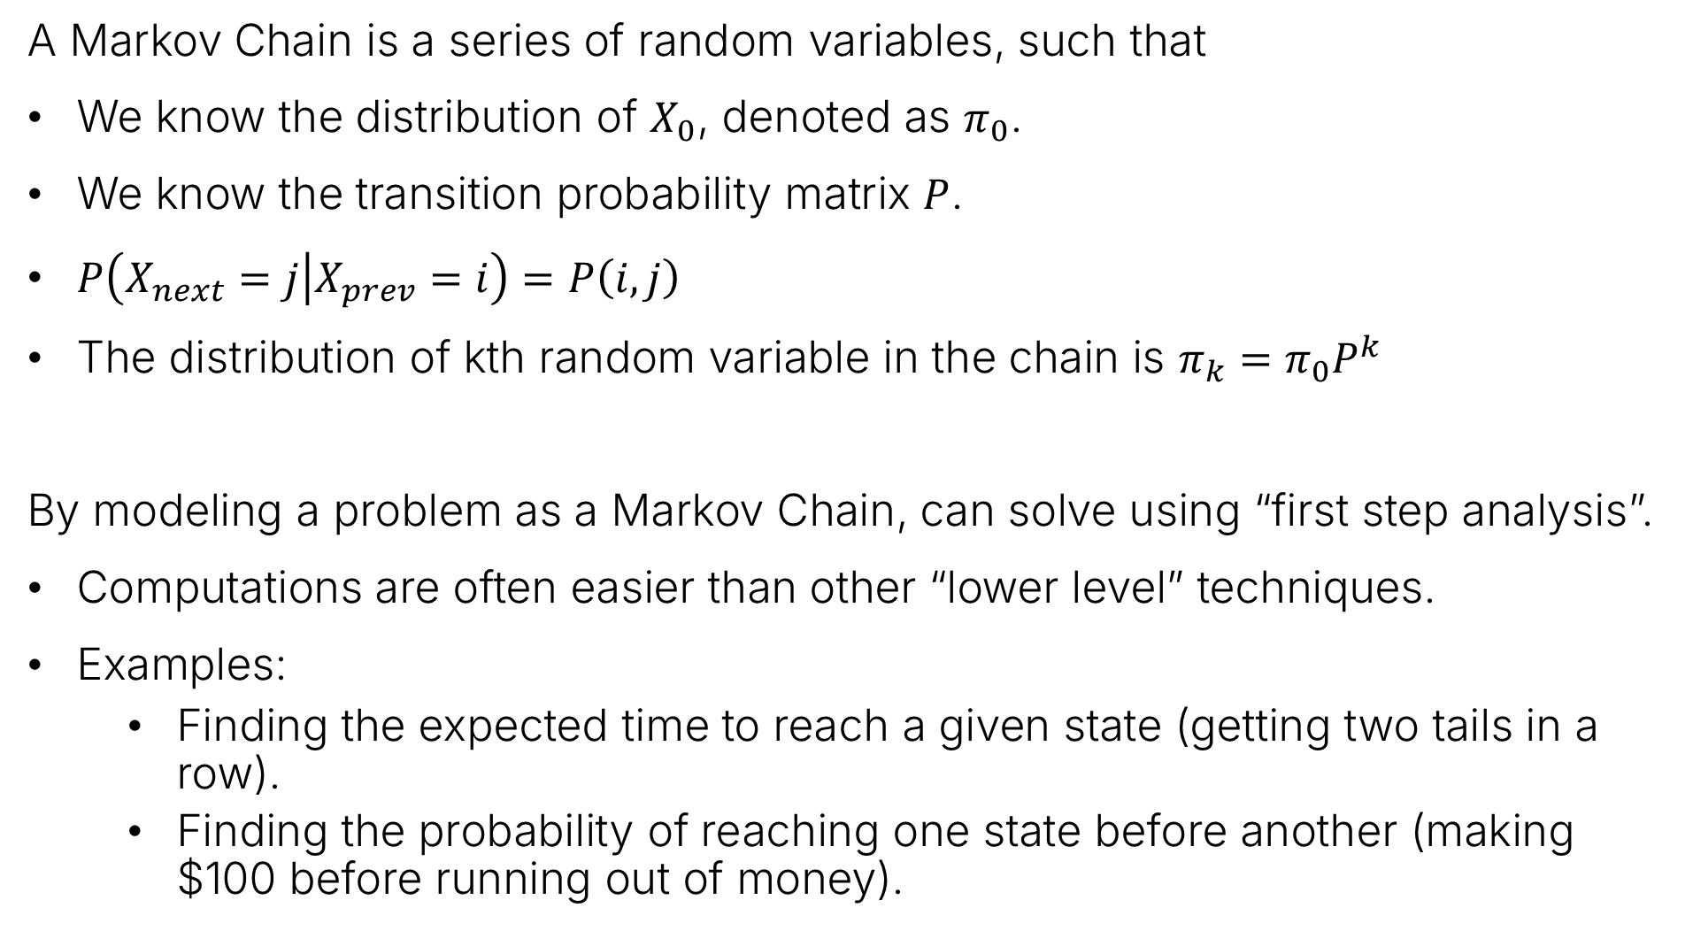
Summary of Last Lecture
A Markov Chain is a series of random variables, such that
We know the distribution of $X_{0}$, denoted as $π_{0}$.
We know the transition probability matrix $P$.
$P\left(X_{next}=j | X_{prev}=i\right)=P\left(i,j\right)$
The distribution of kth random variable in the chain is $π_{k}=π_{0}P^{k}$
By modeling a problem as a Markov Chain, can solve using “first step analysis”.
Computations are often easier than other “lower level” techniques.
Examples:
Finding the expected time to reach a given state (getting two tails in a row).
Finding the probability of reaching one state before another (making $100 before running out of money).

Slide 2
The Stationary Distribution Revisited
Lecture 27, CS70 Summer 2025

Slide 3
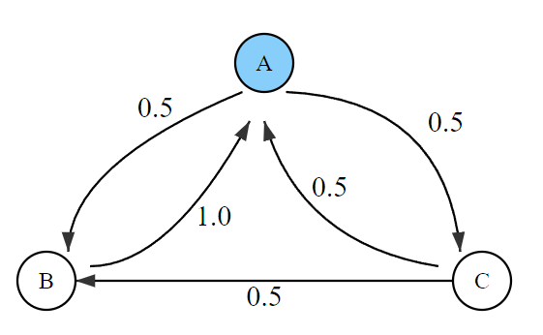
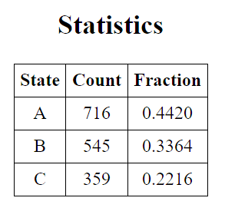
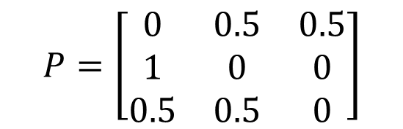
Long Term Behavior of Three State Markov Chain
Consider the Markov Chain below.
If we generate samples, we end up with around:
44% of the time in state A.
33% of the time in state B.
22% of the time in state C.
$$P=\left[\begin{matrix}0 & 0.5 & 0.5 \\ 1 & 0 & 0 \\ 0.5 & 0.5 & 0\end{matrix}\right]$$

Slide 4
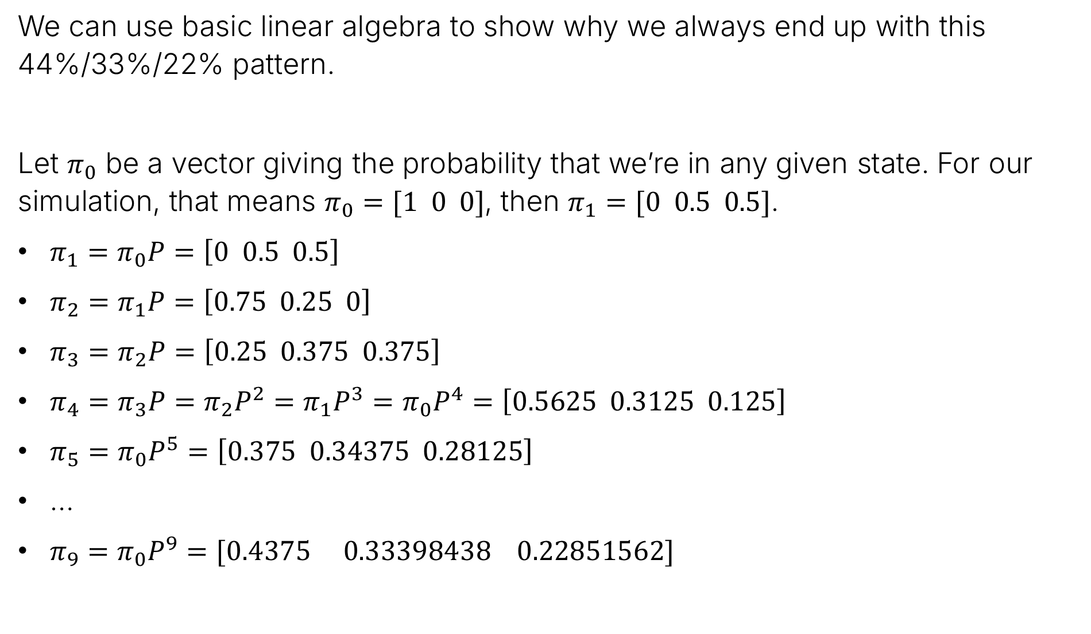
Long Term Behavior of Three State Markov Chain using Linear Algebra
We can use basic linear algebra to show why we always end up with this 44%/33%/22% pattern.
Let $π_{0}$ be a vector giving the probability that we’re in any given state. For our simulation, that means $π_{0}=[1 0 0]$, then $π_{1}=[0 0.5 0.5]$.
$π_{1}=π_{0}P=\left[0 0.5 0.5\right]$
$π_{2}=π_{1}P=\left[0.75 0.25 0\right]$
$π_{3}=π_{2}P=\left[0.25 0.375 0.375\right]$
$π_{4}=π_{3}P=π_{2}P^{2}=π_{1}P^{3}=π_{0}P^{4}=\left[0.5625 0.3125 0.125\right]$
$π_{5}=π_{0}P^{5}=\left[0.375 0.34375 0.28125\right]$
…
$π_{9}=π_{0}P^{9}=[0.4375 0.33398438 0.22851562]$

Slide 5
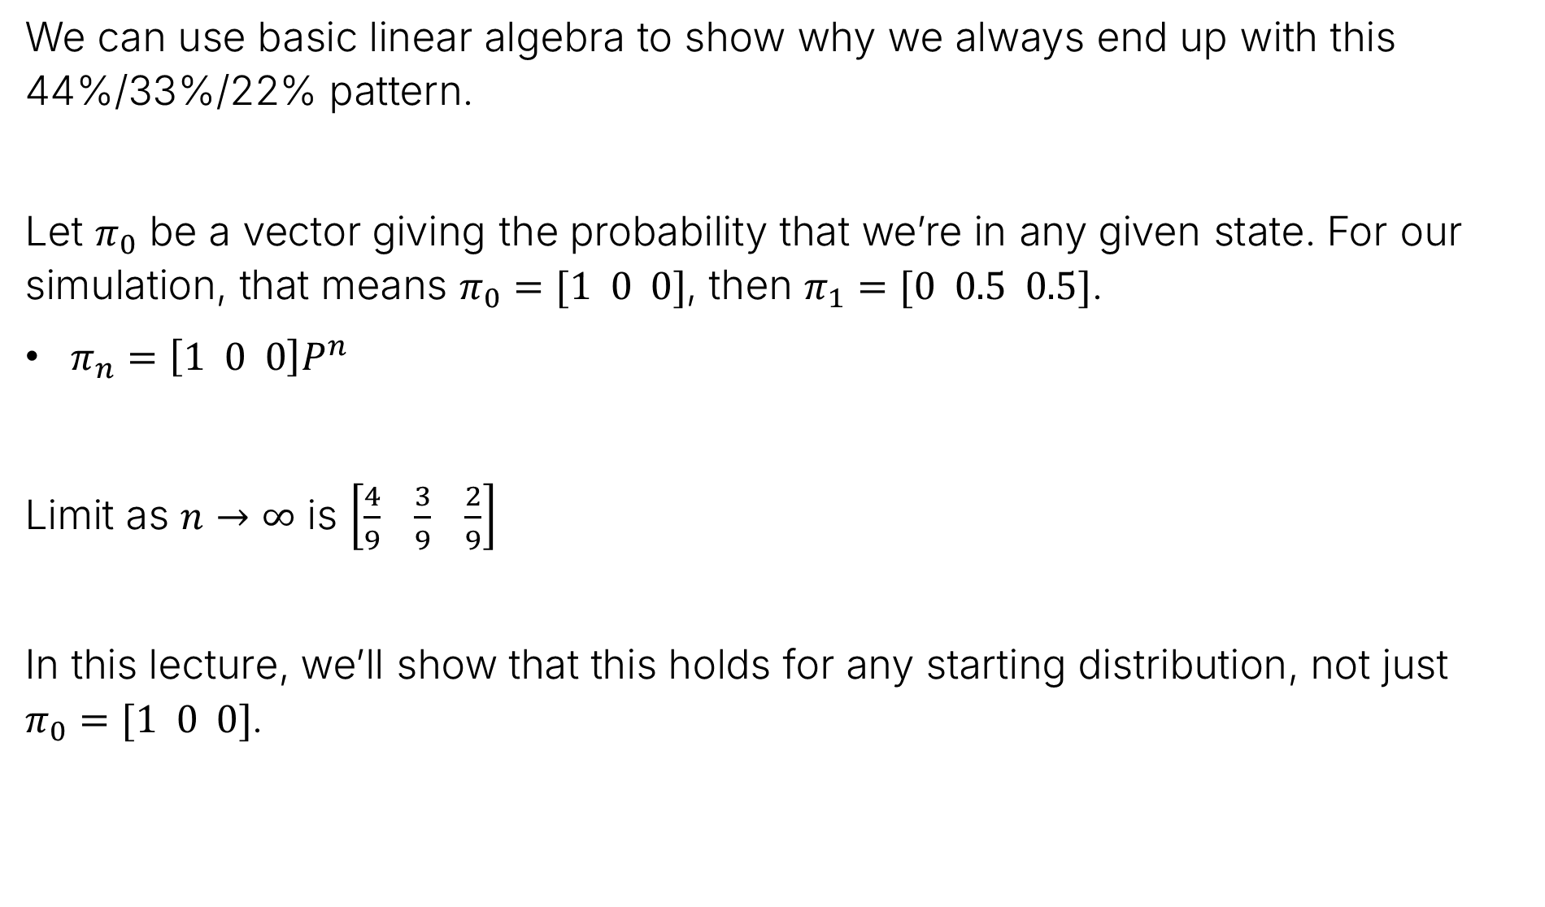
Long Term Behavior of Three State Markov Chain using Linear Algebra
We can use basic linear algebra to show why we always end up with this 44%/33%/22% pattern.
Let $π_{0}$ be a vector giving the probability that we’re in any given state. For our simulation, that means $π_{0}=[1 0 0]$, then $π_{1}=[0 0.5 0.5]$.
$π_{n}=\left[1 0 0\right]P^{n}$
Limit as $n→∞$ is $\left[\frac{4}{9} \frac{3}{9} \frac{2}{9}\right]$
In this lecture, we’ll show that this holds for any starting distribution, not just $π_{0}=[1 0 0]$.

Slide 6

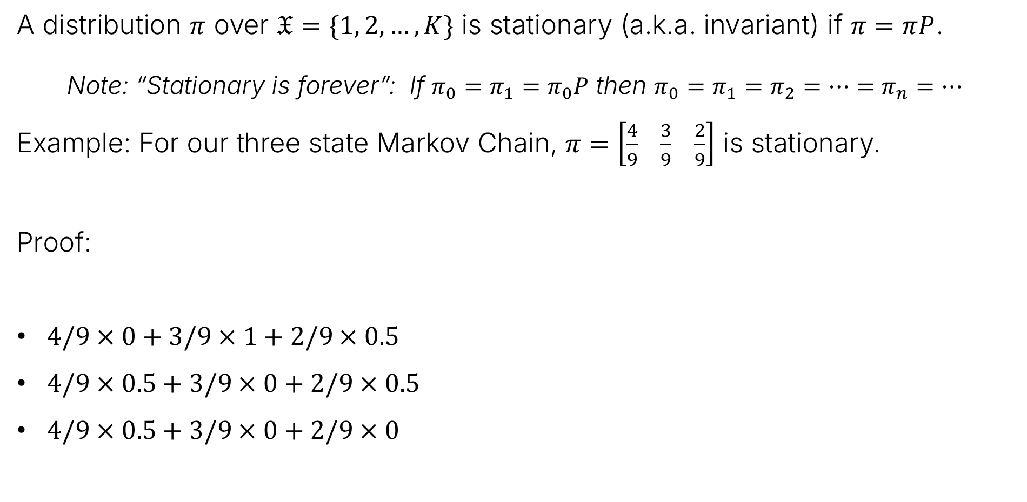


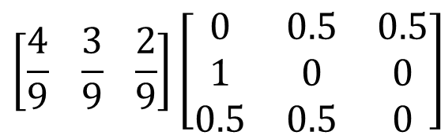
Example: Stationary Distribution
A distribution $π$ over $𝔛=\{1, 2, …, K\}$ is stationary (a.k.a. invariant) if $π=πP$.
Note: “Stationary is forever”: If $π_{0}=π_{1}=π_{0}P$ then $π_{0}=π_{1}=π_{2}=…=π_{n}=…$
Example: For our three state Markov Chain, $π=\left[\frac{4}{9} \frac{3}{9} \frac{2}{9}\right]$ is stationary.
Proof:
$4/9×0+3/9×1+2/9×0.5$
$4/9×0.5+3/9×0+2/9×0.5$
$4/9×0.5+3/9×0+2/9×0$
$$\left[\frac{4}{9} \frac{3}{9} \frac{2}{9}\right]\left[\begin{matrix}0 & 0.5 & 0.5 \\ 1 & 0 & 0 \\ 0.5 & 0.5 & 0\end{matrix}\right]$$
$=$ $4/9$
$=$ $3/9$
$=$ $2/9$

Slide 7
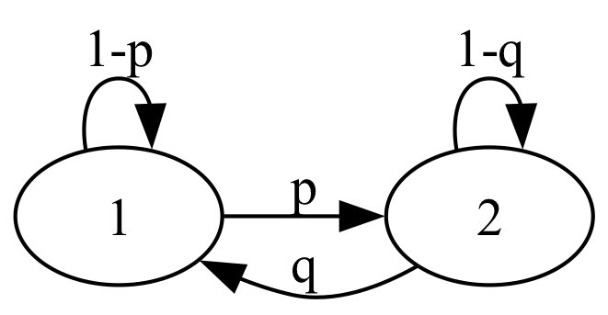




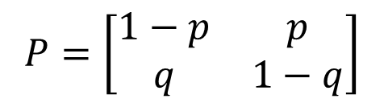
Example 2: Stationary Distribution
Consider this Markov Chain:
$π=[a b]$ is stationary iff $\left[a b\right]=\left[a b\right]$ $\left[\begin{matrix}1−p & p \\ q & 1−q\end{matrix}\right]$
$$P=\left[\begin{matrix}1−p & p \\ q & 1−q\end{matrix}\right]$$
$$a=a\left(1−p\right)+bq$$
$$⟺$$
$$ap=bq$$

Slide 8



Example 2: Stationary Distribution
Consider this Markov Chain:
$π=[a b]$ is stationary iff $\left[a b\right]=\left[a b\right]$ $\left[\begin{matrix}1−p & p \\ q & 1−q\end{matrix}\right]$
$$P=\left[\begin{matrix}1−p & p \\ q & 1−q\end{matrix}\right]$$
$$a=a\left(1−p\right)+bq$$
$$⟺$$
$$ap=bq$$
$$b=ap+b(1−q)$$
$$⟺$$
$$bq=ap$$
What we do next? We have two equations and two unknowns, but the equations are redundant. Are there other constraints we’re not using?

Slide 9
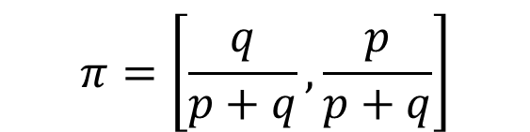

Example 2: Stationary Distribution
Consider this Markov Chain:
$π=[a b]$ is stationary iff $\left[a b\right]=\left[a b\right]$ $\left[\begin{matrix}1−p & p \\ q & 1−q\end{matrix}\right]$
$$P=\left[\begin{matrix}1−p & p \\ q & 1−q\end{matrix}\right]$$
$$a=a\left(1−p\right)+bq$$
$$⟺$$
$$ap=bq$$
$$b=ap+b(1−q)$$
$$⟺$$
$$bq=ap$$
We also know:
$$a+b=1$$
$$π=\left[\frac{q}{p+q},\frac{p}{p+q}\right]$$

Slide 10
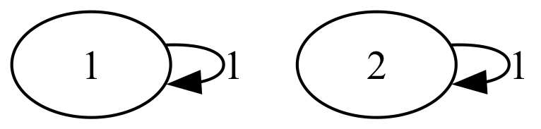


Example 3: Stationary Distribution
Consider this Markov Chain:
$π=[a b]$ is stationary iff $\left[a b\right]=\left[a b\right]$ $\left[\begin{matrix}1 & 0 \\ 0 & 1\end{matrix}\right]$
What distribution is stationary, i.e., what $a$and $b$ can we pick?
$$P=\left[\begin{matrix}1 & 0 \\ 0 & 1\end{matrix}\right]$$

Slide 11
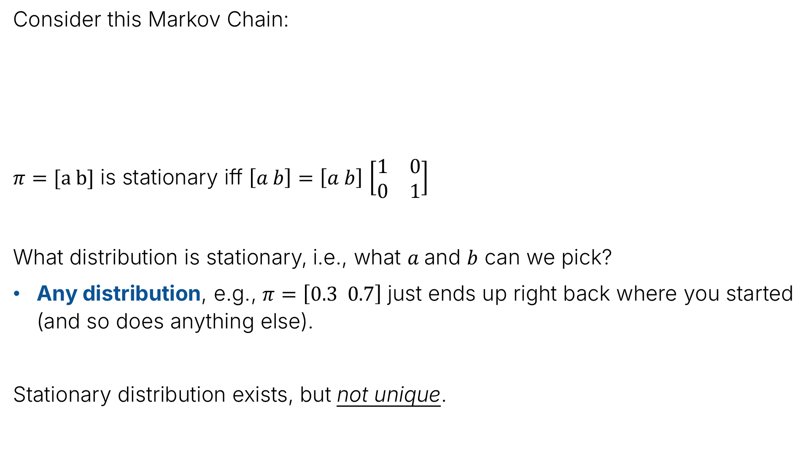
Example 3: Stationary Distribution
Consider this Markov Chain:
$π=[a b]$ is stationary iff $\left[a b\right]=\left[a b\right]$ $\left[\begin{matrix}1 & 0 \\ 0 & 1\end{matrix}\right]$
What distribution is stationary, i.e., what $a$and $b$ can we pick?
Any distribution, e.g., $π=\left[0.3 0.7\right]$ just ends up right back where you started (and so does anything else).
Stationary distribution exists, but not unique.
$$P=\left[\begin{matrix}1 & 0 \\ 0 & 1\end{matrix}\right]$$

Slide 12
Irreducibility and Periodicity
Lecture 27, CS70 Summer 2025

Slide 13
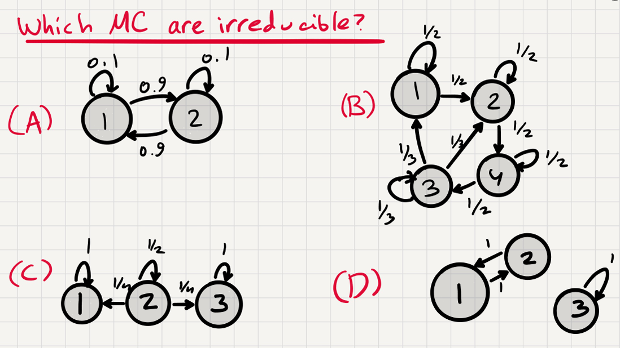

Irreducible Markov Chains
A Markov Chain is irreducible if you can get from any state $i$ to any other state $j$, possibly by following multiple (non-zero probability) transitions.
Stealing a nice exercise from Avishay Tal in Fall 2023:

Slide 14

Irreducible Markov Chains
A Markov Chain is irreducible if you can get from any state $i$ to any other state $j$, possibly by following multiple steps.
Stealing a nice exercise from Avishay Tal in Fall 2023:

Slide 15
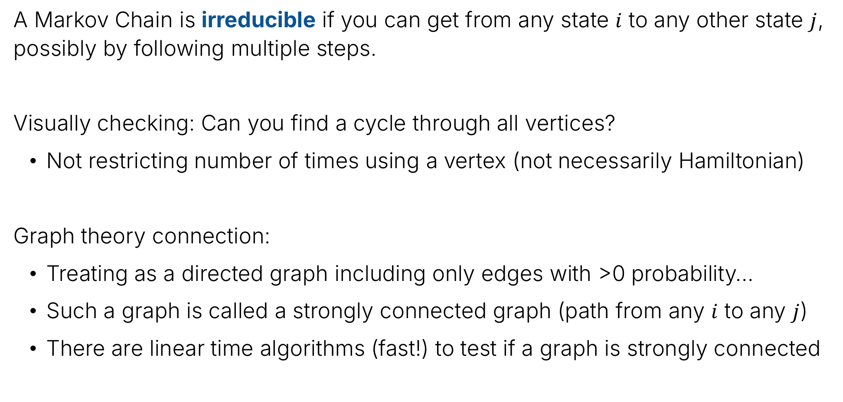
A few side notes about irreducibility
A Markov Chain is irreducible if you can get from any state $i$ to any other state $j$, possibly by following multiple steps.
Visually checking: Can you find a cycle through all vertices?
Not restricting number of times using a vertex (not necessarily Hamiltonian)
Graph theory connection:
Treating as a directed graph including only edges with >0 probability…
Such a graph is called a strongly connected graph (path from any $i$ to any $j$)
There are linear time algorithms (fast!) to test if a graph is strongly connected

Slide 16
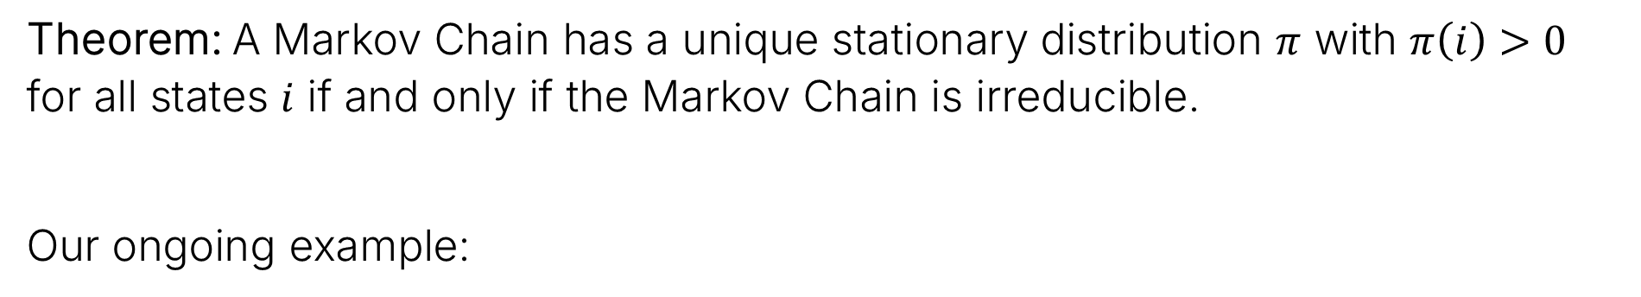
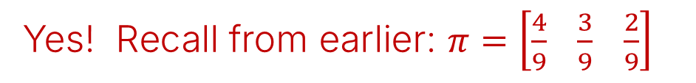
Unique stationary distribution exists iff Markov Chain is irreducible
Theorem: A Markov Chain has a unique stationary distribution $π$ with $π\left(i\right)>0$ for all states $i$ if and only if the Markov Chain is irreducible.
Our ongoing example:
Irreducible?
Yes!
Stationary distribution?
Yes! Recall from earlier: $π=\left[\frac{4}{9} \frac{3}{9} \frac{2}{9}\right]$
Theorem tells us: This is the only stationary distribution.

Slide 17


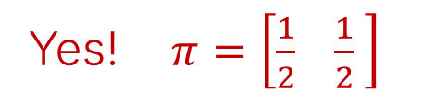
Unique Stationary Distribution – Example 2
Theorem: A Markov Chain has a unique stationary distribution $π$ with $π\left(i\right)>0$ for all states $i$ if and only if the Markov Chain is irreducible.
Another previous example:
Irreducible?
No!
Stationary distribution?
Yes! $π=\left[\frac{1}{2} \frac{1}{2} \right]$
But also $π=\left[\frac{1}{3} \frac{2}{3} \right]$ and others….
Theorem is consistent with these examples. Won’t prove it, but this is reassuring.

Slide 18
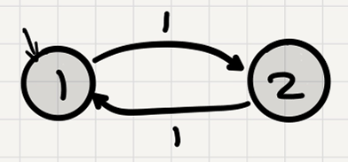

Unique Stationary Distribution – Example 3
Theorem: A Markov Chain has a unique stationary distribution $π$ with $π\left(i\right)>0$ for all states $i$ if and only if the Markov Chain is irreducible.
A new example:
Irreducible?
Yes!
Stationary distribution?
Yes! $π=\left[\frac{1}{2} \frac{1}{2} \right]$
Theorem tells us: This is the only stationary distribution. But something different…

Slide 19
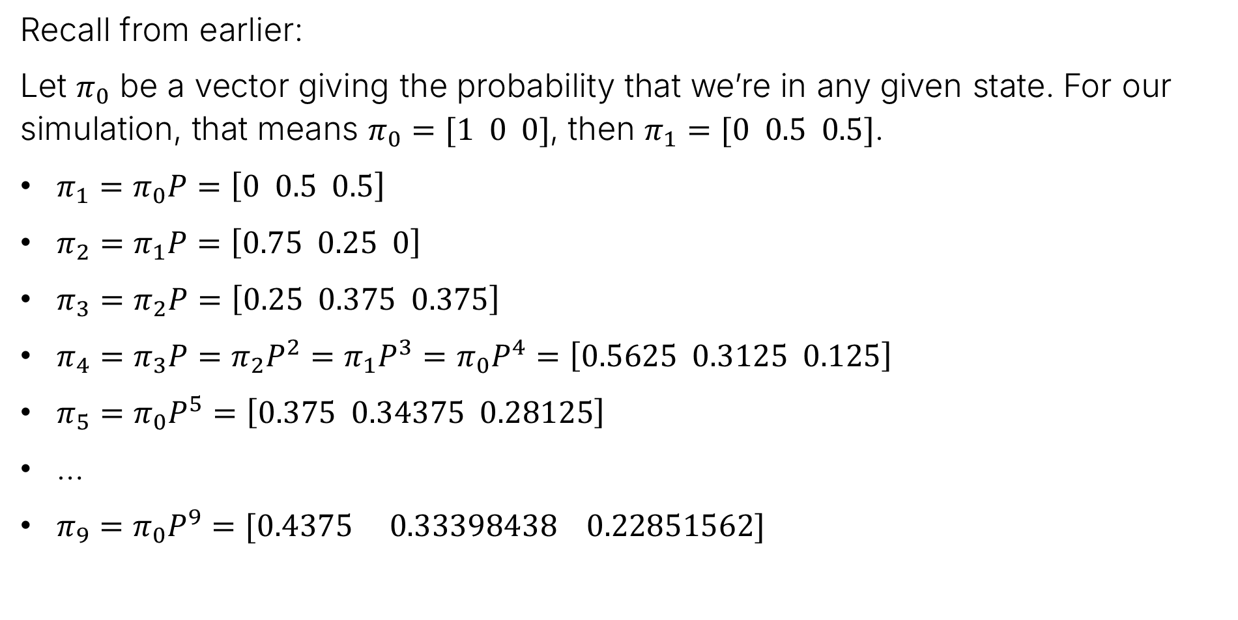
Convergence?
Recall from earlier:
Let $π_{0}$ be a vector giving the probability that we’re in any given state. For our simulation, that means $π_{0}=[1 0 0]$, then $π_{1}=[0 0.5 0.5]$.
$π_{1}=π_{0}P=\left[0 0.5 0.5\right]$
$π_{2}=π_{1}P=\left[0.75 0.25 0\right]$
$π_{3}=π_{2}P=\left[0.25 0.375 0.375\right]$
$π_{4}=π_{3}P=π_{2}P^{2}=π_{1}P^{3}=π_{0}P^{4}=\left[0.5625 0.3125 0.125\right]$
$π_{5}=π_{0}P^{5}=\left[0.375 0.34375 0.28125\right]$
…
$π_{9}=π_{0}P^{9}=[0.4375 0.33398438 0.22851562]$
Fact: Distribution converges to stationary dist. Proof: “Trust me”

Slide 20
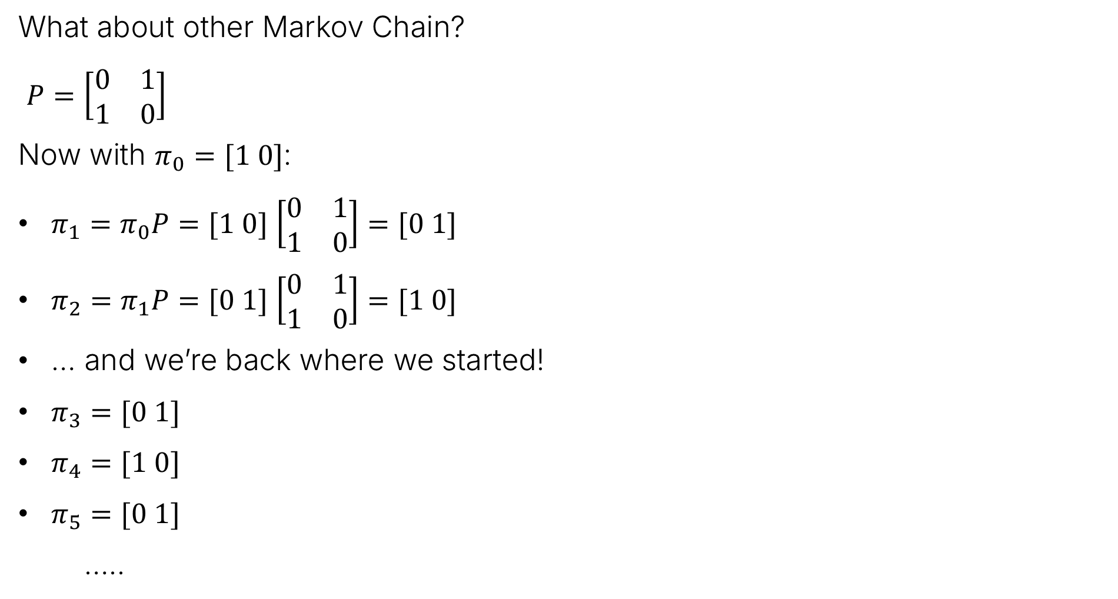
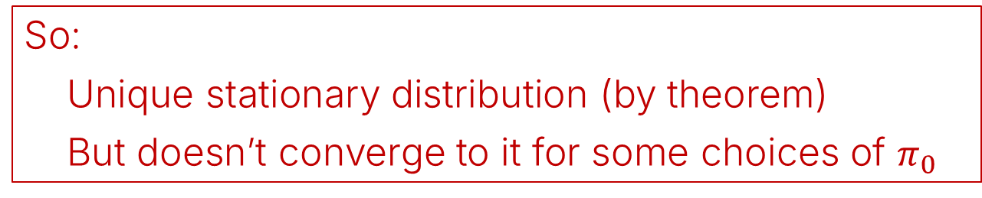
Convergence?
What about other Markov Chain?
$P=\left[\begin{matrix}0 & 1 \\ 1 & 0\end{matrix}\right]$
Now with $π_{0}=[1 0]$:
$π_{1}=π_{0}P=[1 0]$ $\left[\begin{matrix}0 & 1 \\ 1 & 0\end{matrix}\right]=[0 1]$
$π_{2}=π_{1}P=[0 1]$ $\left[\begin{matrix}0 & 1 \\ 1 & 0\end{matrix}\right]=[1 0]$
… and we’re back where we started!
$π_{3}=[0 1]$
$π_{4}=[1 0]$
$π_{5}=[0 1]$
…..
So:
Unique stationary distribution (by theorem)
But doesn’t converge to it for some choices of $π_{0}$

Slide 21

Periodicity
The periodicity of a Markov Chain with transition matrix $P$ is the gcd of the lengths of all closed walks (cycles) in the chain.
Example:
gcd of lengths of all cycles, which is 2.

Slide 22
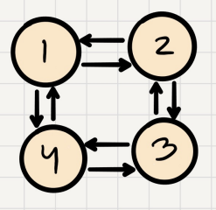
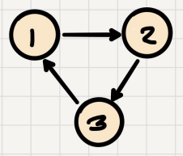
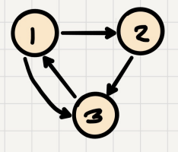

Periodicity
The periodicity of a Markov Chain with transition matrix $P$ is the gcd of the lengths of all closed walks (cycles) in the chain.
More examples: What do you think are the periods of these graphs?

Slide 23

Periodicity
The periodicity of a Markov Chain with transition matrix $P$ is the gcd of the lengths of all closed walks (cycles) in the chain.
More examples: What do you think are the periods of these graphs?
Period: 3
Period: gcd(2, 4)=2
Period: gcd(2, 3)=1
Period = 1 is the important case! Such a Markov chain is aperiodic.

Slide 24
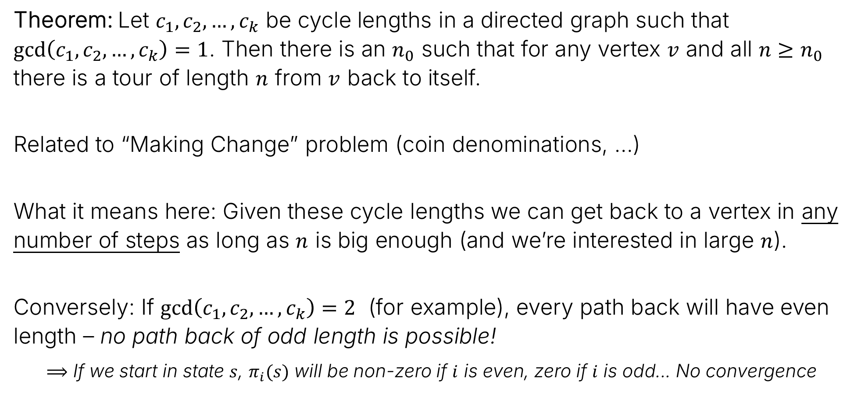
Why Period Is Important
Theorem: Let $c_{1},c_{2},…, c_{k}$ be cycle lengths in a directed graph such that $\gcd\left(c_{1},c_{2},…, c_{k}\right)=1$. Then there is an $n_{0}$ such that for any vertex $v$ and all $n≥n_{0}$ there is a tour of length $n$ from $v$ back to itself.
Related to “Making Change” problem (coin denominations, …)
What it means here: Given these cycle lengths we can get back to a vertex in any number of steps as long as $n$ is big enough (and we’re interested in large $n$).
Conversely: If $\gcd\left(c_{1},c_{2},…, c_{k}\right)=2$ (for example), every path back will have even length – no path back of odd length is possible!
$⟹$ If we start in state $s$, $π_{i}(s)$ will be non-zero if $i$ is even, zero if $i$ is odd... No convergence
Tip: If the Markov Chain has any self-loops (which is common), it is aperiodic!

Slide 25
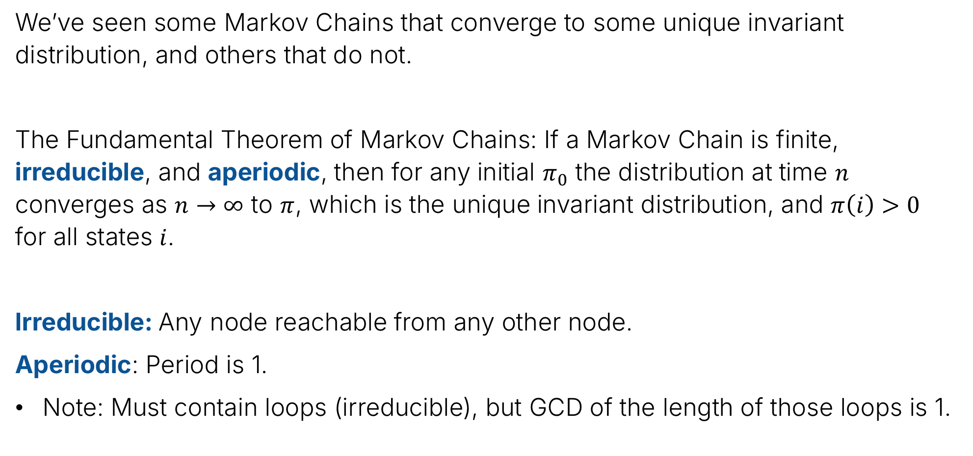
The Fundamental Theorem of Markov Chains
We’ve seen some Markov Chains that converge to some unique invariant distribution, and others that do not.
The Fundamental Theorem of Markov Chains: If a Markov Chain is finite, irreducible, and aperiodic, then for any initial $π_{0}$ the distribution at time $n$ converges as $n→∞$ to $π$, which is the unique invariant distribution, and $π\left(i\right)>0$ for all states $i$.
Irreducible: Any node reachable from any other node.
Aperiodic: Period is 1.
Note: Must contain loops (irreducible), but GCD of the length of those loops is 1.

Slide 26
An Application: Predicting Text
Lecture 27, CS70 Summer 2025

Slide 27
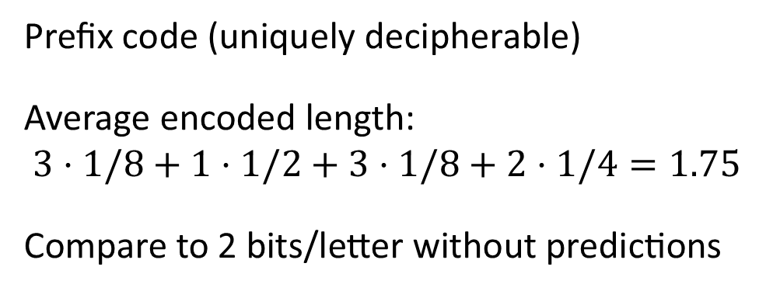
Claude Shannon: A Mathematical Theory of Communication (1948)
In 1948, Claude Shannon wrote a paper called “A Mathematical Theory of Communication”.
Focus: What is “information” and how do we encode it?
Why? (other than it’s an incredibly fundamental question)
Data compression in half a slide:
Predict characters:
P(“A”)=1/8
P(“B”)=1/2
P(“C”)=1/8
P(“D”)=1/4
Use to encode:
A = 111
B = 0
C = 110
D = 10
Prefix code (uniquely decipherable)
Average encoded length:
$3⋅1/8+1⋅1/2+3⋅1/8+2⋅1/4=1.75$
Compare to 2 bits/letter without predictions

Slide 28
Claude Shannon: A Mathematical Theory of Communication (1948)
In 1948, Claude Shannon wrote a paper called “A Mathematical Theory of Communication”.
Focus: What is “information” and how do we encode it?
How to predict?
Order 0: A single probability distribution for each letter
E = 12.7%
T=9.1%
A=8.2%
O=7.5%
…
Remarkably consistent across a wide
variety of English writing…
Sufficient to encode English text in about 4.2 bits/letter

Slide 29
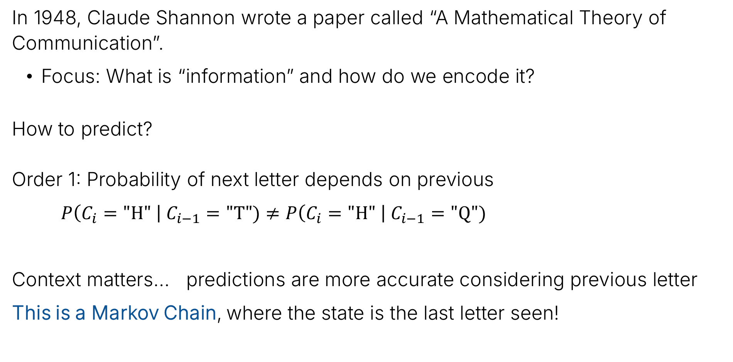
Claude Shannon: A Mathematical Theory of Communication (1948)
In 1948, Claude Shannon wrote a paper called “A Mathematical Theory of Communication”.
Focus: What is “information” and how do we encode it?
How to predict?
Order 1: Probability of next letter depends on previous
$P\left(C_{i}="H" \right| C_{i−1}="T")≠P\left(C_{i}="H" \right| C_{i−1}="Q")$
Context matters… predictions are more accurate considering previous letter
This is a Markov Chain, where the state is the last letter seen!

Slide 30
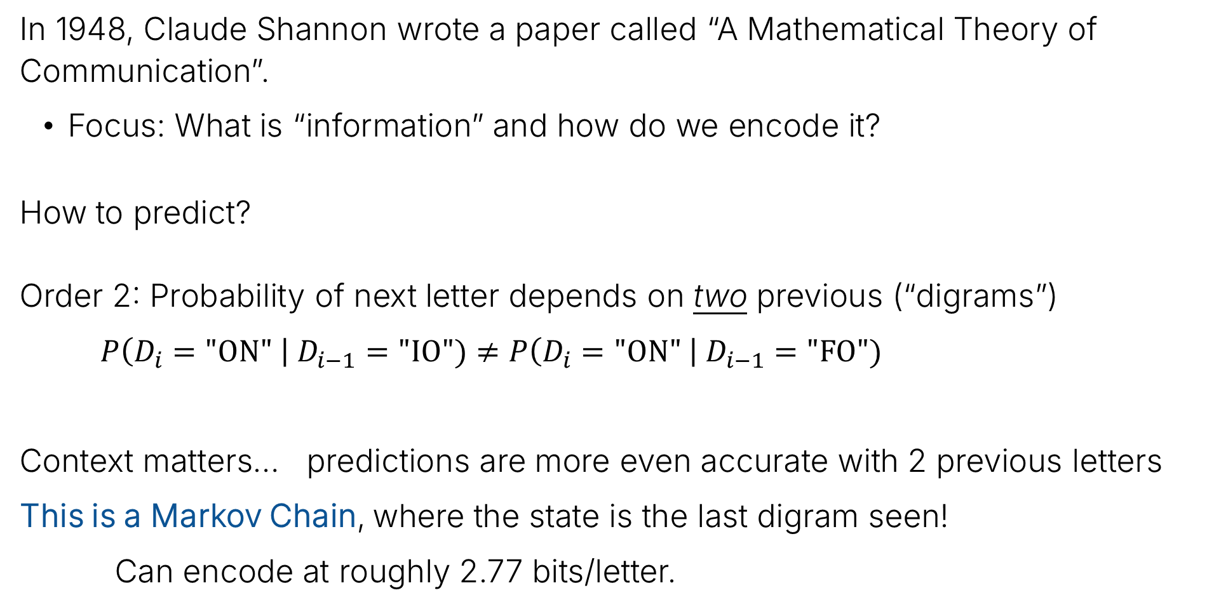
Claude Shannon: A Mathematical Theory of Communication (1948)
In 1948, Claude Shannon wrote a paper called “A Mathematical Theory of Communication”.
Focus: What is “information” and how do we encode it?
How to predict?
Order 2: Probability of next letter depends on two previous (“digrams”)
$P\left(D_{i}="ON" \right| D_{i−1}="IO")≠P\left(D_{i}="ON" \right| D_{i−1}="FO")$
Context matters… predictions are more even accurate with 2 previous letters
This is a Markov Chain, where the state is the last digram seen!
Can encode at roughly 2.77 bits/letter.

Slide 31
Modern Compression – and more
There’s an entire class of compression algorithms based on Markov Chain predictions: the “PPM” (Prediction by Partial Matching) algorithms.
In the real world: The RAR compression program uses this.
If you can predict, what else can you do?
Generate text!
Auto-complete
Large language models (LLMs)

Slide 32
Some examples of text generation
Order 0 example: Follows letter frequencies, but that’s about it:
OCRO HLI RGWR NMIELWIS EU LL NBNESEBYA TH EEI ALHENHTTPA OOBTTVA NAH BRL
Going up to order 4 (trained on all ASCII chars, using Moby Dick):
I am in that down broad glazier.” true cylindefinitely from yondering again one visible tinkled in this colourite myself to suit of the old wrinkling that stood city offin.”
Better… but still not going to fool anyone.
LLMs: Token based prediction (not characters) with additional context
… but it’s still just a (very large) Markov Chain!

Slide 33
Reflections on CS70
Lecture 27, CS70 Summer 2025

Slide 34
Day 1 Slide: “What Is This Class?”
Discrete Math: Math with structures with distinct objects
Not continuous
Not “discreet”!
But not (necessarily) finite
Digital? What computers work with...
Probability Theory: Probability and properties of random events
Can use continuous functions
Basically counting....
But really this class is about: building important ideas by putting together simple concepts; careful and precise reasoning about those constructions; proofs; counting
This can be uncomfortable at first – hopefully you feel better about it now…

Slide 35
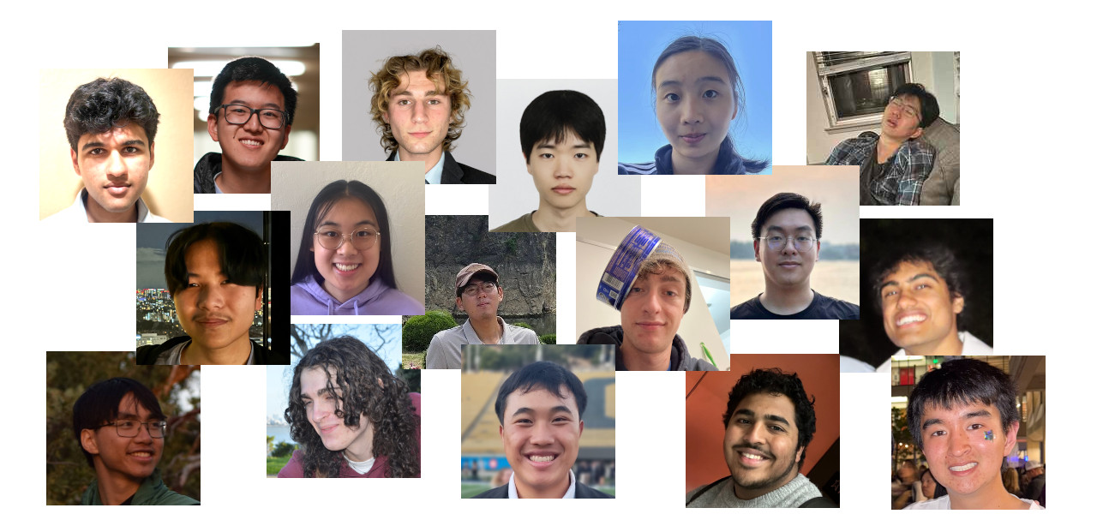
Also From Day 1
Lots of people to thank:
And thank you!
If Berkeley students, I hope this supports your future studies!
If visitors, I hope you found your time here worthwhile
(and that you had some time to enjoy being here!)

Slide 36
You’re not done yet – the final exam!
Important details:
Main exam location: Dwinelle 155
Main exam day/time: Tuesday, Aug 12, 7:00-10:00
Those with DSP accommodations: You’ll be contacted with details
What topics are covered?
Everything in the notes except “optional” parts – and not my side-tracks…
Roughly 2/3 on post-midterm (counting and later) material
Taking the exam:
You can bring hand-written notes: two sheets of paper (front and back)
Nothing else!
Remember to write answers inside the marked boxes.

Slide 37
Final exam - Preparation
Best resources
The notes (always!) and lectures
Discussion sheets and posted HW solutions
Past exams (do a realistic run-through!)
Final review by TAs:
When? Fri Aug 8, 12:00-2:00 and 3:00-5:00 – 30-minute blocks for topics
Where? Cory 521
See Ed post for more details
Also: Regular TA office hours on Friday
Monday:
Student-choice lecture (see Ed)
No discussion or TA office hours – professor OH if needed
And Ed is always available for questions/discussion

Slide 38
Related classes at Berkeley for those who want more!
CS170: Efficient Algorithms and Intractable Problems a.k.a. Introduction to CS Theory: Graphs, Dynamic Programming, Complexity.
EE126: Probability in EECS: An Application-Driven Course: PageRank, Digital Links, Tracking, Speech Recognition, Planning, etc. Hands on labs with python experiments (GPS, Shazam, ...).
CS188: Artificial Intelligence: Hidden Markov Chains, Bayes Networks, Neural Networks.
CS189: Introduction to Machine Learning: Regression, Neural Networks, Learning, etc. Programming experiments with real-world applications.
EE121: Digital Communication: Coding for communication and storage.
EE223: Stochastic Control.
EE229A: Information Theory; EE229B: Coding Theory

Slide 39
The End
… and they all lived happily ever after.

